Slide 1


Opioids
ETSU Family Medicine
Pete Bockhorst, DO
Joyce Troxler, MD

Slide 2
Conflicts
Pete Bockhorst, DO
  None
Joyce Troxler, MD
  None

Slide 3
Objectives
Recognize association between adverse childhood experiences and addiction
Recognize a very specific type of opiate addiction
Increase comfort in identifying, potential appropriate patients for MAT
Improve your understanding of how to obtain a DATA 2000 waiver and how it has changed in the last 2 years
Understand the difference between chronic pain management and SUD
Improve your risk assessment for patients utilizing long-term opioids
Improve understanding of SUD care in the setting of pregnancy

Slide 4
Why Am I Like This?
Pete Bockhorst DO

Slide 5


Slide 6


Slide 7
Opioids
Oxycontin released to general market in 1996
Pain as the “fifth vital sign” adopted by VA in late 1990s
JCAHO mandated inpatient pain scales shortly thereafter
Since 2000, opiate-related rates of death up 200% (CDC MMWR)
1,776 Tennesseans died from overdoses 2017, the most since reporting began
  up from 1,631 in 2016, also a record and a 12 percent increase from 1,451 in 2015.
In 2016 there were 40,000 deaths from MVA, 60,000 from drug overdose
TN and Hawaii both crossed the ‘MVA’ threshold in 2010
In 2015, deaths in the U.S. from drug overdose surpassed deaths from gun homicides and motor vehicles combined.
In 2007, Purdue Pharma pleaded guilty to a felony charge of “misbranding” OxyContin

Slide 8
So What Did TN Do?
  Medicaid stopped paying for most popular opiates
  October 2014, Lortab/Vicodin schedule II
  7/1/2018 TN mandated strictest controls in US on pharmacies and prescribers, csmd, strict quantity limits. Informed consent. Michigan and FL also passed strict laws at same time.
  Prescriptions are limited to a 10-day supply (and no more than 500 cumulative morphine milligram equivalents).
  Post-op Rx are limited to a 20-day
  Large percentage of “pain clinics” have shuttered due to increased scrutiny and fear of prosecution

Slide 9
What happened?
Increased admissions for heroin overdose 200% in 2 years
Everyone's least favorite drug now favored

Slide 10
Buprenorphine
France de-regulated buprenorphine in 1996, open to all prescribers
Decreased overdose deaths by 80% in 4 years
At least 6X safer than methadone
Ceiling effect after 24mg
Drug Addiction Treatment Act of 2000 (DATA2000) increased access to and availability of opiate addiction treatment with schedule III-V drugs in an outpatient, office-based setting.
Vast majority of regionally waived physicians are cash only.
So why aren’t you on the buprenorphine provider registry?
Residencies catching up. DATA2000 does not preclude residents with a license and DEA number from holding a waiver
Evidence of use for substances other than opioids e.g. Methamphetamine

Slide 11
Prevalent theories of opiate addiction –misleading
Opiates are intrinsically addictive, and anyone who takes them long enough will become addicted.
Some people just have an "addictive personality", and that explains why they become addicts
People with poor will power are unable to quit using drugs once they start, and that's why they are addicts.

Slide 12
So, what actually causes addiction?
Like diabetes, there are two distinct types of opiate addiction.
The first is due to genetic influences, and is referred to as endogenous opiate dependence.
The second type is due to external influences, such as emotional trauma, and is called exogenous opiate dependence.

Slide 13
The use of opioids to treat depression
In the US before the 1950’s opioids were used to treat depression
If a person responds to nortriptyline and you give them an opioid blocker, the anti-depressant effect goes away
Studies using opiates in patients with refractory depression, some of whom with a history of substance abuse, showed robust improvement in their symptoms without concomitant abuse.
Tramadol is largely used in Europe as an antidepressant.
Notes:
Treatment-refractory depression is a term used in clinical psychiatry to describe cases of major depressive disorder (MDD) that do not respond adequately to appropriate courses of at least two antidepressants

Slide 14
Exogenous Opiate Dependence:
Emotional trauma is another cause of addiction
Up to 30% of all soldiers with PTSD will become opiate addicts
For the vast majority of people, the real cause is emotional trauma in childhood
  Linked to ACE study

Slide 15
Adverse Childhood Experiences Study (ACE)
1990’s Kaiser Permanente and CDC partnered to do a study
Results were that individuals with dysfunctional childhoods experienced an increase risk of addiction
Ace study produced a 10 point questionnaire which covered various causes of emotional trauma in childhood and gave an individual score anywhere from 0 – 10
17,337 participants, all had jobs and good health care (Kaiser members)

Slide 16
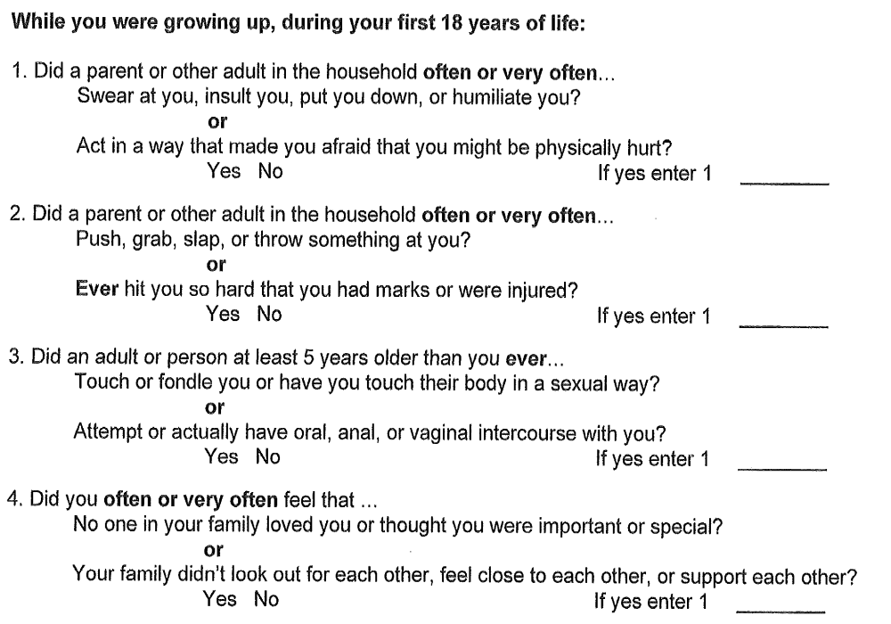
Finding Your ACE Score

Slide 17
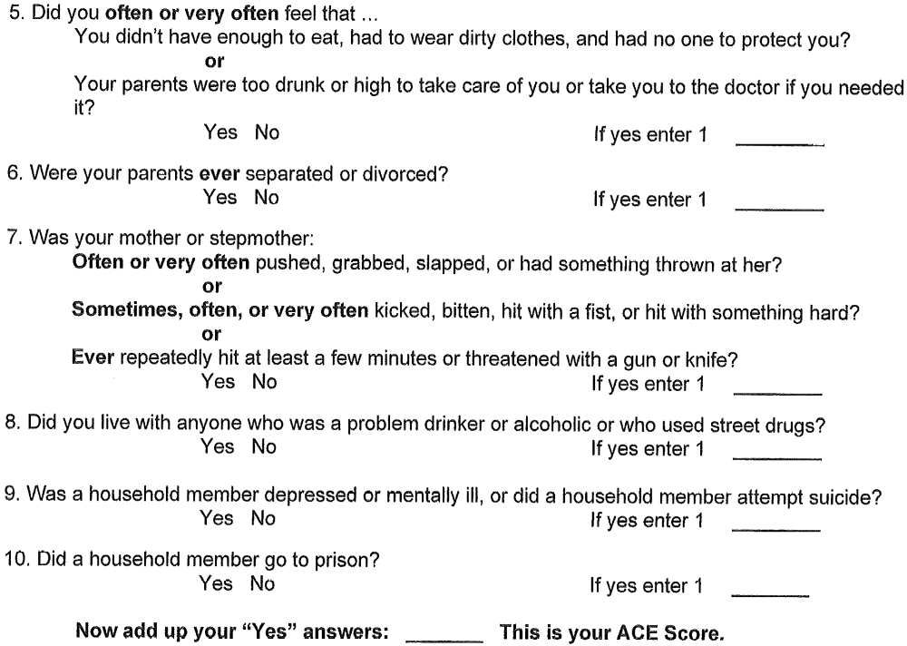
Finding Your Ace Score Cont’d

Slide 18
Relationship of ACE Score
“The relationship of ACE score to IV drug use is particularly striking, given that male children with ACE score 6 or more have a 4600% increased likelihood of later becoming an injection drug user, compared to an ACE Score 0 male child; this moves the probability from an arithmetic to an exponential progression.
Relationships of this magnitude are rare in epidemiology. This, coupled with related information, suggests that the basic cause of addiction is predominantly experience-dependent during childhood and not substance-dependent. This challenge to the usual concept of the cause of addiction has significant implications for medical practice and for treatment programs. “
“The Hidden Epidemic: The Impact of Early Life Trauma on Health and Disease” Felitti /Anda ACE study chapter

Slide 19
Women, ACE and Addiction
“Analysis of our Study data for injected drug use shows a powerful relation to ACEs. Population Attributable Risk analysis shows that 78% of drug injection by women can be attributed to adverse childhood experiences.” “The Origins of Addiction: Evidence from the Adverse Childhood Experiences Study” Vincent Felitti,MD

Slide 20
Extrapolations From Ace Study
Of American soldiers returning from Vietnam, only 5% of those considered addicted were still using 10 months after their return to the US.
So what are these patients trying to do via opiates?
Notes:
Robins LN, Helzer JE, Davis DH. Arch Gen Psychiatry 1975 Aug;32(8):955-61 Narcotic use in southeast Asia and afterward. An interview study of 898 Vietnam returnees.

Slide 21
Prevalent but largely incorrect theories of opiate addiction
Opiates are intrinsically addictive, and anyone who takes them long enough will become addicted.
Some people just have an "addictive personality", and that explains why they become addicts
People with poor will power are unable to quit using drugs once they start, and that's why they are addicts.

Slide 22
Find your patients
3 Question Study
  Do you remember the 1st pain pill you took
  Did it give you energy
  Were you sexually or physically abused before the age of 18
  Y Y N = likely endogenous opiate addiction and has low likelihood of failing UDS with maintenance therapy.
  ACE score < 4 likely endogenous and has low likelihood of failing UDS

Slide 23
Get Involved
https://www.aafp.org/afp/2018/0301/p313.html
http://www.suboxonerems.com/documents/Prescriber_Brochure.pdf
http://www.suboxonerems.com/documents/App_Use_Checklist.pdf
Get Your DATA2000 Waiver
https://www.samhsa.gov/medication-assisted-treatment
https://elearning.asam.org/products/treatment-of-opioid-use-disorder-waiver-qualifying-8-hours-online#tab-product_tab_overview
https://pcssnow.org/education-training/mat-training/

Slide 24
References
1. Kennedy SE, Koeppe RA, Young EA, and Zubieta JK. Dysregulation of endogenous opioid emotion regulation circuitry in major depression in women. Arch Gen Psychiatry. November 2006. 63(11): 1199-1208.
2. Way BM, Taylor SE, and Eisenberger NI. Variation in the mu-opioid receptor gene (OPRM1) is associated with dispositional and neural sensitivity to social rejection. Proc Natl Acad Sci USA. September 2009. 106(35): 15079-15084.
3. Harris RE, Clauw DJ, Scott DJ, McLean SA, Gracely RH, and Zubieta JK. Decreased central mu-opioid receptor availability in fibromyalgia. J Neurosci. September 2007. 27(37): 10000-10006.
4. Robins LN, Helzer JE, Davis DH. Arch Gen Psychiatry 1975 Aug;32(8):955-61 Narcotic use in southeast Asia and afterward. An interview study of 898 Vietnam returnees.
5. Robins LN. Vietnam Veterans’ rapid recovery from heroin addiction: a fluke or normal expectation? Addiction 1993; 88:1041-1054.
6. Marteau D, McDonald R, Patel K.The relative risk of fatal poisoning by methadone or buprenorphine within the wider population of England and Wales.BMJ Open 2015;5:e007629. doi: 10.1136/bmjopen-2015-007629
7. References: Cochrane DOI: 10.1002/14651858.CD002207.pub4
8. Cochrane DOI: 10.1002/14651858.CD011117.pub2
9. Adverse childhood experiences reported by adults-Five states 2009. MMWR Dec17, 2010 59(49);1609-1613 Felitti, et al.,
10. "Relationship of childhood abuse and household dysfunction to many of the leading causes of death in adults: The adverse childhood experiences (ACE) study," American Journal of Preventive Medicine, 1998, Vol. 14, Issue 4, pp. 245-258.
11. DB Fudala PJ, Bridge TP, Herbert S, et al.Office-based treatment of opiate addiction with a sublingual-tablet formulationof buprenorphine and naloxone. N Engl J Med 2003; 349(10):949–58
12. Mehrdad Salehi; Alireza Emadossadat; Gholam Reza Kheirabadi; Mohammad Reza Maracy; Mohammad Reza Sharbafchi. The Effect of Buprenorphine on Methamphetamine Cravings. J Clin Psychopharmacol. 2015 Dec;35(6):724-7.

Slide 25
Getting a Waiver

Slide 26
Getting a Waiver
To become a Buprenorphine waivered practitioner, submit an NOI (notice of intent) buprenorphine waiver application.
Search samhsa.gov

Slide 27
What is the difference between a 30-level waiver and a 30E-level waiver?
A 30-level waiver allows providers who wish to treat up to 30 patients to prescribe Buprenorphine. For this level waiver, physicians need 8 hours of training and APRNs or PAs need 24 hours of training.
The 30E (E for “exempt”) is an alternative that does not require training or attestation to provide counseling and other ancillary services (i.e., psychosocial services). Time spent practicing under this exemption will not qualify the practitioner for a higher patient level.

Slide 28
100 increase
How do I apply for an increase to a 100- or 275-level waiver?
Apply for an increase in patient waiver limits with the NOI buprenorphine waiver application.

Slide 29
100 direct request
Physicians must either possess additional credentialing in addiction psychiatry or addiction medicine as specified in 42 CFR 8.610(a) from the American Board of Addiction Medicine, the American Board of Medical Specialties, or the American Osteopathic Association or certification by the American Board of Addiction Medicine, or the American Society of Addiction Medicine.
OR
Physicians, APNAs or PAs must provide medication-assisted treatment (MAT) in a "qualified practice setting."

Slide 30
275 Waiver
Practitioners who are at the 275-patient limit need to renew their patient limit every 3 years and submit a yearly report annually.
Emergency 275E increases need to be renewed at 6 months; only one renewal is allowed. During the second 6 months, an application for a full 275-waiver should be submitted if you meet the criteria for a 275 waiver.

Slide 31
Immediate ability to prescribe
Can physicians begin immediately treating patients if they have checked "Immediate" on the waiver notification form?
The "Immediate" check box is included on the form to address a provision in DATA that permits treatment while a notification is under review. Treatment in this case is limited to ONE patient per form submitted.

Slide 32
No waiver?
The Drug Enforcement Administration (DEA) allows prescribing without a waiver under what is known as the "three-day rule" (Title 21, Code of Federal Regulations, Part 1306.07(b)).
This allows a practitioner to administer (but not prescribe) narcotic drugs to a patient for the purpose of relieving acute withdrawal symptoms while arranging for the patient’s referral for treatment, under the following conditions:
1) not more than one day’s medication may be administered or given to a patient at one time;
2) this treatment may not be carried out for more than 72 hours; and
3) this 72-hour period cannot be renewed or extended.

Slide 33
Waiver Training
American Society of Addition Medicine (ASAM)
American Academy of Addition Psychiatry (AAAP)
American Osteopathic Association (AOA)
American Nurses Credentialing Center (ANCC)
American Psychiatric Association (APA)
American Association of Nurse Practitioners (AANP)
American Academy of Physician Assistants (AAPA)

Slide 34
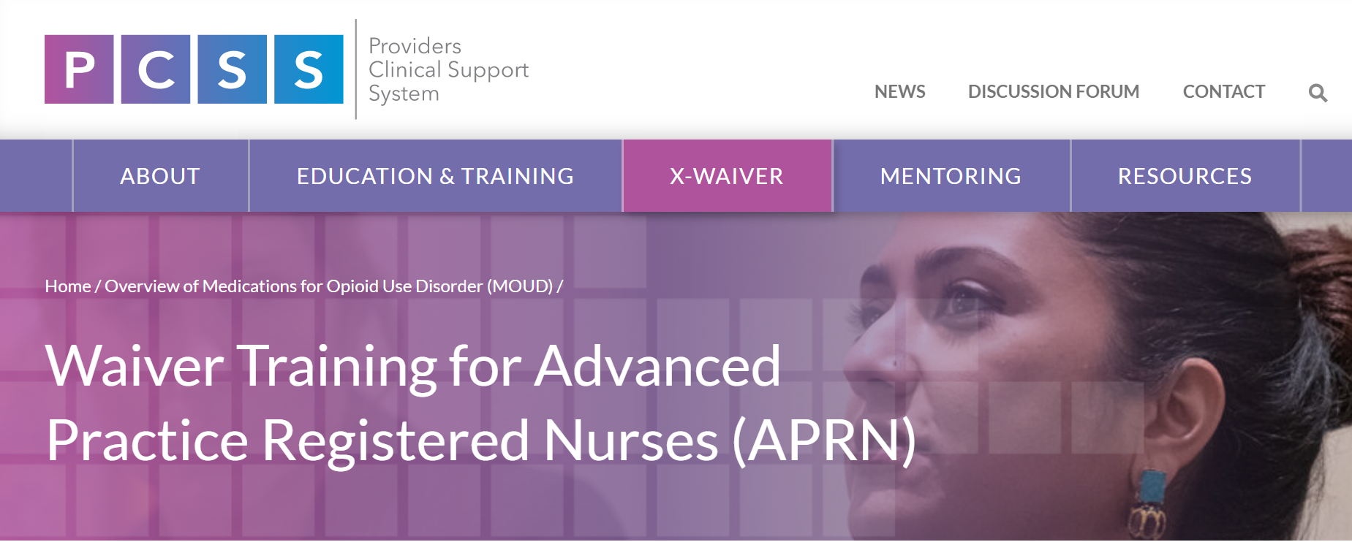

Slide 35
Pain and Opioid Use Disorder

Slide 36
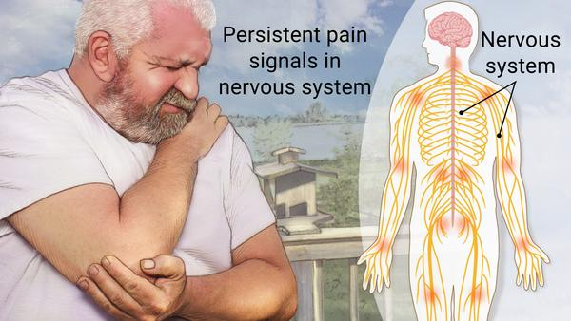
Prevalence
Percentages of patients with OUD who also have Chronic Pain:
  55% (Peles et al. 2005)
  54% (Yang et al 2017)
  64% (Hser et al 2017)

Slide 37
Bidirectionality of pain & OUD
Pain often comes first
N = 5307 adults with OUD from 2006-2015
~35% had no pain
~10% had OUD first and then pain
~15% had concurrent pain and OUD at presentation
Almost 40% had pain first and then developed OUD

Slide 38
Patients who had pain before onset of opioid use disorder had high rates of mental health disorders and other co-morbidities
Patients who had OUD before onset of pain are likely to have other SUD, HIV and Hep C.

Slide 39
Management of Chronic Pain and OUD
Pain should be addressed in setting of OUD
Pain is often a trigger for return to use
Comprehensive pain management is best strategy (include BH in this plan)
Can use methadone and buprenorphine to treat both
  Do not diagnose OUD to meet the ends of using bup or methadone to treat pain

Slide 40
Pain, OUD – How do I know what I am treating?
Sometimes, treating both
Need to confirm diagnoses
Physical Exam
Records review
Assessing for Substance Use Disorder

Slide 41
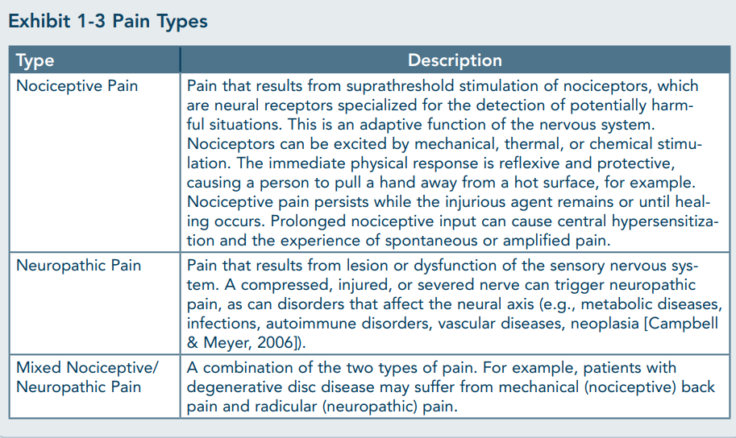
SAMHSA TIPS 54

Slide 42
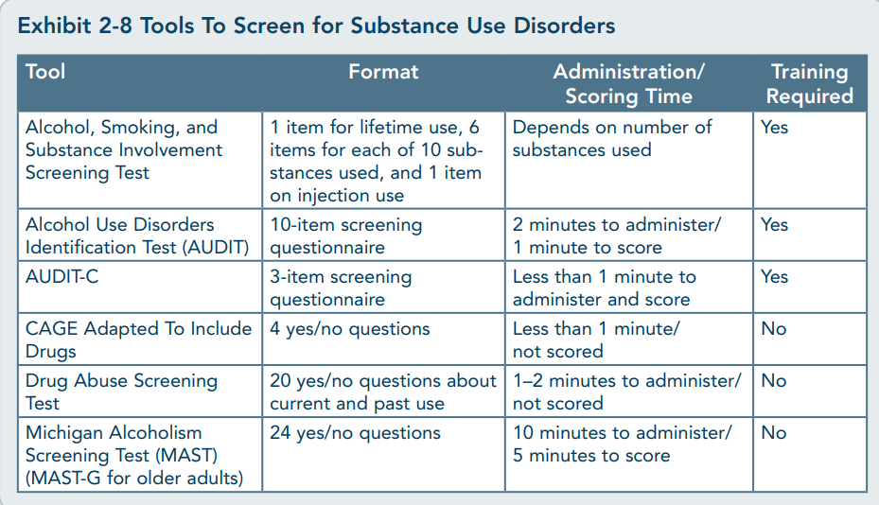
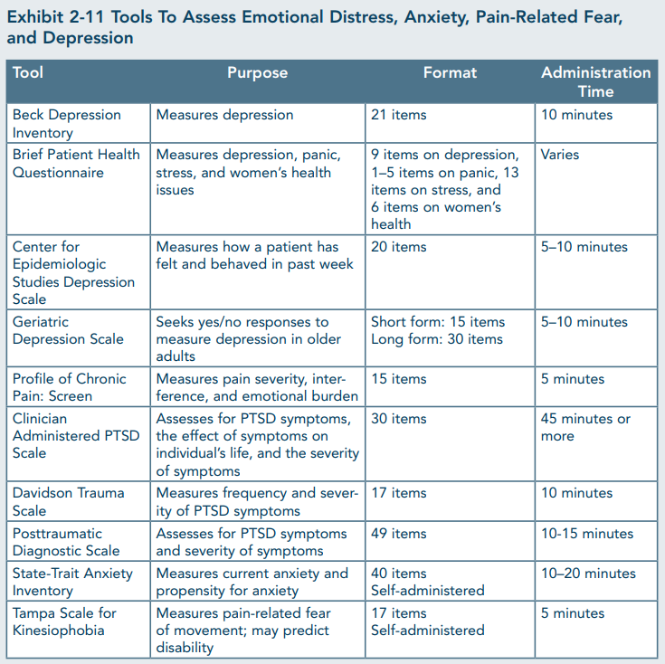
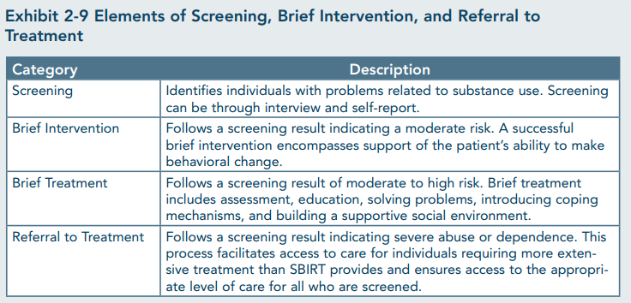
Assessment Tools
SAMHSA TIPS 54

Slide 43
Treating Pain

Slide 44
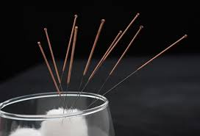


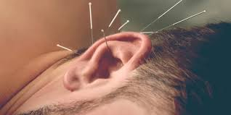
Non-Pharm Pain Management
  Ice
  Rest
  Elevate
  Soak
  Compression
  Brace
  Physical Therapy
  Massage Therapy
  Mindfulness/Meditation/Counseling
  Exercise
  Fix (suture, repair, set, remove)
  Acupuncture

Slide 45
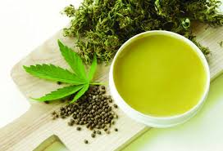
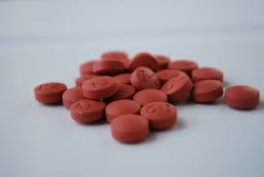
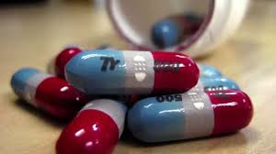
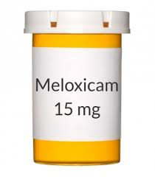
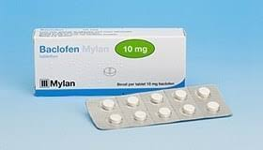
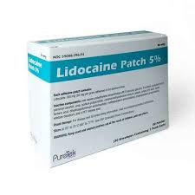

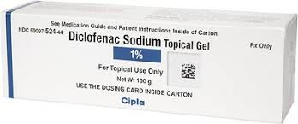
Pharm, Non-Opioid Pain Management

Slide 46
Strategies and other options
Scheduled dosing of
  Acetaminophen
    While avoiding combo opi/APAP meds
  Systemic NSAIDs
  Gabapentin
  Local/topicals
    Lidocaine
    Diclofenac
    Compounded creams
Other considerations
  Ketamine
  Propofol
  Nerve Blocks/Regional Anesthetics
  SNRIs, TCAs
  Short acting opioids

Slide 47

Acute Pain Management in Buprenorphine Maintained Patients
  Initially try non-opioid
  analgesics
  Continue Same buprenorphine maintenance dose but add non-opioid analgesics
  Use split dose for concurrent pain and dependence
    Buprenorphine’s analgesic duration is about 4 hours
  Stop buprenorphine and initiate full agonist therapy (not my go to choice)
Slide courtesy of PCSS Waiver Course
Notes:
Speaker Notes:
Management of pain in patients maintained on buprenorphine can be complicated and often has different approaches
The patient’s acute pain will not be treated by their once daily maintenance dose of buprenorphine – other management of pain will be required
In the US, only the injectable form of buprenorphine is approved for the treatment of pain.
If sublingual buprenorphine were used for the treatment of pain, then the dosing frequency would need to be increased. Buprenorphine’s analgesic duration is only a few hours.

Slide 48
Specifically,
With a sublingual formulation, buprenorphine shows onset of effects at 30–60 minutes postdosing and the peak clinical effects are observed at 1–4 hours. The duration of effect may last for 6–12 hours at low dose (<4 mg) and 24–72 hours at higher dose (>16 mg).
Buprenorphine – an attractive opioid with underutilized potential in treatment of chronic pain. Ish K Khanna and Sivaram Pillarisetti. J Pain Res. 2015; 8: 859–870.
Published online 2015 Dec 4. doi: 10.2147/JPR.S85951

Slide 49
Perioperative Management
Pre-Op:
  Confirm Multi-Party Consent and Coordination of care with providers
  Encourage patients to tell surgeon that they are prescribed MOUD/MAT
  Be available to talk with surgeon about post-op pain management
Notes:
Speaker Notes:
There is a lack of consensus in the field
Discuss with Surgery and Anesthesia services before procedure
In the Merrill Study, the key themes that emerged were that (1) Providers (a) feared deception, (b) had an inconsistent approach; (2) Patients felt that (a) their pain concerns were avoided and (b) that they were mistreated and stigmatized.

Slide 50
Ventral wall hernia repair, abdominal cerclage, c-section, open heart surgery, mastectomy
  Increase Buprenorphine dose
  Divide dose
  Add short acting opioids
  After a few days, short acting opioids gone
  Titrate back down to original buprenorphine, pre-op dose
  If adding opioids, talk to your patient about triggering medications – you may not want to prescribe the one that was the go to for your patient (MSO4 ok, but oxycodone is not, or…)

Slide 51
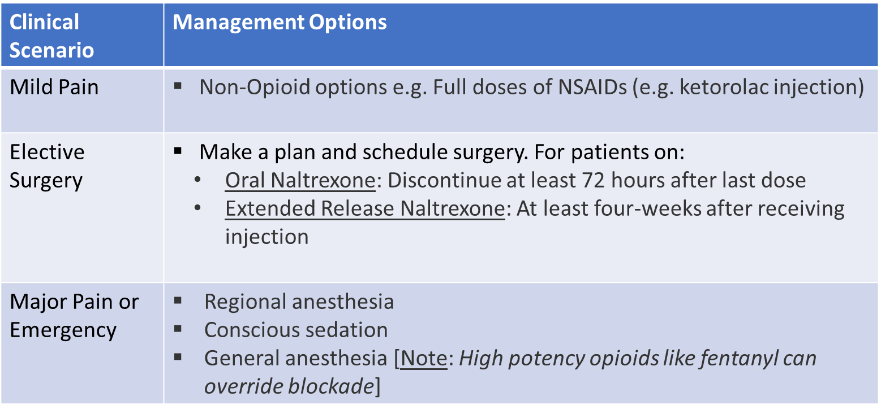
Acute Pain Management for
Patients currently on Naltrexone
Alford et al., 2006
CSAT, 2004
Kampman et al., 2015
WHO, 2009
Slide courtesy of PCSS Waiver Course
Notes:
Speaker Notes:
Discuss with Surgery and Anesthesia services before procedure

Slide 52
Opioids to Avoid in Opioid Dependent Patient
Butorphanol (Stadol) & Nalbuphine (Nubain)
  Why? These opioids are agonist-antagonist in action and can precipitate withdrawal in the opioid dependent patient.
Epocrates, Pharmacologic action

Slide 53
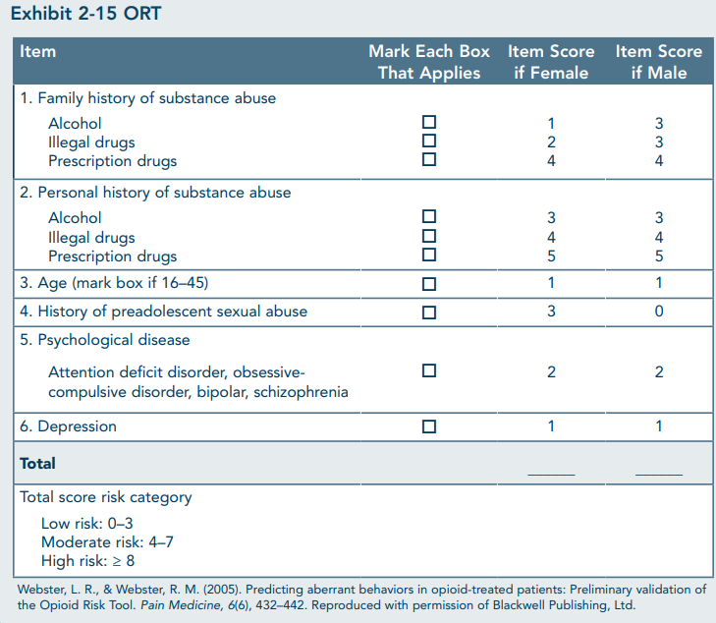
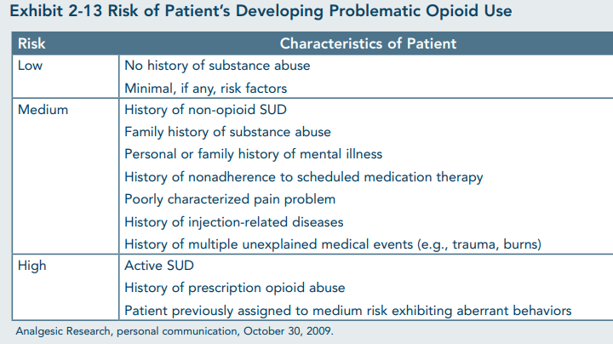
Risk assessment for long-term opioid use
SOAPP-R

Slide 54
Special State: Pregnancy

Slide 55
For Starters…
ACOG, SAMHSA discourage tapering/cessation of medication for OUD (opioid agonists) during pregnancy or after delivery
Attempt to avoid NAS/NOWS is not a reason to cease MAT
NAS, as the name implies, is abstinence from a substance on which the neonate is dependent. This could be stimulants (nicotine, caffeine, meth, cocaine), gabapentinoids, SSRIs, opioids, benzodiazepines, alcohol

Slide 56
Gold Standard
As we currently understand the evidence, opioid agonists are gold standard treatment for OUD in the pregnant patient.
Not enough evidence to date to safely endorse naltrexone as we do not know long term impact of opioid antagonist on brain development.

Slide 57
Neglected Substances
Tobacco/Nicotine
Cannabis
Alcohol

Slide 58
Recognizing the impact of SUD/OUD was present prior to pregnancy and will continue to be far reaching into the future lives of both the soon to be mother and her infant, we must take into account the bigger picture.
There is much more at stake than what we put on a prescription pad.

Slide 59
Social Stressors Create Vulnerability to Substance Use
Multiple factors outside of one’s own control can greatly contribute to increased exposure and vulnerability to chronic stress
Chronic exposure to stressors lead to overactivation of the body’s stress response
This interferes with functions such as reward pathways in the brain
Social determinants of health that generate/ support chronic and prolonged stressors are predictive of SUDs

Slide 60
Chronic Stressors
Concentrated poverty
Systematically thwarted opportunities (read: discrimination)
Incarceration
Loss or separation from a parent at an early age
Emotional, physical or sexual trauma
Parental divorce/conflict
Neglect
Isolation
Housing insecurity
Food insecurity

Slide 61
Stress Response
Activation of stress response linked to craving of substances
Exposure to stressors and next day alcohol intake linked
Rats!
  Substance exposed socially deprived rats chose interaction over substance

Slide 62
Resilience
Children confronted with childhood adversity and who have a safe, stable, nurturing relationship with at least one adult fosters positive outcomes.
Supportive relationships buffer stress response allowing the children to more successfully confront stressful situations.

Slide 63

Questions?
.

Slide 64
References (not noted on individual slides)
Getting a Waiver:
  https://www.samhsa.gov/medication-assisted-treatment/become-buprenorphine-waivered-practitioner/buprenorphine-waiver-faqs
Pain and OUD:
  Hser YI, Mooney LJ, Saxon AJ, Miotto K, Bell DS, Huang D. Chronic pain among patients with opioid use disorder: Results from electronic health records data. J Subst Abuse Treat. 2017;77:26-30. doi:10.1016/j.jsat.2017.03.006
  National Academies of Sciences, Engineering, and Medicine; Health and Medicine Division; Board on Health Sciences Policy; Committee on Pain Management and Regulatory Strategies to Address Prescription Opioid Abuse; Phillips JK, Ford MA, Bonnie RJ, editors. Pain Management and the Opioid Epidemic: Balancing Societal and Individual Benefits and Risks of Prescription Opioid Use. Washington (DC): National Academies Press (US); 2017 Jul 13. 2, Pain Management and the Intersection of Pain and Opioid Use Disorder.
  Einat Peles, Shaul Schreiber, Jacob Gordon, Miriam Adelson, Significantly higher methadone dose for methadone maintenance treatment (MMT) patients with chronic pain, Pain, Volume 113, Issue 3, 2005, Pages 340-346, ISSN 0304-3959.
  https://store.samhsa.gov/sites/default/files/d7/priv/sma13-4671.pdf

Slide 65
References (not noted on individual slides)
Special State:
Hortensia Amaro, Mariana Sanchez, Tara Bautista, Robynn Cox. Social vulnerabilities for substance use: Stressors, socially toxic environments, and discrimination and racism. Neuropharmacology, Volume 188, 2021, 108518, ISSN 0028-3908, https://doi.org/10.1016/j.neuropharm.2021.108518.
Wemm SE, Sinha R. Drug-induced stress responses and addiction risk and relapse. Neurobiol Stress. 2019 Feb 1;10:100148. doi: 10.1016/j.ynstr.2019.100148. PMID: 30937354; PMCID: PMC6430516.
Venniro, M., Zhang, M., Caprioli, D. et al. Volitional social interaction prevents drug addiction in rat models. Nat Neurosci 21, 1520–1529 (2018). https://doi.org/10.1038/s41593-018-0246-6
https://www.acog.org/clinical/clinical-guidance/committee- opinion/articles/2017/08/opioid-use-and-opioid-use-disorder-in-pregnancy
https://store.samhsa.gov/sites/default/files/d7/priv/sma18-5054.pdf

