Slide 1
Diabetes and Dentition
E Jackson Threet, DMD
Board Eligible, American Board of Oral Medicine
Head for the Hills
November 2022
Martha Washington Inn
Abingdon, VA

Slide 2
Conflicts of Interest
I have no conflicts of interest to declare

Slide 3
Objectives
A. Understand the etiology, pathogenesis of periodontal disease
B. Understand effects of poorly controlled diabetes on periodontium
C. Identify patients at risk of periodontal disease

Slide 4
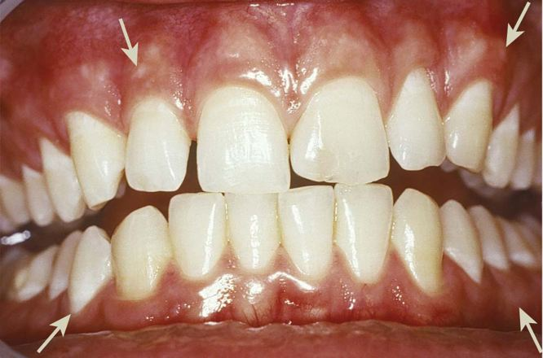
Periodontium
Notes:
(Newman, 072014, p. 10)
Newman, M., Takei, H., Klokkevold, P., Carranza, F. (072014). Carranza's Clinical Periodontology, 12th Edition [VitalSource Bookshelf version]. Retrieved from vbk://9780323188241
pink in appearance, not swollen, not inflamed, and firmly attached to the underlying tooth and bone, with minimal bleeding on probing.

Slide 5
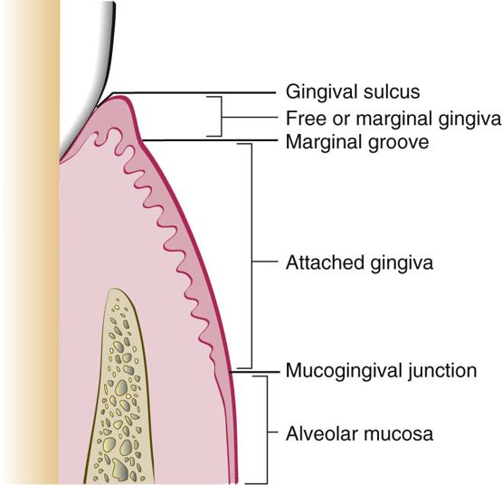
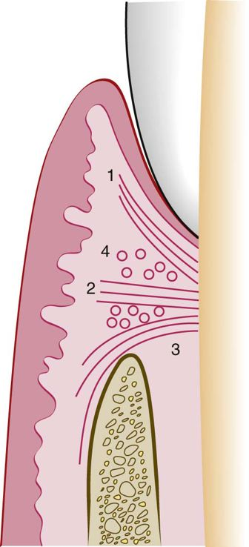
Notes:
(Newman 10)
Newman, Michael, Henry Takei, Perry Klokkevold, Fermin Carranza. Carranza's Clinical Periodontology, 12th Edition. W.B. Saunders Company, 072014. VitalBook file.
1 oral gingival epithelium – stratified squamous epithelium composed of keratinocytes, Langerhans, melanoycytes, merkle cells
2 sulcular epithelium – nonkeratinized squamous without rete pegs
3 junctional epithelium – nonkeratinized stratified squamous epithelium, loose cellular connections to allow immune / inflammatory response

Slide 6
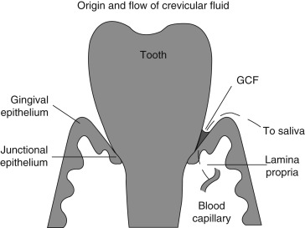
Stephen J. Challacombe, ... Martin H. Thornhill, in Mucosal Immunology (Fourth Edition), 2015
Notes:
Stephen J. Challacombe, ... Martin H. Thornhill, in Mucosal Immunology (Fourth Edition), 2015
Constant low state of inflammation with neutrophils progresses to macrophages, lymphocytes,

Slide 7
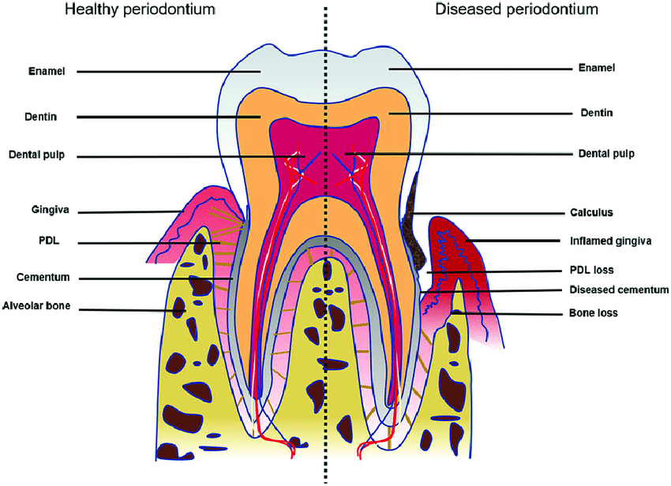
Periodontium
Xu, Xin-Yue & Li, Xuan & Wang, Jia & He, Xiao-Tao & Sun, Hai-Hua. (2018). Concise Review: Periodontal Tissue Regeneration Using Stem Cells: Strategies and Translational Considerations: Periodontal Regeneration Using Stem Cells. STEM CELLS TRANSLATIONAL MEDICINE. 8. 392-403. 10.1002/sctm.18-0181.
Notes:
Xu, Xin-Yue & Li, Xuan & Wang, Jia & He, Xiao-Tao & Sun, Hai-Hua. (2018). Concise Review: Periodontal Tissue Regeneration Using Stem Cells: Strategies and Translational Considerations: Periodontal Regeneration Using Stem Cells. STEM CELLS TRANSLATIONAL MEDICINE. 8. 392-403. 10.1002/sctm.18-0181.
What is periodontal disease

Slide 8
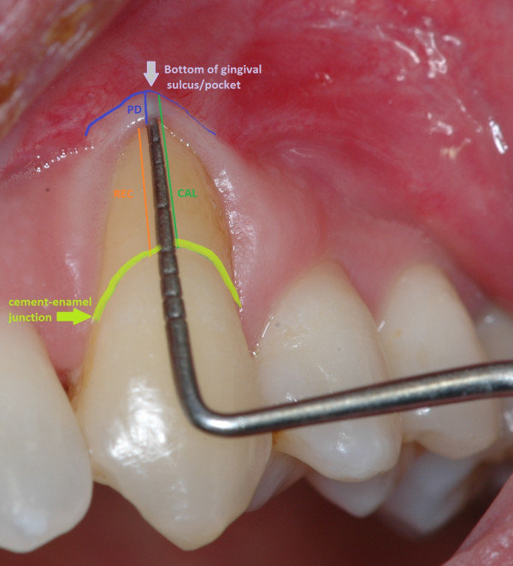
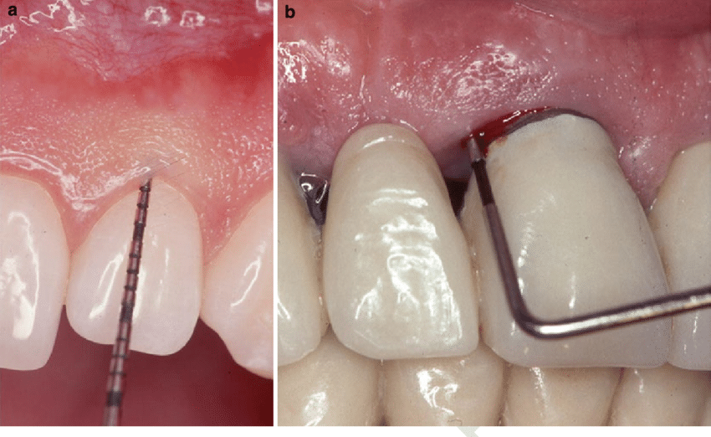
Diagnosis
Saliva Diagnostics for Oral Diseases - Scientific Figure on ResearchGate. Available from: https://www.researchgate.net/figure/The-clinical-evaluation-of-periodontal-disease-by-probing-a-Healthy-gum-and-b_fig4_283676711 [accessed 12 Sep, 2022]
https://www.researchgate.net/figure/PPD-CAL-and-REC-measurements-PPD-blue-line-is-the-distance-from-the-gingival-margin_fig26_237819432
Notes:
Saliva Diagnostics for Oral Diseases - Scientific Figure on ResearchGate. Available from: https://www.researchgate.net/figure/The-clinical-evaluation-of-periodontal-disease-by-probing-a-Healthy-gum-and-b_fig4_283676711 [accessed 12 Sep, 2022]
How is it diagnosed

Slide 9
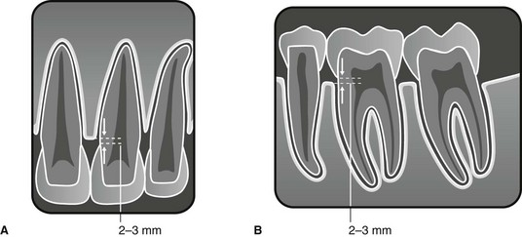
Diagnosis
https://pocketdentistry.com/19-the-periodontal-tissues-and-periodontal-disease/
Notes:
https://pocketdentistry.com/19-the-periodontal-tissues-and-periodontal-disease/
Considered physiologic

Slide 10
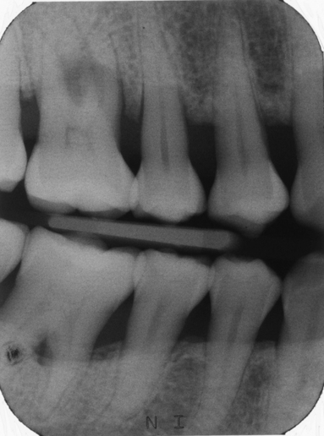
Diagnosis
Corbet, E., Ho, D. and Lai, S. (2009), Radiographs in periodontal disease diagnosis and management. Australian Dental Journal, 54: S27-S43. https://doi.org/10.1111/j.1834-7819.2009.01141.x
Notes:
Corbet, E., Ho, D. and Lai, S. (2009), Radiographs in periodontal disease diagnosis and management. Australian Dental Journal, 54: S27-S43. https://doi.org/10.1111/j.1834-7819.2009.01141.x
Advanced periodontal disease

Slide 11
Etiology
Local –
  Overwhelmingly plaque (mixed bacteria)
  Defective dental restoration or prostheses
  Trauma
  Foreign body reaction

Slide 12
Etiology
Systemic –
  Immune mediated
  Hereditary
  Specific bacteria, fungi, virus
  Blood dyscrasias
  Langerhans Cell Histiocytosis

Slide 13
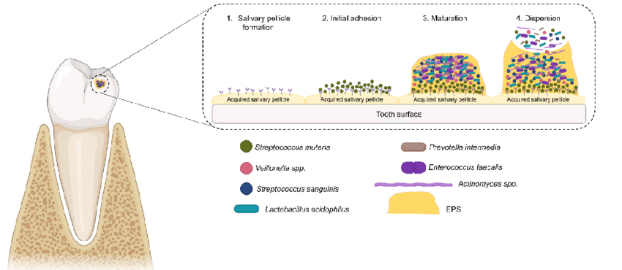
Etiology – bacterial
https://www.mdpi.com/2076-3417/11/9/4020/htm

Slide 14
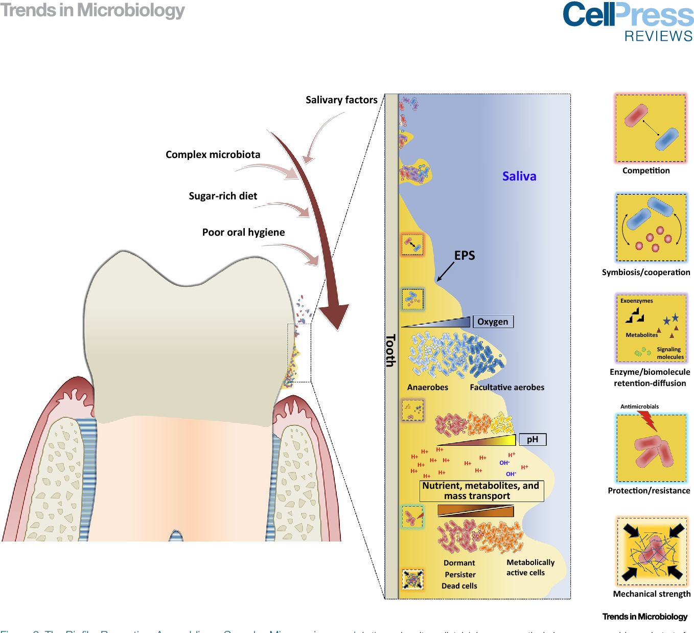
https://www.semanticscholar.org/paper/Oral-Biofilms%3A-Pathogens%2C-Matrix%2C-and-Polymicrobial-Bowen-Burne/5c38851f2ab70143f9b3ea8bc8bfb989ff7a134e/figure/2
Notes:
1 pellicle formation
2 proliferation of bacteria – anaerboes
3 biofilm
4 immune response
5 inflammation leads to tissue destruction

Slide 15
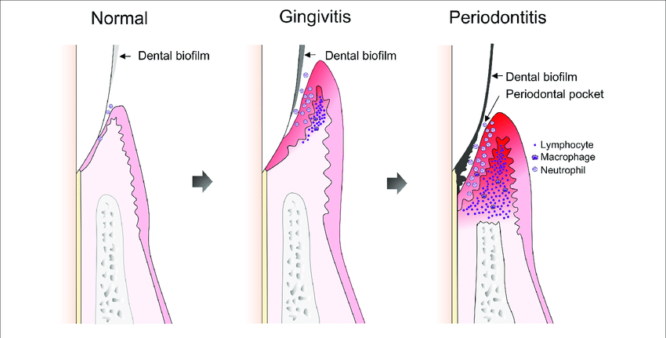
Pathogenesis
Host immune response
Notes:
Bacterial virulence factors initiate and perpetuate but the host response is most destructive – LPS from gram –
produce metabolic products that damage cells such as ammonia and hydrogen sulfide giving malodor
produce proteases
Elevated release of matrix metalloproteinases and lysosomal contents from neutrophils
Predominance of plasma cells in dense inflammatory cell infiltrate of connective tissues
JE migrate apically
Pocket deepens
Better environment for anaerobic bacteria that contribute to periodontitis

Slide 16
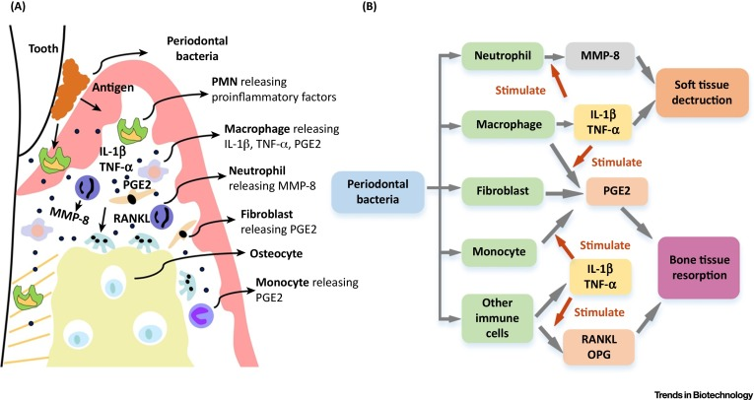
Notes:
(Newman 174)
Newman, Michael, Henry Takei, Perry Klokkevold, Fermin Carranza. Carranza's Clinical Periodontology, 12th Edition. W.B. Saunders Company, 072014. VitalBook file.
COX-2 is upregulated by IL-1β, TNF-α, and bacterial LPS, resulting in increased production of PGE2 in inflamed tissues. PGE2 is produced by various types of cells and most significantly in the periodontium by macrophages and fibroblasts. PGE2 results in the induction of MMPs and osteoclastic bone resorption, and it has a major role in contributing to the tissue damage that characterizes periodontitis.
cytokines mediate connective tissue and alveolar bone destruction through the induction of fibroblasts and osteoclasts to produce proteolytic enzymes (i.e., MMPs) that break down structural components of these connective tissues.12
proinflammatory cytokines IL-1β and TNF-α

Slide 17
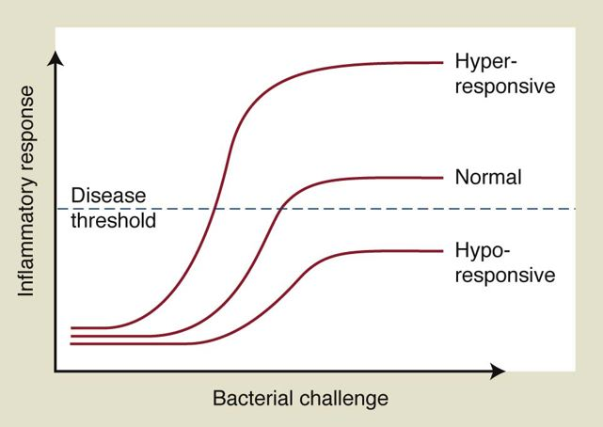
Notes:
(Newman 98)
Newman, Michael, Henry Takei, Perry Klokkevold, Fermin Carranza. Carranza's Clinical Periodontology, 12th Edition. W.B. Saunders Company, 072014. VitalBook file.

Slide 18
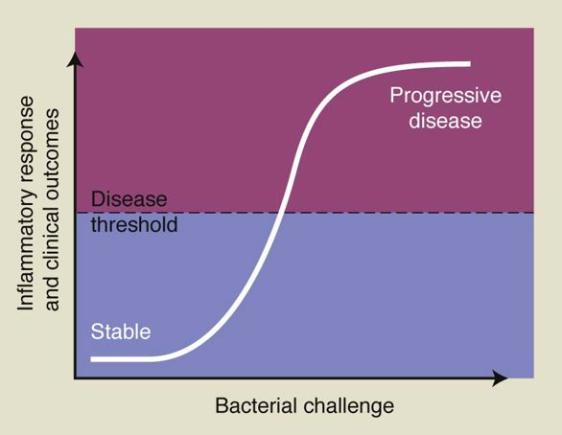

Slide 19
Similarities between periodontitis and Diabetes
Chronic -> more frequent surveillance
Improved by -> modification of habits (increased oral hygiene, altered diet, exercise)
Inflammation

Slide 20
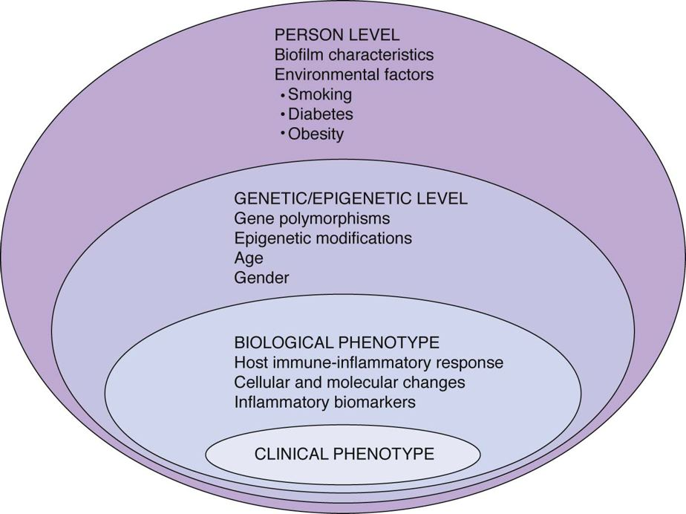

Slide 21
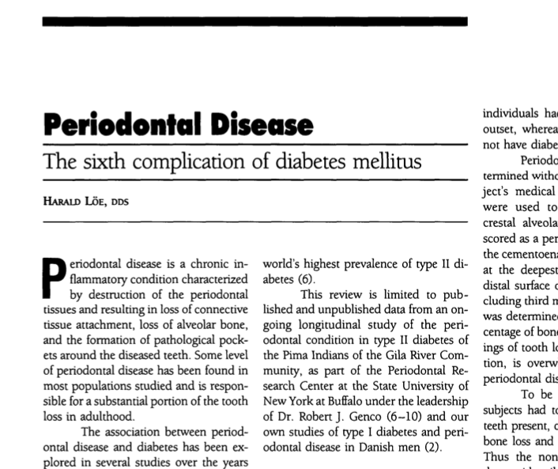
Sixth Complication of Diabetes?

Slide 22
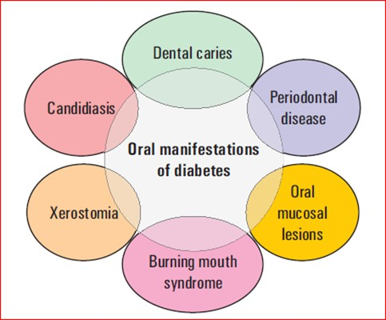
https://slideplayer.com/slide/7703767/
Notes:
1 - decreased salivary flow allows bacteria to linger, acidic
2 – increased glucose of saliva and blood
3 – altered function of PMNs, monocytes, macrophages
4 – impaired collagen structure, formation of AGEs (accumulated glycolation end products)

Slide 23
Evidence
Most well controlled studies show increased incidence and prevalence of periodontal disease.
More severe periodontitis.
Lack of consistency in studies.

Slide 24
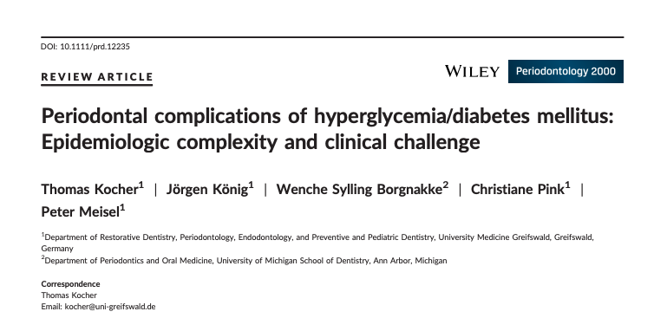

Slide 25
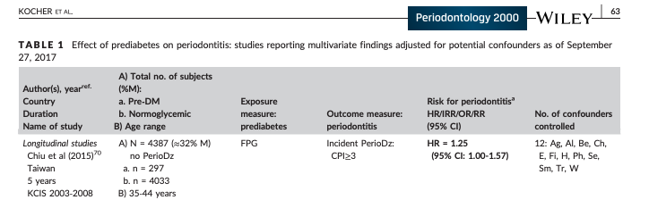

Slide 26
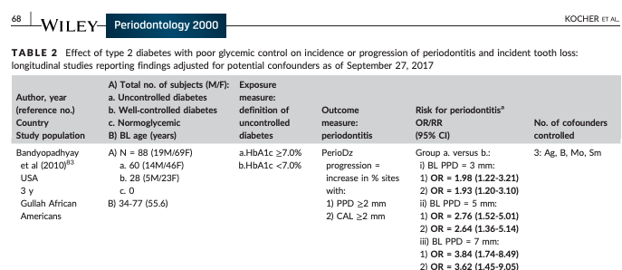

Slide 27
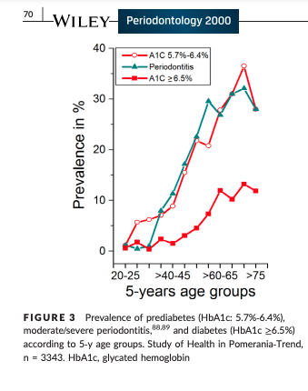

Slide 28
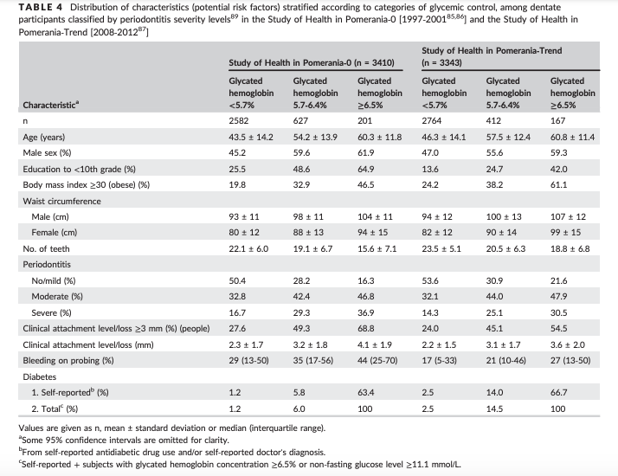

Slide 29
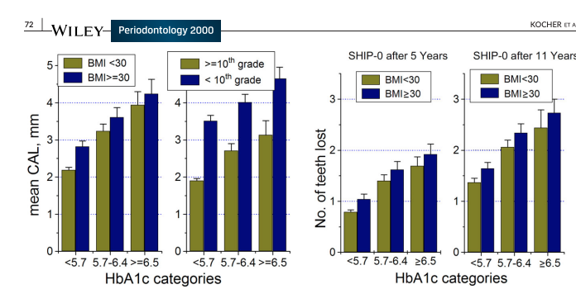

Slide 30
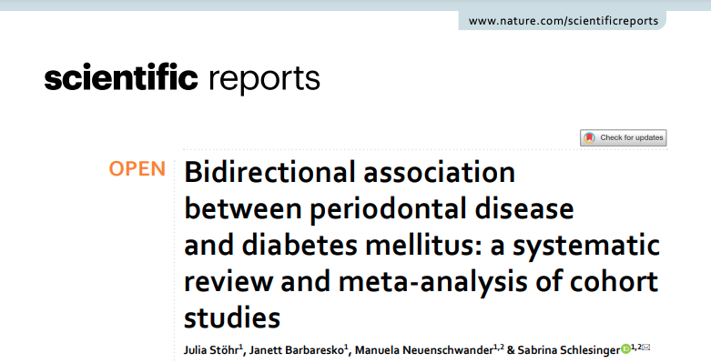
Notes:
9384 studies were initially identifed, and afer removing 2427 duplicates and excluding 6411 articles by title and abstract, 546 were investigated in a full-text analysis (Figure S1). Finally, 15 cohort studies
427,620 participants and 114,361 identifed cases of diabetes mellitus over a mean follow-up period of 9.9 years (range

Slide 31
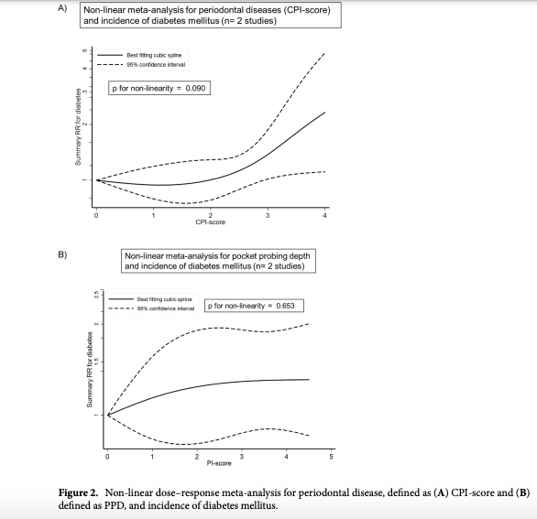
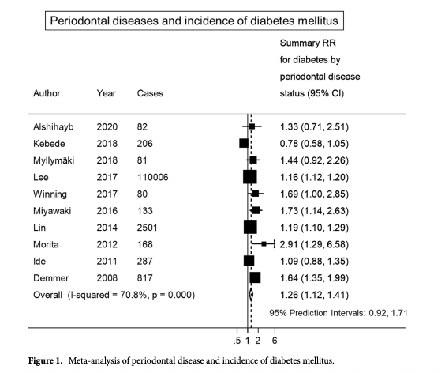
Notes:
427,620 participants and 114,361 identifed cases of diabetes mellitus over a mean follow-up period of 9.9 years (range
n increase in the incidence of diabetes was observed afer a CPI score≥3 (score 3: SRR (95% CI): 1.38 (1.02, 1.87); score 4: SRR (95% CI): 2.33 (1.11, 4.87); p for non-linearity:0.090; n=2) (

Slide 32
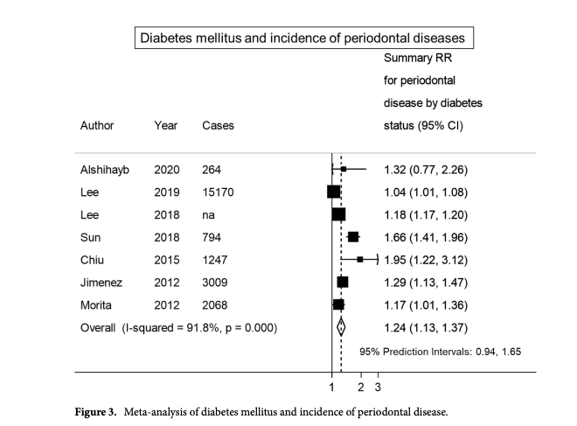
Notes:
295,804 participants and>22,500 diagnosed cases of periodontal disease (missing information on cases for Lee et al. 36) 33,36–41. Te mean follow-up period was 11.1 years (range
For patients with diabetes, the data indicated a 24% (95% CI 13%, 37%) increase in the incidence of periodontal disease. For patients with periodontitis, the relative risk of developing diabetes mellitus was elevated by 26% (95% CI 12%, 41%).

Slide 33
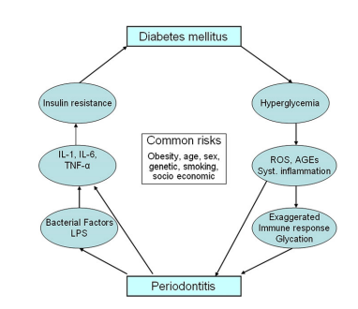
Periodontal - Diabetes Possible Mechanisms
https://deepblue.lib.umich.edu/bitstream/handle/2027.42/146293/prd12235.pdf?sequence=1

Slide 34
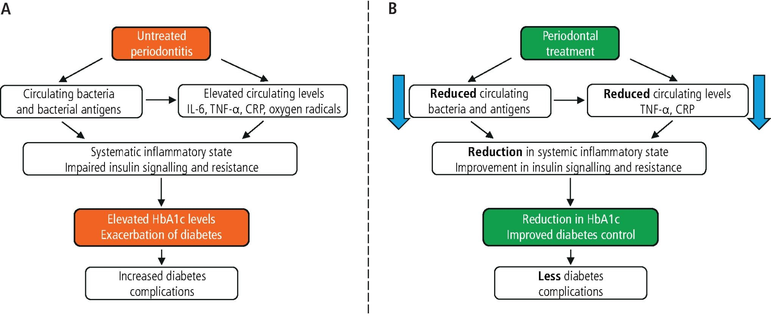
Periodontal Treatment Implications
If the bidirectional model is correct, will periodontal treatment help with diabetes?
Notes:
https://www.ncbi.nlm.nih.gov/pmc/articles/PMC3228943/pdf/125_2011_Article_2342.pdf

Slide 35
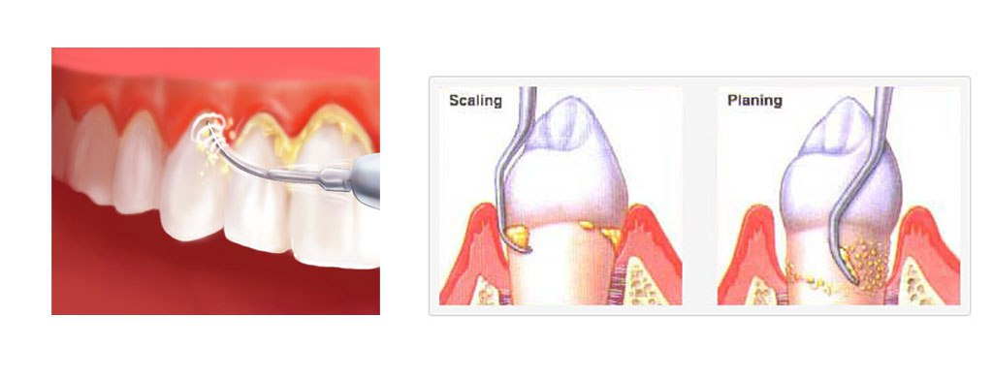
https://www.midlandparkfamilydentistry.com/scaling-and-root-planing/

Slide 36
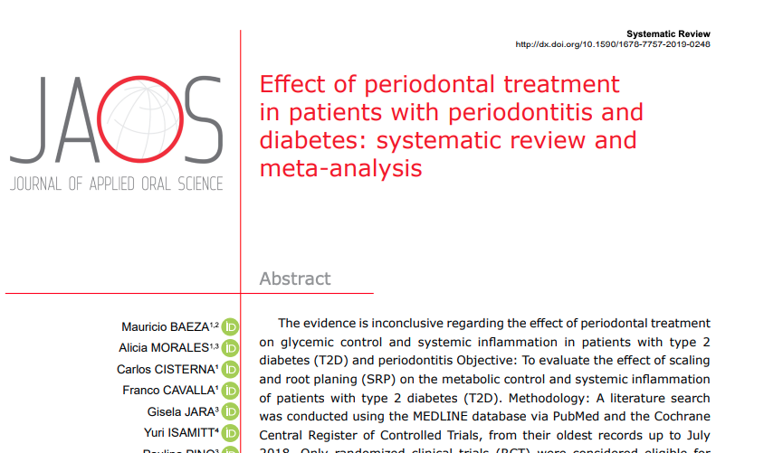
Notes:
9 studies included

Slide 37
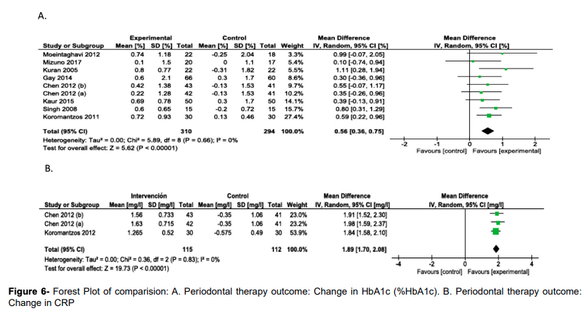
Notes:
SRP has an impact on metabolic control and reduction of systemic inflammation of patients with T2D. Periodontal treatment could constitute an innovative therapeutic approach as a public health measure to reduce complications and improve the cardiovascular health of patients with T2D. Intervention and cost-effectiveness studies in the context of public health systems in different countries are necessary to evaluate the possible design of public policies in this area

Slide 38
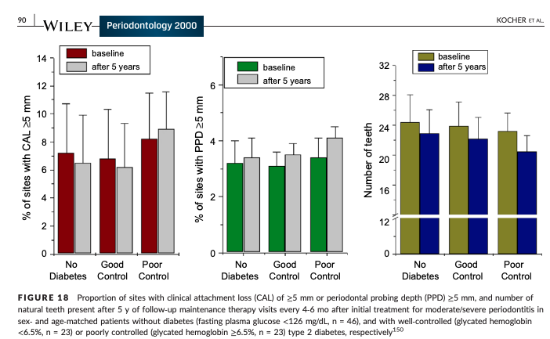

Slide 39
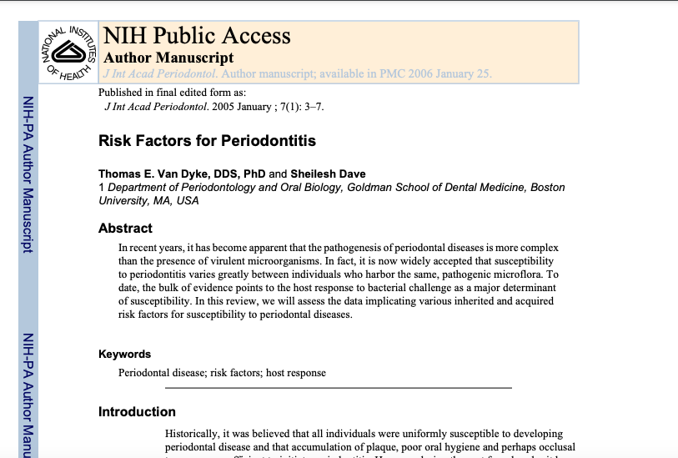
https://dimensionsofdentalhygiene.com/article/assess-periodontal-risk/bjn
Notes:
https://dimensionsofdentalhygiene.com/article/assess-periodontal-risk/bjn

Slide 40
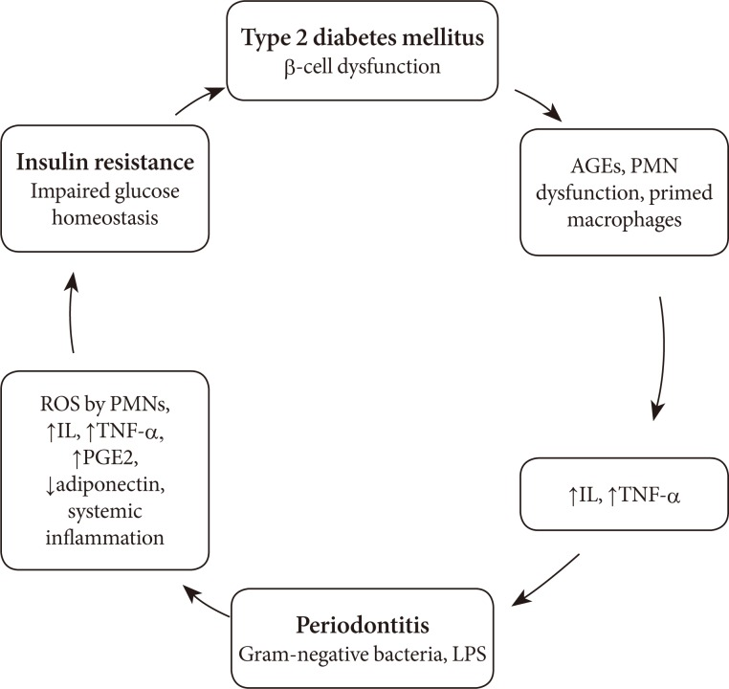
Summary
https://www.researchgate.net/figure/Bidirectional-relationship-between-diabetes-mellitus-and-periodontitis-AGEs-advanced_fig1_234012539

Slide 41
References
Carranza's Clinical Periodontology, 12th Edition. W.B. Saunders Company, 072014.
Silverman, Sol. Essentials of Oral Medicine. B.C. Decker, 012002. VitalBook file.
Stöhr J, Barbaresko J, Neuenschwander M, Schlesinger S. Bidirectional association between periodontal disease and diabetes mellitus: a systematic review and meta-analysis of cohort studies. Sci Rep. 2021 Jul 1;11(1):13686. doi: 10.1038/s41598-021-93062-6. PMID: 34211029; PMCID: PMC8249442.
Baeza M, Morales A, Cisterna C, Cavalla F, Jara G, Isamitt Y, Pino P, Gamonal J. Effect of periodontal treatment in patients with periodontitis and diabetes: systematic review and meta-analysis. J Appl Oral Sci. 2020 Jan 10;28:e20190248. doi: 10.1590/1678-7757-2019-0248. PMID: 31939522; PMCID: PMC6919200.
Kocher T, König J, Borgnakke WS, Pink C, Meisel P. Periodontal complications of hyperglycemia/diabetes mellitus: Epidemiologic complexity and clinical challenge. Periodontol 2000. 2018 Oct;78(1):59-97. doi: 10.1111/prd.12235. PMID: 30198134.
Poudel P, Griffiths R, Wong VW, Arora A, Flack JR, Khoo CL, George A. Oral health knowledge, attitudes and care practices of people with diabetes: a systematic review. BMC Public Health. 2018 May 2;18(1):577. doi: 10.1186/s12889-018-5485-7. PMID: 29716561; PMCID: PMC5930945.
Preshaw PM, Alba AL, Herrera D, Jepsen S, Konstantinidis A, Makrilakis K, Taylor R. Periodontitis and diabetes: a two-way relationship. Diabetologia. 2012 Jan;55(1):21-31. doi: 10.1007/s00125-011-2342-y. Epub 2011 Nov 6. PMID: 22057194; PMCID: PMC3228943.

