Slide 1
Biopsychosocial Approach to Addressing Addiction in Primary Care
Kevin Myers, Psy.D.
Licensed Clinical Psychologist
Cherokee Health Systems

Slide 2
SUD – By The Numbers
30.5 million individuals 12 years and older used an illicit drug(s) in the past 30 days
11.1 million individuals have experienced the misuse of a prescription pain reliever in the past year
140.6 million individuals use alcohol, 66.6 million binge drink, and 16.7 million are heavy drinkers
48.7 million use cigarettes with 11.4 million using one or more packs per day
19.7 million individuals have a substance use disorder; only 12.7% needing care received specialty addiction treatment
45.6% of SUD patients 18 years and older suffer from a co-morbid mental illness; only 8.3% received care for both
www.samhsa.gov/data/report/2017-nsduh-annual-national-report

Slide 3
Primary Care often Functions as the De Facto Mental Health System
In the US, 51% of all physician office visits are to primary care while 4.6% are to psychiatry
20% of all primary care visits are mental health related
National Center for Health Statistics, 2015, CDC MMWR 2010
PCPs report being unable to access specialty care for 2/3 or their patients
Cunningham, 2009
20% of patients who receive a referral to specialty care “comply”
Cummings et. al, 2003
Patients are most likely to seek care when in crisis and are less likely to engage when distress decreases
Brown & Jones, 2005

Slide 4
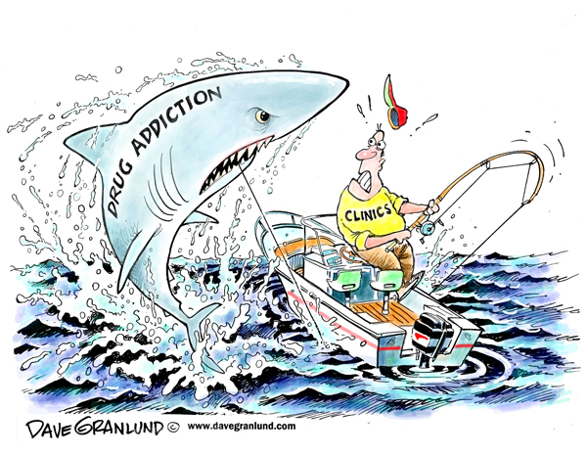
Is This You?

Slide 5
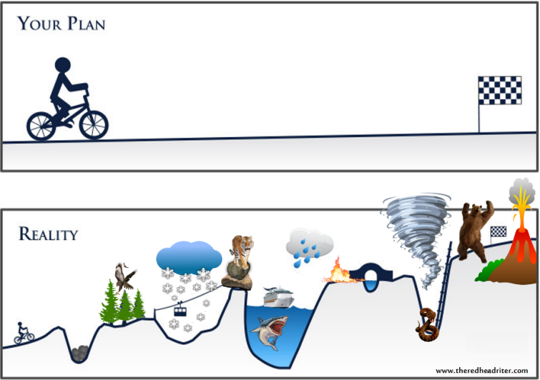

Slide 6

WHO Definition of Health
Health is a state of complete physical,
Mental, and social well-being
and not merely the absence of disease or infirmity.

Slide 7
“That means moving away from a system that
focuses on episodic care in response to acute
Illness and towards a system that is proactive and
emphasizes health across a lifetime.”
- World Health Organization

Slide 8
Integrated Addiction Medicine

Slide 9
Brief Interventions and Treatment in Primary Care
Social Determinants of Health
Patient Preference
Difficulty Accessing Specialty Care
Poor Physical Health
Limited Motivation and Engagement
Poor Mental Health

Slide 10
Intervention in Primary Care
Primary Prevention
Brief Intervention
Referral, Co-management & Reabsorption

Slide 11
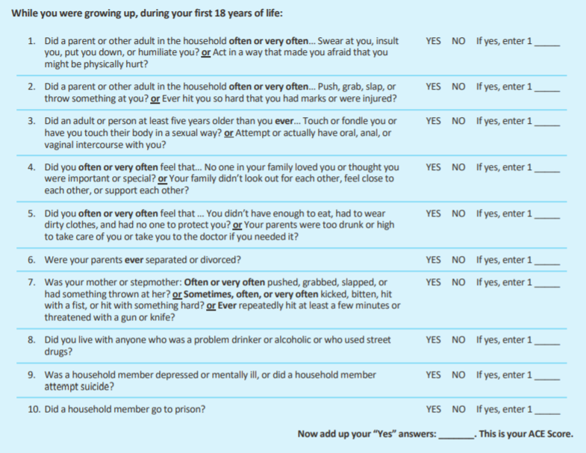
Prevention Example: Addressing ACES
Center for Healthcare Strategies, 2019
Robert Wood Johnson Foundation

Slide 12
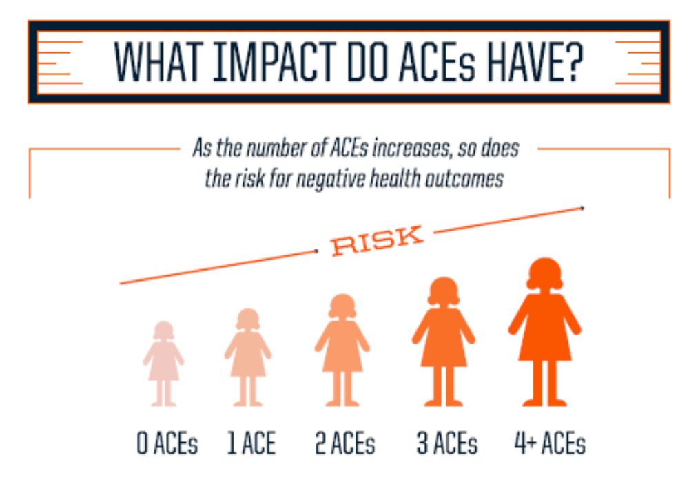
Shin, McDonald, & Conley, 2018

Slide 13
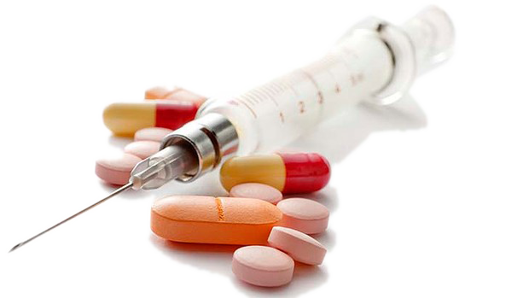
10.8% of pregnant women drink alcohol
  3.7% binge drink
4.4% of pregnant women use illicit drugs
16.3% of pregnant women smoke some cigarettes
Up to 20% of infants are born exposed to substances
(SAMHSA, 2010)

Slide 14
Biological Impact
Neonatal Abstinence Syndrome (NAS)
  Irritability
  Continuous high pitched crying
  Decreased sleep
  Seizures
Potential Long-Term Effects
  Developmental delays (Executive Functioning)
  SIDs
  Cardiac Difficulties
  (McGlone & Mactier, 2014)
  Vomiting
  Diarrhea
  Poor Feeding
  (Behnke & Smith, 2013)

Slide 15
Environmental Factors
(Family Impact)
Reduced caregiver responsiveness
Caregiver unpredictability
Limited appropriate coping strategies among caregivers
Housing/food instability
Noncompliance with medical care
Multiple caregivers
Increased risk of physical/emotional/sexual abuse

Slide 16
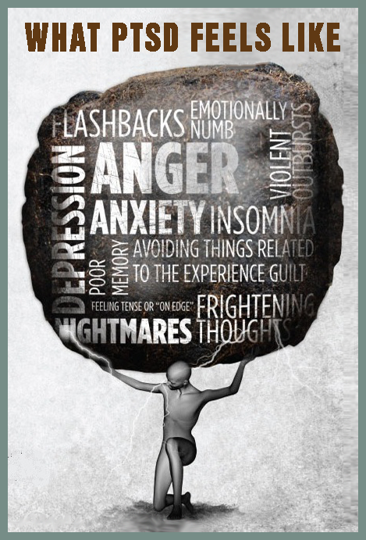
Trauma
Parent
Child
Impact of past trauma
  Parenting stress as trigger
  Lack of appropriate models
  Minimal social support
Heightened risk for trauma exposure
  Emotional neglect
  Physical neglect
  Emotional abuse
  Physical abuse
  Sexual abuse
  Domestic violence exposure

Slide 17


Slide 18

Bridging the Barriers
Connecting families to recovery resources
  Setting up or completing an intake for the parent and submitting referral to addiction clinic
Connecting to assistance with immediate basic needs (case manager)
Consulting with DCS and other involved systems (e.g., court)
Creating healthcare home for the family

Slide 19
The likelihood of negative long term impacts can be reduced by helping families foster resilience and create an environment that is
Positive
Predictable
Nurturing
Substance Free
(Hans & Jeremy, 2001)

Slide 20
“Addiction is a whole family problem…one person may use, but the whole family is affected.”
Unknown

Slide 21
Identification
Foundational goal of behavioral enhanced primary care is to identify and treat substance use and behavioral health concerns
Most patients with substance use disorders get no substance use treatment
However, most patients with substance use disorders seek primary care services for something other than their substance use
The continuous and longitudinal nature of primary care makes it an ideal venue to screen for and address at-risk use and substance use disorders

Slide 22
Distribution of Patients with Diagnosable Behavioral Disorder

Slide 23
Identification Strategies
Screening
Team Huddles
Schedule Review
Reporting
Chart Review
Patient Self-referral
Provider Referral

Slide 24
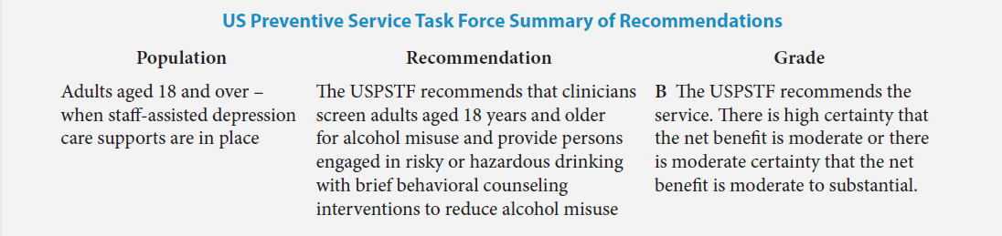
Screening Recommendations
The United States Preventative Service Task Force (USPSTF) recommends screening and brief counseling for alcohol misuse in adult patients with a grade of B.
Alcohol screening followed by brief counseling intervention was the third highest priority among all preventive recommendations offered by the USPSTF.
Notes:
United Stated

Slide 25
Selecting Pre-screening Tools
Screening begins with a brief pre-screen
A positive pre-screen indicates distress that should be further evaluated
There are several evidence-based pre-screening tools; thus, it is possible to tailor the screening process to best meet the needs of the clinic and patient population
  Alcohol Use Disorder Identification Test (AUDIT-C)
  National Institute on Drug Abuse (NIDA) Quick Screen

Slide 26

Pre-screening
National Institute on Drug Abuse (NIDA) Quick Screen
  The NIDA Quick Screen assesses frequency of alcohol, tobacco, prescription and illegal drug use in the past year. If the patient answers “never” for all drugs, the screening is considered negative. Any answer other than “never” indicates a positive screen and the need for additional assessment.

Slide 27
Selecting a Screening Tool
Most will generate negative pre-screens. Patients with a positive pre-screen need additional assessment to help guide intervention and treatment planning.
There are numerous evidence-based screening tools.
  Alcohol, Smoking, and Substance Involvement Screening Test (ASSIST)
  Alcohol Use Disorders Identification Test (AUDIT)
  CAGE-AID
  Drug Abuse Screening Test (DAST-10)
  Michigan Alcoholism Screening Test (MAST)

Slide 28
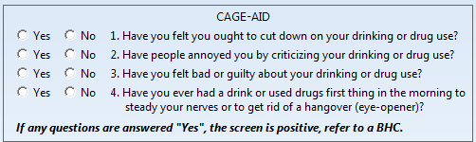
Screening
The CAGE-AID
  The CAGE-AID is an expanded version of the CAGE screener that assesses both alcohol and drug misuse. CAGE is an acronym for key words in the four questions (Cut Down, Annoyed, Guilty, Eye-Opener) and AID indicates it is Adapted to Include Drugs. Each “yes” response earns one point. One point indicates a possible problem, whereas two points indicates probable substance misuse.

Slide 29
Screening Workflow
Embed screening into the existing clinic workflow.
  Improves acceptance
  Sustainability of the screening process
  Becomes a routine aspect of care

Slide 30
Stage Matched Interventions

Slide 31
Assessment of Substance Use
Ask with the assumption of use.
  What drugs do you use?
  When’s the last time you took a medication not prescribed to you?
  How much alcohol do you drink a day?
  How much marijuana do you smoke daily?

Slide 32
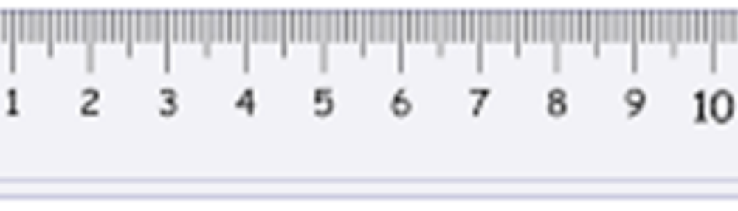
Assessment of Motivation
“On a scale of 1-10, with 10 being the most, how interested are you in working to decrease your substance use?”

Slide 33
Severity and motivation are separate constructs that vary independent of one another.
Severity
Motivation

Slide 34

Stages of Change
  Anticontemplation- “I resent your assertion that I have a problem.”
  Precontemplation – “I don’t have a problem.”
  Contemplation – “I have a problem, but I’m not sure I’ll change.”
  Preparation - “I think I will change soon.”
  Action – “I’m working to change.”
  Maintenance – “I’m working to maintain the changes I’ve made.”
    Prochaska and DiClemente (1983)

Slide 35
Enhancing Engagement
Provider’s empathy is significant predictor of treatment outcome.
  Treatment by provider with low empathy is less effective than self-help manuals. (Miller et al., 1980)
  Harsh confrontation is counterproductive.
Fluidly adjusting the treatment plan in response to changes in the severity of symptoms and motivation is key to treating substance use disorders.

Slide 36
Enhancing Engagement
Engagement is the initial target of treatment
Develop treatment partnership
  Use a collaborative, Socratic style
  Apply strategic dosing principles
Align treatment with patient’s values
  Use patient’s language
Convey empathy and hope

Slide 37
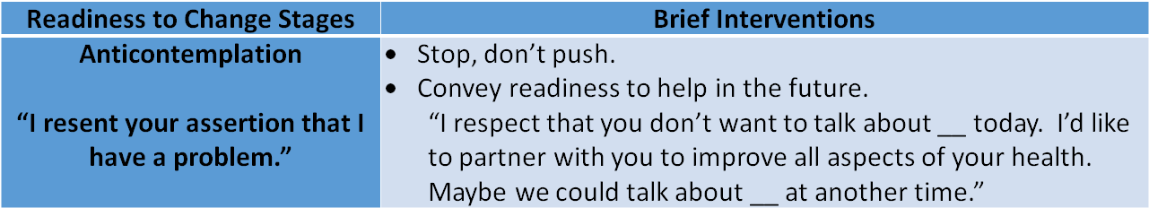
Stage Matched Interventions:
Anticontemplation

Slide 38

Severity
Motivation

Slide 39
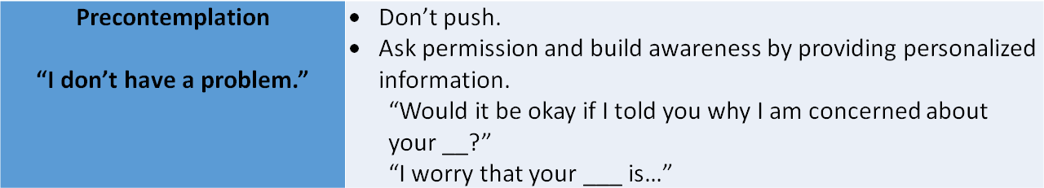
Stage Matched Interventions:
Precontemplation

Slide 40

Severity
Motivation

Slide 41
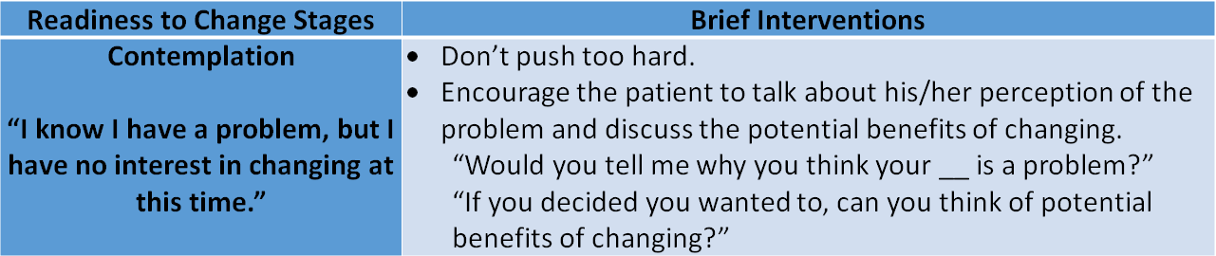
Stage Matched Interventions:
Contemplation

Slide 42

Severity
Motivation

Slide 43
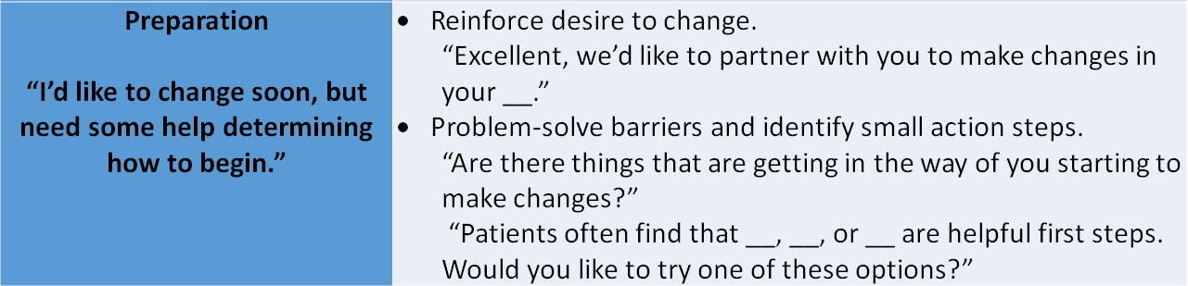
Stage Matched Interventions:
Preparation

Slide 44

Severity
Motivation

Slide 45
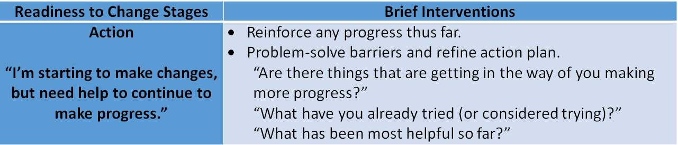
Stage Matched Interventions:
Action

Slide 46
Severity
Motivation

Slide 47
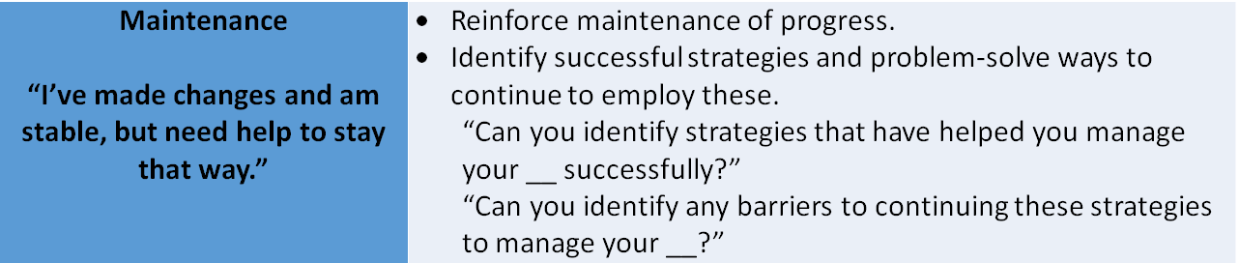
Stage Matched Interventions:
Maintenance

Slide 48

Severity
Motivation

Slide 49
Psychosocial Supports

Slide 50
Psychosocial Interventions
Common elements – Intended to 1) modify the underlying processes that maintain addictive behavior, 2) treat psychiatric comorbidity that complicates recovery or triggers relapse, and 3) encourage engagement and adherence to pharmacotherapy when clinically indicated
(Dugosh, 2016)
Can be used in a variety of treatment settings, as stand-alone treatment, or in combination with pharmacological interventions, individually or in groups, briefly or intensive and specialized, and provided by a range of health workers (Jhanjee, 2014)
Notes:
The term “psychosocial support” is used here to refer to a broad range of interventions at a social and psychological level. Interventions at a social level include assistance with basic needs such as food, clothing, accommodation and employment, as well as basic health-care, friendship, community and the pursuit of happiness. Interventions at a psychological level range from unstructured supportive psychotherapy and motivational interviewing techniques, to highly structured psychological techniques.
Need to tailor patients plan to their individual needs and values

Slide 51
Psychosocial Interventions in Conjunction with Medications
Recommended with any pharmacological treatment – at a minimum should include assessment of:
    Psychosocial needs
    Supportive counseling
    Links to existing family and community services
Best practice
  A variety of structured psychosocial interventions available based on patient population needs
  May include but not limited to various forms of counseling & psychotherapy, assistance with social needs (e.g., housing, employment), and on-site treatment for comorbid psychiatric concerns (WHO, 2009)
Notes:
Ensure the assessment includes a medical and psychiatric history, a substance use history, and evaluation of family and psychosocial supports.
The main criterion of effectiveness is that a psychological therapy leads to either a reduction in, or abstinence from, that substance and improvements across a broad range of areas of functioning, which include physical health, psychological health, human immunodeficiency virus and hepatitis risk behaviors, interpersonal relationships, employment and criminal behavior.

Slide 52

Joining Forces
Medication Assisted Treatment (MAT) has robust treatment effects, but traditionally limited to addiction medicine specialty field
Psychosocial Interventions are considered essential components to any comprehensive substance use disorder treatment plan
    Research shows psychosocial interventions can promote behavior change for this population (Hubbard et al., 1997)
    Review of the literature indicates those exposed to psychosocial interventions have signficantly better substance use outcomes (e.g., reduction in or abstinance from use, improvements in functioning across broad range of areas)
WHO strongly recommends psychosocial support be offered routinely in association with MAT
    MAT + Psychosocial Interventions are more effective than MAT or Psychosocial Interventions alone (Jhanjee, 2014)
Notes:
Robust treatment effects of MAT but knowledge has been contained to addiction specialty med field
Need to provide access to MAT and possibly enhance effects with provision of psychosocial interventions
Still trying to understand the safest and most effective combination of the 2 (research often has poor control groups, so hard to really know full impact, but evidence indicates psychosocial interventions improve outcomes)
Goal of psychosocial interventions: Gain control of urges & remain abstinent
Assist in coping with emotional strife that often accompanies addiction (Dutra et al 2008)
More research on methadone – but less on buprerenorphine & naltrexone (which can be delivered in PC)
Hubbard RL, Craddock SG, Flynn PM, Anderson J, Etheridge RM. Overview of 1-year follow-up outcomes in the drug abuse treatment outcome study (DATOS) Psychol Addict Behav. 1997;11:261–78.

Slide 53

Life-Saving Intervention
Receipt of any psychosocial treatment associated with lower mortality at 12 and 24 months in individuals with Opioid Use Disorder (Watkins, et al. 2017)
Defined as one dx related treatment visit in observation year
    Individual or group psychotherapy
    Family interventions
    Supported employment
    Skills training
    Intensive case management
Notes:
Study with VA looked at 7 quality of care process measures. 3 things that impacted mortality rate were quarterly physician visits, not being prescribed opioids or benzodiazepines (measure indicating absence of inappropriate prescribing), receipt of ANY psychosocial intervention and quarterly physician rates
Process measures not associated with mortality outcome: receipt of Hep B, C, or HIV screening; FDA approved OUD pharmacotherapy

Slide 54

Individualized Treatment Planning
Behavioral Health Intake Assessment
Collaboration in development of Tx Plan tailored to meet pt’s unique strengths, goals, values

Slide 55

Trauma-Informed Care
In clinical populations (focusing on either disorder), about 25-50% have dual diagnosis of PTSD and substance use disorder in their lifetime
    This is associated with more severe clinical profile, lower functioning, poorer well-being, and poorer outcomes (Schafer & Najavits, 2007)
Notes:
Trauma-Informed Approach
According to SAMHSA’s concept of a trauma-informed approach, “A program, organization, or system that is trauma-informed:
Realizes the widespread impact of trauma and understands potential paths for recovery;
Recognizes the signs and symptoms of trauma in clients, families, staff, and others involved with the system;
Responds by fully integrating knowledge about trauma into policies, procedures, and practices; and
Seeks to actively resist re-traumatization."
A trauma-informed approach commits to and acts upon the to six key principles rather than a prescribed set of practices or procedures. These principles may be generalizable across multiple types of settings, although terminology and application may be setting- or sector-specific:
Safety
Trustworthiness and Transparency
Peer support
Collaboration and mutuality
Empowerment, voice and choice
Cultural, Historical, and Gender Issues
Trauma informed care also reconsiders and evaluates all components of the system “in light of a basic understanding of the role that violence plays in the lives of people seeking mental health and addiction services”
… it applies this understanding to design services systems that accommodate the vulnerabilities of trauma survivors
… requires to the extent possible close collaborative relationships with other public sector service systems serving these clients and the local network of private practitioners with particular clinical experience in trauma

Slide 56
Individual BH Intervention
Behavioral Health Consultation
    Frequently first line treatment of substance use disorder
    Can be used in primary care and specialty medical settings or as an adjunct to other services (e.g., IOP, Group Medical Visits, DBT)
    Excellent venue for working to increase motivation for more intensive A&D treatment options
    Can be used opportunistically (e.g., in response to screeners, hospital follow ups)
Specialty Mental Health/Individual Psychotherapy
    Can be used as a stand-alone service or as an adjunct to other services (e.g., IOP, Group Medical Visits, DBT)
                (Jhanjee, 2014)
Notes:
There is no limit to the # of visits a patient may see BHC in PC focusing on building motivation for engagement in A&D services, reduction of use, relapse prevention and tx planning, maintenance of gains, etc. A patient may be open to this service long before more intensive services like IOP or MAT and this allows us to build rapport and engage a patient ultimately leveraging this relationship to assist them in transitioning to other levels of care if/when severity/motivation increases.

Slide 57

Group Psychotherapy
Cognitive Processing Therapy
Dialectical Behavior Therapy (DBT)
Anger Management
Chronic Pain Management
Healthy Lifestyles/Weight Management
Parenting Skills
Notes:
As we mentioned, we’re focusing on assessing and providing appropriate treatment options for concerns underlying and/or triggering continued substance use – frequently patients benefit from group therapy options targeting these concerns – the most common types of group therapy referrals provided for addiction medicine patients have been DBT and CPT – depending on the healthcare burden and patient’s social circumstances, this could occur concurrently with engagement in other group therapies or sequentially when time/transportation/motivation is limited.

Slide 58
Extended Outpatient (EOP)
(3 hours x 1 day per week for 6 months)
24 Session Curriculum
    Motivational Interviewing
    CBT
    Motivation Enhancement Therapy
    DBT
    Solution-Focused Therapy
    Family Behavior Therapy
Relapse Prevention/Aftercare Group (1 hour weekly)
Notes:
The frequency and length of groups should be considered with a focus on finding an appropriate balance between pt’s treatment needs and life demands – we more commonly/rigidly adhere to offering IOP programing (3 hrs, 3x/week) or inpatient services; however, this time demand can be a significant barrier for those with children, FT work, or very limited transportation. We observe benefit from these more condensed time frames and have been able to target patients with unmet needs within our system who otherwise would not have engaged in A&D services.

Slide 59
Intensive Outpatient (IOP)
(3 hours x 3 days per week for 8 weeks)
24 session Curriculum
  Motivational Interviewing
  CBT
  Motivation Enhancement Therapy
  CBT
  Solution-Focused Therapy
  Family Behavior Therapy
Relapse Prevention/Aftercare Group (2 hours weekly)
Notes:
We have offered traditional IOP programing to address substance use for years – this has traditionally been psychologist led and focusing on a variety of evidence based group interventions. In addition to group engagement, patients attend 2 AA/NA/Celebrate Recovery Meetings per week and meet with an individual therapist to discuss progress, engagement, ongoing treatment goals, and coordination of care for next phase of treatment.

Slide 60
What is Integrated Care?
“The care that results from a practice team of primary care and behavioral health clinicians, working together with patients and families, using a systematic and cost-effective approach to provide patient-centered care for a defined population. This care may address mental health and substance abuse conditions, health behaviors (including their contribution to chronic medical illnesses), life stressors and crises, stress related physical symptoms, and ineffective patterns of health care utilization.”
Peek CJ and the National Integration Academy Council. Executive Summary - Lexicon for Behavioral Health and Primary Care Integration: Concepts and Definitions Developed by Expert Consensus. AHRQ Publication No.13-IP001-1-EF. Rockville, MD: Agency for Healthcare Research and Quality. 2013. http://integrationacademy.ahrq.gov

Slide 61
Traditional Work Flow
Withdrawal Care Coordination
Disease Monitoring
Medication Refills
Acute Care
Test Results
PROVIDER
HEALTHCARE
SUPPORT
TEAM
Case Manager
Behavioral Health
Nursing Team
Peer Support
Source: Southcentral Foundation, Anchorage AK

Slide 62
Who is on the Team?
  Patient
    “Team Captain”
  Addiction Medicine Provider
    Assess and treat diseases of addiction with assistance of a BHC or specialty behavioral health provider, as clinically indicated
  Behavioral Health Consultant
    Communicate with prescriber to clarify diagnosis and unify treatment plan
    Monitor symptoms and functioning and communicate concerns/progress to prescriber
    Facilitate A&D treatment groups

Slide 63

Who is on the Team?
Certified Peer Recovery Specialist (CPRS)
  Lead Care Team Member: Certified Peer Recovery Specialist (VA)
    http://www.dbhds.virginia.gov/library/recovery/certification_registration_peer_recovery_specialist_v%20_1_30_2017.pdf
  Services delivered by a person in recovery drawing upon lived experiences
  Social modeling theory states that other people in similar circumstances might have the most influence on behavior change
  Common roles: Patient engagement, co-leading groups, assistance with accessing higher levels of care, technology for self-management skills, emotional support, coaching strategies, developing action plans for coping, promotion health and wellness, & patient advocacy
Notes:
Within our CHS team, our CPRS assists in facilitating engagement (e.g., helping orient patient to services, answering logistical questions, outreaching no shows), co-leading groups (enhancing information presented in group, providing ‘real life’ examples, talking about tools they used to get better themselves), assistance with accessing higher levels of care (e.g., helping to make calls to medical detox, inpatient, residential), technology for self-management skills (teaching patients how to use agency patient portal, online tools), emotional support, coaching strategies, developing action plans for coping (careful not to present their way of coping in the past as the only option), promotion health and wellness (supportive of medical recommendations, not providing medical advice), and patient advocacy (teaching others appropriate person-first language, advocating for unmet patient needs with tx team and community, assisting patients with effective communication in appointments)

Slide 64
Who is on the Team?
  Direct Administrative Support (Front Office Staff, Office Managers, etc.)
    Coordinate scheduling of same-day appointments
    Obtain medical/behavioral releases for outside agencies
  Direct Medical Support (RNs, LPN, CMAs, CNAs)
    Administer behavioral health screening tools
    Identify presenting problems during visit
    Coordinate with multidisciplinary staff to manage clinic flow and delivery of multiple services on single date of service
    Administer injectable medications
    Perform point of care UDS

Slide 65
Who is on the Team?
  Community Health Coordinator (Case Manager)
    Build patient engagement and motivation
    Create linkages with community resources for unmet basic needs
    Identify and problem-solve barriers to improved self-sufficiency
    Expand health literacy
    Promote self-management and adherence
  Support preventive care and chronic disease management in the fieldSpecialty Therapists
    When referral to specialty therapy is clinically indicated to support addiction treatment
    Communicate with BHC for care coordination & determine when/if clinically appropriate to return to BHC management only in addiction medicine

Slide 66
Who is on the Team?
  Integrated Psychiatric Provider
    Enhance skills of MAT provider
    Real-time consultation with MAT providers regarding psychotropic medication recommendations and/or concerns
    Direct Care:
      Fast track access to psychiatry for patient stabilization
      Stabilize patients & return to MAT care for medication management
  Clinical Pharmacist
  Evaluate the appropriateness and effectiveness of the patient’s medications
  Follow the patient’s progress to determine the effects of the patient’s medications on their health
  Advise the patient on how to best take their medications
  Help reinforce care plan and attendance at group appointments

Slide 67

Psychiatric Medication Management
Psychopharmacology to treat symptoms of co-existing psychiatric disorder
Provided by PCPs, Specialty Psychiatry, Psychiatry Consultation, Addiction Specialists
Notes:
Treat psychiatric comorbidity that complicates addictive disorder or acts as trigger for relapse

Slide 68
Continuum of Services
Behaviorally-enhanced medical home
Primary Care
BHC, Specialty Therapy
Outpatient group services
Group Psychotherapy
Referrals to higher levels of care
Medical detox
CHC
Peer Support
EOP
IOP
Group Medical Visits
Inpatient A&D services
Residential/Sober Living
Psychiatry

Slide 69
Continuum of Behavioral Health Support
Individual Behavioral Interventions – often first line, can be provided by Behavioral Health Consultant or specialty therapist, many have comorbid concerns (e.g., depression, anxiety, PTSD)
Peer Support - engagement, modeling, coordination of care, self-management skills, emotional support, developing action plans & patient advocacy
Group Therapy – following stabilization, length and frequency can vary (EOP, IOP, Group Medical Visits)
Psychiatric Medication Management – consultative or as an adjunct to addiction care
Community Health Coordination – expanded case management role

Slide 70
In A Perfect World
Outreach & Community Collaboration (e.g. Criminal Justice)
Peer Support
Care Management & Coordination
Individual Behavioral Interventions
Psychiatric Medication Management
Group Psychotherapy (1 hr/week)
Extended Outpatient (EOP)
Intensive Outpatient (IOP)
MAT + Group Medical Visits

Slide 71
In A Perfect World
  Local agencies (alternative levels of care)
  Naloxone Collaborative
  Metropolitan Drug Commission
  Community education meetings (e.g., church groups)

Slide 72
Questions?

