Slide 8
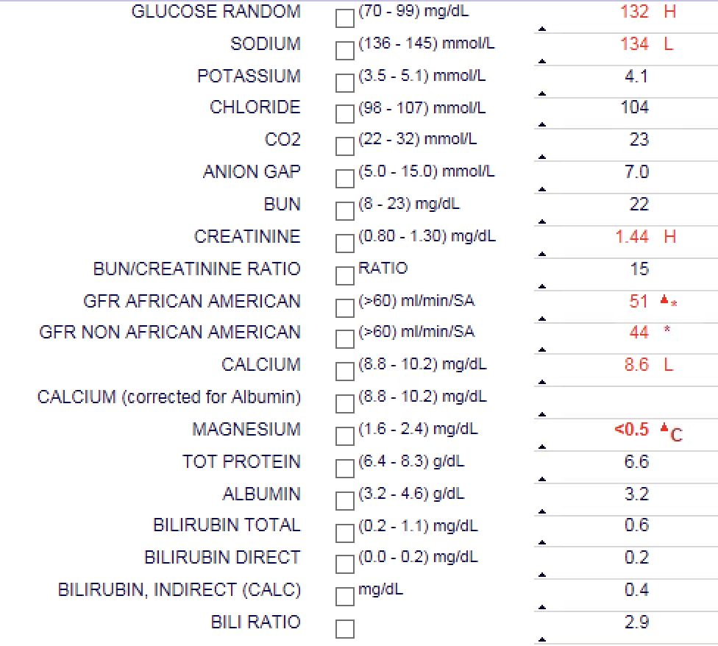

Slide 9
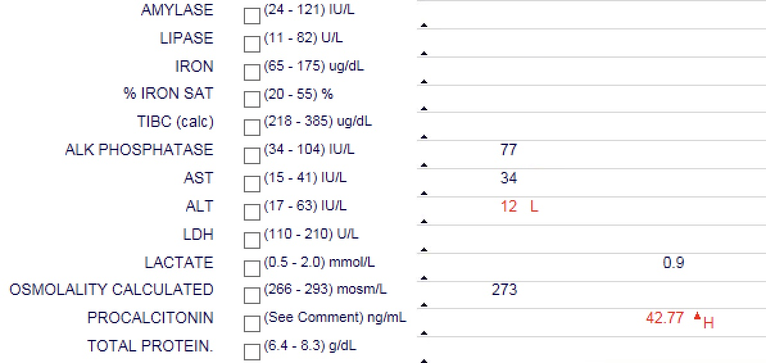

Slide 10
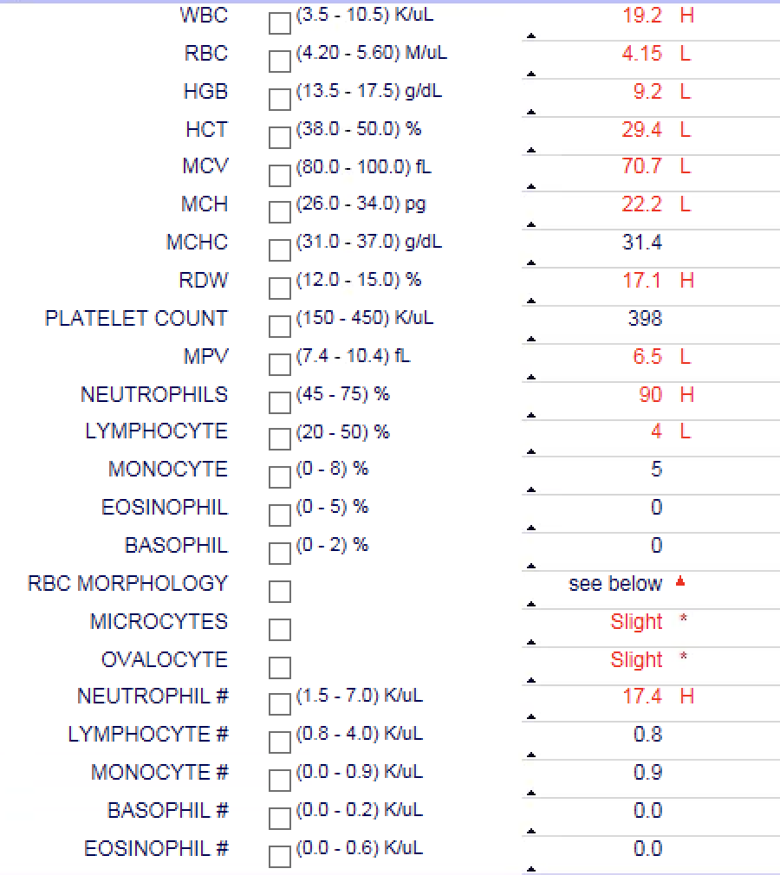

Slide 11
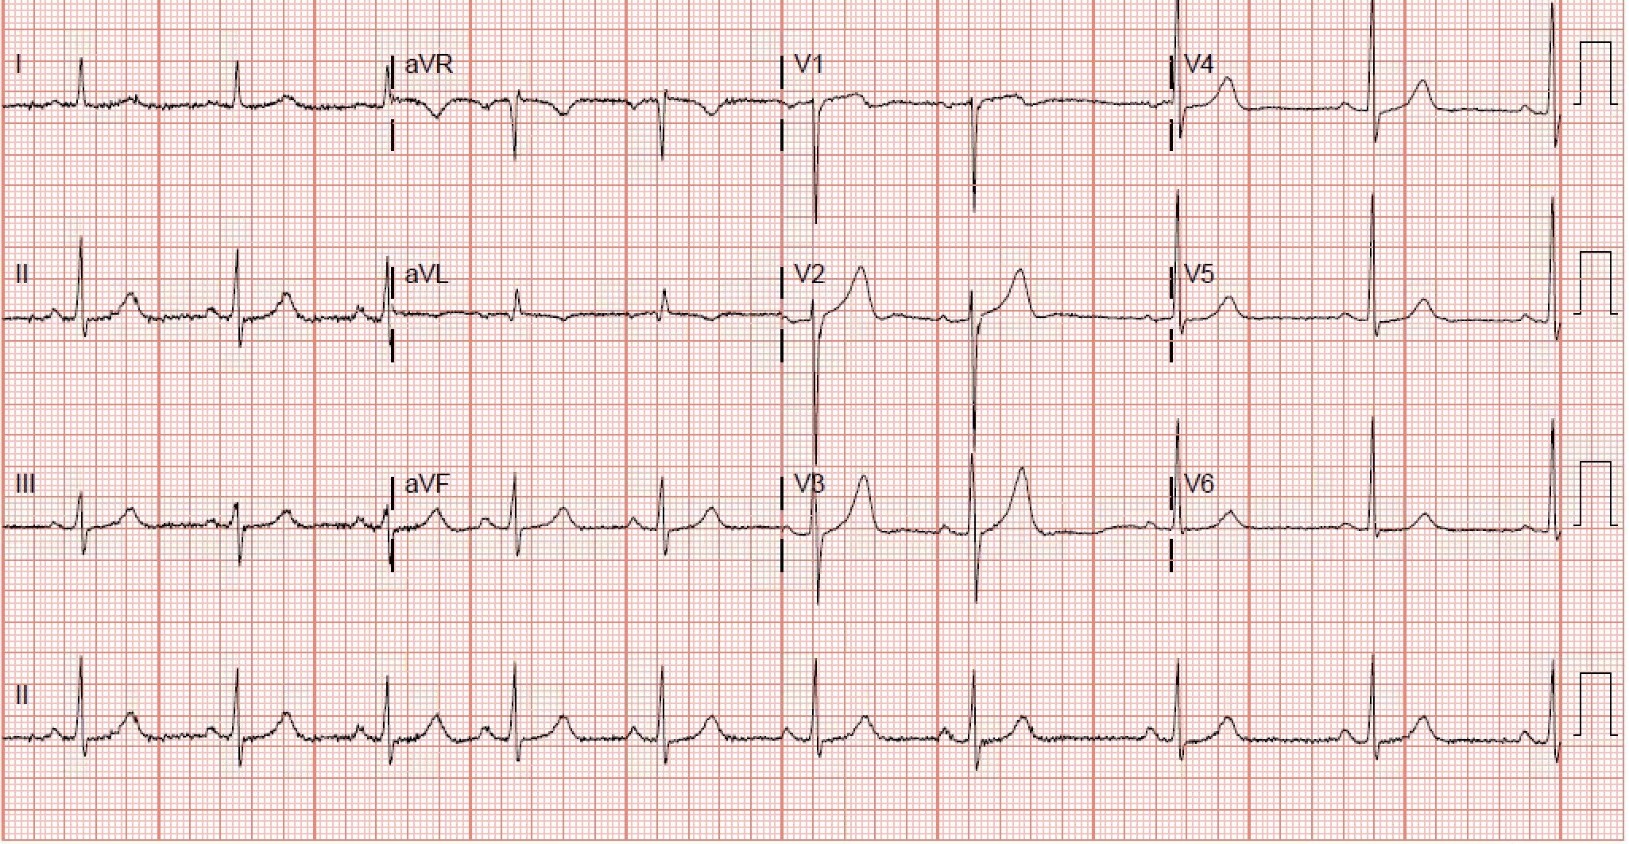
Upon questioning patient reported having intermittent sharp chest pains that comes and goes at rest and constant SOB that has been going on for several months.
Troponins : 0.48 ->0.42 and 0.27 , Total CK : 322
EKG :

Slide 12
PORTABLE CHEST:
Cardiac size and contour normal. Previous median sternotomy. Vascularity
is normal. Lungs are clear.
IMPRESSION:
Previous median sternotomy. No acute process.
CT head :
IMPRESSION:
Negative for acute intracranial pathology. Normal exam.
US abdomen:
IMPRESSION:
Cholelithiasis. No sonographic findings to suggest acute cholecystitis

Slide 13
CT Abdomen
IMPRESSION:
1. Cholelithiasis
2. Colonic diverticulosis with giant diverticulum arising from the
sigmoid colon
3. Prostatic enlargement with urinary bladder wall thickening
CT Chest w/o contrast :
IMPRESSION:
Tiny bilateral pleural effusions. Mild dependent atelectasis

Slide 14
Pt was treated per ACS protocol for NSTEMI. Cardiology was on board who decided to cath the patient after current illness was resolved. ECHO was reviewed that showed EF 45-50 % without any valvular or wall motion abnormalities.
Febrile illess:
Pt was started on IV vancomycin and Zosyn.
Seizure : Neurology consulted. EEG was ordered.

Slide 15
Day 2:
Pt continues to spike fever on and off .
T MAX : 103 .2
Had an episode of extreme shakiness with lips turning blue.
Vitals during episode : T 102.2, BP 189/98, RR 30, Pulse 132.
Responded well to “ATIVAN” .
Remains absolutely symptom free other than these episodes.

Slide 16
ESR – 50
CRP – 105
Blood cultures : Negative
Fungal culture : Negative
C- Diff : Negative
Stool studies: negative
Occult blood : positive
Hepatitis panel : negative
HIV : negative

Slide 17
Atypical antigents : Negative
Quantiferon gold : negative
Lymes titer : Negative
Borrelia burgdorferi: None detected.
PSA: WNL
UA : WNL
ANA : none detected
Rheumatoid factor : Mildly elevated 125.
Angiotensin converting enzyme : WNL
Anti mitochondrial antibodies : Negative

Slide 18
Day 3 :
Pt had 3 episodes of fever, chills, shakiness and cyanosis. T max 103.9.
Responds well to Ativan and Tylenol.
EEG obtained during one of this episodes was normal.
Pt is frustrated . Family frustrated as we do not have answer.

Slide 19
Day 4 :
Pt reports oncologists intention to do a peripheral smear.
Peripheral smear :
1. Leukocytosis with left shifted granulocytosis to bands; no
evidence of dysplastic morphology or blasts.
2. Microcytic, hypochromic anemia; recent history of iron deficiency
anemia.
3. Normal platelet count and platelet morphology.

Slide 20
Infectious Disease :
Tele consult was done. Do not want to accept the patient as they do not think pt has medical necessity for them to accept the transfer but recommends to work the patient up for any gram-negative source especially from abdomen.
Recommends changing the antibiotics from vancomycin and Zosyn to meropenem 1 gram IV q.8 hours.
Follow-up on urine Histoplasma and urine blastomycosis antigen.
Recommended tagged WBC scan if all other tests were negative.
Also recommended starting the patient on Eraxis if there was no response in with meropenem.
Asked if patient needed to follow up with them as an outpatient.
Informed that they were booked for next 3 months and would be difficult to find an appointment before that.
Recommends to send the patient where he can find earliest possible appointment

Slide 21
Discussed the plan with Patient :
Patient : ” I am tired , I do not want to pursue anything. Just take care of my fever and chills”
However agrees to continue Vancomycin and Meropenem.
Also agrees to stay in the hospital until we consulted rheumatologist.

Slide 22
Day 6 :
Pt had 2 similar episodes over night . T max 103.2
Adamant to go home .
Rheumatologist was consulted who recommended starting the patient on colchcine and agreed to see the patient in his clinic within a week.
Pt was subsequently discharged home with maintenance medication with only addition of colchicine and Xanax PRN for febrile and tremulous episodes.

Slide 23
Post discharge day 7 :
Pt seen by rheumatologist.
Pt had only 2 events in those 7 days and none in the last 4 days.

Slide 24
Familial Mediterranean fever (FMF)
Familial Mediterranean fever (FMF) is an autosomal recessive disease, characterised by recurrent attacks of fever and peritonitis, pleuritis, arthritis, or erysipelas-like skin disease.
The disease occurs predominantly among Sephardic Jews, Armenians, Turks, and Arabs, though sporadic cases have been found among Ashkenazic Jews.
A typical attack consists of fever and serositis, lasting from one to four days.
Between attacks patients are free of symptoms and appear healthy.
The frequency of attacks varies considerably from weekly bouts to once every three to four months, or even less.

Slide 25
When to consider the diagnosis —
The diagnosis of familial Mediterranean fever (FMF) should be suspected in individuals with recurrent febrile episodes accompanied by peritonitis, synovitis or pleuritis, recurrent erysipelas-like erythema, repeated laparotomies for an acute abdomen with no identifiable underlying pathology.
A first-degree relative with FMF, and/or membership in an at-risk ethnic group.
FMF has been described primarily in North African Jews, Armenians, Turks, Arabs, Greeks, and Italians. However, the disease is not restricted to these groups. In the United States, for example, FMF is frequently encountered in Ashkenazi Jews.

Slide 26
Diagnostic criteria:
Diagnose FMF in patients with any one of the following :
●≥1 major criteria
●≥2 minor criteria
●1 minor plus 5 supportive criteria
●1 minor criterion plus ≥ 4 of the first five supportive criteria
Major criteria — Major criteria for the clinical diagnosis of FMF consist of a typical attack involving one or more of the following sites:
●Peritonitis (generalized)
●Pleuritis (unilateral) or pericarditis
●Monoarthritis (hip, knee, ankle)
●Fever alone

Slide 27
Minor criteria — Minor criteria for the clinical diagnosis of FMF consist of an incomplete attack involving one or more of the following:
●Abdominal pain
●Monoarthritis
●Exertional leg pain
●Favorable response to colchicine
Supportive criteria — Supportive criteria for FMF include the following:
●Family history of FMF
●Appropriate ethnic origin
●Age <20 years at disease onset
●Severe attack requiring bed rest
●Spontaneous remission of attack
●Symptom-free interval between attacks
●Attacks associated with transient inflammatory response with one or more abnormal laboratory results for white blood cell count, erythrocyte sedimentation rate, serum amyloid A, and/or fibrinogen
●Episodic proteinuria/hematuria
●Negative laparotomy or removal of normal appendix
●Consanguinity of parents

Slide 28
Genetic testing —
Genetic testing is used to support the diagnosis of FMF and to exclude other autoinflammatory diseases that may clinically mimic FMF. FMF is usually inherited as an autosomal recessive trait.
The detection of two pathogenic mutations in the MEFV gene in an individual confirms the diagnosis. However, approximately 33 percent of patients who meet clinical criteria for FMF have only one identifiable mutation.
Furthermore, 10 to 20 percent of patients who meet clinical diagnostic criteria do not carry any known mutation for FMF

Slide 29
Our patient :
Born and raised in USA.
Parents born in USA .
Had Ancestry DNA analysis – which showed Middle eastern roots.
Genetic study is pending .
Has not had any similar episode in last 4 months.

Slide 30



Slide 31


