Slide 1

Ballad: a physician leadership case study in corporate/community cooperation and challenges

Slide 2

Who Cares?!?
People will always be sick
Hospitals will always be around
Between Insurance Companies and the State people will be fine
Quality Medicine? You get what you pay for!
Doctors treat patients, not Boards of Directors
Physicians lead on the wards and in the clinics
The business of medicine is not a part of the Hippocratic Oath

Slide 3


Youz Cares!
More than 100 Hospitals Closed since 2010
CNBC

Slide 4
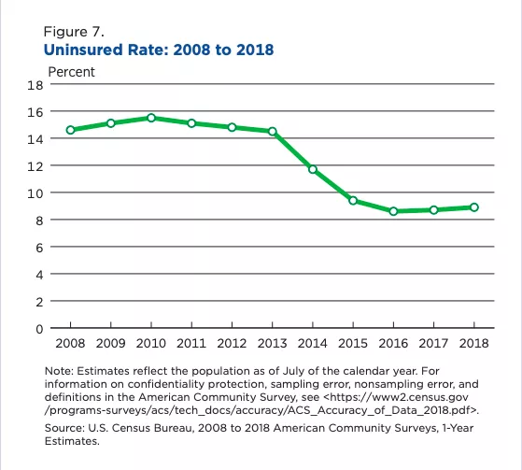
Theyz Cares!
In 2018, the number of uninsured people in the U.S. rose to 27.5 million or 8.5% of the population

Slide 5
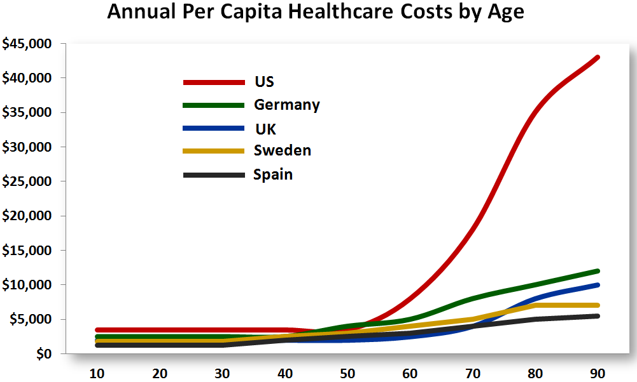
Wez All Cares!
In 2018, the United States spent $3.65 Trillion on Health care
  More than the GDP of counties like Brazil, the U.K. Mexico, Canada, and Spain
This was up 4.4% from 2017
This is About 17% of the U.S. GDP
This amounts to $11,212 per person in the U.S.
The U.S. ranks 27th in the world for health care
Sherman.

Slide 6
Learning Objectives
Describe current physician leadership ideology
Understand the unique position of physicians in hospital leadership positions
Identify elements of successful physician-led enterprises
Notes:
We want to take this opportunity to provide information of a current effort related to this process for community health needs assessments.

Slide 7
Current Physician Leadership Ideology

Slide 8
We should take care not to make the intellect our God. It has, of course, powerful muscles, but no personality. It cannot lead, it can only serve.
Albert Einstein

Slide 9
Physician Leadership
Types of leadership
  Transformational Leadership
    Organizing around a collective purpose in order to engage group members in the mission and vision of the organization.
    Intentionally intended to transform colleagues through the strategy, processes, systems, culture, and structure of the organization
  Servant Leadership
    Utilizing community-building behaviors of listening, empathy, awareness, and stewardship.
  Transactional Leadership
    Rewards that are prized in exchange for actions or behaviors
  Laissez-faire Leadership
    Indifferent leadership
Food for thought:
What is your Mission? Do you have a sense that those in your office or hospital know that Mission? Did you help to create that Mission?
Swensen

Slide 10
Physician Leadership
Traditional | Modern
Leader crafts vision | Group crafts vision that leader articulates
Leader demands performance | Leader inspires performance
Paternalistic model | Partnership model
Emphasis on leader’s intellect | Emphasis on leader’s emotional intelligence
Leader seeks to control others | Leader seeks to empower, motivate and empathize with others
Team focuses on work arena | Team seeks balance between work and home
Leadership is no longer a top-down effort, it is team-based
and supportive
Serio

Slide 11
Physician Leadership
EQ Elements
Self-awareness | Awareness of your own emotions Knowledge of your strengths and weaknesses Confidence in your abilities
Self-management | Emotional self-control Honesty and integrity Flexibility in adapting to different circumstances and challenges Initiative and optimism
Social awareness | Empathy for others Awareness of the organization’s needs
Relationship management | Mentoring others through feedback and coaching Inspiring others toward a common goal Building bonds Managing conflict
Serio

Slide 12
The unique position of physicians in hospital leadership positions

Slide 13
Physician leadership: The Good
Physicians are uniquely positioned to address these issues
We have the ability to educate the non-clinicians on the elements of care that are important
We have the benefit of time talking to patients and families about their care and their experiences
All of healthcare requires physicians to initiate care, continue care, and end care
Value=Quality/Cost
If physicians are willing to become engaged in the provision of care within and beyond the ward and clinic and OR, we can be transformational in the future of healthcare in this country.
Xirasagar

Slide 14
Physician Leadership: The Bad
As leaders, physicians are often in a unique position…
The expectation of their physician colleagues to protect their autonomy and status as captains of their field.
The expectation of the organization that the physician leader facilitate the collective movement of physicians toward the outcomes deemed important by the organization.
Xirasagar

Slide 15
Physician Leadership: The Ugly
Physician leaders are of the faced with harsh criticism of their place in the world of medicine
Many are seen as “sell-outs” or second-class physicians
Some have even been dismissed from the community of physicians in their hospitals. Deemed to have soiled their medical careers and unfit to be called a doctor
Xirasagar

Slide 16
Elements of successful physician-led enterprises

Slide 17
Physician Leadership
Should physicians run hospitals?
161 physician-owned hospitals in the U.S. (roughly 5000 total hospitals)
  In Value Based Purchasing from CMS: 122 are gaining money; 39 are losing
  In non-physician owned hospitals 79% are losing money in the VBP equation
  In general Physician-owned hospitals lead in patient satisfaction and following clinical guidelines
    These hospitals are specialty in nature generally, and focus on elective care
Angood

Slide 18
Physician Leadership
Elements of a healthy organization
  Minimal politics
  Minimal confusion
  High morale
  High productivity
  Low turnover
Engagement is the degree to which people are invested in the mission of an organization leading to increased effort to achieving organizational goals
When an organization and its leaders are healthy and engaged, one can see a direct correlation with improved overall performance. In healthcare this translates into improved patient care, outcomes, and experience
Swensen

Slide 19
Physician Leadership
What makes a good physician leader?
  The smartest physician in the room?
  The oldest physician in the hospital?
  The most popular physician?
  Mayo Clinic 12 Leadership Dimensions:
    Holds career development conversations with me
    Inspires me to do my best
    Empowers me to do my job
    Is interested in my opinion
    Encourages employees to suggest ideas for improvement
    Treats me with respect and dignity
    Provides helpful feedback and coaching on my performance
    Recognizes me for a job well done
    Keeps me informed about changes taking place at the organization
    Encourages me to develop my talents and skills
    I would recommend working for this leader
    Overall, how satisfied are you with this leader
Swensen

Slide 20
Sources
Wortley, David. (2016). The future of digital medicine in the aging society. Digital Medicine. 2. 43. 10.4103/2226-8561.189502.
https://www.cnbc.com/2018/03/22/the-real-reason-medical-care-costs-so-much-more-in-the-us.html
E. Sherman. U.S. Health Care Costs Skyrocketed to $3.65 Trillion in 2018. Forbes Online. February 21, 2019.
A. Ellison. State-by-state breakdown of 102 rural hospital closures. Becker’s Hospital Review Online. March 20, 2019
S. Xirasagar. Physician Leadership Styles and Effectiveness: An Empirical Study. Medical Care Research and Review. Dec. 2005.
C. Serio. Physician Leadership: A New Model for a New Generation. Family Practice Management. 2006
S. Swensen. Leadership By Design: Intentional Organization Development of Physician Leaders. Journal of Management Development. 2016
P. Angood. Demographics, Shifting Models of Care and Physician Leadership. PEJ. 2013.
J. Quinn. The Impact of Social Competences and Role Factors on the Relational Construction of Identity and Participation of Physician Leaders. Case Western Reserve. May 2013

Slide 21

Ballad Health
Honor those we serve by delivering the best possible care

