Slide 1
The Role of Primary Care in Diagnosis & Treatment of Psychiatric Disorders
E. Michael Kahn, MD
BALLAD
michael.kahn@balladhealth.org
Copyright 2019

Slide 2
Goals
As a result of this educational activity, the participant will be able to:
  Outline the extent of morbidity and mortality related to psychiatric disorders
  Identify epidemiological factors and health care delivery system characteristics that place primary care physicians in the forefront of psychiatric care
  List skill areas requiring mastery to address this demand, and identify plans of action to build these skills

Slide 3
No Potential Conflicts of Interest

Slide 4
Introduction
Early career: Academic neuropsychiatry (Duke, Pitt, Dartmouth)
Mid career: Outpatient practice in rural New Hampshire.
Now: Working with Ballad — Focus on integrating psychiatric / BH services in primary care

Slide 5
We are all PCPs….
Illness and healing are intensely personal
Patients aren’t their diagnoses
Practitioners are more than procedures and codes
Relationship is the heart of healing
Psychiatry is “home base” for these skills

Slide 6
What Has Held Psychiatry Back ?
It’s complicated….
The “Streetlamp Problem”: Look where it’s easy to look
The “Hammer Problem”: Find problems that fit your solutions
The “Mind Body Problem”: You can’t look from outside the system
Avoid what we don’t understand: Politics of stigma — impact on public policy and payment

Slide 7
    Psychiatry + Science = “Neuropsychiatry”
“Knowledge regarding the clinical and pathological aspects of neural processes associated with cognition, emotion, behavior, and elementary neurological functioning, the mastery of the clinical skills required to evaluate and treat persons with such problems.”

Slide 8
The Challenge
Bringing “state of the art” care “back home”
  Overview, extent & rationale
  Core knowledge & strategy
  Application & implementation

Slide 9
The Focus:
Psychiatric disorders are common, debilitating and costly
Majority of individuals with psychiatric disorders either do not receive care, or receive care from PCPs
Treatments are increasingly effective, safe, and accessible
A chance to make a big difference

Slide 10
Debilitating ?: Check Disability Adjusted Life Years (DALYs)
Years lost to illness, disability, and premature death due to disorders
DALY = Years of life lost + years lived with disability
NIH / NIMH Data, 2013
Here, expressed as per cent of total….

Slide 11
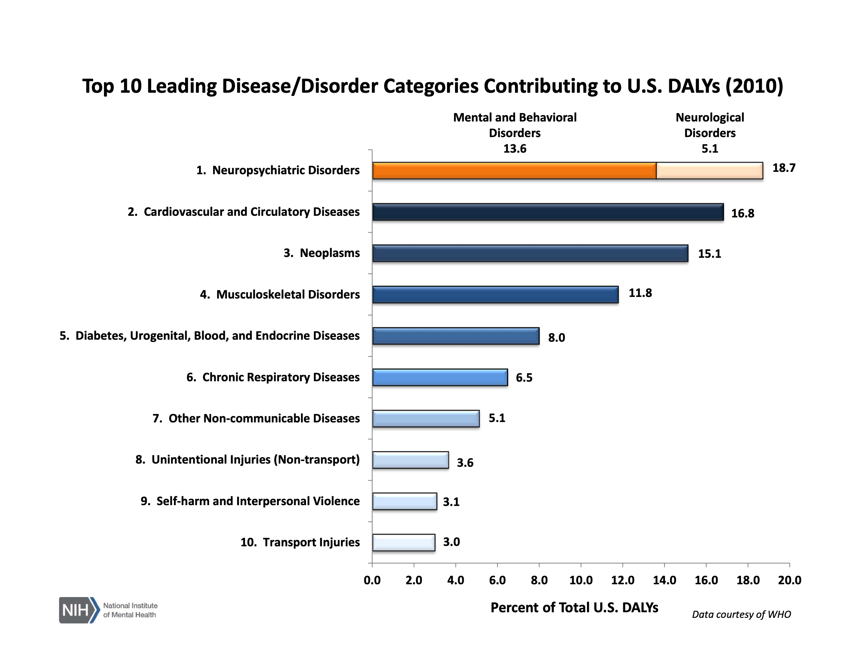


Slide 12
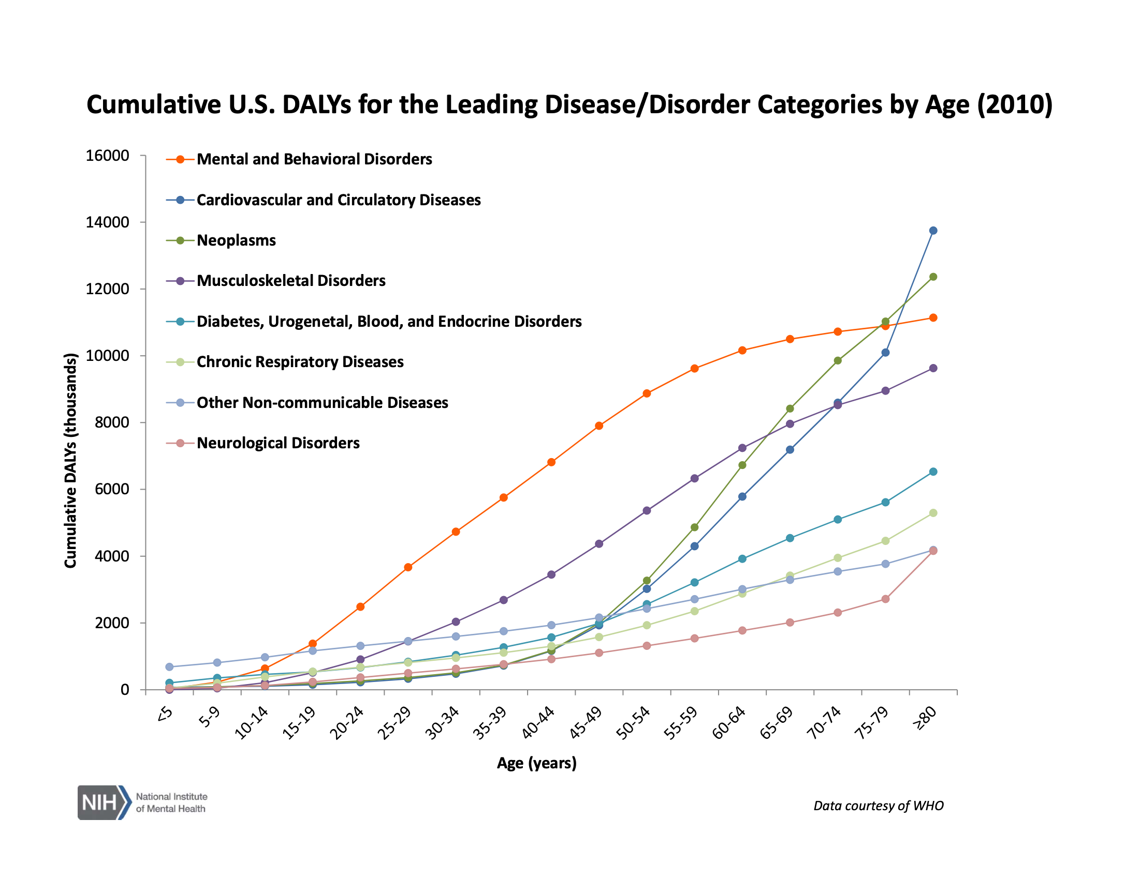

Slide 13
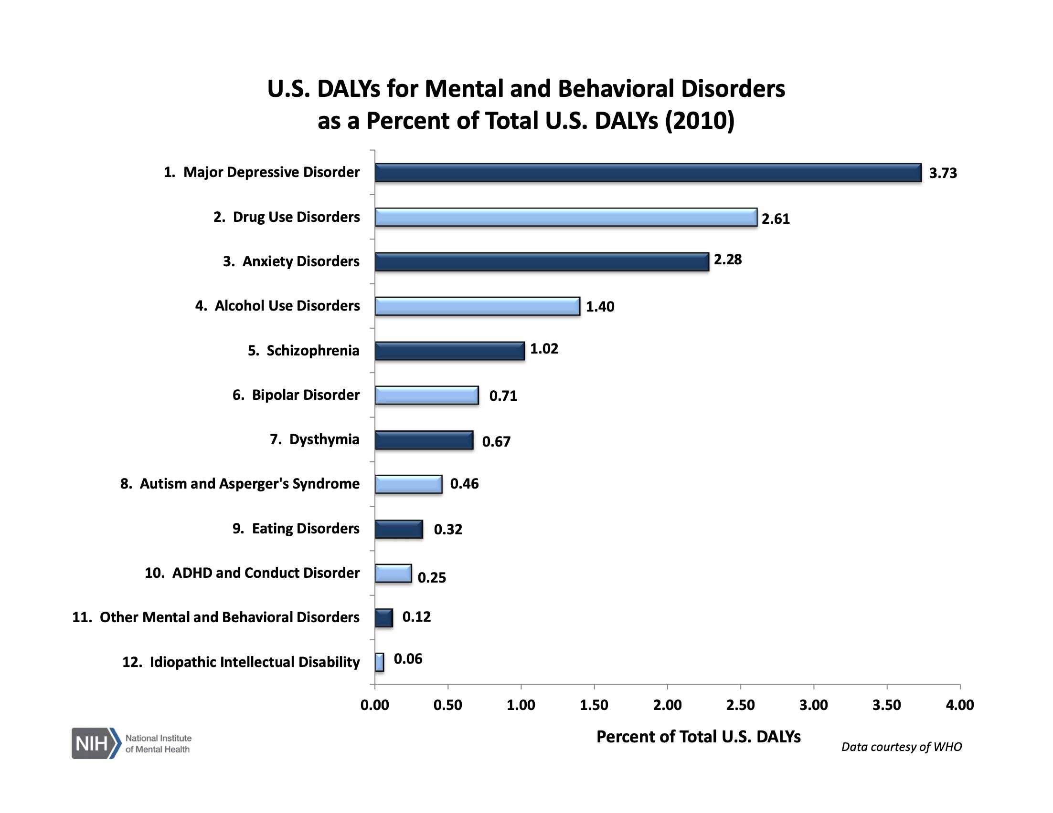


Slide 14
In the US: Rising Mortality Rates
Case and Deaton, PNAS, 11-2-2015
Life expectancy and physical and emotional health, US, EU, Canada, Australia, 1999 to 2013
Average overall mortality decline 2 % per year
But, for non-Hispanic whites in the U.S., mortality is increasing by 0.7 % per year, especially for disadvantaged
Increase due to drug and alcohol overdose, suicide, and chronic liver disease
Attributed to growing economic insecurity, and related emotional and physical stress, and, possibly, increasing opioid use

Slide 15
Most Frequently Mentioned Drug Classes in Ambulatory Care Office Visits, NAMCS, 2014 (cdc.gov)
    Analgesics 11.6 %
    Antihyperlipidemic 5.1 %
    Antidepressant 4.5 %
    Anxiolytic / Hypnotic 3.9 %
    Vitamins 3.9 %
    Antidiabetic 3.8 %
    Antiplatelet 3.8 %

Slide 16
Who Prescribes Antidepressants to Whom ?
National Prevalence of Receipt of Antidepressant Prescriptions by Persons Without a Psychiatric Diagnosis
Gregory E Simon, MD MPH1, et al., Psychiatr Serv. 2014 July ; 65(7): 944–946
Approximately 10% of US adults now fill one or more antidepressant prescriptions each year (1, 2) with 75% of these prescriptions are written by non-psychiatrists (1, 3).
The most common mental health diagnoses recorded included depressive disorders (47%), anxiety disorders (27%), bipolar disorders (3%), and attention deficit disorders (3%). 39% of those filling antidepressant prescriptions received no mental health diagnosis during the year, but this proportion fell to 27% after excluding antidepressants often prescribed for non-psychiatric indications (tricyclic antidepressants, trazodone, bupropion).

Slide 17
The Depression Treatment Cascade in Primary Care: A Public Health Perspective
Pence, et al. Current Psychiatry Reports
August 2012, Volume 14, Issue 4, pp 328–335
Major depressive disorder (MDD) is common and costly. Primary care remains a major access point for depression treatment, yet the successful clinical resolution of depression in primary care is uncommon. The clinical response to depression suffers from a “treatment cascade”: the affected individual must access health care, be recognized clinically, initiate treatment, receive adequate treatment, and respond to treatment. Major gaps currently exist in primary care at each step along this treatment continuum. We estimate that 12.5% of primary care patients have had MDD in the past year; of those with MDD, 47% are recognized clinically, 24% receive any treatment, 9% receive adequate treatment, and 6% achieve remission. Simulations suggest that only by targeting multiple steps along the depression treatment continuum (e.g. routine screening combined with collaborative care models to support initiation and maintenance of evidence-based depression treatment) can overall remission rates for primary care patients be substantially improved.

Slide 18
Screening for Depression in Adults: US Preventive Services Task Force Recommendation, JAMA (2016)
Cost to US, annually, estimated at $210 Billion
Reduced productivity, Costs of medical and social disorders, Treatment
Death from suicide now more frequent than death from MVA
And death from drug overdose surpassing
Annual prevalence in Men 5 %, Women 8 %, Post-partum > 10%
So…. Screen (PHQ-9) and Treat

Slide 19
Where are the psychiatrists ?…
In the US, approximately 55,000 psychiatrists at work.
60% of these practitioners are age 55 years, or older.
Roughly 1 / 6,000 people (1 / 4,000 considered threshold for “underserved”).
And 8,300 child & adolescent psychiatrists for approximately 80 million minors (1 / 10,000).
80 per cent of rural counties have no psychiatrist
Over the past 20 years, number of physicians has grown 45 %, and number of psychiatrists, 12 %.
Psychiatrist salaries had been stagnant for two decades until 2014. (Comparable with FM / IM.)

Slide 20
In Summary
“Psychiatric” disorders are:
  Extraordinarily common
  Cause “top 5” morbidity and mortality
  Underdiagnosed and undertreated
  Primary care is the only resource for many patients
Time to “train up”….

Slide 21
So what next ?
Many potential paths to positive outcomes
Essential ingredients:
  Learn “practical” DSM-5
  Review medication classes and strategies
  Work with skilled consultants
  Collaborate with your patients
In Summary: You never stop learning….

Slide 22
Core Concepts
Strategic thinking
Diagnosis
Formulation
Differential therapeutics

Slide 23
“Secret Weapons”
Barriers to treatment, are, at their heart, public policy problems
Treatment is an epigenetic process, not an “episode” or an “encounter”
Alliance is (still) the cornerstone of medical practice
  Kindness, communication, consistent presence
Create fault-tolerant, self-correcting processes
Focus on actionable information, Interrogate incongruities
Go for “well”, not “better”

Slide 24
DSM-5 Explained
Anxiety & PTSD
Attention & Learning
Impulse control
Mood (Depressive, Bipolar)
Neurocognitive
Pain & Somatoform
Personality (Odd, Erratic, Anxious)
Schizophrenic
Substance use

Slide 25
Comorrbid “Psychosomatic” Disorders
Pain Disorders (and PTSD)
Autonomic Cephalagias (e.g., Migraine, Cluster)
GI Dysmotility Disorders
Insterstitial Cystitis
Fibromyalgia
Chronic Fatigue Syndrome
“Spells” (“Seizures” to Dissociation)

Slide 26
Applications
FAQs
R/Os
Psychopharmacology
  Adequate trials
  Symptom focused
  Clever combinations
  Scope of practice
  Out of “the weeds”

Slide 27
FAQ’s
Depression with multiple unsuccessful medication trials
Anxiety responsive “only” to benzodiazepines
“Bipolar Disorder” (or NOT)
Chronic Pain
Substance Use Disorder
Insomnia
Do you have patients with all 6 diagnoses on record ?

Slide 28
R / O’s
R/O
  OSA
  Hypothyroidism
  B12 Deficiency
  Hypogonadism
  (Occult) SUD
  (Unacknowledged) Trauma (PTSD, TBI)

Slide 29
Combined Targeted Pharmacotherapy
Match symptoms to underlying functional / neurochemical systems
Match medication actions to these systems
Bridge from symptom to treatment without side trips through DSM-5 or “Anti- land”
Make medication combinations that augment benefits and minimize side effects

Slide 30
Improving Outcomes
Inadequate medication trials:
  Low dose
  Brief duration
  Confounding side effects
  Infrequent follow-up
  “Re-inventing the wheel” (SSRI x 3)
  ==> Under-treatment is risky <==

Slide 31
Diagnosis: Distress
Most folks with depression have anxiety, and vice-versa
Most folks with PTSD have anxiety and depression
Distressed folks are vulnerable to pain
Distressed folks sleep poorly
So treat the Distress, not the diagnosis
“Antidistressants” include: SSRIs, SNRIs, Bupropion, Mirtazepine, Vilazidone, TCAs
And, in ancillary roles, Buspirone, Beta blockers, Antihistamines, 2GAPs, and GABAergic “anticonvulsants”

Slide 32
Med Strategy: Distress
First antidepressant (SSRI, SNRI)
Second antidepressant with different MOA (Buproprion, Mirtazepine) or beneficial “side effects” (TCA)
First augmenting “mood stabilizer”
Second augmenting “mood stabilizer”
E.G.: Duloxetine, Mirtazepine, Aripirazole, Lamotrigine

Slide 33
Scope of Practice
Thesis: Primary care providers should be able to provide thoughtfully chosen three-medication combinations effectively and safely
“Off Label” use is common, and sometimes the standard of care
No regimen is sancrosanct: Keep refining !

Slide 34
Caveats
Antidepressant “rebound”
5HT and DA toxicity: Over-activation —> Agitation
GABAergic Anticonvulsants: Hepatic function
Lithium: Thyroid function, Renal function
Pregnancy:
  Most psychotropics are class “C”
  (Often) Risk of no treatment > Risk of treatment
  Class D: Depakote, Paxil, Benzo’s
  Class “B”: Buspirone, Bupropion

Slide 35
Is it OK to prescribe Benzo’s ?
Conditions:
  As a “bridge” to other treatments with delayed onset of action — “Rescue” medication
  In patients who are at low risk for SUD
  And who are not taking opioids
  For days or weeks, not months or years
  With frequent office visits and adherence monitoring

Slide 36
What About Bipolar D/O ?
Reasonable experts disagree, and diagnosis is often a longitudinal one
Does the patient have CYCLIC, endogenous shifts in mood state (days to months)
Actually three “poles”:
  Dysphoria, Depression
  Hypomania, Mania
  Agitation (Mixed)
Lows and Highs = “Type 1”, Lows >> Highs = “Type 2”

Slide 37
Why is this important ?
Cyclic depression may not respond to antidepressant treatment alone — Mood stabilizer needed
Antidepressant treatment for cyclic depression may “kindle” agitated or elevated cycles
This kindling is distinct from anti-depressant related over- arousal
==> If suspected, “lead” with a stabilizer
Treatment response =/= Diagnosis

Slide 38
How about Genetic Testing ?
Useful, possibly, if your looking for slow metabolizers (intolerance) or rapid metabolizers (non-response)
Not useful for assessing risk of disorder / diagnosis
Not useful for treatment assignment / differential therapeutics

Slide 39
Synthesis

Slide 40
Impression / Formulation
(e.g., 60 yo presents with anxiety, dysphoria, insomnia)
 | Biologic | Psychologic | Social
Predisposing | F Hx SUD Hx PPD | Trauma | Limited Supports
Precipitating | Declining Hormone Levels | Existential Issues | “Empty Nest” No Promotion
Perpetuating | Beta Blocker | Boredom, Denial | Progressive Disengage-ment

Slide 41
Pharmacotherapy:
Anxiety, Dysphoria, Insomnia
Benzo’s: Lorazepam (Ativan)
SSRIs: Escitalopram (Lexapro)
SNRIs: Duloxetine (Cymbalta)
NDRI: Bupropion (Wellbutrin)
NASSA: Mirtazepine (Remeron)
SPARI: Vilazidone (Viibryd)
Not Now: Tricyclic and MAOI Antidepressants
Not Now: GABA-modulating and 2GAP Stabilizers, T3

Slide 42
Decision Matrix: Tailored Rx
 | Targets |  |  |  | Deal Breakers |  |  |  | Total
 | Sad-ness | Anxiety | Anergia | Insom-nia | Weight Gain ? | Sexual SE | Other | Cost | Score
Benzo | 0 | +++ | ? | ++ | ? | + | S-T Only | 0 | 5
SSRI | +++ | +++ | ? | ? | ++ | ++ | Numb-ing | 0 | 3
SNRI | +++ | +++ | ++ | ? | + | + | ? | 0 | 7
NDRI | +++ | + | +++ | ? | + | + | ? | 0 | 7
NASSA | +++ | +++ | ++ | ++ | ++ | ? | ? | 0 | 8
SPARI | +++ | +++ | +++ | ? | + | ? | ? | ++ | 8

Slide 43
Be a Rockstar !
See the patient more often (q 2 - 4 weeks)
Book the patient for a “double”
Go for it !
  Higher doses, Newer meds, Combined targeted therapy
Integrate biologic and psychosocial intervention
Aim for “well”

Slide 44
Bringing it Home
Psychiatric disorders are a chief problem in primary care practice
Education and training are not commensurate with need, nor is reimbursement
Psychiatry is not mysterious or inscrutable
Build skill set through ongoing patient care, backed by study and consultation
IT’LL MAKE A BIG DIFFERENCE !

Slide 46
Case Study ?

Slide 47
Let’s Discuss a (Fictional) Patient
60 year old female, married, retail shop shift manager, who lives with husband and elderly mother, grown son at technical school
Under your care for hypertension and hyperlipidemia, uncomplicated, stable on medication
Presents for regular checkup, which is uneventful, until she confides that she worries constantly, no longer enjoys life, and is tired all the time
Insidious onset over < 12 months

Slide 48
What Next ?
Other symptoms ?— Tearfulness, somatic anxiety, gnawing doubt about the future
Stressors / Precipitants ?— “Boring” day to day routines
Past history ?— Post part depression, moderate, took Prozac briefly, “numb”
Relevant social history ?— “Introvert”, no SUD, episodic emotional abuse as a child
Relevant family history ?— Alcohol use disorder
Labs ?— TSH normal two years ago

Slide 49
Mental Status Exam
BMI 31 (80th percentile)
Alert, tidy, cooperative, demeanor c/w context & content, clear, detailed recall
Mood, affect c/w HPI
No psychosis, no SI, no flashbacks, no mania
PHQ-9 score 15 (moderately severe)

Slide 50
Diagnoses
MDD — Yes
GAD — Maybe
PTSD — Unlikely
Bipolar — Unlikely
Personality Disorder — Relevant ?
R/O Hypothyroidism, Low Vitamin D, OSA, (Low Gonadotropic Steroids) — “Low Hanging Fruit”

Slide 51
Prescription
Educational—
Psychotherapeutic—
Rehabilitative—
Pharmacologic—

Slide 52
Decision Matrix: Tailored Rx
 | Targets |  |  |  | Deal Breakers |  |  |  | Total
 | Sad-ness | Anxiety | Anergia | Insom-nia | Weight Gain ? | Sexual SE | Other | Cost | Score
Benzo | 0 | +++ | ? | ++ | ? | + | S-T Only | 0 | 5
SSRI | +++ | +++ | ? | ? | ++ | ++ | Numb-ing | 0 | 3
SNRI | +++ | +++ | ++ | ? | + | + | ? | 0 | 7
NDRI | +++ | + | +++ | ? | + | + | ? | 0 | 7
NASSA | +++ | +++ | ++ | ++ | ++ | ? | ? | 0 | 8
SPARI | +++ | +++ | +++ | ? | + | ? | ? | ++ | 8

Slide 53
Now, An Informed Consent Discussion and Therapeutic Trial

