Slide 1
Head for the Hills
Discuss the epidemic of chronic disease and its impact to society.(epidemic?)
How did get to this epidemic of chronic disease.
Future directions to combat chronic disease.

Slide 2


Slide 3


Slide 4
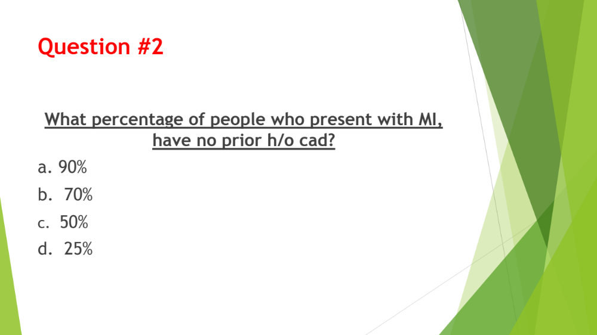

Slide 5
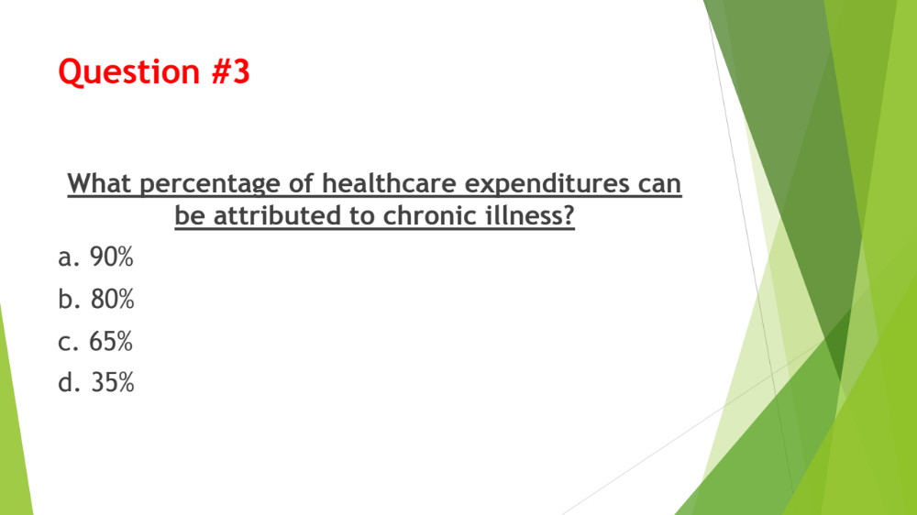

Slide 6
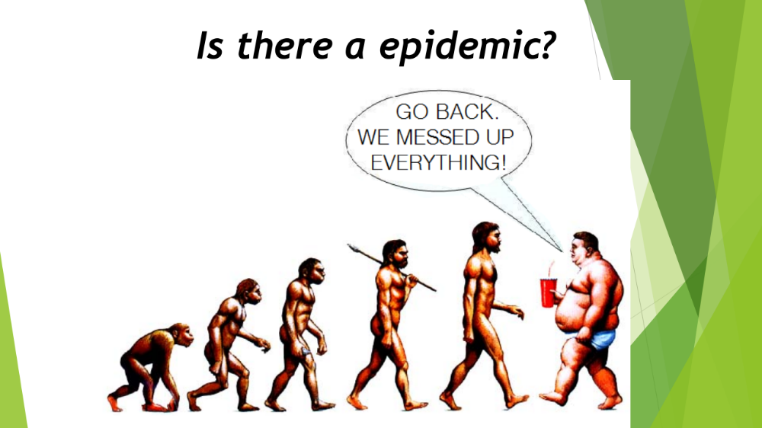

Slide 7
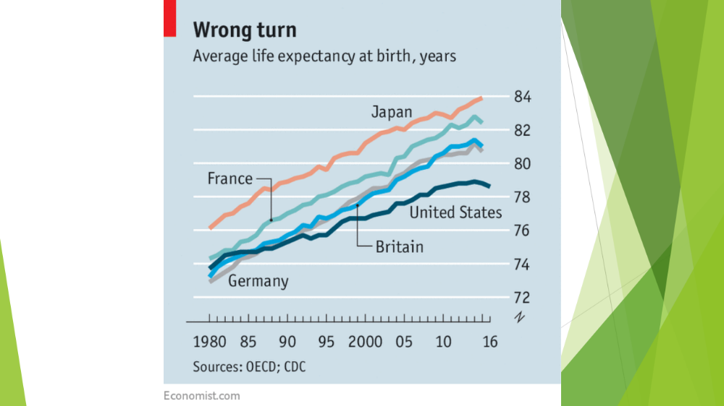

Slide 8
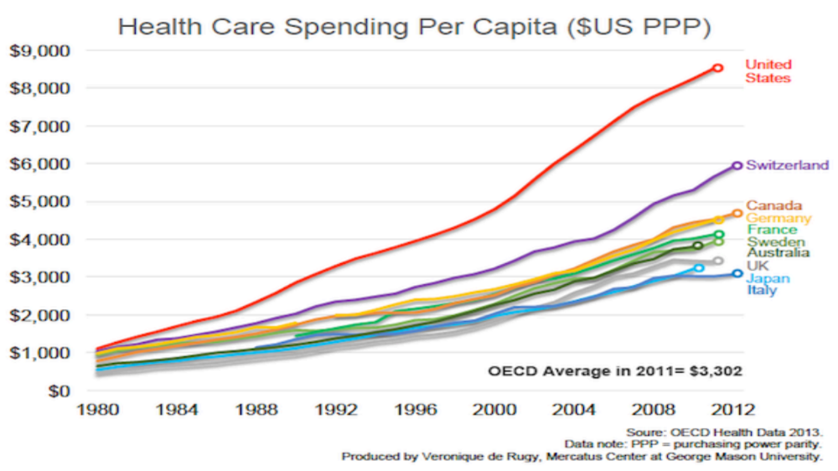

Slide 9
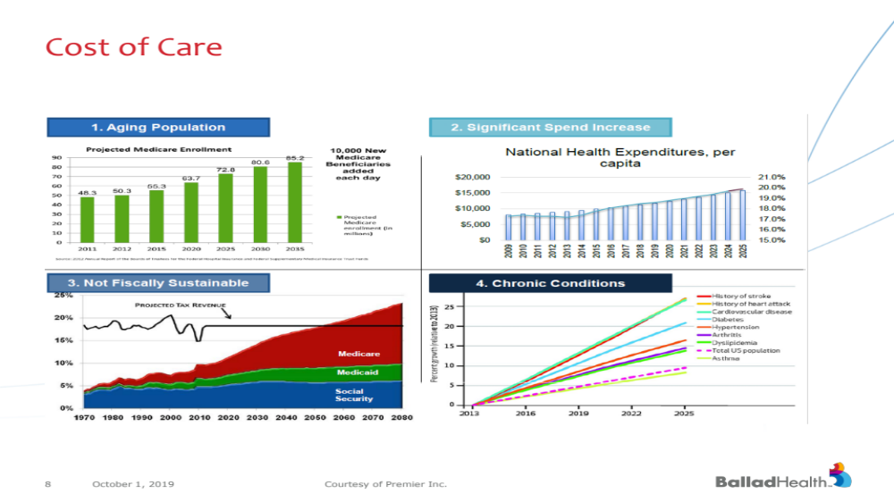

Slide 10
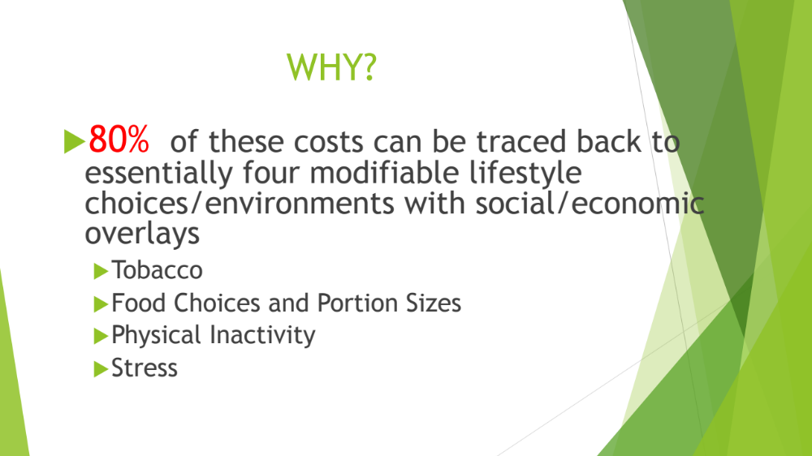

Slide 11
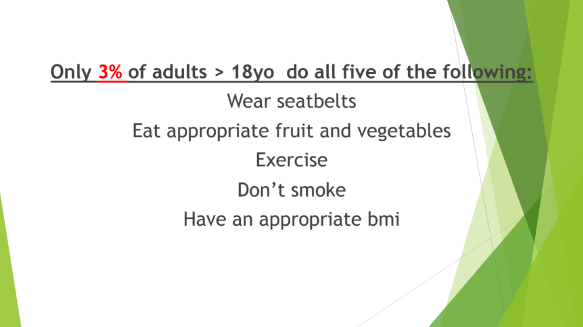

Slide 12
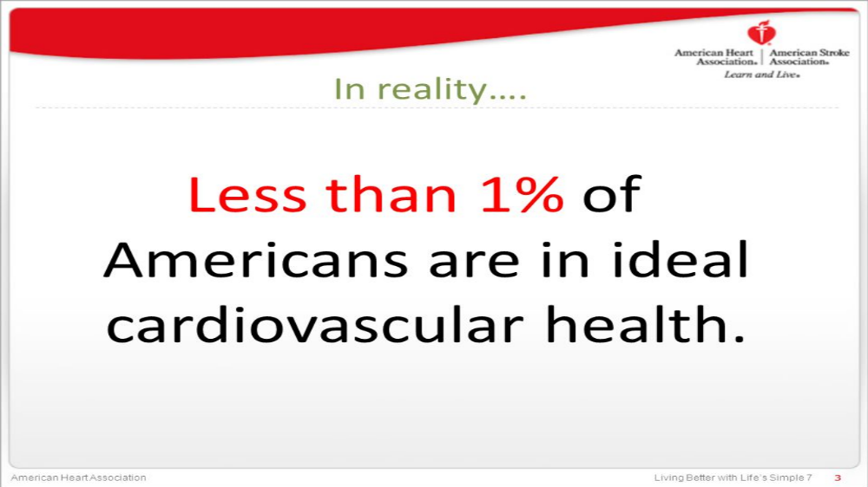

Slide 14
Declining Life Expectancy
Life expectancy fell for the third consecutive year
Last time this occurred was 1915 to 1918.
  WW I and Spanish Flu pandemic
Baby born today can expect to live to be 78.6. Down from 78.9(2014)

Slide 15
Declining Life Expectancy
Opioid and suicides
Sedentary lifestyle and poor nutrition
  Obesity and chronic illness
  Liver disease
Interrelated
Heart Disease and Cardiovascular Disease

Slide 16


Slide 17
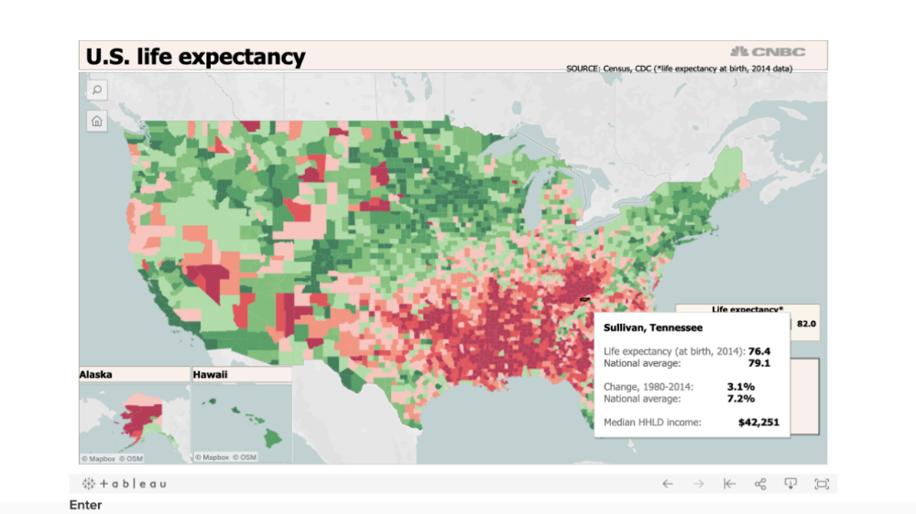

Slide 18
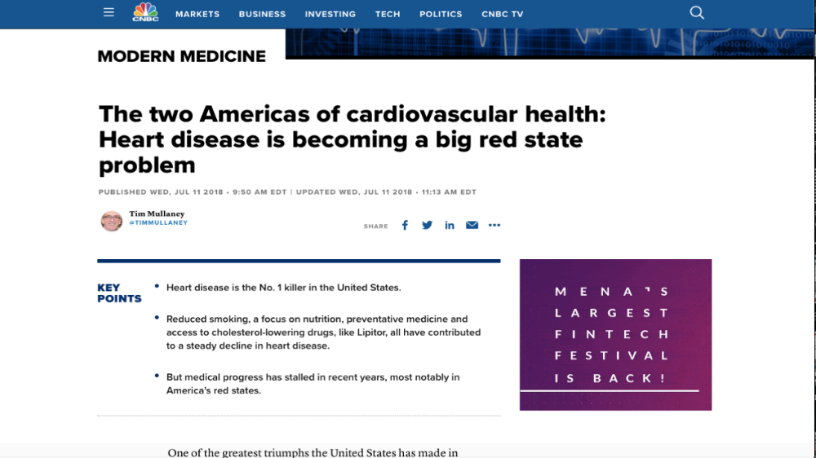

Slide 19
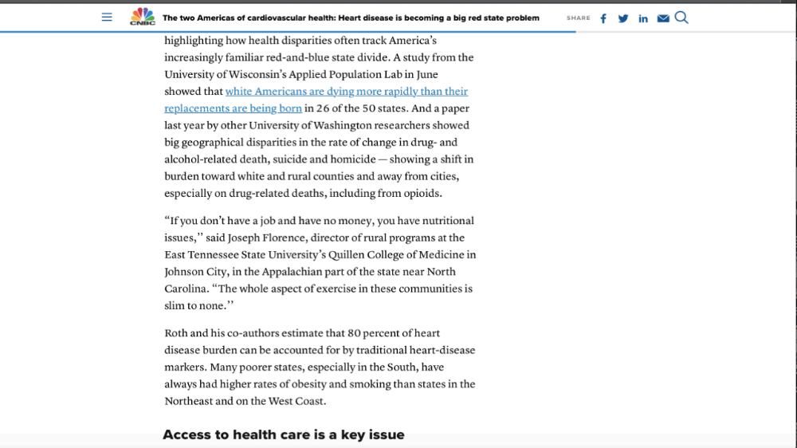

Slide 20
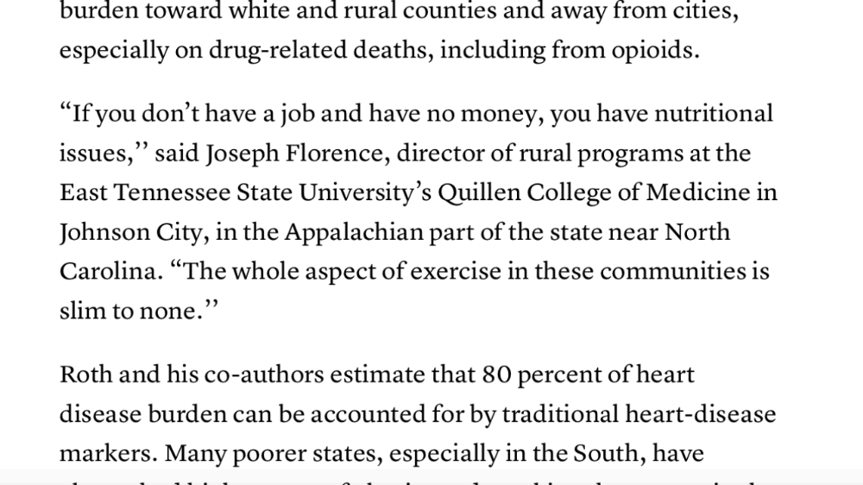

Slide 21


Slide 22

1930s to the 1950s
Introduction of processed foods.
Technology began to take the place of more physical labor.
Food became more plentiful and portion sizes increased.
Marketing

Slide 23
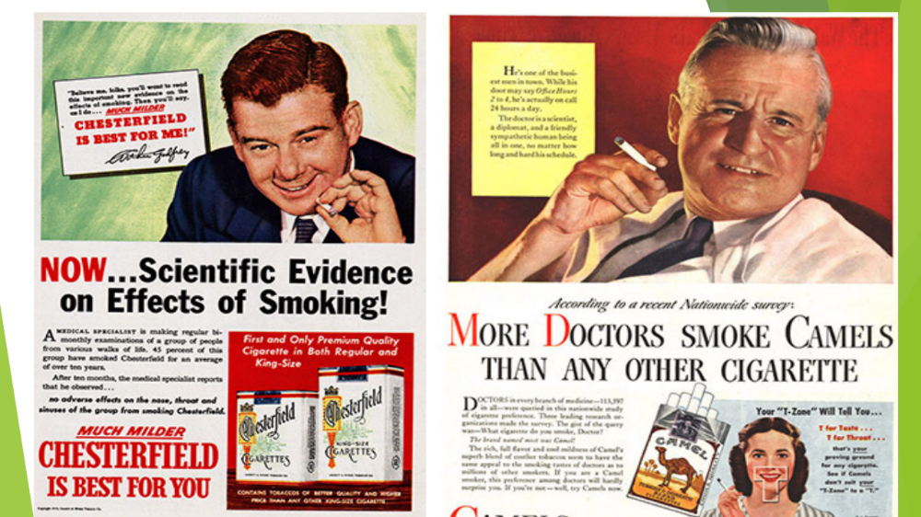

Slide 24
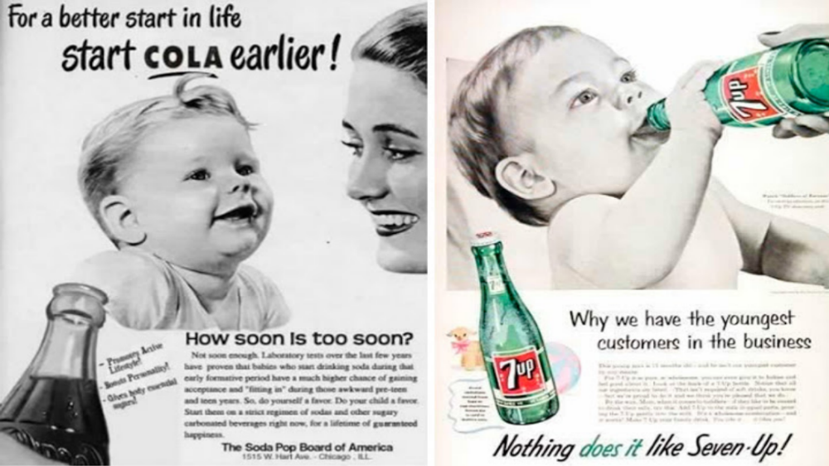

Slide 25
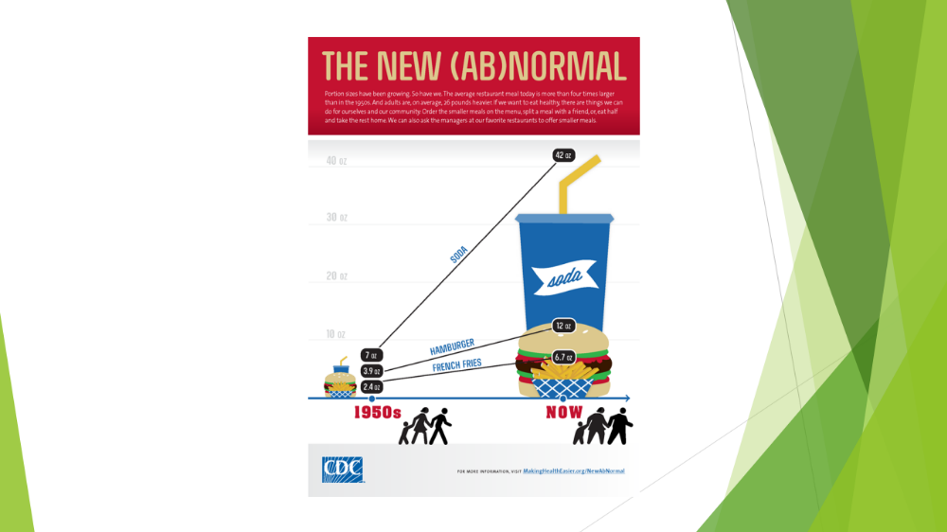

Slide 26
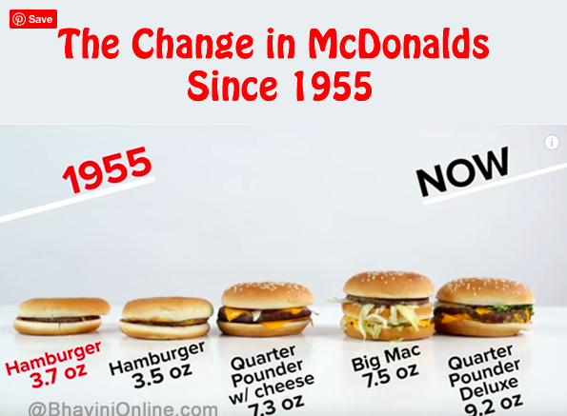

Slide 27


Slide 28


Slide 29
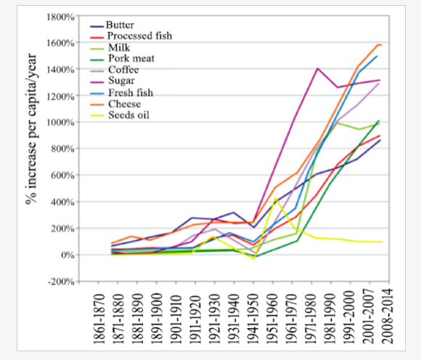

Slide 30
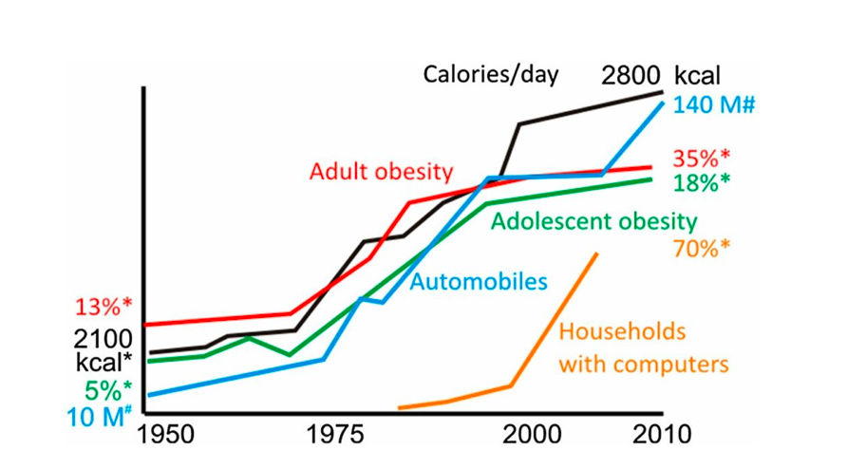

Slide 31
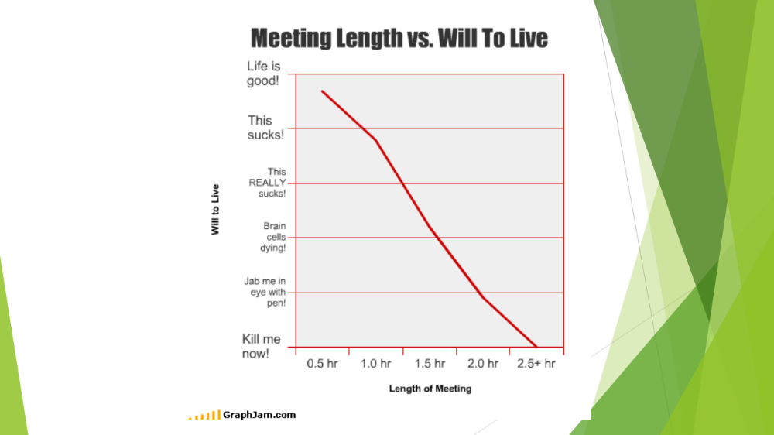

Slide 32
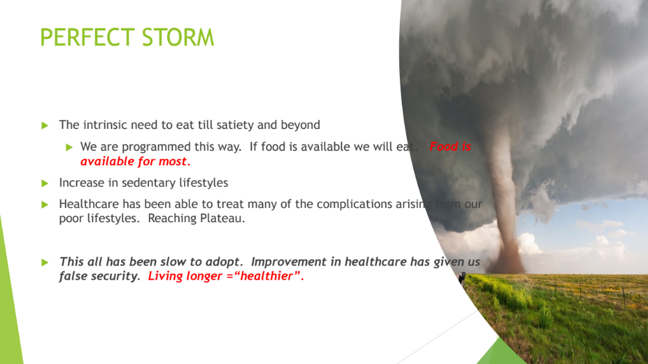

Slide 33


Slide 35
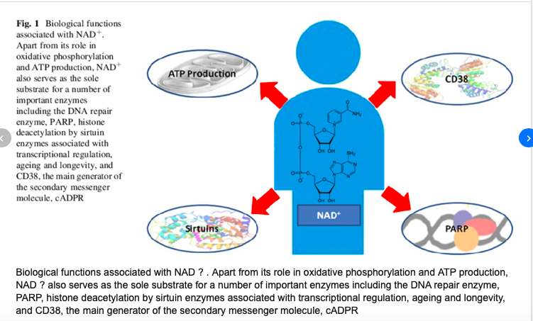

Slide 36
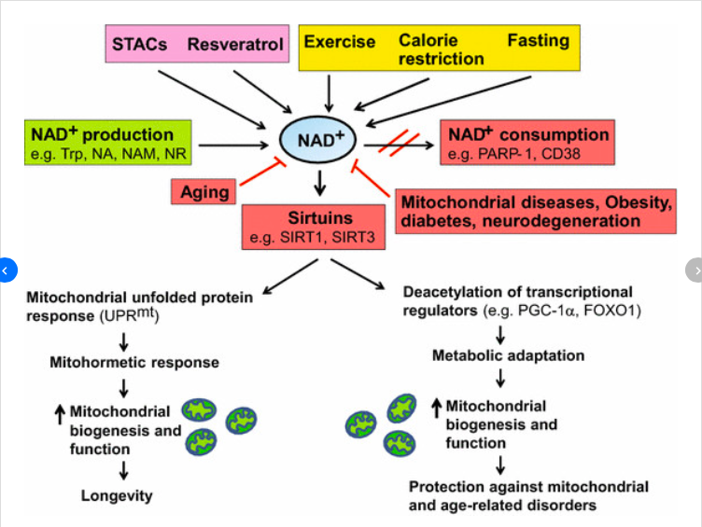

Slide 37
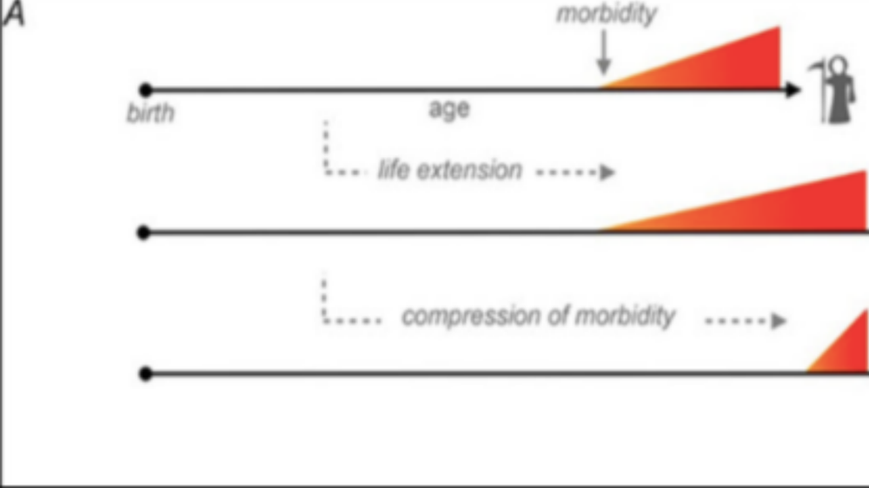

Slide 38
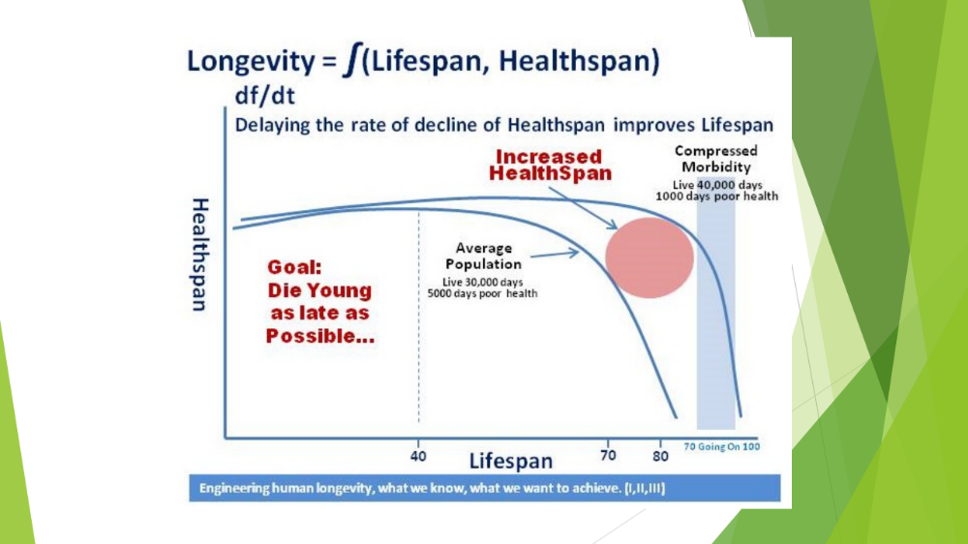

Slide 39
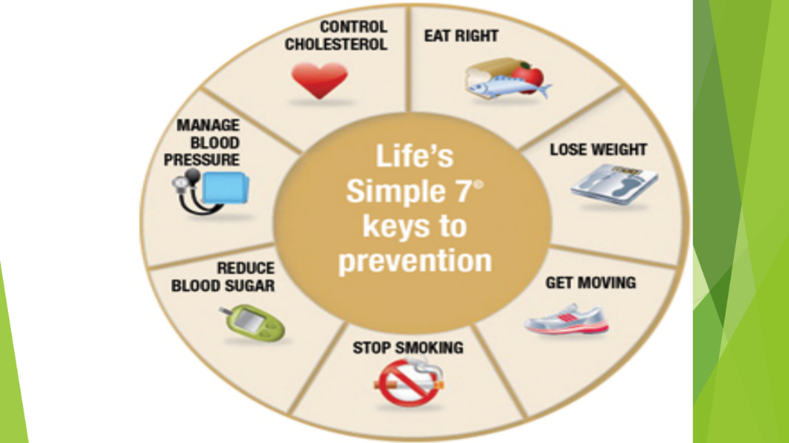

Slide 40
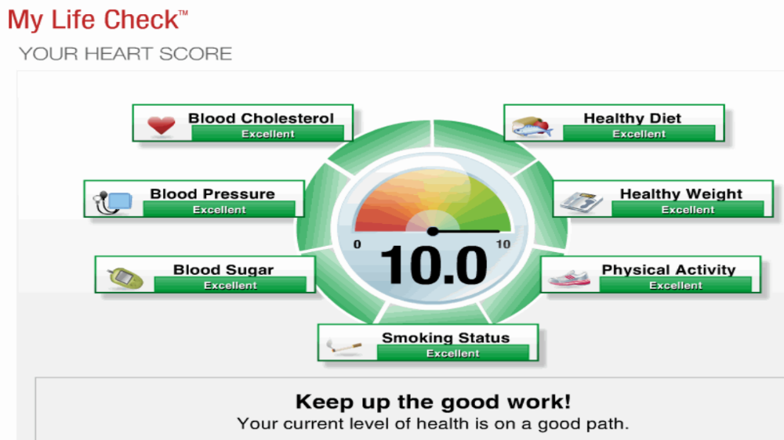

Slide 41
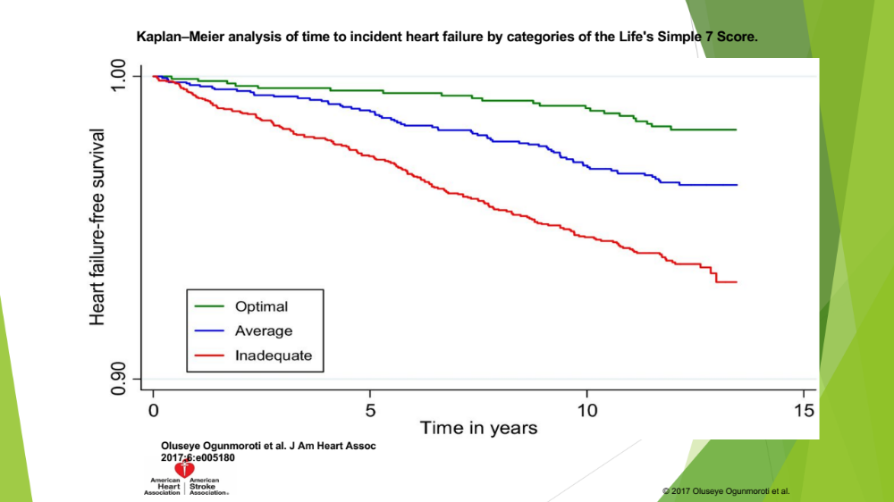

Slide 42


Slide 43


Slide 44
Dr Michael Roizen
Chief Wellness Officer Cleveland Clinic
Partner in Sharecare.com
Realage.com
Four NYT best sellers

Slide 45
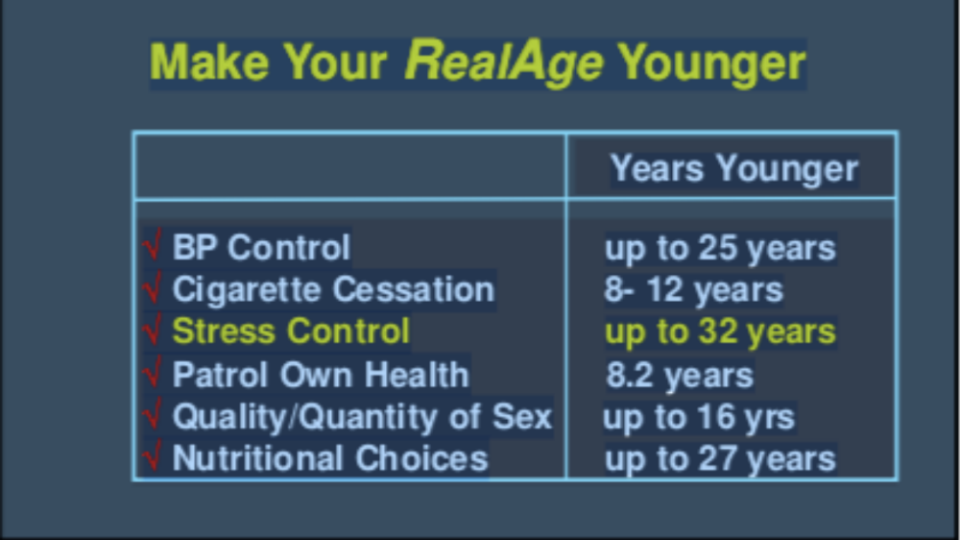

Slide 46
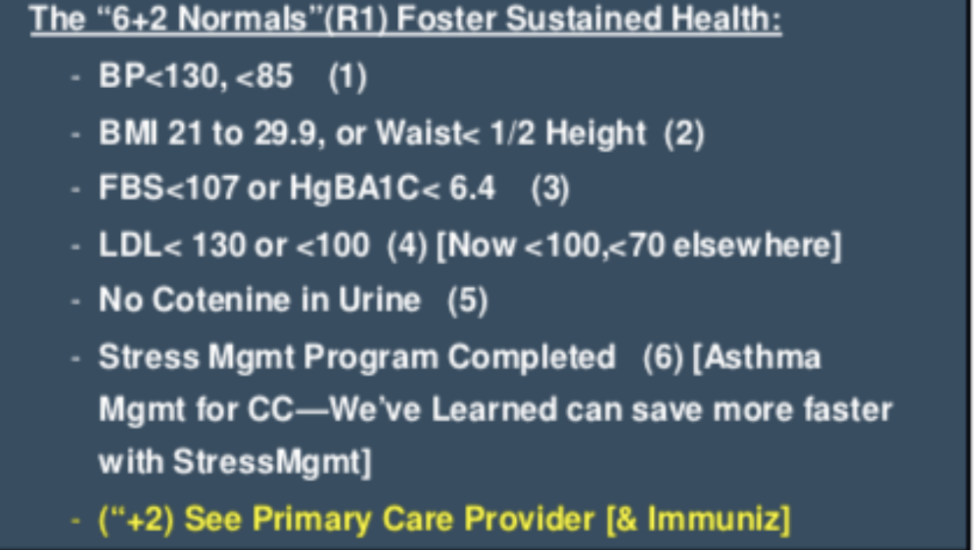

Slide 47
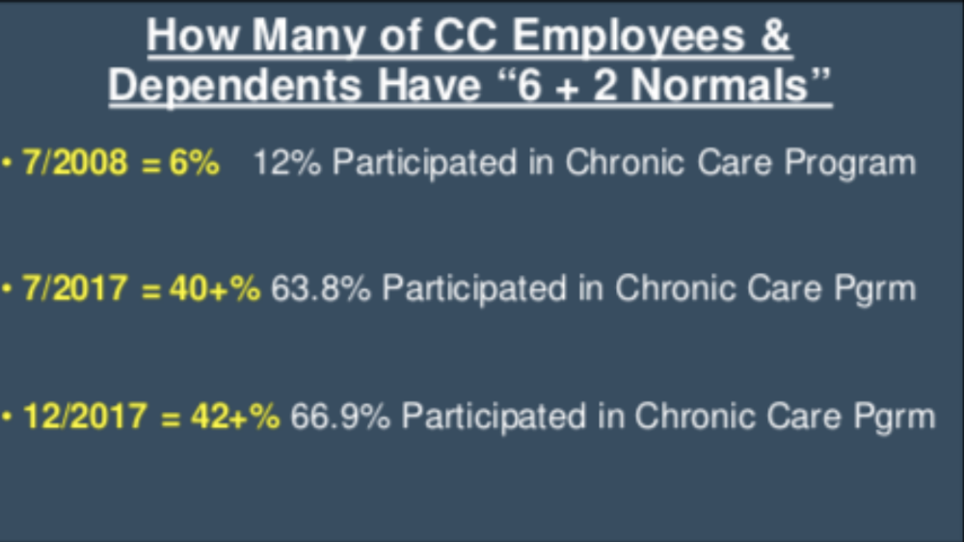

Slide 48
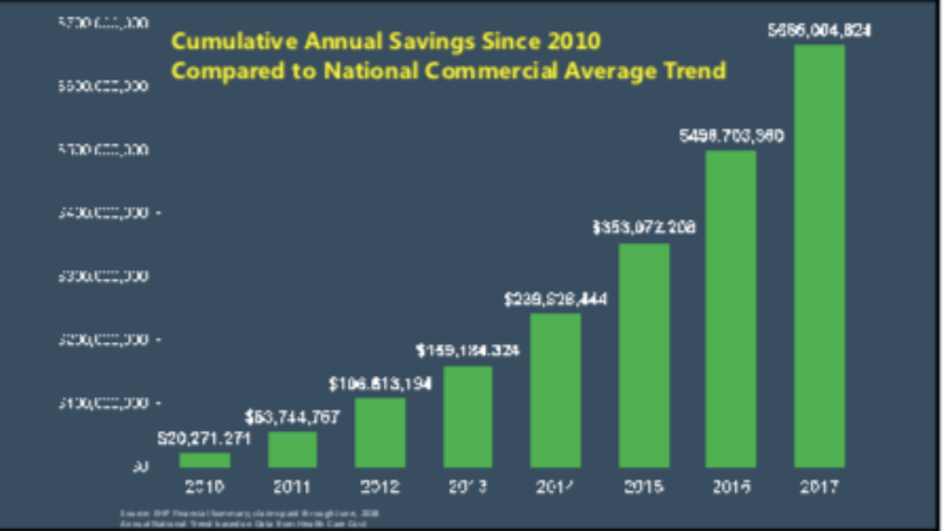

Slide 49


Slide 50
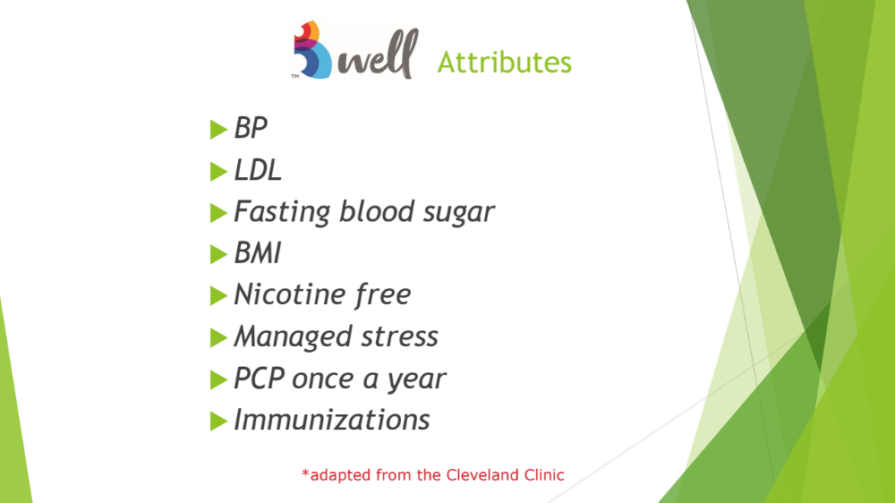

Slide 51
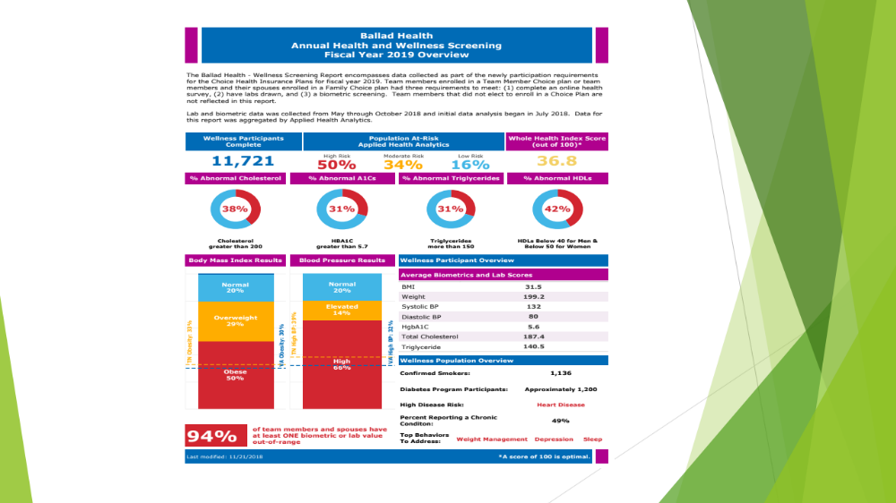

Slide 52
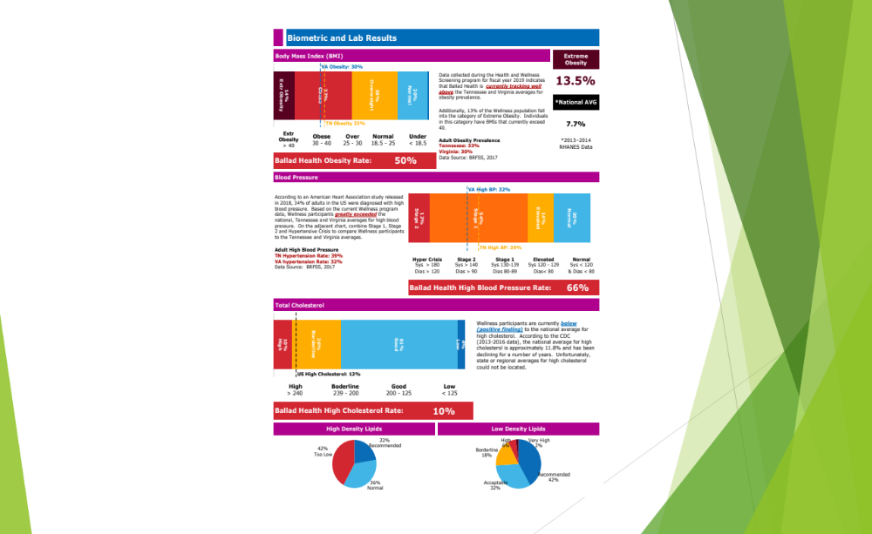

Slide 53
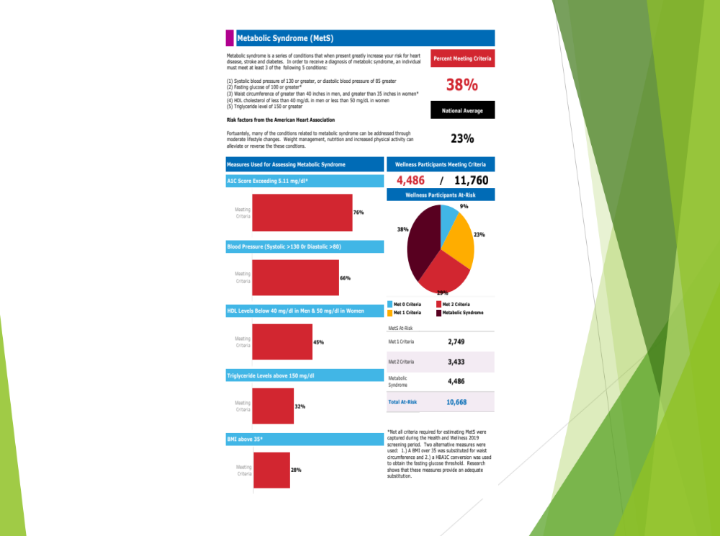

Slide 54
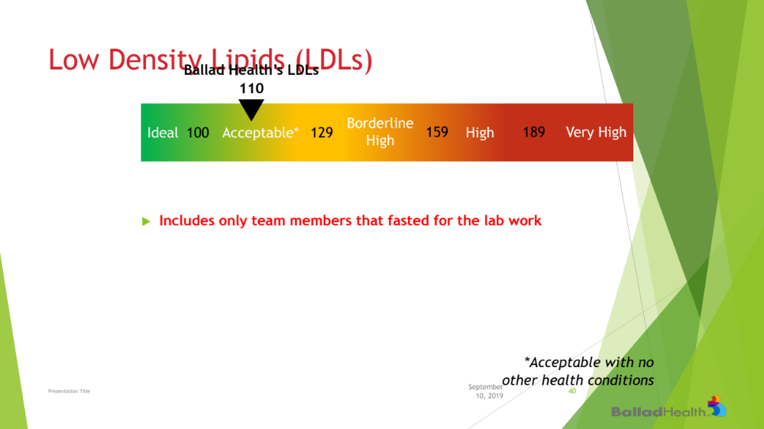

Slide 55
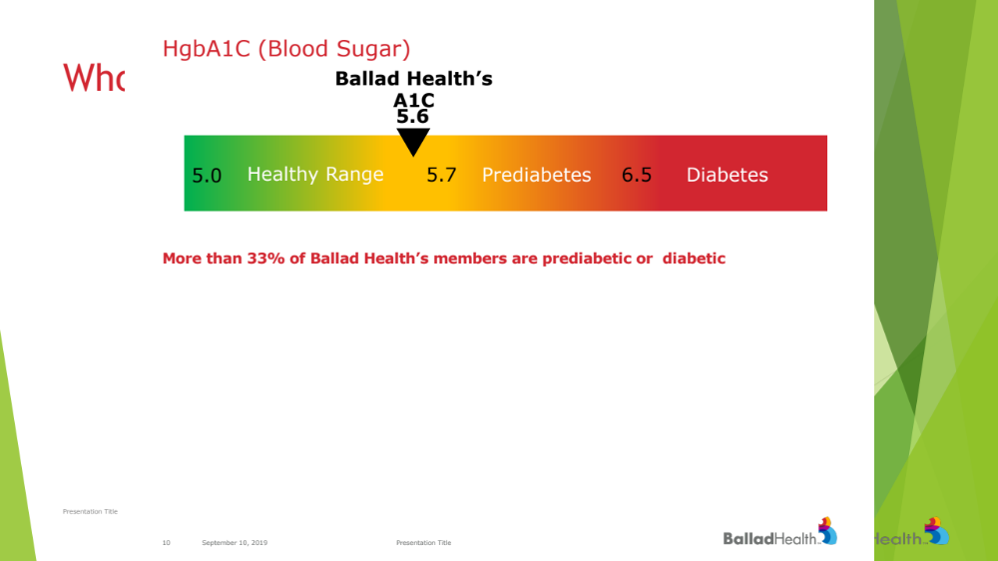

Slide 56
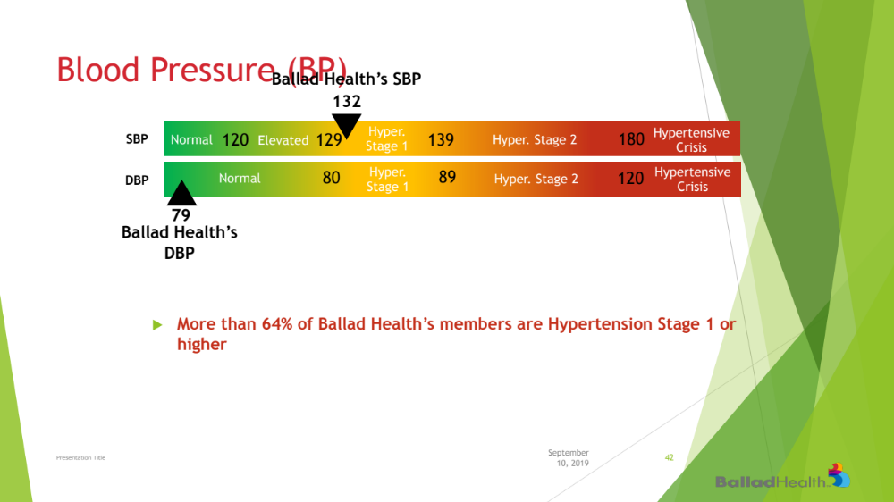

Slide 57
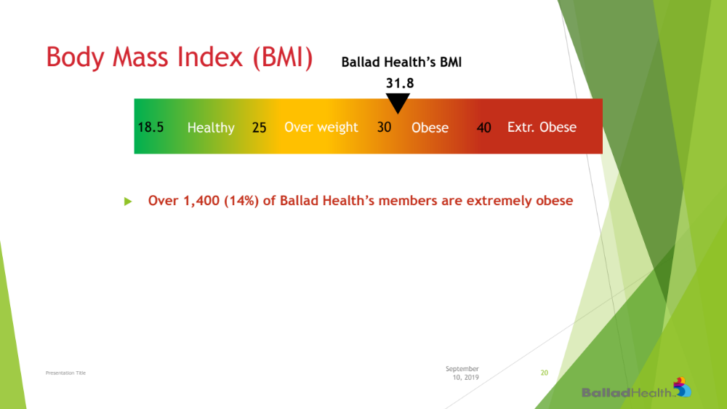

Slide 58
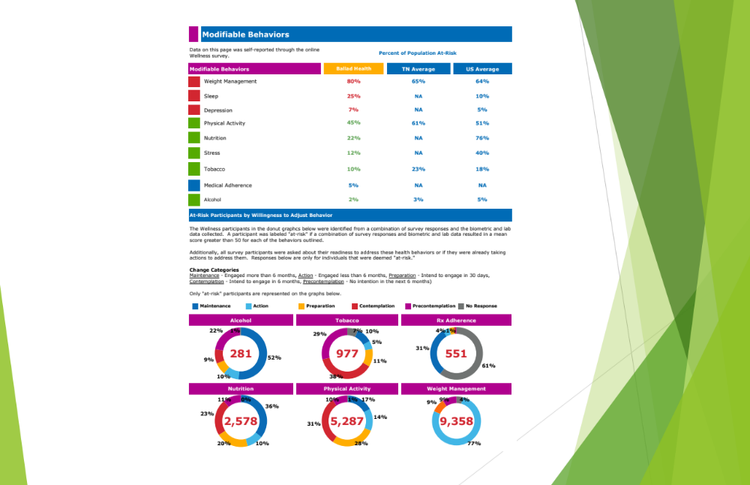

Slide 59
How?
Incentivize the team member
Involve PCP
Address Stress
Make healthy choices easier and less healthy choices more difficult.
Programs which help team members address chronic disease.
Marathon not a sprint.

Slide 60


Slide 61


Slide 62
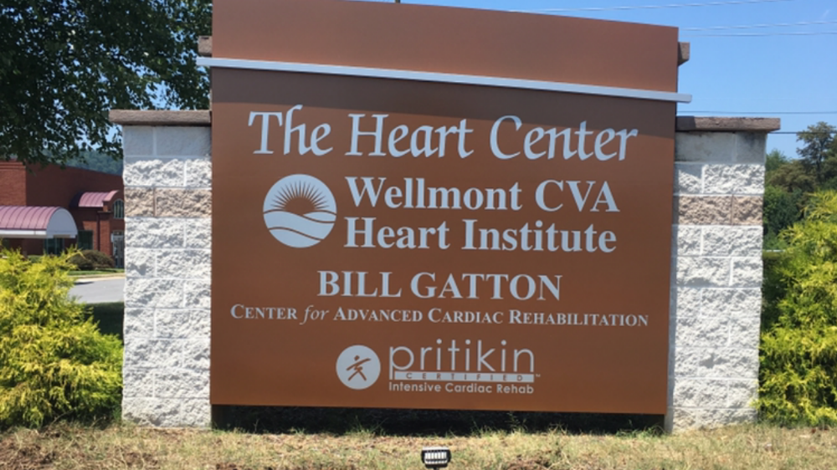

Slide 63
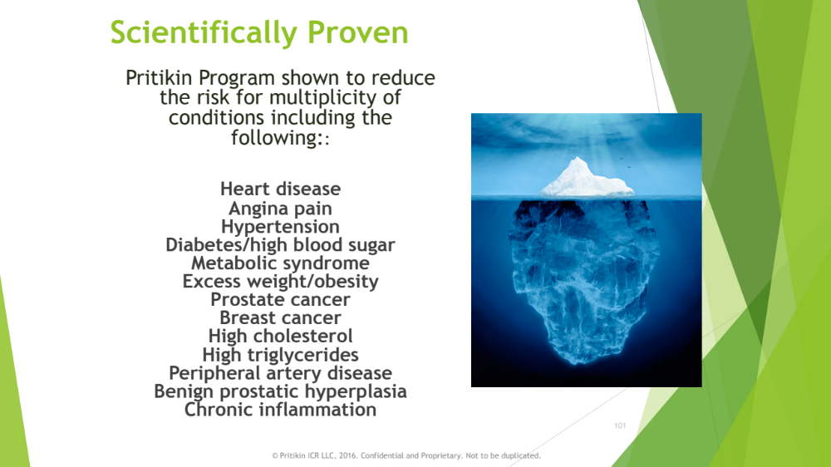

Slide 64
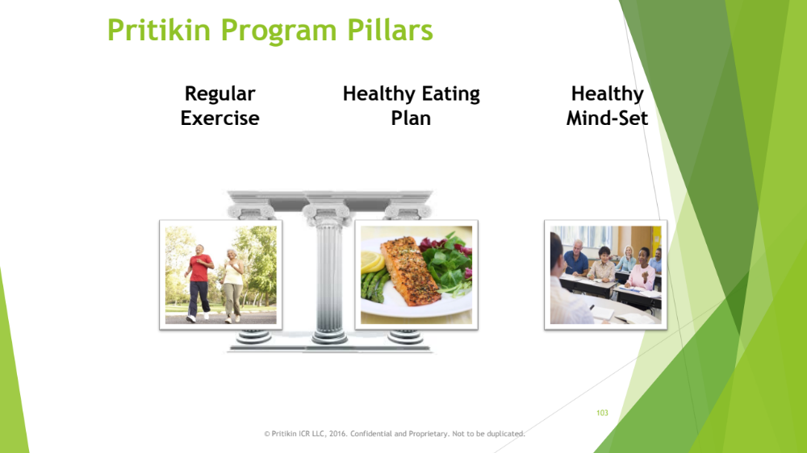

Slide 65
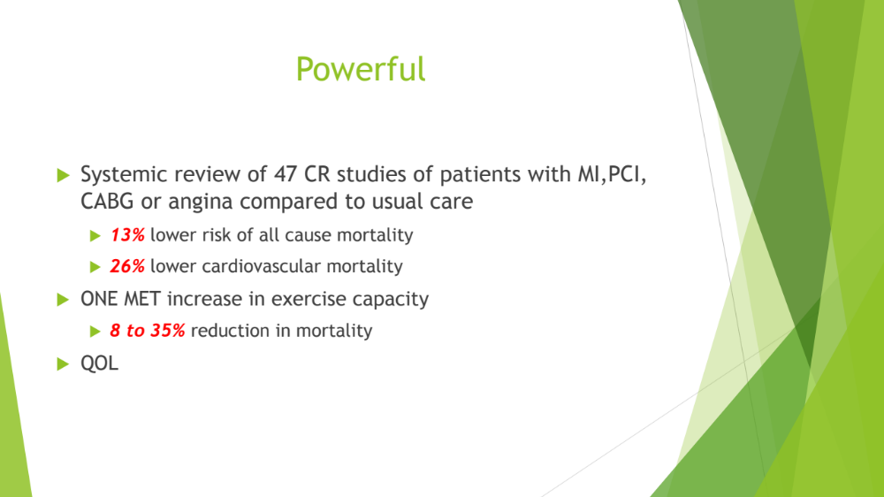

Slide 66
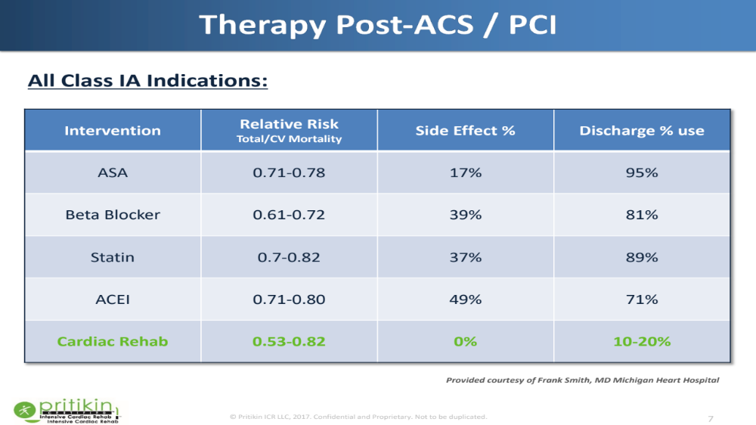

Slide 67
Pritikin Longevity Program Study
First in country for Pritikin
  Applied the Pritikin program in a community setting.
In partnership with Washington University
Co-Principle investigators
  Dr Sam Klein MD
  Dr David Beckner MD

Slide 69
Results
All metabolic measures were reduced significantly.
METS increased over 1.5 from baseline.
ROI?

Slide 70


Slide 72


Slide 73


Slide 74


