Slide 1

Screening, Brief Intervention, and Referral to Treatment
Marshall University SBIRT
Lyn O’Connell, Ph.D., IMFT
Assoc. Director of Addiction Sciences
The material included in this course is funded by a SAMHSA grant awarded to Marshall University

Slide 2
What figment of the human imagination has the power to:
  isolate individuals and families;
  encourage people to deny a fatal illness and ignore its symptoms;
  keep desperately ill people from seeking help;
  block funding for treatment for all but a small fraction of those who need it; and
  persuade society to choose far more expensive alternatives - alternatives like imprisonment; the human and financial cost of accidents and secondary illnesses; and the wholesale loss of human lives, productivity, and potential?

Slide 3
Stigma
Public-stigma: Misperceptions, negative language, and negative beliefs about a certain group of the population
  An imaginary stain we see on a person and those without the stain are superior
Self-stigma: Internal beliefs about your “otherness” or inadequacy leading to isolation and lack of engagement in treatment
  Pushes someone deeper into the addiction process
Stigma towards addiction is one of the top barriers to accessing treatment
  Hundreds-of-thousands of people who need help are not getting it, even though we have effective addiction interventions and treatment methods.
Vogel et al., 2006, 2007

Slide 4
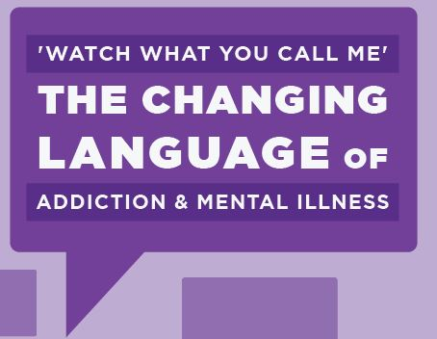
Avoiding Stigmatizing Language
“Research shows that the language we use to describe this disease can either perpetuate or overcome the stereotypes, prejudice and lack of empathy that keep people from getting treatment they need. Scientific evidence demonstrates that this disease is caused by a variety of genetic and environmental factors, not moral weakness on the part of the individual. Our language should reflect that.”
-Drug Czar Botticelli (2017)

Slide 5
Current Language | Suggested De-Stigmatizing Language | Reason
Addict, Junkie, Crack-head, User, Abuser, Alcoholic *please don’t use “addict” | Individual struggling with the disease of addiction. Individual not yet in recovery. A person with a substance use disorder. | Person-centered language
Drug-addicted baby/ Drug-baby | Infant who was neonatally exposed. Infant with pre-natal exposure. Infant experiencing withdrawals. | Person-centered language & infants are not addicted
Non-compliant/ Resistant | Struggling with Ambivalence. In the pre-contemplation stage. Choosing not to. | Not-blaming; talking about the stages of change; offers change rather than label
Denial | Ambivalent, Pre-contemplation stage | Not-blaming; talking about the stages of change; offers change rather than label
Substance Abuse | Substance Use Disorder | Medical diagnosis
Drug of Choice | Drug used/ Drug of Use/ Commonly Used Drug | It's not a "choice"
Relapse prevention | Recovery management, maintenance | Positive, strength-based, stages of change
[AA/Faith-based/MAT/Abstinence] … is the only way | Each individual takes a different path towards recovery or becoming drug free | Offering opportunities and acknowledging the individual process
Drug overdose | Drug poisoning | Medicalize
Clean/Sober | In recovery/ Drug free/ Free from illicit drugs or medication | Stigma-free language not associating dirtiness with drug use
Chooses to use drugs | Disease of addiction | Medicalize the problem
Relapse | Recurrence/ Return to Use | The word relapse brings a lot of baggage
Abstinence | Individual in recovery process | Using abstinence language precludes those using medication assisted treatment
Replacement drugs | Medication Assisted Treatment | MAT may be part of the process for some

Slide 6
A Substance Use Disorder
…is a chronic relapsing brain disease.
  Craving for the object of addiction
  Loss of control over its use
  Continuing involvement with it despite adverse consequences
Addiction is a description and not a formal diagnosis in the Diagnostic Statistical Manual of Mental Disorders (DSM-V).
  Comes from the Latin term for “enslaved by” or “bound to”
  The medical diagnosis and correct terminology is a Substance Use Disorder.
National Institute on Drug Abuse, National Institutes of Health, U.S. Department of Health and Human Services. (2010). Drugs, brains and behavior: The science of addiction. Retrieved from http://www.drugabuse.gov/sites/default/files/sciofaddiction.pdf

Slide 7
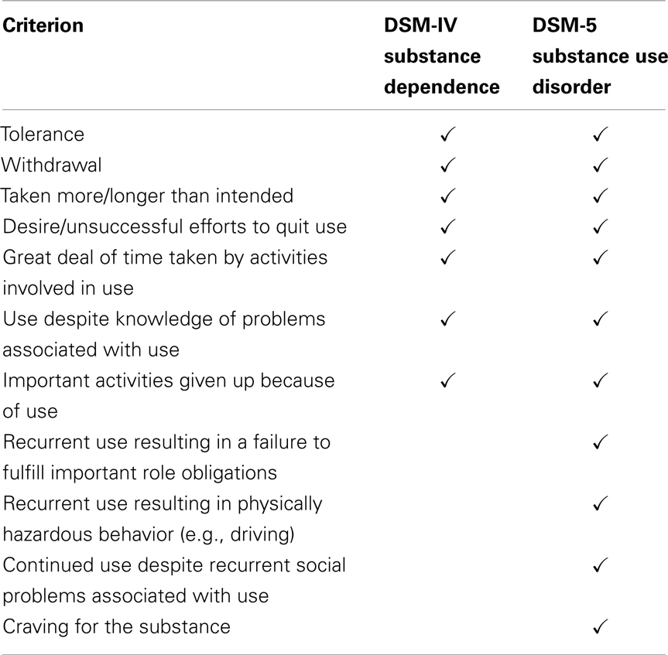
DSM-V: Substance Use Disorder
Substance Use Disorder (SUD): the existence of at least 2 symptoms in the following categories: impaired control, social impairment, risky use, and pharmacological criteria (i.e. tolerance and withdrawal)
  Includes alcohol, prescription drugs, illicit drugs, and tobacco
  Multiple qualifiers
https://www.drugabuse.gov/publications/media-guide/science-drug-abuse-addiction-basics

Slide 8
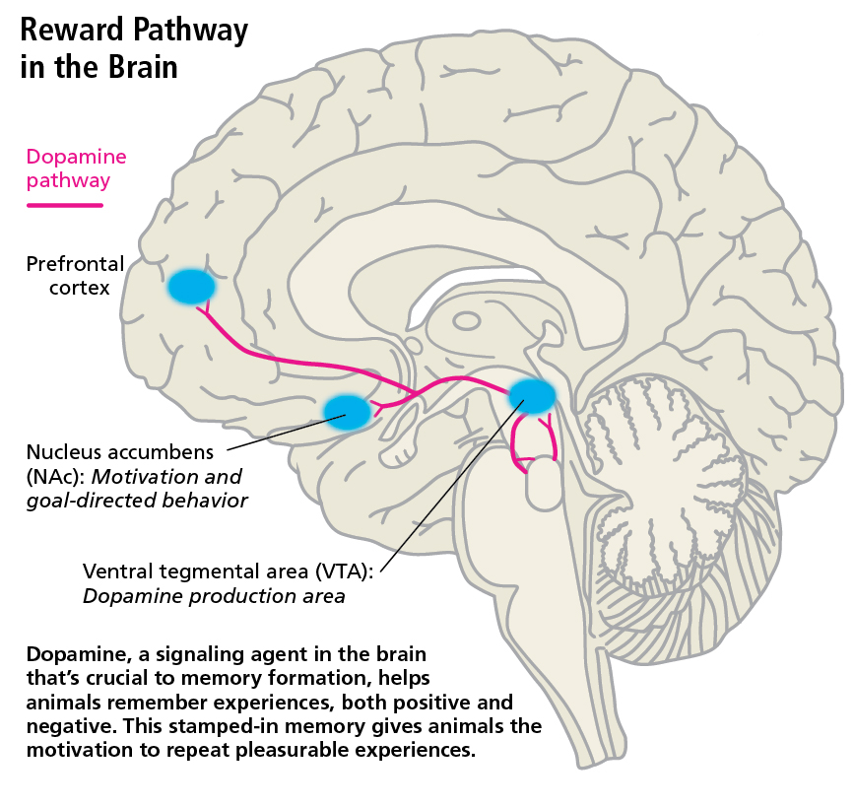
Hijacking the Brain
Initial use – prescribed or experimenting
Brain is flooded with dopamine
  Dopamine is a neurotransmitter that controls the reward-motivation circuit
  Affects emotions, movements, and sensations of pleasure and pain
  Drugs cause the body to make less natural dopamine and/or reduces ability to respond to dopamine (i.e. tolerance)
http://discovermagazine.com/2015/may/17-resetting-the-addictive-brain
Notes:
Dopamine neurotransmitters are located in the substantia nigra region of the brain (deep inside). There are 5 neurotransmitters. The most common disease associated with the loss of the chemical dopamine is Parkinsons (dopamine is part of basal ganglia motor loop, which controls fine motor movements).
In the case of Schizophrenia, the person is producing too much dopamine – similar symptoms seens with amphetamines, which cause the brain to produce more dopamine.
By the mid-1990s, most addiction researchers came to believe that dopamine’s role is more complex than a simple pleasure juice. Dopamine serves as a learning signal that helps animals remember pleasurable experiences and develops the motivation to repeat them. But this signal somehow goes awry with addiction. Research also has demonstrated that dopamine needed to be present for rats to remember unpleasant experiences, such as electric shocks. When an animal experiences any intense stimulus that is worth remembering, dopamine is released in the brain.
“One of the things that has been stressed in recent literature is that the dopamine system is activated by stress,” says Wise, who is now at the National Institute of Drug Abuse (NIDA). “These [stressors] are not pleasant, and yet they stamp in memory as effectively as pleasurable experiences. Dopamine is responsible in both cases.”

Slide 9
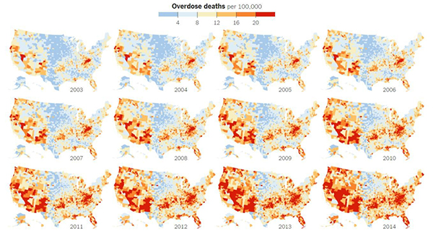
National Epidemic
22.5 Million Americans, 12 and older, are currently using drugs
  90,000+ deaths annually are a result of alcohol and drug abuse
  63,600 individuals died of an overdose in 2016
    32,445 involved prescription opioids
  480,000 deaths are a result of tobacco use
CDC 2010;2014; NIH; SAMSHA 2015 https://www.healthypeople.gov/2020/topics-objectives/topic/substance-abuse, https://www.nytimes.com/interactive/2016/01/07/us/drug-overdose-deaths-in-the-us.html
Notes:
Rising rates of substance abuse and addiction is a national epidemic that is being particularly hard-felt here in the WV, specifically Cabell Co and the town of Huntington. Nation wide there are 22.5 million current drug users over the age of 12. However, we do know that some individuals start using drugs before the age of 12. This is especially common in situations of sex trafficking or manipulation through drugs. At the Health Department in Huntington they’re collecting data as part of their needle exchange. Their data indicates that some report initial use at age 8. This continues to show that you don’t know who is a drug user or has been exposed to drugs. 1 in 6 Americans reports binge drinking (4 of more drinks in an occasion for women & those over 65 or 5 or more drinks for men on an occasion) in the past 30 days, 1 in 12 qualifies for an alcohol use disorder and 1 in 50 people qualifies for a drug abuse disorder. Substance abuse cots America $700 billion annually (updated 2015) from things like loss of productivity and medical treatment. It is important that we come together to decrease the effects of substance abuse especially as it has been designated a national goal by Healthy People 2010.

Slide 10
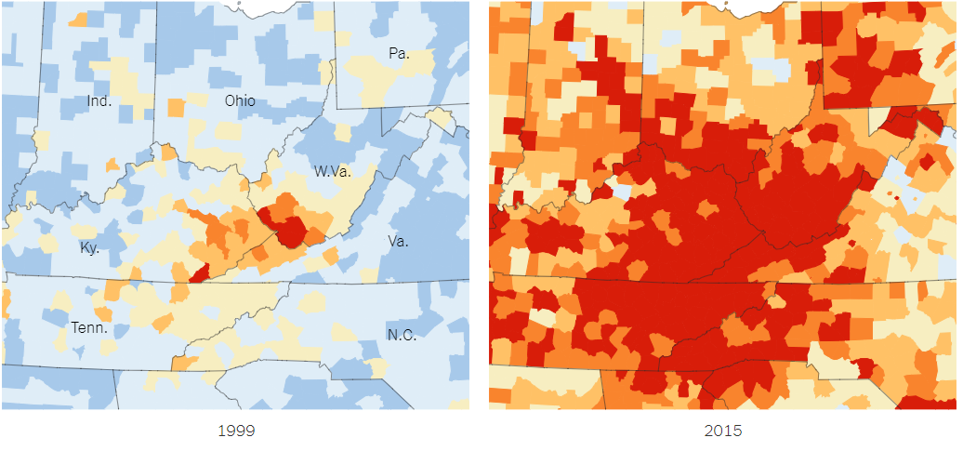
Appalachia & Southwest VA

Slide 11
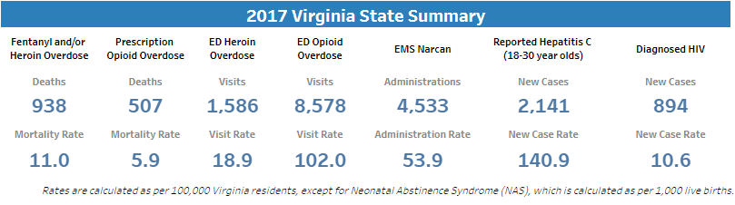
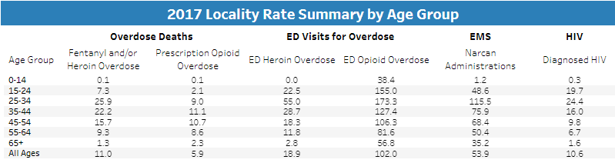
VA Overdose Statistics
http://www.vdh.virginia.gov/data/opioid-overdose/
Notes:
Half of the controlled substance doses detailed in the report — more than 118 million — are opioids. The other substances included anti-anxiety medications and amphetamine products. West Virginia has just 1.8 million people. The means the doses of legal opioids dispensed in the state last year were equivalent to 65 doses for every man, woman and child.
At least 944 overdoses occurred in 2015 and 72 of those resulted in death. That’s 2.58 overdoses every day and the range of people affected ranges from 12 to 78 with the average age of someone overdosing at 37. According to the Centers for Disease Control and Prevention, West Virginia's drug overdose death rate was about 41.5 cases per 100,000 in 2015. The next highest states were New Hampshire (34.3 per 100,000) and Kentucky (29.9 per 100,000).
2 of the top 5 states
Both included in states that statistical significant drug overdose increase rates
Ohio 29.9 per 100,000 21.5% change from 2014 to 2015
Ohio is 2nd in drug overdose rates
Ohio – fentanyl-related overdose
2014 = 503
2015 = 1,155
Decline in unintentional drug overdose deaths from prescription opioids on decline for 4th year

Slide 12
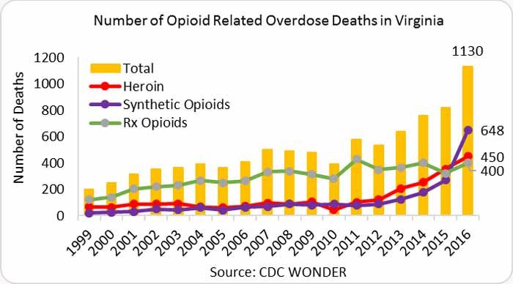
VA Overdose Deaths

Slide 13
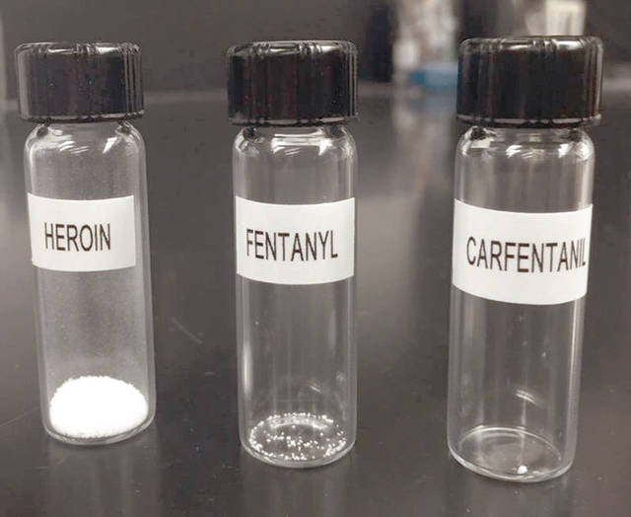
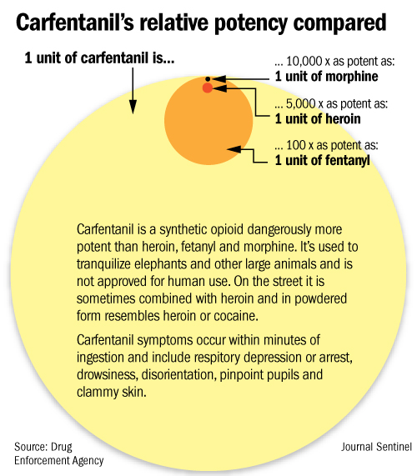
Rise of Synthetic
Opioids
In 2016, there were more than 19,000 deaths relating to synthetic opioids (other than methadone) in the US.
  the largest increases in overdose death rate from were in persons aged 25-44, specifically males 25-44.
Synthetic opioid overdose deaths significantly increased in 21 states, with 10 states at least doubling their rates in 2016. New Hampshire, West Virginia, and Massachusetts had the highest death rates from synthetic opioids.
Synthetic overdoses are treated the same way as any other opioid overdose. Naloxone/Narcan still works.

Slide 14
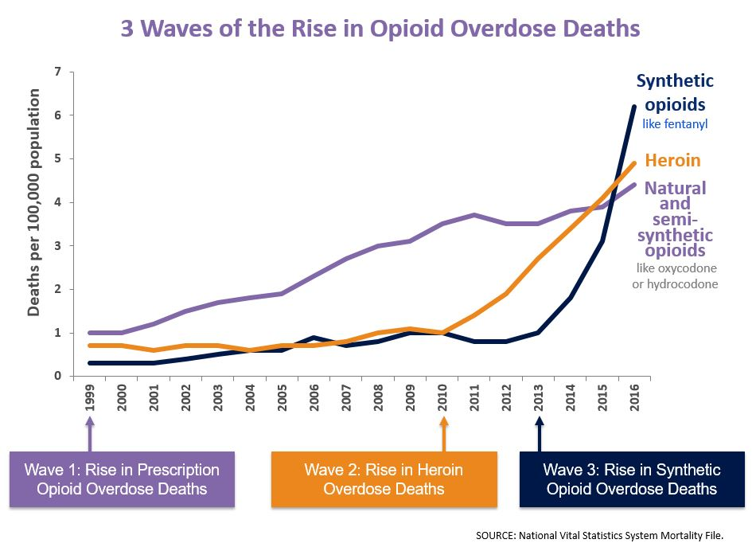
Ohio Department of Health via the Federal Reserve Bank of Cleveland
Notes:
This rise in opioid overdose deaths can be outlined in three distinct waves.
The first wave began with increased prescribing of opioids in the 1990s ², with overdose deaths involving prescription opioids (natural and semi-synthetic opioids and methadone) increasing since at least 1999.
The second wave began in 2010, with rapid increases in overdose deaths involving heroin.
The third wave began in 2013, with significant increases in overdose deaths involving synthetic opioids – particularly those involving illicitly-manufactured fentanyl (IMF). The IMF market continues to change, and IMF can be found in combination with heroin, counterfeit pills, and cocaine. ^{1,3}

Slide 15
Development of Substance Use Disorders
Pain Scale
OxyContin
Marketing
Lack of Behavioral Health Care
Lack of Integrated Care
Health Care Professionals Education
Mental Illness
ACEs
Multiple factors have played a role in the development of the substance abuse epidemic.
https://www.drugabuse.gov/publications/preventing-drug-abuse-among-children-adolescents/chapter-1-risk-factors-protective-factors/what-are-risk-factors

Slide 16
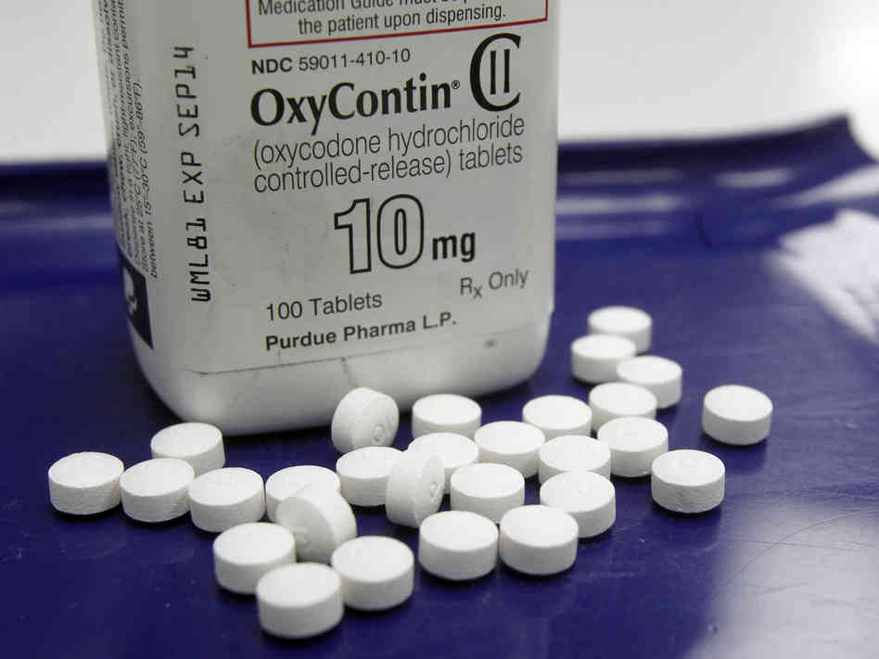
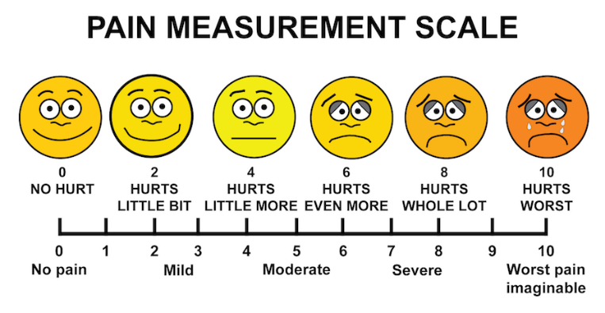
Societal Factors Contributing to Use
1. Pain Scale
2. OxyContin
Purdue Pharma introduced OxyContin in 1996, a controlled-release version (more potent active ingredient) of the pain killer Oxycodone
  Included a $200 million marketing campaign in 2001
2 unique components of FDA approval of OxyContin:
  Only drug to have been labeled “abuse resistant”
    NO rigorous supporting study rather sampled acute short-term hospital setting patient.
    After alarming rates of abuse were detected a Black Box warning was released : “tablets are to be swallowed whole and are not to be broken, chewed, or crushed. Taking broken, chewed, or crushed tablets leads to rapid release and absorption of potentially fatal dose of oxycodone”
  Promised a unique 12-hour dosing capability (6-8 on avg.)
    Again, NO rigorous supporting study rather sampled acute short-term hospital setting patient – many double-blind assessments disprove this
Paid $634 million in files following lawsuit, which proved they suppressed findings and created false “scientific charts.”
In 1999, “Pain as the 5th Vital Sign” initiative
Joint Commission for Accreditation of American Healthcare Organizations made it a physician requirement.
David Gutman 10/17/15 Charleston Gazette; FDA, April 2013 Press Release; opioids.com/oxycodone/oxycontin
Notes:
The drug epidemic in our state did not appear over night. Two major events coincided which contributed to the rise of opioid pain relievers in the community. In 1999, the pain measurement scale was introduced, which lead to the consideration of pain during routine doctors appointments. WV has a hard working blue-collar /factory community with generations of people who started work early and work often till they no longer can. Around the same time, Purdue Pharma was allowed to release Oci-Contin as a “non-addictive” slow-acting medication. It is the only time the FDA has allowed a pain reliever to be marketed as abuse resistant. “The FDA approved the original formulation of OxyContin in Dec. 1995. The product was abused, often following manipulation intended to defeat its extended-release properties. Such manipulation causes the drug to be released more rapidly, which increases the risk of serious adverse events, including overdose and death. In April 2010, the FDA approved a reformulated version of OxyContin, which was designed to be more difficult to manipulate for purposes of misuse or abuse. Purdue stopped shipping original OxyContin to pharmacies in August 2010 (FDA, 2013).” This ultimately false advertising allowed people to prescribe in good faith something that was highly addictive and potent to a huge number of people.
The tablet is more difficult to crush, break, or dissolve. It also forms a viscous hydrogel and cannot be easily prepared for injection. The agency has determined that the physical and chemical properties of the reformulated product are expected to make the product difficult to inject and to reduce abuse via snorting. However, abuse of OxyContin by these routes, as well as the oral route, is still possible. The reformulated product also may reduce incidents of therapeutic misuse, such as crushing the product to sprinkle it onto food or to administer it through a gastric tube.
A 2012 study that was published in the journal Pain Physician found that 60 percent of opioid deaths occurred in patients who were "using opioids exactly as prescribed" and whose doctors were prescribing the pills according to existing medical board guidelines. The study found that the other 40 percent of opioid deaths occurred in people who obtained their drugs through pill mills — multiple prescriptions, doctor shopping, and drug diversion. This has lead to new hospital guidelines and suggested guidelines for prescribing however these are only “guidelines” and need to be adopted by each physician, doctor’s office, or hospital.
Further info on Purdue Pharma: Purdue attempted to manipulate these issues and stated before the February 12, 2002 subcommittee:
And as recently as 1999, DEA wrote to us and again reminded us that this was principally a problem of oral abuse. It was not until last year, when OxyContin press became so prevalent, when we began investigating, when we had these meetings that were just described to you, that we learned that in addition to the oral abuse, that OxyContin was also, on occasion, being crushed and used intravenously. As a result of that, we have started on a very intensive program, around the first of this year, to formulate it with Naloxone.
Purdue was doing two questionable things here; first, it was suggesting that it had been informed of the problem by the DEA in 1999, contrary to its assertion that it had not known about the problem until April of 2000; second, it was attempting to focus attention on the intravenous use of OxyContin and suggest that the opioid antagonist Naloxone could be used to combat the problem, knowing that in reality a Naloxone formulation was unfeasible.
On July 22, 2002 Purdue came forward with an update on its development of the abuse-resistant formulation, stating that it would not be able to complete clinical development of the product for at least 4 to 5 years. The announcement highlighted that Purdue had spent over $100 million in the previous 2 years on the development of the abuse-resistant formulation. Purdue explained that during clinical trials, Naloxone sometimes blocked pain relief for legitimate patients who were taking the tablets correctly. No one drew attention to the fact that this outcome had already been predicted and that Purdue was clearly doing this as a public relations ploy. During the press release, the company also announced that it was investigating the use of the opioid antagonist Naltrexone which would be sequestered in special beads which would break if crushed or injected, continuing to draw attention to this subgroup of users and away from the issue of oral abuse. While in fairness the technology to block the ‘high’ of opioids is currently unavailable, Purdue took liberties with the science in a hollow attempt to show that it was taking action.

Slide 17
Increased Risk Factors = Increased Chance of Misuse
Biology: Genes at birth account for 40-60% of a person’s risk
Environment: An individual’s quality of life is correlated with increased risk of use/addiction
  Peer pressure, early exposure, stress, SES, positive social support, family use, & physical and sexual abuse
  70% of individuals receiving addiction treatment have a history of trauma exposure (Funk, McDermeit, Godley, Adams, 2003)
Developmental: The earlier use occurs, the more likely that person will develop an addiction
  ACEs – Adverse Childhood Experiences
  Teens may be especially prone to risky use
Environment
Development
Biology
https://www.drugabuse.gov/publications/drugfacts/understanding-drug-use-addiction

Slide 18
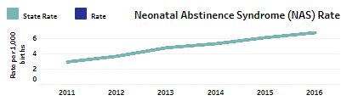
Early Exposure
Neonatal abstinence syndrome (NAS) or Neonatal Opioid Withdrawal Symptoms (NOWS) may occur when a pregnant woman takes prescribed drugs or illicit drugs
  type of drug used, number of drugs used, genetic factors that affect metabolism, quantity, frequency and duration of use, and prematurity
Infants with NAS are often harder to soothe, struggle with feeding and weight gain, over-react to stimulation, and may show long term developmental and educational deficits
  Require low light, gentle rocking, swaddling, and minimal to no noise or stimulation
https://medlineplus.gov/ency/article/007313.htm
Notes:
Includes, but not limited to, heroin, codeine, oxycodone (Oxycontin), tobacco, alcohol, benzodiazepines, barbiturates, SSRIs, amphetamines, cocaine, marijuana, methadone, buprenorphine

Slide 19
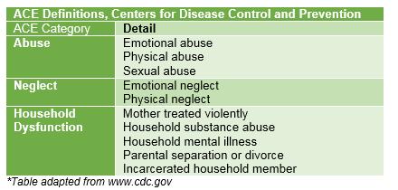
Adverse Childhood Experiences
Adverse childhood experiences (ACEs) are 10 stressful or traumatic events
ACEs are strongly related to the development and prevalence of a wide range of health problems throughout a person’s lifespan
  Very Common: 28% of study participants reported physical abuse and 21% reported sexual abuse.
  Multiple Experienced: Almost 40% of the Kaiser sample reported two or more ACEs and 12.5% experienced four or more.
  Dose-response: A person’s cumulative ACEs score has a strong, graded relationship to numerous health, social, and behavioral problems
https://www.samhsa.gov/capt/practicing-effective-prevention/prevention-behavioral-health/adverse-childhood-experiences

Slide 20
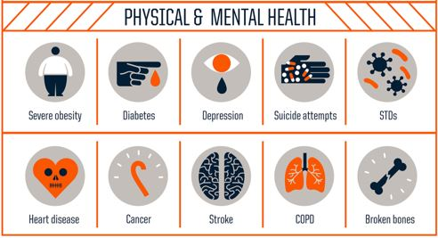
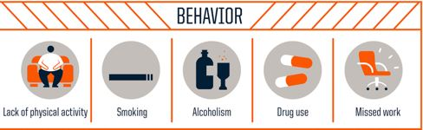
Consequences of ACEs
ACE of 4+ = 12x more likely to commit suicide
ACE of 6+ = 20 years less of life expectancy
https://www.samhsa.gov/capt/practicing-effective-prevention/prevention-behavioral-health/adverse-childhood-experiences
Notes:
Increased risk of suicide attempts. ACEs in any category increased the risk of attempted suicide by 2- to 5-fold throughout a person’s lifespan.
Lifetime depressive episodes. Exposure to ACEs may increase the risk of experiencing depressive disorders well into adulthood—sometimes decades after ACEs occur.
Sleep disturbances in adults. People with a history of ACEs have a higher likelihood of experiencing self-reported sleep disorders.
High-risk sexual behaviors. Women with ACEs have reported risky sexual behaviors, including early intercourse, having had 30 or more sexual partners, and perceiving themselves to be at risk for HIV/AIDS.
Fetal mortality. Fetal deaths attributed to adolescent pregnancy may result from underlying ACEs rather than adolescent pregnancy

Slide 21
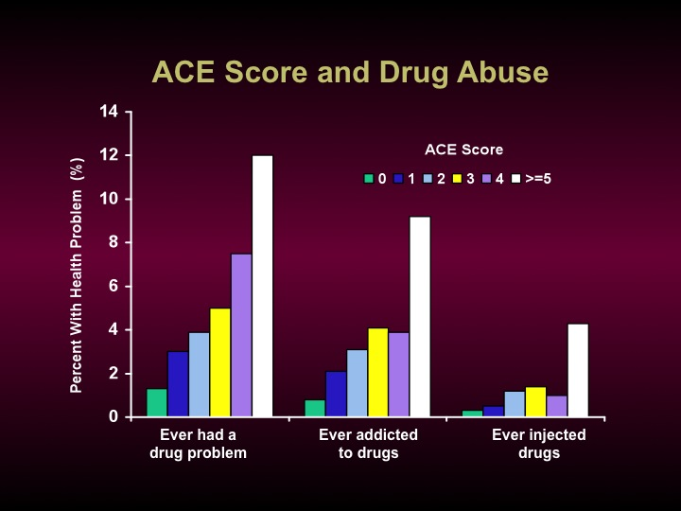
Slide courtesy of Robert Anda and Vincent Felitti & Presentation by Dr. Brumage

Slide 22
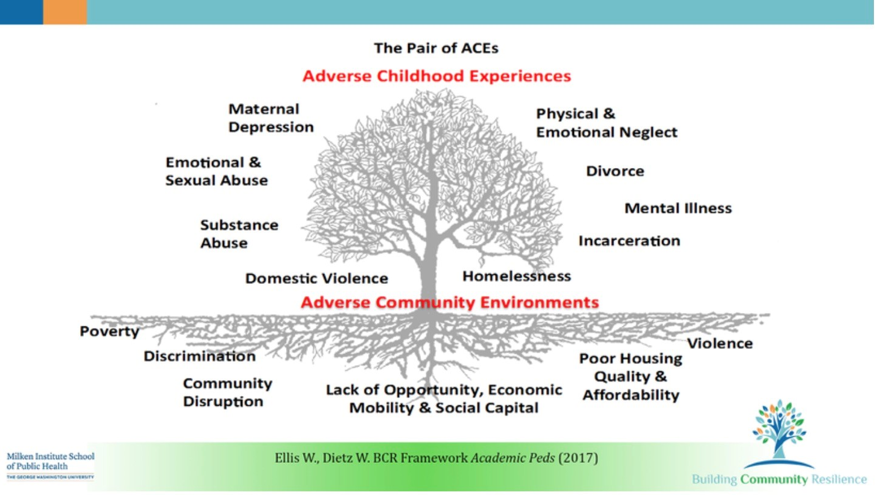
Adverse Childhood & Community Experiences

Slide 23
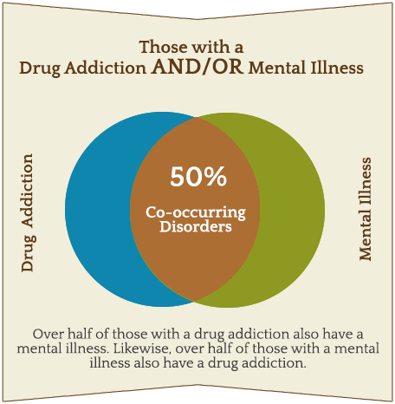
Co-Occurring Disorders: Mental Health & Substance Abuse
Co-Occurring disorders are the combination of 2 more disorders (substance use disorder and any mental health disorder).
  Most commonly includes depression and/or anxiety with SUD.
  Both must be treated to be successful.
SAMHSA’s 2014 National Survey on Drug Use and Health
Notes:
Chicken – egg
Mental health can make drug use happen and drug use can trigger mental health problem

Slide 24
Awareness of the Problem
Everyone assumes that someone else will ask, intervene, or treat and often assume the medical profession is addressing it.
  94% of physicians fails to diagnose early substance abuse in adults.
  A small percentage of physicians consider themselves “very prepared” to diagnosis alcoholism (19.9%); illegal drug use (16.9%); prescription drug abuse (30.2%).
Individuals report not screening due to “not knowing” how to address a positive screen or being worried about patient/client reaction.
http://www.centeronaddiction.org/addiction-research/reports/national-survey-primary-care-physicians-patients-substance-abuse

Slide 25
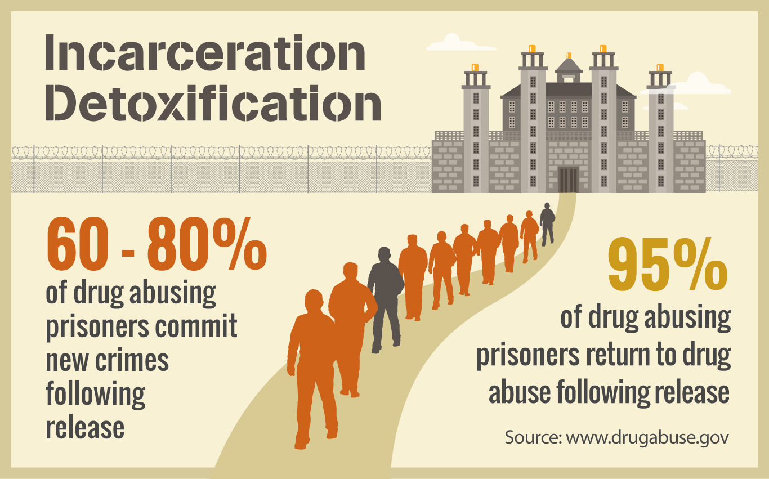
What we’ve been doing isn’t working…
Typically, treatment isn’t offered until a crisis point or legal involvement.
Early (and ongoing points of) intervention are key to addressing the addiction epidemic and reducing stigma.
SBIRT treats addiction as a chronic illness and applies a public health approach that doesn’t wait until someone is in crisis.
Screens for underlying issues
Source: Adapted from SBIRT Curriculum; drugabuse.gov
Notes:
Our current treatment philosophy has been to treat those in crisis and provide limited resources to prevention, screening, or early intervention. The common treatment is also incarceration, however this is no way a treatment and drugs are often prevalent in the prison system. SBIRT seeks to change all of that. It is a public health approach focused on screening EVERYONE in the community and providing early intervention for individuals in the early stages of use or questionable use and engaging those who are using at high risk levels. SBIRT, as an evidence based program, has the capacity to decrease the stigma around substance use and make the conversation more common place.

Slide 26

What is SBIRT?

Slide 27
SBIRT Defined
Screening, brief intervention, and referral to treatment (SBIRT) is a comprehensive, integrated, public health approach, focused on the delivery of early intervention and treatment services.
An intervention based on “motivational interviewing” strategies
Screening: Universal screening for quickly assessing use and severity of alcohol; illicit drugs; and prescription drug use, misuse, and abuse
Brief Intervention: Brief motivational and awareness-raising intervention given to risky or problematic substance users
Referral to Treatment: Referrals to specialty care for patients with substance use disorders
Treatment may consist of brief treatment or specialty AOD (alcohol and other drugs) treatment.
Screen
Moderate/High Risk
Low Risk
Brief Intervention
Affirm Positive Choices
Referral to Treatment
Follow Up: Risk Reduction
Source: Adapted from SBIRT Curriculum
Notes:
SBIRT is a public health approach that is focused on screening everyone, intervening briefly, and referring patients to treatment for their substance use disorder.

Slide 28

SBIRT is used to screen EVERYONE* for:
moderate to higher levels of risk of developing a substance use disorder.
a substance use disorders (SUD).
*SBIRT promotes Universal Screening!
The primary GOAL of SBIRT is to identify and effectively intervene with those who are at moderate or high risk for psychosocial or health care problems related to their substance use.
Source: Adapted from SBIRT Curriculum

Slide 29
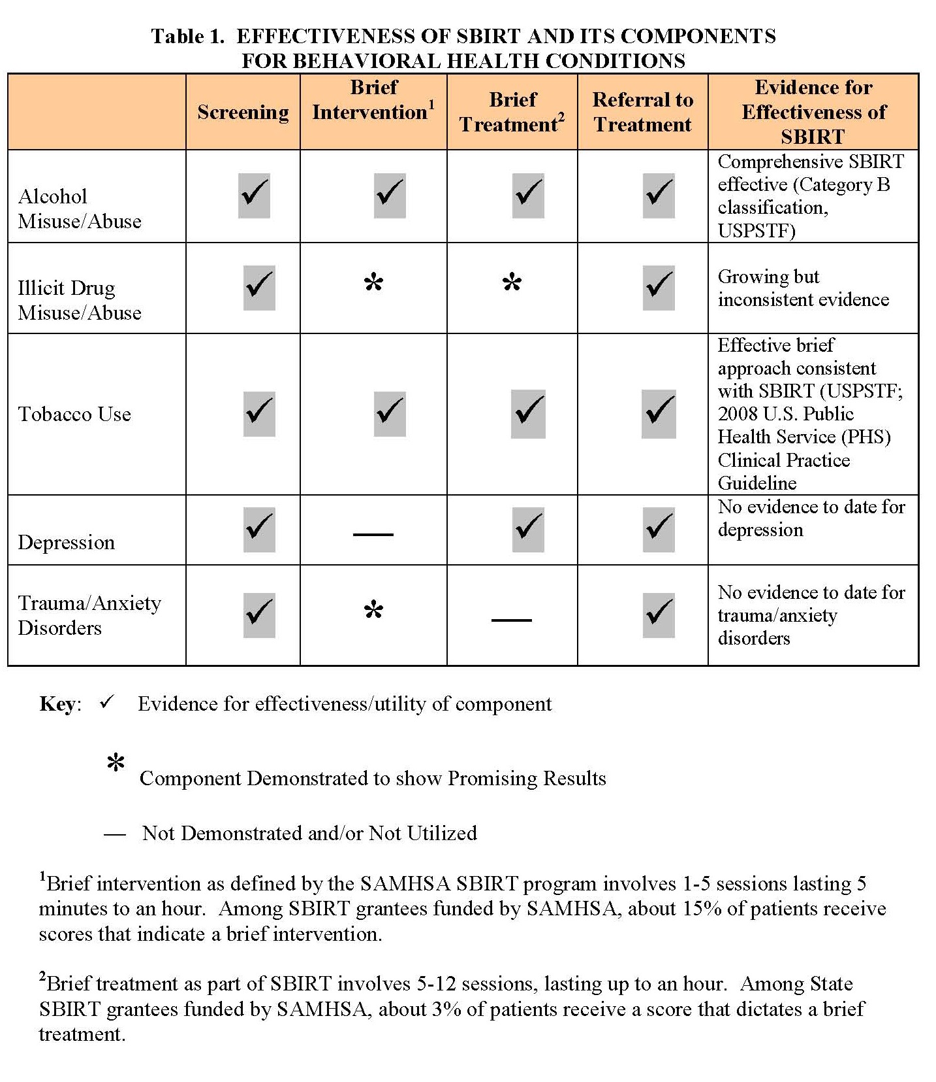
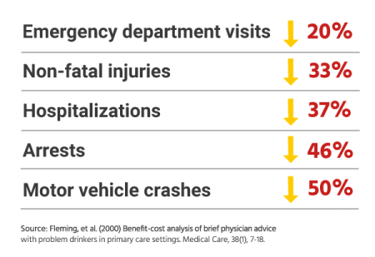
SBIRT is Effective
  SBIRT reduces:
    Health care costs
    Severity of drug and alcohol use
    Risk of trauma
    % of at-risk patients who go without specialized substance use treatment
People who receive screening in ER, hospital, or primary care visit:
Source: SBIRT Curriculum Based on review of SBIRT GPRA data (2003−2011)

Slide 30
SBIRT Process
Screen
AUDIT/DAST/CRAFFT
Abstinence/Low Risk
AUDIT (<7), DAST (<2)
Affirm/ ReScreen in Future
Positivity
High Risk Use
AUDIT (20-40), DAST (6+)
Req. Referral to Treatment
Detox/SA treatment
Moderate Risk Use
AUDIT (8-19), DAST (3-5)
Brief Negotiated Interview
Reduce Risk
May Refer to Treatment
Therapy/Treatment
Brief Negotiated Interview
Motivate into Treatment
4-15 minute brief intervention
Utilized WHO validated screening tools
20% change in behavior from brief interaction
Source: Adapted from SBIRT Curriculum

Slide 31
The “S” in SBIRT: Screening

Slide 32
Screen
AUDIT/DAST/CRAFFT
Abstinence/Low Risk
AUDIT (<7), DAST (<2)
Affirm/ ReScreen in Future
Positivity
High Risk Use
AUDIT (20-40), DAST (6+)
Req. Referral to Treatment
Detox/SA treatment
Moderate Risk Use
AUDIT (8-19), DAST (3-5)
Brief Negotiated Interview
Reduce Risk
May Refer to Treatment
Therapy/Treatment
Brief Negotiated Interview
Motivate into Treatment
STEP 1: Pre-Screen
Brief Question
Source: Adapted from SBIRT Curriculum

Slide 33
Step 1
Pre-Screen
  In the past year, have you had 3 or more drinks containing alcohol on any one day?
  In the past year, have you used prescription medication more than prescribed or that was not prescribed to you?
    More comprehensive: Are you currently using prescription medication and if so, what & for how long?
  In the past year, have you used drugs other than those required for medical reasons?
  In the past year, have you used tobacco (cigarettes or any tobacco use)?
  Mental Health:
  In the past year, have you felt down or depressed?
  In the past year, have you felt anxious or helpless?
  Suicide:
  Have you ever had thoughts about harming yourself?
If yes to any, complete Step 2: Brief-Screen. If no, at this time, nothing further is necessary but affirm the client’s positive health decisions!
Adapted from SBIRT Curriculum

Slide 34
Step 2: Screen
AUDIT/DAST/CRAFFT
Abstinence/Low Risk
AUDIT (<7), DAST (<2)
Affirm/ ReScreen in Future
Positivity
High Risk Use
AUDIT (20-40), DAST (6+)
Req. Referral to Treatment
Detox/SA treatment
Moderate Risk Use
AUDIT (8-19), DAST (3-5)
Brief Negotiated Interview
Reduce Risk
May Refer to Treatment
Therapy/Treatment
Brief Negotiated Interview
Motivate into Treatment
Pre-Screen
Brief Question

Slide 35
Step 2
Concern | Brief-Screen
Alcohol (18+) | US Alcohol Use Disorder Identification Test (USAUDIT)
Prescriptions/Drugs (18+) | Drug Abuse Screening Test (DAST)
Alcohol or Drug Use (Under 18) | CRAFFT
Tobacco | No Brief Screen - Provide quit line information: 1-800-QUIT-NOW (800-784-8669) or 1-877-966-8784
Depression | Patient Health Questionnaire 9-item (PHQ-9)
Anxiety | Generalized Anxiety Disorder 7-item (GAD-7)
Suicide | Columbia-Suicide Severity Rating Scale (C-SSRS)
Score based on scale instructions & provide brief intervention or refer to necessary services
Adapted from SBIRT Curriculum

Slide 36
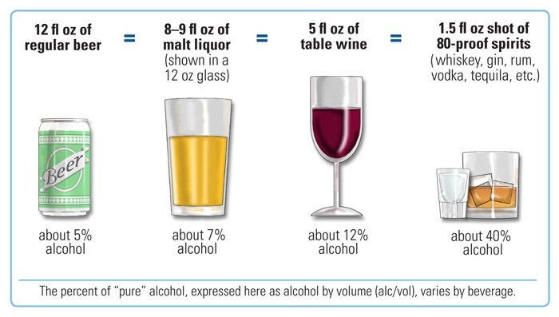
When Screening, It’s Useful To Clarify What One Drink Is!
Recommended Limits
Men = 2 drinks per day/14 per week
Women/anyone 65+ = 1 drink per day or 7 drinks per week
Binge drinking
≥5 for men or ≥4 for women/anyone 65+

Slide 37
AUDIT Questionnaire
The World Health Organization (WHO) developed the Alcohol Use Disorders Identification Test (AUDIT) in 1989 as a simple method of screening for hazardous and harmful drinking.
The AUDIT was recently adapted for use in the United States (Centers for Disease Control and Prevention [CDC], 2014)
The purpose of the USAUDIT is to identify individuals with risky patterns of alcohol consumption, as defined by the U.S. standard drink (14 grams) and recommended drinking limits (National Institute on Alcohol Abuse and Alcoholism [NIAAA], 2007), and those who may have an alcohol use disorder (AUD), according to the International Classification of Mental and Behavioral Diseases – Tenth Revision (ICD-10; WHO, 1993) and the Diagnostic and Statistical Manual of Mental Disorders – Fifth Edition(DSM-5; American Psychiatric Association [APA], 2013).

Slide 38
USAUDIT Questions | 0 | 1 | 2 | 3 | 4 | 5 | 6 | Score
1. How often do you have a drink containing alcohol? | Never | Less than monthly | Monthly | Weekly | 2-3 times a week | 4-6 times a week | Daily
2. How many drinks containing alcohol do you have on a typical day when you are drinking? | 1 drink | 2 drinks | 3 drinks | 4 drinks | 5-6 drinks | 7-9 drinks | 10 or more drinks
3. How often do you have X (5 for men; 4 for women & men over the age of 65) or more drinks on one occasion? | Never | Less than monthly | Monthly | Weekly | 2-3 times a week | 4-6 times a week | Daily
4. How often during the past year have you found that you were not able to stop drinking once you had started? | Never | Less than monthly | Monthly | Weekly | Daily or almost daily
5. How often during the past year have you failed to do what was normally expected of you because of drinking? | Never | Less than monthly | Monthly | Weekly | Daily or almost daily
How often during the past year have you needed a first drink in the morning to get yourself going after a heavy drinking session? | Never | Less than monthly | Monthly | Weekly | Daily or almost daily
How often during the past year have you had a feeling of guilt or remorse after drinking? | Never | Less than monthly | Monthly | Weekly | Daily or almost daily
How often during the past year have you been unable to remember what happened the night before because of your drinking? | Never | Less than monthly | Monthly | Weekly | Daily or almost daily
Have you or someone else been injured because of your drinking? | No |  | Yes, but not in the past year |  | Yes, during the past year
Has a relative, friend, doctor, or other health care worker been concerned about your drinking or suggested you cut down? | No |  | Yes, but not in the past year |  | Yes, during the past year
Total In Each Column:
Total Score:

Slide 39
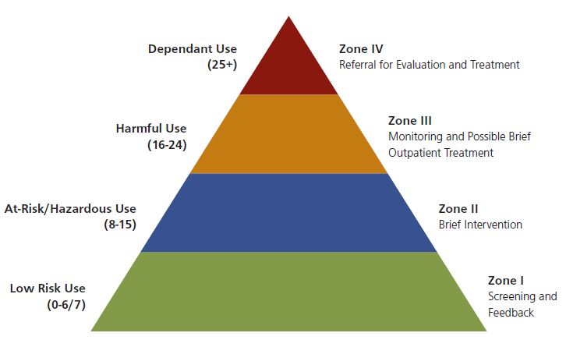
AUDIT Scoring
Scoring the AUDIT: Use the number at the top of the column (0-6) to total the individual’s score. For each item selected assign it the necessary points (from the top column) and total those for the final score.
Column 1 responses = 0 points each, column 2 responses = 1 point each, column 3 = 2 points, column 4 = 3 points, column 5 = 4 points, column 6 = 5 points
Notes:
The red part of the pyramid requires a referral to substance abuse treatment

Slide 40
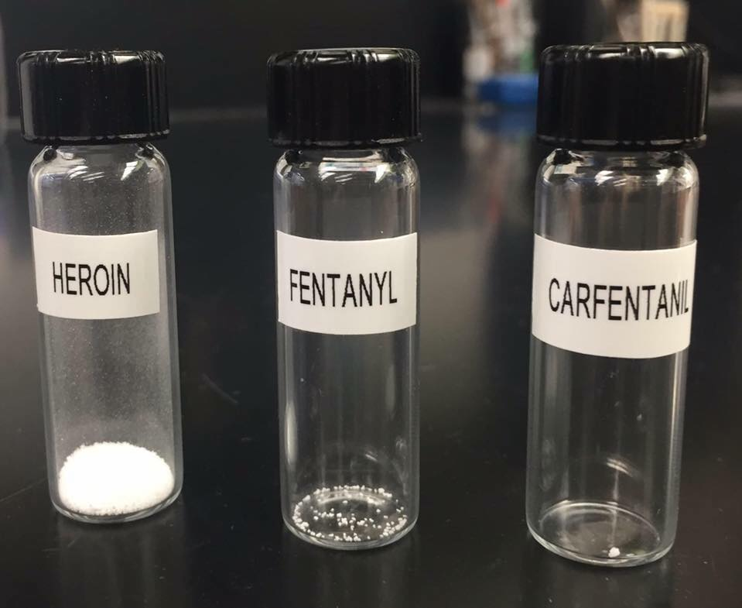
Common Prescription Drug Misused
Opioids: Substance that act on the nervous system. (Ex. morphine, tramadol, oxycodone, hydrocodone, methadone, fentanyl)
Benzodiazepines: Sedative, anxiolytic, or anticonvulsant medications. (Ex. Valium, Xanax, Klonopin)
Stimulants: Psychoactive drugs to improve mental or physical functions (Ex. Ritalin, Concerta, amphetamine, dextroamphetamine, methylphenidate
Sleep aids (zolpidem, zaleplon, eszopicione)
Other assorted including clonidine (sedative), carisoprodol (muscle relaxant), & Neurontin (gabapentin).
CDC 2015

Slide 41
DAST(10) Questionnaire
In the past 12 months: | Circle Response
1. Have you used drugs other than those required for medical reasons? | Yes | No
2. Do you abuse more than one drug at a time? | Yes | No
3. Are you always able to stop using drugs when you want to? | Yes | No
4. Have you had “blackouts” or “flashbacks” as a result of your drug use? | Yes | No
5. Do you ever feel bad or guilty about your drug use? | Yes | No
6. Does your spouse/partner/parents/ friends ever complain about your involvement with drugs? | Yes | No
7. Have you neglected your family because of your use of drugs? | Yes | No
8. Have you engaged in illegal activities in order to obtain drugs? | Yes | No
9. Have you ever experienced withdrawal symptoms (felt sick) when you stopped taking drugs? | Yes | No
10. Have you had medical problems as a result of your drug use (e.g., memory loss, hepatitis, convulsions, bleeding, infection, etc.)? | Yes | No
Shortened version of DAST 28, containing 10 items, completed as self-report or via interview.
Screening questions for at-risk drug use
Developed by Addiction Research Foundation, now the Center for Addiction and Mental Health
Yields a quantitative index of problems related to drug misuse
Strength: Sensitive screening tool for at-risk drug use
Weakness: Does not include alcohol use
  Drug abuse refers to (1) the use of prescribed or “over-the-counter” drugs in excess of the directions, and (2) any non-medical use of drugs. Consider the past year (12 months) and carefully read each statement.

Slide 42
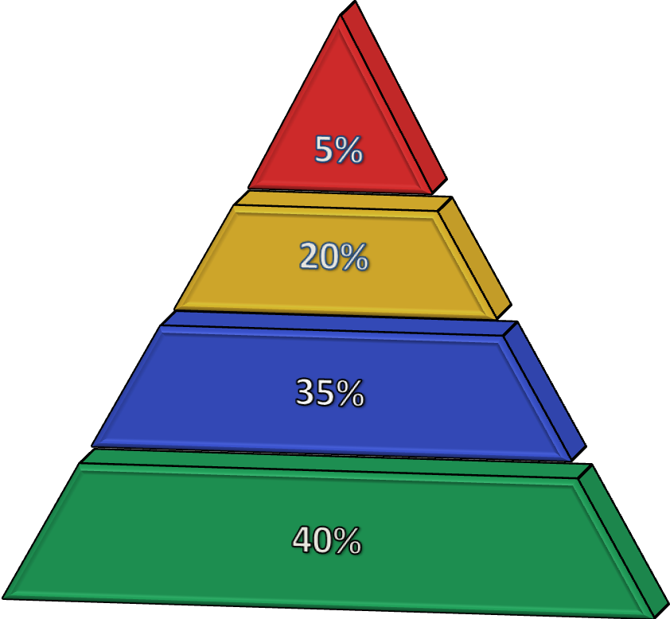
DAST(10) Scoring
Score 1 point for each questions answered “yes,” except for question 3, for which “no” receives 1 point.
Score | Degree of Problems Related to Drug Abuse | Suggested Action
0 | No problems reported | None at this time
1-2 | Low level | Monitor, re-assess at a later date
3-5 | Moderate level | Further investigation - referral
6-8 | Substantial level | Intensive assessment -referral
9-10 | Severe level | Intensive assessment - referral
High/Severe Risk (6+)
Harmful/Risky Use (3‒5)
Hazardous/At-Risk Use (1‒2)
Abstinent/Low Risk (0)
Yudko et al., 2007

Slide 43
CRAFFT (<21 Alcohol & Drug Screen)
CRAFFT is a mnemonic acronym of first letters of key words in the six screening questions. The questions should be asked exactly as written. The first 3 questions are considered the pre-screen.
Questions | Circle Below
1. Drink any alcohol (more than a few sips)? (Do not count sips of alcohol taken during family or religious events. | Yes | No
2. Smoke any marijuana or hashish? | Yes | No
3. Use anything else to get high? (“anything else” includes illegal drugs, over the counter and prescription drugs, and things that you sniff or “huff”) | Yes | No
If yes, to any above continue below. If no, only ask number 4.
4. Have you ever ridden in a CAR driven by someone (including yourself) who was “high” or had been using alcohol or drugs? | Yes | No
5. Do you ever use alcohol or drugs to RELAX, feel better about yourself, or fit in? | Yes | No
6. Do you ever use alcohol or drugs while you are by yourself, or ALONE? | Yes | No
7. Do you ever FORGET things you did while using alcohol or drugs? | Yes | No
8. Do your FAMILY or FRIENDS ever tell you that you should cut down on your drinking or drug use? | Yes | No
9. Have you ever gotten into TROUBLE while you were using alcohol or drugs? | Yes | No
SCORING INSTRUCTIONS:
Each “yes” response in Part B scores 1 point.
A total score of 2 or higher is a positive screen, indicating a need for additional assessment.

Slide 44
Mental Health Screening Tools
Screen for Depression & Anxiety as potential co-occurring disorders

Slide 45
PHQ-9
Patient Health Questionnaire
9-item
Over the past 2 weeks, how often have you been bothered by any of the following problems? | Not at all | Several Days | More Than Half the Days | Nearly Every Day
Little interest or pleasure in doing things. | 0 | 1 | 2 | 3
2. Feeling down, depressed or hopeless. | 0 | 1 | 2 | 3
3. Trouble falling asleep, staying asleep, or sleeping too much. | 0 | 1 | 2 | 3
4. Feeling tired or having little energy. | 0 | 1 | 2 | 3
5. Poor appetite or overeating. | 0 | 1 | 2 | 3
6. Feeling bad about yourself – or that you’re a failure or have let yourself or your family down. | 0 | 1 | 2 | 3
7. Trouble concentrating on things, such as reading the newspaper or watching television. | 0 | 1 | 2 | 3
8. Moving slowly or speaking slowly that other people could have noticed. Or, the opposite – being so fidgety or restless that you have been moving around a lot more than usual. | 0 | 1 | 2 | 3
9. Thoughts that you would be better off dead or of hurting yourself in some way. | 0 | 1 | 2 | 3
Total In Each Column:
Add up each column. Total:
10. If you checked off any problems, how difficult have those problems made it for you to do your work, take care of things at home, or get along with other people? Not difficult at all Somewhat difficult Very difficult Extremely difficult
Brief evidence-based screening instrument for depression.
Only certified and/or licensed mental health clinicians can diagnose an individual with depression.
Use this scale, like others as a tool for intervention.
  Remember it is always a good idea to refer to behavioral health care expert when you identify high risk behavior.

Slide 46
GAD-7
Generalized Anxiety Disorder 7-item
Over the past 2 weeks, how often have you been bothered by any of the following problems? | Not at all | Several Days | Over Half the Days | Nearly Every Day
Felling nervous, anxious, or on edge. | 0 | 1 | 2 | 3
2. Not being able to stop or control worrying. | 0 | 1 | 2 | 3
3. Worrying too much about different things. | 0 | 1 | 2 | 3
4. Trouble relaxing. | 0 | 1 | 2 | 3
5. Being so restless that it’s hard to sit still. | 0 | 1 | 2 | 3
6. Becoming easily annoyed or irritable. | 0 | 1 | 2 | 3
7. Feeling afraid as if something awful might happen. | 0 | 1 | 2 | 3
Total In Each Column:
Add up each column. Total:
8. If you checked off any problems, how difficult have these made it for you to do your work, take care of things at home, or get along with other people? Not difficult at all Somewhat difficult Very difficult Extremely difficult
Brief evidence-based screening instrument for anxiety.
Only certified and/or licensed mental health clinicians can diagnose an individual with anxiety.
Use this scale, like others as a tool for intervention.
  Remember it is always a good idea to refer to behavioral health care expert when you identify high risk behavior.

Slide 47

Key Points for Screening
Screen everyone.
  Don’t pre-screen if you are seeing someone who you know is in active addiction. Rather assess for overall use to make referral source or intervention decisions (depending on profession).
Prescreening can be included in another health and wellness survey.
  Could be built into Home Care screening procedures or outpatient intake screens
Screen for both alcohol and drug use including prescription drug abuse and tobacco.
  Remember: People may not thinking they are taking prescriptions drugs incorrectly (too many or crushing).
  Sharing is common in this community and in Appalachian culture (they mean well).
Explore each substance; many patients use more than one.
Use a validated tool (AUDIT, DAST, CRAFFT)
Follow up positives or "red flags" by assessing details and consequences of use.
Use your MI skills and show nonjudgmental, empathic verbal and nonverbal behaviors during screening.
Adapted from SBIRT Curriculum

Slide 48
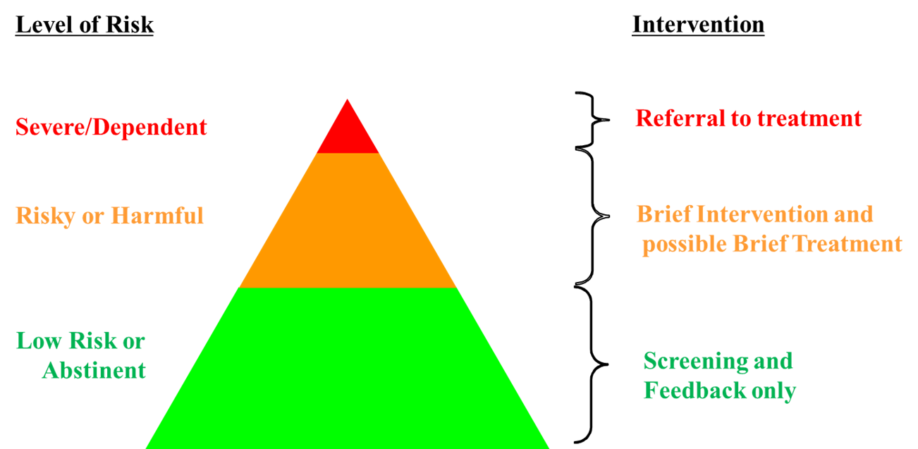
Screening: Summary
Screening is the first step of the SBIRT process and determines the severity and risk level of the client/patient’s substance use.
The result of a screen allows the provider to determine if a brief intervention (reduce risk- top of green/bottom range of orange in diagram below) or referral to treatment (top range of orange/red in diagram below) is the necessary next step.

Slide 49
Where Do We Go From Here?
Screen
AUDIT/DAST/CRAFFT
Abstinence/Low Risk
AUDIT (<7), DAST (<2)
Affirm/ ReScreen in Future
Positivity
High Risk Use
AUDIT (20-40), DAST (6+)
Req. Referral to Treatment
Detox/SA treatment
Moderate Risk Use
AUDIT (8-19), DAST (3-5)
Brief Negotiated Interview
Reduce Risk
May Refer to Treatment
Therapy/Treatment
Brief Negotiated Interview
Motivate into Treatment
Pre-Screen
Brief Question
Next training is on the Motivational Interviewing skills necessary to conduct a Brief Negotiated Interview (BNI)
Adapted from SBIRT Curriculum

Slide 50

Questions?

Slide 51
Motivational Interviewing Skills
Learning the necessary basic skills and techniques from the evidence-based practice of Motivational Interviewing in order to apply them to clients/patients in the next step of SBIRT (Brief Intervention).

Slide 52

Why Should We Be Interested in a Client’s Motivation for Behavior Change?
Adapted from SBIRT Curriculum
Notes:
Ask the class for reasons

Slide 53

Where Do You Meet Someone?
Notes:
Stages of change allow us to know where to meet out client/patient. Without them we will make assumptions about how motivated or un-motivated the client is.

Slide 54
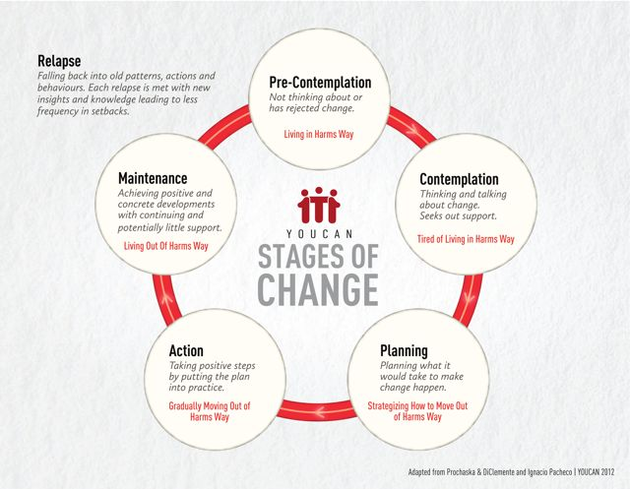
Stages of Change

Slide 55
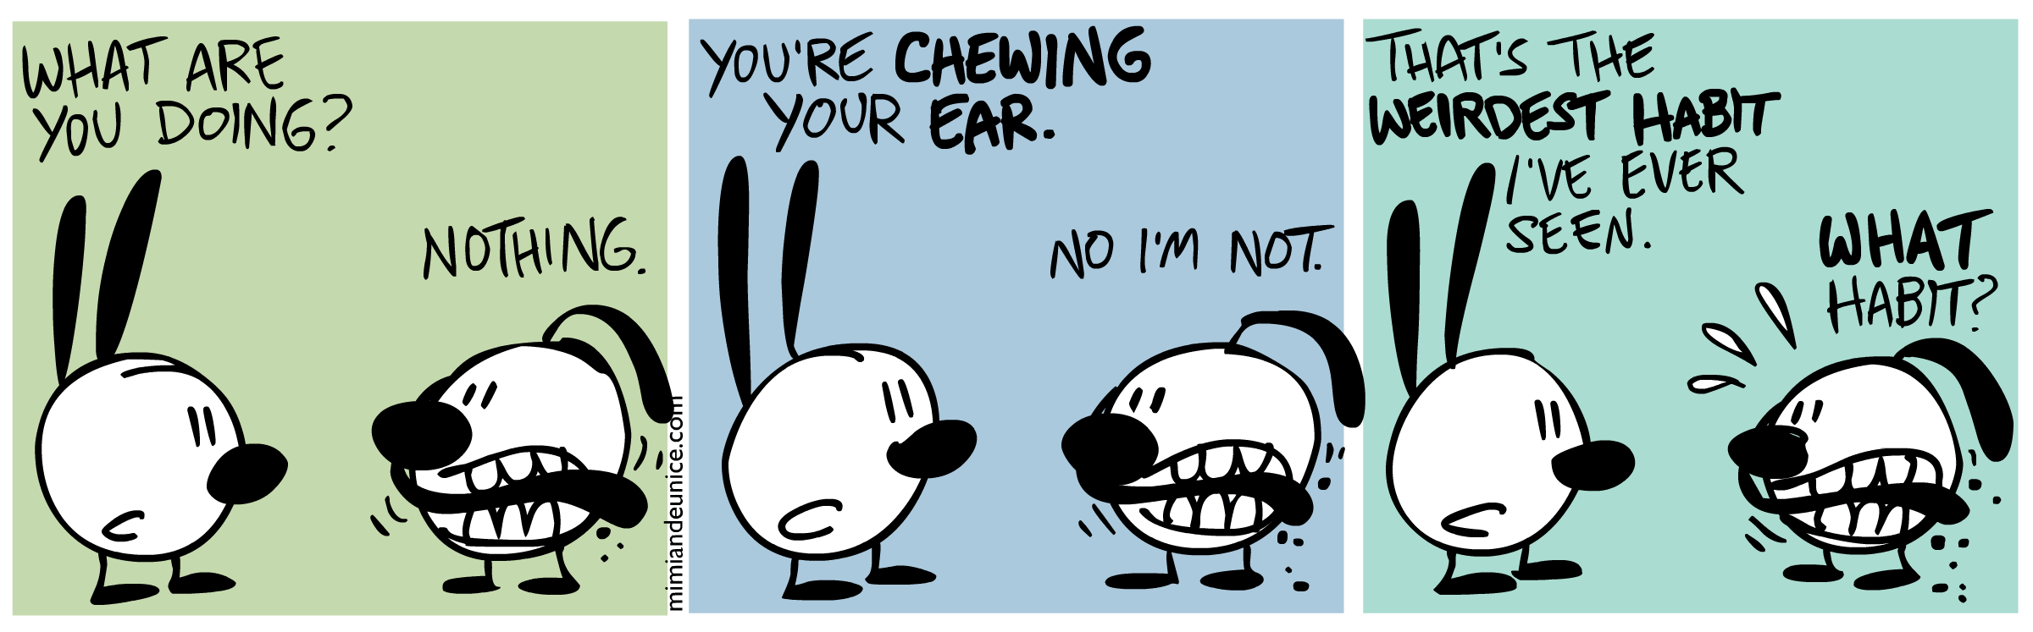
1. Precontemplation
Unaware that their behavior is problematic
Not planning on making a change in the foreseeable future (next 6 months)
Interventions
  Education, pros-cons of change
    Normally they underestimate the pros and overestimate the cons
  Encourage intentionality and mindful decision making
  Highlight “stuckness,” negative emotions, and benefits of change
(Prochaska & DiClemente, 1984; Prochaska & Velicer, 1997)
Notes:
“I don’t have a problem with alcohol. Everyone I’m around drinks the same amount. We’re in college! That’s what we’re meant to do!”

Slide 56
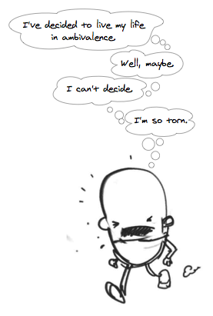
2. Contemplation
Starting to consider making a change in the next 6 months
Greater awareness about the pros and cons of change
  However, the pros and cons appear about equal to them
  This is defined as ambivalence (“yes but…”)
Interventions:
  Reduce the cons of changing behavior
  Highlight the positives of change – long term
  Watch for “stuckness”
  Focus on “tipping the scales”
This stage is a perfect intervention stage
(Prochaska & DiClemente, 1984)

Slide 57
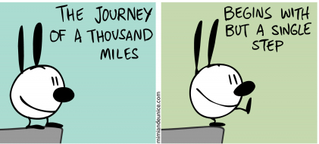
3. Preparation
Pre-action stage (ie. getting ready to change)
Many people rush through this stage or minimize it
Preparation is key because people need to imagine what change looks like and how his/her life will be impacted.
  “What do you need?”
  “How will you do it?’
  “What else should be considered?”
  “What is it going to look like?”
Interventions:
  focus on gathering information
  developing strategies & plans for change
  discussing the impact of the change, setting a date, informing others, behavior-contracting
  building on self-efficacy
Number 1 concern: “What happens if I fail?”
(Prochaska & DiClemente, 1984; Prochaska & Velicer, 1997)

Slide 58

4. Action
People are “in action”- Change is being made and has been made within the past 6 months.
Focus on strengthening the individual's commitment to change and reinforce the positive changes.
Interventions:
  Provide support
  Teaching techniques for maintaining change
  Sticking with something even when it’s hard
  Normalizing difficulty with change or feeling uncomfortable with change
  Supplementing other activities
  Self-rewarding activities as changes are made and maintained
  Avoiding negative people, places, and things
  Re-negotiate areas when the individual is continuing to struggle
(Prochaska & DiClemente, 1984; Prochaska & Velicer, 1997)

Slide 59


5. Maintenance
People have made a change more than 6 months ago
Promote awareness about potentially tempting situation – stress, anniversaries
Interventions:
  Help someone identify who can support them and who will continue to provide support and trust
  Engage in healthy behaviors and continue to grow habit/hobby/skill list
  Avoid temptation
  Consistently review progress
  Anticipate relapse
(Prochaska & DiClemente, 1984; Prochaska & Velicer, 1997)

Slide 60
Relapse
Precontemptation
Contemplation
Preparation
Action
Maintenance
Relapse
Relapse is not inevitable however it may be an important step or process for someone to learn from and grow from.
  We wear a seatbelt not because we expect to crash but we should be prepared if it were to happen.
Not all relapses are treated equal.
  Lapse vs. Relapse
They should be planned for but not expected or required.
Relapse can happen at or during any stage.
It is not a stage of change.
(Prochaska & DiClemente, 1984; Prochaska & Velicer, 1997)
Notes:
The different between a lapse and a relapse can be described as the difference between eating a piece of cake and eating the whole cake when on a diet. This is important because it is common for someone struggling with addiction to believe that if they mess up they should just throw in the towel and give up everything. This is dangerous because it can lead to a fatal OD and it’s a very negative way of thinking. Preparing someone for that time is an important conversation whether or not it should ever occur.

Slide 61
Why do the Stages of Change Matter?
Understand why someone is acting the way they are
Normalizes resistance, ambivalence, and “stuckness”
Interventions should be stage appropriate
Change is most successful when it moves through the stages
Gives you a step by step path/plan using MI tools
(Prochaska & DiClemente, 1984; Prochaska & Velicer, 1997)

Slide 62

What are Some Reasons People Change?
?
?
?
?
?
Adapted from SBIRT Curriculum

Slide 63
What are Some Reasons People Don’t Change?
?
?
?
?
?
Adapted from SBIRT Curriculum

Slide 64
Change
What are Some Reasons People
Cite for Changing?
What are Some Reasons People Cite for NOT Changing?
Sick and tired of being sick and tired
For their family, kids, partner
Want a new future
Medical or health reasons
Improved life conditions
Don’t know how
Don’t have the resources
Don’t know who to ask
Scared
Fear of failure
Adapted from SBIRT Curriculum

Slide 65
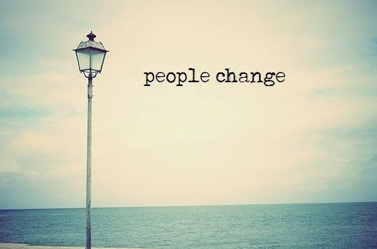
Only when they …
  become Interested and Concerned about the need for change
  become Convinced change is in best interest or will benefit them more than cost them
  organize Plan of Action that they are Committed to implementing
  Take the Actions necessary to make and sustain the change

Slide 66

What is Motivational Interviewing
A collaborative conversation style for strengthening a person’s own motivation and commitment to change.
“Motivational interviewing is a client-centered, directive method for enhancing intrinsic motivation to change by exploring and resolving ambivalence.”

Slide 67
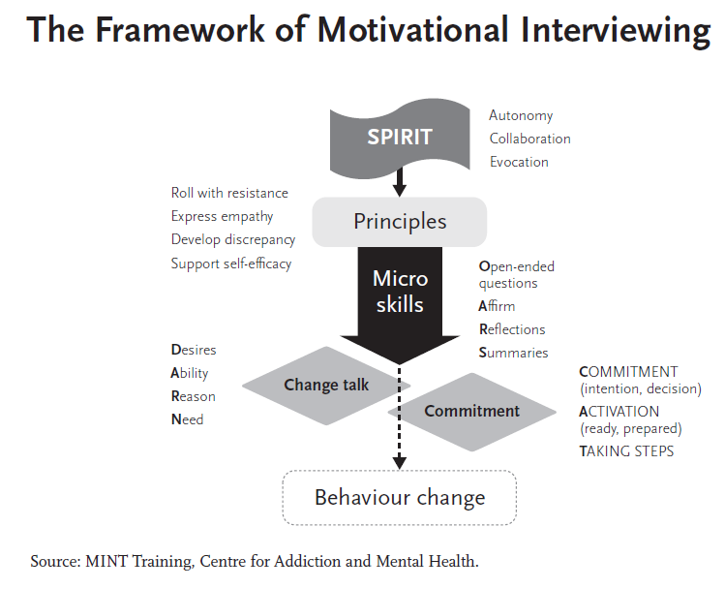

Slide 68
3 Communications Style
Direct
Guide
Follow
Observe
Lead
Tell
Encourage
Support
Permit

Slide 69
Exercise 1
Think of something that you’ve been thinking about changing or recognize that you should make a change.
Turn to a partner and tell them this thing
“Helper” please give them a list of reasons they should change
  Emphasize the importance of changing
  Tell them how to do it
  Assure them that they could and should do it
  And encourage them to get on with it
How did this feel?

Slide 70
Exercise 2
Now try again, again tell your partner what you’d like to change.
But now “helper” ask the following questions and listen closely for the answers.
  What would you want to make this change?
  How might you go about it in order to succeed?
  What are the three best reasons for you to do it?
  How important is it for you to make this change, and why?
“Helper” summarize what they said to you.
Now “helper” ask the following…
  So what do you think you will do?

Slide 71
Feedback
How were these two experiences different?
Who would you rather spent time working with in either role?
Note you are the same people in each experiences but the conversation changed… not the person.

Slide 72
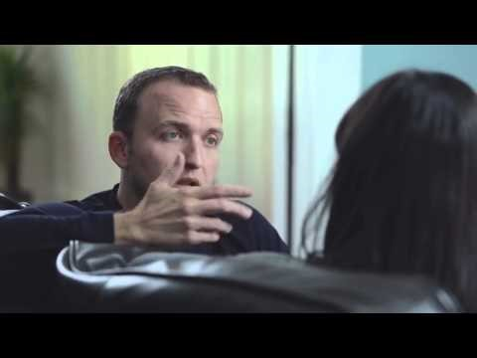
Notes:
The video demonstrates a comical way of moving from not listening towards using motivational interviewing skills of reflection

Slide 73
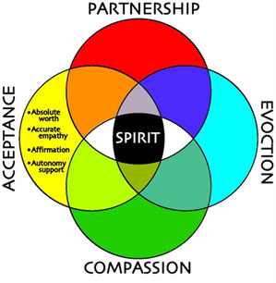
The “Spirt” of MI
Partnership/Collaboration | Patient/Client is the expert. Developing a partnership in which the patient’s expertise, perspectives, and input are central to the consultation.
Evocation | Motivation is enhanced by eliciting and drawing on the patient’s own perceptions, experiences, and goals. Use open-ended questions.
Acceptance (“autonomy”) | The person has the potential to move in the direction of health.
Compassion | Belief and commitment to act in the best interests of the patient.
https://youtu.be/eaD_Py5ZYQE
Miller & Rollnick

Slide 74
Four Processes of MI
Engaging
Focusing
Evoking
Planning
Shall we travel together
Where are we going?
Why travel?
How and When?

Slide 75

Engaging
Engagement is the thermometer for the likelihood of change
People are drawn to things that feel safe, useful, helpful, and hopeful

Slide 76
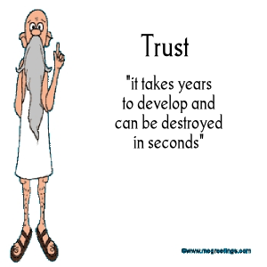
Engagement Process
The minute you enter into an interaction with someone the engagement process has started.
  This includes walking into the room.
  The space in which you meet with the person.
  “First impressions.”
People are looking to see if they can trust you AND decide what they’ll share and whether or not they’ll come back to talk to you.
Engagement is a necessity.

Slide 77
5 Key Principles to Build Engagement
Principle | Key Points
Express empathy | All behavior serves a purpose Ambivalence is normal Reflective listening is fundamental
Develop Discrepancy | Awareness of consequences Discrepancy between present behavior and future goals Client driven
Avoid Argumentation | Counterproductive Breeds defensiveness Resistance is a signal to change your strategy Labeling is unnecessary
Roll with Resistance | Perceptions can be shifted Gives you information Invite new ideas – don’t impose Client holds the key to change
Support Self-Efficacy | Belief in the individual Responsible for choosing their path and creating change Hope in future alternatives
Miller & Rollnick

Slide 78
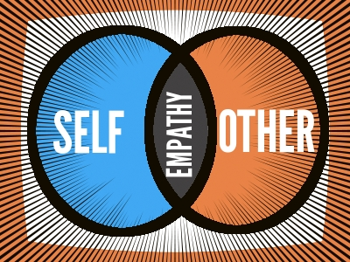
Express Empathy
Why is empathy important in MI?
Communicates acceptance, which facilitates change
Encourages a collaborative alliance, which also promotes change
Leads to an understanding of each person’s unique perspective, feelings, and values, which make up the material we need to facilitate change
Tips…
Good eye contact
Responsive facial expression
Body orientation
Verbal and nonverbal “encouragers”
Reflective listening/asking clarifying questions
Avoid expressing doubt/passing judgment

Slide 79


Develop Discrepancy
Current behavior versus future goals
Example: “Sometimes when you drink during the week, you can’t get out of bed to get to work. Last month, you missed 5 days. But you enjoy your work, and doing well in your job is very important to you.”

Slide 80
Practice
Identify points of discrepancy in this statement. How could you respond?
  “Most people I know drink more than me so I don’t know why I’m the one that got in trouble. It could have been anyone I live with but I was the scapegoat because I was outside near the street. I never thought I’d get in trouble and be on probation. This is ruining so plans for the semester, and it was awful having to call my parents because now they don’t trust me.”
Notes:
“It sounds like you want to have fun with your friends but getting in trouble wasn’t worth it.”
“It sounds like you didn’t think you were doing anything wrong but you’re regretting getting in trouble and disappointing your parents.”

Slide 81

Avoid Argumentation
Arguing with someone causes defensiveness.
They already have heard the arguments and have prepared a response.
  “Yeah but...”
You cannot win… nor is that the goal.
  You want to support their self-efficacy and remain client/patient-centered.

Slide 82

Roll With Resistance
Examples
Patient: I don’t plan to quit drinking anytime soon.
Clinician: You don’t think that abstinence would work for you right now.
Or
Patient: My husband is always nagging me about my drinking—always calling me an alcoholic. It really bugs me.
Clinician: It sounds like he really cares about you and is concerned, although he expresses it in a way that makes you angry.
Roll with Resistance:
https://youtu.be/ef9kPpZGJX8

Slide 83
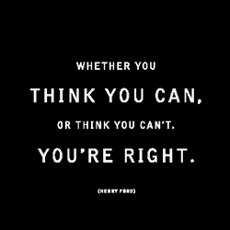
Support Self-Efficacy
Patients are responsible for choosing and carrying out actions to change.
They may not be ready or willing to change right now and you cannot force them.
Return to basic engagement.

Slide 84
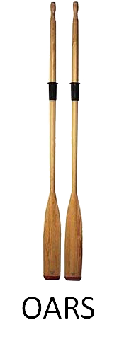
OARS
Open-ended questions
  Enables the patient to convey more information
  Encourages engagement
  Opens the door for exploration
Affirmations
  Statements acknowledging the patient’s strengths and efforts
  Conveys belief in the patient’s ability to make desired changes
Reflections
  Involves listening and understanding the meaning of what the patient says
  Accurate empathy is a predictor of behavior change
Summaries
  Periodically summarize what has occurred in the conversation
  Conveys that the patient is being heard

Slide 85

Ask Open Questions
Avoids the question-answer trap.
Do not listen to reply… listen to understand!
Helps explore the individual rather than you deciding what is important
  What brings you here today?
  What concerns you the most?
  How have you been doing since the last time I saw you?
  Tell me more about…?

Slide 86
Practice
Turning this close ended question into an open-ended question.
Close Ended: Do you want to change your drinking?
How do you want to change your drinking?
Why might you want to make changes to your drinking habits?
Tell me about your drinking habits?
What are you thoughts about making changes to your drinking?

Slide 87
2. Affirming
To recognize and acknowledge that which is good, including the individual’s worth as a human being. It is supportive & encouraging. It overlaps with empathy.
  MUST BE DONE SINCERELY
“You did this…” rather than “I am proud of you for…”
  Focus on the individual not yourself or the “thing/reason”
  It is is not the same as praise
  Affirmations can reframe imperfection, doubt, or apparent failure
  Affirmations can relate to specific behaviors
  Emphasize something relevant to your work with them
Examples:
  “You really tried hard this week!”
  “Even though it didn’t turn out exactly as you hoped, look at what you were able to accomplish!”
  “You were really discouraged, but you hung in there. Awesome!”
  “Listening to all you’ve been through, I’m not sure I could’ve come out as well as you did. You are a survivor.”
  “You’re the kind of person that puts a lot of thought into something”
Affirmations:
https://youtu.be/tbQlCrVMpew

Slide 88

Activity
Mining for Affirmations
Notes:
Think of the worst person you know… serial killer for example or historical figure and com up with positive statements about them (suggest avoiding current politics)

Slide 89
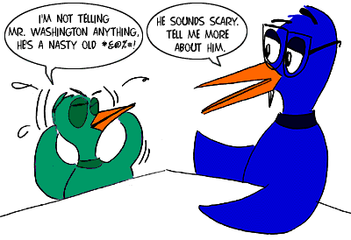
3. Reflections & Reflective Listening
Make a statement about what the person has said to you.
“Reflective listening is a way of checking rather than assuming that you know what is meant.”
Simple restatement of their words
Restatement with different words
A metaphor
Making a guess at the implied meaning
(Miller and Rollnick, 2002)

Slide 90
Examples of Reflections
Simple Reflection —stays close to what you heard - restates
  Example
    Patient: I hear what you are saying about my drinking, but I don’t think it’s such a big deal.
    Clinician: So, at this moment you are not too concerned about your drinking.
Complex Reflection —makes a hypothesis or moves towards more meaning
  Paraphrasing—major restatement, infers meaning, “continuing the paragraph”
  Examples:
    Content: You see a connection between your drug use and the possibility of going back to jail.
    Feeling: You are worried that if you continue to use you might end up back in jail.
    Meaning: You children are important to you and you want to be there for them.
Reflections:
https://youtu.be/kDd0cG19krU
Notes:
Another complex reflection example
Patient: “I just don’t want to take pills. I ought to be able to handle this on my own.”
Clinician: “You don’t want to rely on a drug. It seems to you like a crutch.”

Slide 91
Examples of Reflections
  Basic Style: Opening + Feeling + About/Because/When + Thought
  Clinician: “It sounds like… you feel afraid to make a change… because you have failed before.”
  Clinician: “I think I hear you saying… you feel ashamed… to tell your family you have a problem.’
  Clinician: “I’m not sure I am understanding… you are worried… you’ll be lonely if you stop drinking.”
  ************
  Patient: My wife decided not to come today. She says this is my problem, and I need to solve it or find a new wife. After all these years of my using around her, now she wants immediate change and doesn’t want to help me!
  Clinician: Her choosing not to attend today’s meeting was a big disappointment for you.

Slide 92
How could you reflect the following?
“But I can’t quit!! I mean, all of my friends get high.”

Slide 93
“But I can’t quit!! I mean, all of my friends get high.”
Simple: “Quitting seems difficult because you spend a lot of time with people who smoke”
Amplified: “There’s NO WAY you can quit because you’d lose ALL your friends”
Double-sided: “You can’t imagine how you could be around your friends and not get high but at the same time you’re worried about the consequences of your use.”
Shifting Focus: “I don’t want to get stuck on the act of quitting right now; lets focus on talking through the issues and we can decide what to do about it later.”
Reframe: “It’s important that your friends are protected while you figure out your thoughts about using.”
Agree with a Twist: “You are feeling like quitting brings with it big personal risks and yet you're still trying to figure out some possible solutions.”
Coming Alongside: “Quitting your use comes with too big of a lost to your social life. It just don’t feel worth it right now.”

Slide 94

4. Summarizing
Collecting – bring together interrelated statements
Linking – connect to something said before
Transitional – highlight important details and move towards something new
Examples:
  “So, let me see if I’ve got this right…”
  “So, you’re saying… is that correct”
  “Make sure I’m understanding exactly what you’ve been trying to tell me…”

Slide 95
5. Informing & Advising
MI providers should not offer unsolicited expert opinions in a highly directive style.
  They should also only offer advice with permission or when the client asks for it.
  Must understand the client’s perspective and needs and make sure your shared information is relevant.
The client is always free to reject, implement or not, and heed or not the advice.
3 forms of permission:
  Person asks for permission or advice
  You ask permission to give it
  Offer permission for disagreement
What is an example of offering a statement someone can disagree with?

Slide 96
These core skills do not in themselves constitute MI. They are essentially prerequisite skills for the proficient practice of MI. What characterizes MI is the particular way in which these skills are used strategically to help people more in the direction of change.

Slide 97

Notes:
https://www.youtube.com/watch?v=80XyNE89eCs

Slide 98
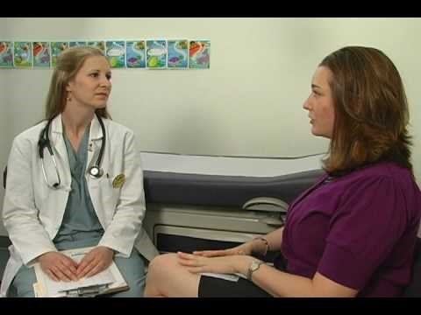
Motivational Interviewing
Notes:
https://www.youtube.com/watch?v=URiKA7CKtfc

Slide 99
Four Processes of MI
Engaging
Focusing
Evoking
Planning
Shall we travel together
Where are we going?
Why travel?
How and When?

Slide 100

Focusing
Use open ended questions and reflections to identify the person’s concerns
You may have your own agenda, some of which may overlap with the client but it might not.
  Share your concerns with permission
One or more change goals may appear
Micro vs. Macro goals
  Short term vs. long term

Slide 101
Focusing Questions
What do they want out of this conversation?
What concerns do they have?
What are their goals for change?
Do I have a clear sense of where we’re going?
Do they have a clear sense of where we’re going?
How can we maintain a clear focus on this throughout the conversation?

Slide 102
Agenda Mapping
?
?
?
?
?
?
Examining a map at the beginning of the journey.
Keep it hypothetical – “might or could”
List all possible concerns and barriers
Write it down
  Zoom in and out on different topics to understand their perspective

Slide 103
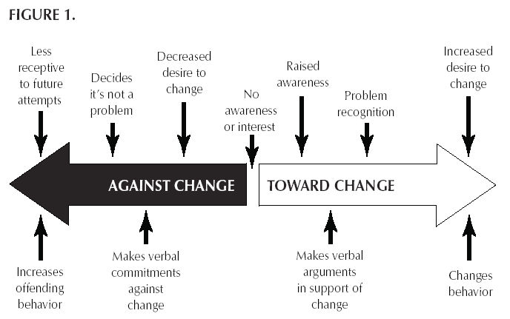
Core Motivational Interviewing Skills
Change talk is any self-expressed language that is an argument for change.
You can elicit change talk by using Strategic Questions.

Slide 104

Preparatory Change Talk
- pro-change side of ambivalence
DARN
Desire (I want to change) | “I want to lose some weight.” “I hope to get better grades.”
Ability (I can change) | “I can…” “I am able to…” “I would be able to figure that out.”
Reason (It’s important to change) | “I would probably have more energy.” “I might sleep better at night.” “I want to be around to see my grandkids.”
Need (I should change) | “I need to…” “I have to…” “I must…” “I’ve got to …”

Slide 105

Mobilizing Change Talk
- movement towards resolution
CAT
Commitment (I will make changes) | To say that one must, can, wants to, or has good reasons to change is not to say that one will. Committing language signals the likelihood of action. “I want to” “I could.” “I have good reasons to.”
Activation (I am ready, prepared, willing to change) | Indicate movement towards action but not yet commitment to do so. “I am willing to…” “I am ready to…”
Taking Steps (I am taking specific actions to change) | Already done something in the direction of change. “I bought some running shoes so I can exercise.” “This week I didn’t snack in the evening.” “I finished my CV.”

Slide 106
I swear…
I want to.
I could.
I have good reason to.
I need to.
I will.
Notes:
Ask each class member to say one of the above statements when you say a statement. So assign the above phrases before you say one of the following and then repeat your phrase to each volunteer and have them respond. Then ask which statement they want to hear… different between sustain… preparatory… mobilizing… and commitment change talk.
“I swear to tell the whole truth and nothing but the truth…. “ “I want to”
“I swear to tell the whole truth and nothing but the truth…. “ “I could”
“I swear to tell the whole truth and nothing but the truth…. “ “I have good reason to”
“I swear to tell the whole truth and nothing but the truth…. “ “I need to”
“I swear to tell the whole truth and nothing but the truth…. “ “I will”
Or…
“I do solemnly swear to cherish you from this day forward till death do us part….” “I want to…”
…

Slide 107
Using Reflects to Promote Change
“I really don’t want to stop smoking [sustain talk], but I know that I should [change talk]. I’ve tried before and it’s really hard [sustain talk].”
Which should you reflect:
  You really don’t want to quit.
  It’s pretty clear to you that you ought to quit.
  You’re not sure if you can quit.
Notes:
It’s pretty clear to you that you ought to quit.

Slide 108
Four Processes of MI
Engaging
Focusing
Evoking
Planning
Shall we travel together
Where are we going?
Why travel?
How and When?

Slide 109
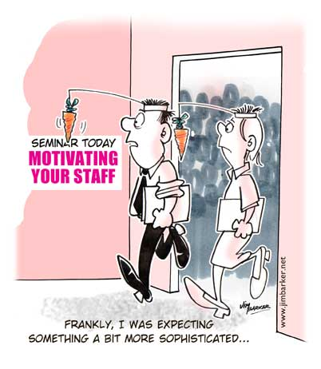
Evoke Motivation

Slide 110
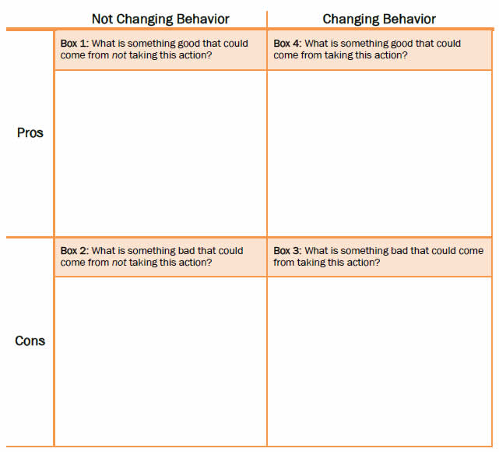
Decisional Balance
Highlights pros and cons of change
Acknowledges and validates ambivalence
Building understanding, empathy, and contributes to the working alliance
Helps move someone towards change talk
Develops discrepancy between where they are now and where they’d like to be.

Slide 111
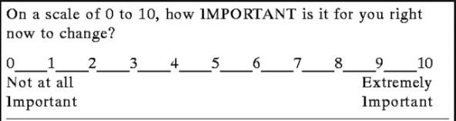
Use Importance Ruler
“How important is it for you to…?”
“On a scale from 0-10, where 0 means ‘not at all important’ and 10 means ‘the most important thing for me right now,’ how important would you say it is for you to…?”
“Wow, you’re a 2 and not a 0! That’s awesome; Why is that?”
What would it look like to be a 10 rather than a 9?
What would it take to move to you to a 3 (from a 2)?
How could we work together to make you more confident?
What might make this more important?
What do you need to feel more ready?
Do not ask “why are you a 3 and not an 8?”
https://www.youtube.com/watch?v=Ng_N__iciJM

Slide 112
Move From Evoke to Planning
The client will tell you when they’re ready to move stages.
Still using MI – don’t suddenly become directive or the expert.
Notice the following signs:
  Increased change talk
  Taking steps
  Diminished sustain talk
  Resolve
  Envisioning
  Questions about change

Slide 113
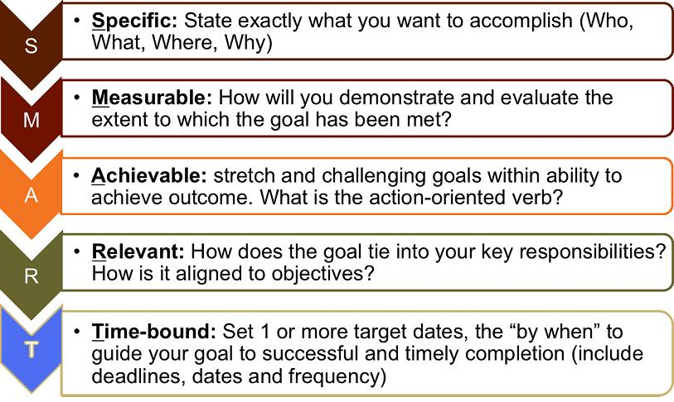
Change Plan

Slide 114
Post-Screening – Time to “Do Something”
Screen
AUDIT/DAST/CRAFFT
Abstinence/Low Risk
AUDIT (<7), DAST (<2)
Affirm/ ReScreen in Future
Positivity
High Risk Use
AUDIT (20-40), DAST (6+)
Req. Referral to Treatment
Detox/SA treatment
Moderate Risk Use
AUDIT (8-19), DAST (3-5)
Brief Negotiated Interview
Reduce Risk
May Refer to Treatment
Therapy/Treatment
Brief Negotiated Interview
Motivate into Treatment

Slide 115
Questions?

Slide 116
Brief Negotiated Interview & Referral to Treatment
Applying the steps from MI to an evidence-based brief intervention to motivate the client to risk-reducing behaviors or treatment.

Slide 117
What Is a Brief Intervention (BI)?
Brief Intervention is a brief motivational and awareness-raising intervention given to risky or problematic substance users.
  There are several models for brief intervention, including the Brief Negotiated Interview
  The BNI is a semi-structured interview process based on MI that is a proven evidence-based practice and can be completed in 5−15 minutes.
(Gail D’Onofrio, M.D., Ed Bernstein, M.D., Judith Bernstein, M.S.N., Ph.D., & Steven Rollnick, Ph.D.) Special acknowledgement is made to Drs. Stephen Rollnick, Gail D’Onofrio, and Ed Bernstein for granting permission to orient participants to the “brief negotiated interview.”

Slide 118

Steps in the BNI
The BNI is built on 4 main steps:
Build Rapport—Raise the Subject.
  Explore the pros and cons of use (decisional balance from MI)
Provide feedback.
Build readiness to change.
Negotiate a plan for change.

Slide 119
SBIRT Brief Intervention
Notes:
https://youtu.be/JUbIrcLY6hc

Slide 120
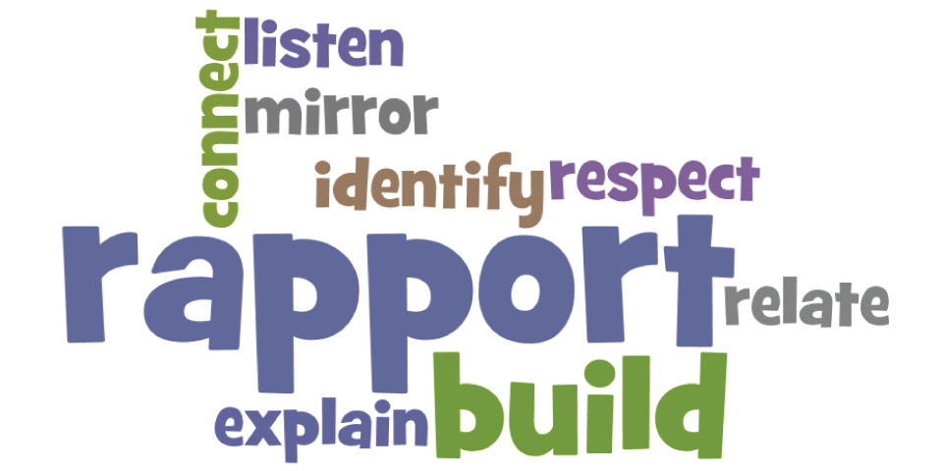
1. Build Rapport—Raise the Subject
Begin with a general conversation.
Ask permission to talk to them about their alcohol or drug use.
What if the patient does not want to talk about his or her use? Many people are reluctant or caught off guard.
  Focus on building the relationships or paving the way for future conversations or interventions.
  Normalize the conversation.
  Discuss the Pros and Cons of Use: “Help me understand through your eyes…”
    What are the good things about using alcohol?
    What are some of the not-so-good things about using alcohol?

Slide 121
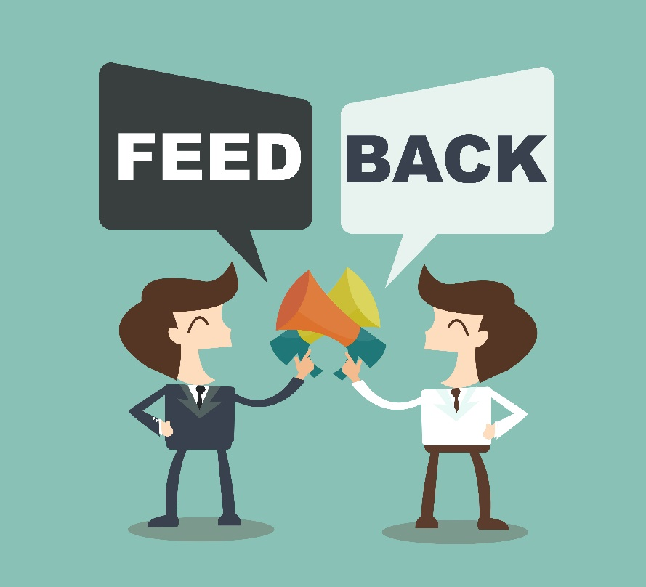
2. Provide Feedback
Ask permission to give information.
  Educational info
  De-normalize their use
  They may be unaware
Discuss screening findings.
Link substance use behaviors to any known consequences.
  Legal, social, relational, emotional, financial…
Evoke a response:
  Positive reaction—move forward
  Negative reaction—revisit the pros and cons
    Do not become defensive

Slide 122

Discuss the Pros and Cons of Use—Applying MI
Using open-ended questions
  Enables the patient to convey more information
  Encourages engagement
  Opens the door for exploration
Using reflections
  Reflective listening
  Thinking reflectively
Summarizing
  Reinforces what has been said
  Shows careful listening

Slide 123

3. Build Readiness To Change
Use scaling questions
  Could we talk for a few minutes about your interest in making a change?
  On a scale from 0 to 10, 0 being not important at all and 10 being incredibly important, how important is it for you to make any changes in your substance use?

Slide 124
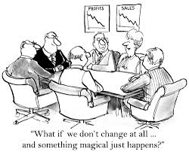
4. Negotiate a Plan for Change
A plan for reducing use to low-risk levels
OR
An agreement to follow up with specialty treatment services

Slide 125
Change Plan
Summarize the change plan
  Consolidate a specific plan and offer a clear summary of it.
  “What will be your first step?”
Troubleshooting
  “What might go wrong?”
  If the client is raising the problems and you’re providing the answers, you’re in the wrong chair.”
Make it Specific
  Set times
  Set dates
  Involve people
Support Persistence
  Prepare for set backs, difficult times, and lack of forward progress. The term relapse is a pejorative label implying that there are only 2 possible states: perfection or relapse.
  Normalize set backs
Re-planning
  Identify the issue or concern and develop a new change plan to address that area.
Remind
  Revisit with the individual their decisions and evoke their motivation.

Slide 126
Video 3
Example Interviews:
Video 1
Video 2
http://www.ed.bmc.org/sbirt/media/doctor_b.html
Using SBIRT Effectively (Doctor B)
This case example demonstrates an ideal SBIRT Brief Negotiated Interview between an emergency department (ED) doctor and a patient. The patient is in the ED for car accident injuries related to his own drunk driving. The doctor has a respectful, nonjudgmental conversation with him to explore the possibility of changing his alcohol use and/or seeking treatment.
http://www.ed.bmc.org/sbirt/media/doctor_a.html
Anti-SBIRT (Doctor A)
This case example demonstrates how ineffective a conversation with a patient can be when the health care provider judges the patient, tells him what to do, and loses his temper.
This increases the patient’s defensiveness and “resistance”, making him less likely to listen and trust the provider’s feedback. It might make the patient just as likely to repeat the harmful behaviors that required emergency care.
The interaction might have gone more smoothly, and the provider might have been more influential, if he had used SBIRT techniques.
http://www.ed.bmc.org/sbirt/media/case1.html
SBIRT for alcohol use: college student.
The patient is in the hospital for a head injury related to falling down while intoxicated. The health care provider has a respectful, nonjudgmental conversation with her to explore the possibility of changing her drinking behavior (cutting back on quantity and frequency).
SBIRT for alcohol use: college student. (2011). United States: Boston University School of Public Health BNI Art Institute. Retrieved from http://www.youtube.com/watch?v=SvqjTOnp_SM
Notes:
Inform students that they will now have an opportunity to view videos demonstrating a health care worker conducting a brief intervention with a patient.
Ask them as they watch to note anything that the health care worker did with the patient that was effective or not effective.
SBIRT for alcohol use: college student. (2011). United States: Boston University School of Public Health BNI Art Institute. Retrieved from http://www.youtube.com/watch?v=SvqjTOnp_SM

Slide 127

Referral to Treatment
Referral

Slide 128
Overview
It is well established that substance abuse treatment can be effective!
Following are strategies to realize the greatest likelihood of a successful treatment referral.

Slide 129
What Is Treatment?
Treatment may include:
Substance abuse treatment is provided at different levels of care and is often available in multiple treatment settings.
The level of care is determined by severity of problem and use.
  It is most important to find out: Is the client a dependent or nondependent substance abuser, and are there medical or psychiatric co-occurring disorders?
Inpatient treatment is reserved for those with more serious use (dependence, comorbidity) or those requiring detox.
Client-centered
Counseling, therapy, and other psychological rehabilitation services
Medications: psychiatric for co-occurring disorders (in conjunction with talk-therapy) or Drug agonist (Buprenorphine) antagonist (naltrexone) therapy
Self-Help or Support Groups(AA, NA,
Al-Anon)
Health & wellness coaching (diet, exercise, meditation)
Combinations of the above

Slide 130
Continuum Of Care:
Intensity Spectrum of Services
Early Intervention
Outpatient Services
Residential Services
Hospitalization
Access through needle exchange, primary care, judicial system, etc.
Screening
Referral
Daily, Weekly, Monthly
Psychiatric services
Indvidual, Family, or Group therapy
Community Based
12 Step Meetings
Support Groups
Day Programs
Co-Occuring treatment
Short Term (28 days, 90 days, 3-6 months)
Long Term (6-12 months)
Population Specific
Faith-based
Medication management
Detox
Stabilization
Medication-assisted
Health Promotion & Prevention
Healthy communities
Wellness plans
Education

Slide 131
Detox?
Clinical Findings: To qualify, patient must meet the diagnostic criteria for a DSM Axis I or ICD-9 Substance Dependence diagnosis. Must have one of the following:
  1. Nature and pattern of use of abused substance (including frequency and duration) predicts the potential for clinically significant withdrawal necessitating 24-hour medical intervention to prevent complications and that is not appropriate for a lower level of care- e.g. alcohol and benzodiazepine withdrawal (note: withdrawal from stimulants or marijuana alone generally does not require a medical detoxification and opiate detoxification is often appropriate for a lower level of care).
  2. Presence of active withdrawal symptoms that can not be safely or effectively managed at a lower level of care-e.g. tremors, unstable vital signs, diaphoresis, GI disturbances, agitation, withdrawal hallucinations, confusion or disorientation or seizures.
Note: Patients who experience severe psychological withdrawal symptoms may require 24-hour care, even though they do not meet the detoxification criteria. Please refer to rehabilitation and psychiatric criteria.

Slide 132
What Is a Warm-Handoff Referral?
The “warm-handoff referral” is the action by which the clinician directly introduces the patient to the treatment provider at the time of the patient’s medical visit. The reasons behind the warm-handoff referral are to establish an initial direct contact between the patient and the treatment counselor and to confer the trust and rapport. Evidence strongly indicates that warm handoffs are dramatically more successful than passive referrals.

Slide 133
VA Information
VaAware – Data, Services and Other Resource
  www.VaAware.org
VDH Opioid Dashboard
  http://www.vdh.virginia.gov/data/opioidoverdose/
Virginia Department of Health Opioid website
  http://www.vdh.virginia.gov/commissioner/opioidaddiction-in-virginia/

Slide 134


VA Specific Resources
http://curbthecrisis.com/
http://dbhds.virginia.gov/behavioral-health/substance-abuse-services/revive

Slide 135

Treatment Locations http://curbthecrisis.com/treatment/

Slide 136



National Referral Resources
SAMHSA’s National Treatment Facility Locator http://findtreatment.samhsa.gov

Slide 137

Questions?

Slide 138
Contact Us
Marshall University SBIRT
Lyn O’Connell - oconnelll@marshall.edu
304-691-1197
Follow us - www.facebook.com/MUSBIRT

Slide 139
Resources
SAMSHA: http://www.samhsa.gov/sbirt
The Association for Medical Education and Research in Substance Abuse https://amersa.org/
American Society of Addiction Medicine http://www.asam.org/
National Institute of Alcohol Abuse and Alcoholism http://www.niaaa.nih.gov/
Missouri SBIRT resources : https://adept.missouri.edu/Portals/0/MU-ADEPT_AdvancedTrainingResources.heatherATTC12.pdf
Yale School of Medicine http://medicine.yale.edu/sbirt/curriculum/
Baylor SBIRT medical residency training: https://www.bcm.edu/education/programs/sbirt/index.cfm?PMID=0
Rhode Island Hospital training: http://www.rhodeislandhospital.org/sbirt.html

Slide 140
Video Resources
Yale training videos: http://medicine.yale.edu/sbirt/curriculum/video/
Missouri training videos: https://adept.missouri.edu/Resources.aspx
MD online module for faculty: http://www.sbirt.umaryland.edu/Medical-Faculty-Supervision-Training/Online-Module-for-Faculty/
MD residency training videos: http://www.sbirt.umaryland.edu/Medical-Residency-Training-Program/MD3-Training-Videos/
CO SBIRT channel: https://www.youtube.com/channel/UCCB4xnHTyWMRT_HFJhO0BAQ
IRETA channel: https://www.youtube.com/playlist?list=PLiML4AFpuB71TAqFWZga6XFuf7j8LLSGp
Baylor Med training: https://www.bcm.edu/education/programs/sbirt/online

