Slide 1
Mindfulness for Physician Wellness
Leah S. Cobb Snodgrass, MD
Chair and Associate Professor, Behavioral Health
LMU DCOM

Slide 2
Objectives
Define physician burnout.
Describe personal and professional sequelae of physician burnout.
Identify factors contributing to physician burnout and those contributing to physician engagement.
Define mindfulness and its benefits for practice of medicine.
Learn 5 time-efficient user-friendly strategies to increase mindfulness and physician well-being.
Review app and online based mindfulness resources.

Slide 3

What goes through your mind in the moment before you walk into the room to see your next patient? A flurry of thoughts about all the patients you’ve seen already? Or the mountain of administrative tasks you need to finish later today?

Slide 4

But what if…you paused – for just a few seconds – as you touch the doorknob, took a deep breath to be present and let go of all that has gone before and all that is ahead of you?

Slide 5
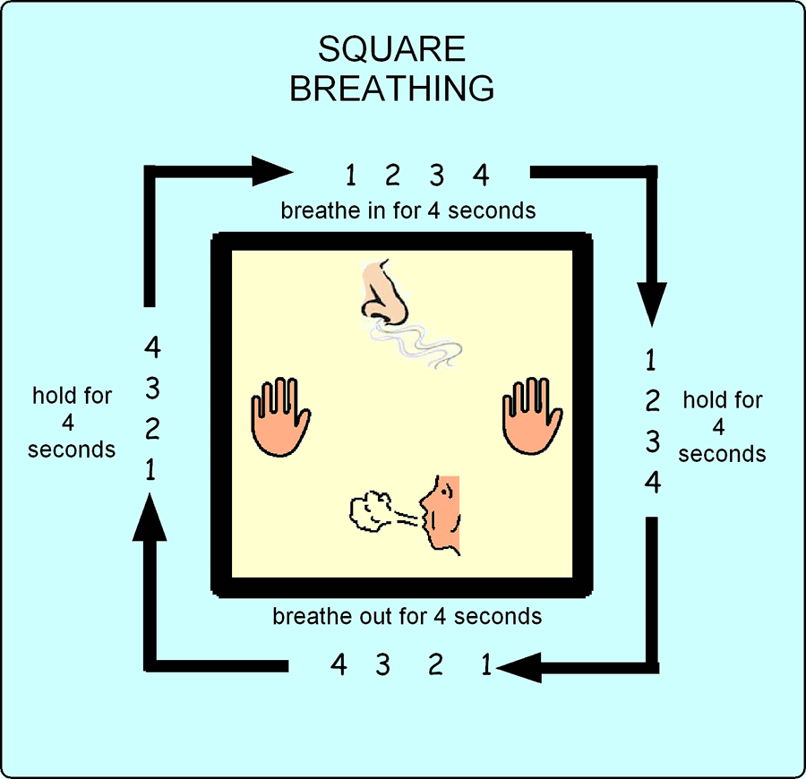
Square Breathing: A technique you can use anytime, anywhere…
Image from Gov’t of Ontario

Slide 6
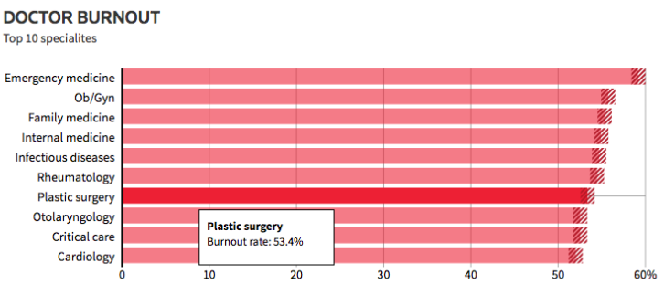
Why are we talking about mindfulness and physician wellness?¹
Physicians experience the highest rate of burnout in healthcare fields
Highest risk: primary care with greatest risk in ER, OB-GYN, Family and Internal Medicine
1:3 physicians are in burnout at any given time
~60% of all physicians report burnout symptoms at some point in their medical education/practice
Nearly half of all third year medical students report burnout; strong associations between burnout and suicidal ideation
Every year 400 U.S. physicians commit suicide
Notes:
1.41 x higher risk than general population in male doctors; 2.27 x higher risk than gen pop for female doctors.

Slide 7
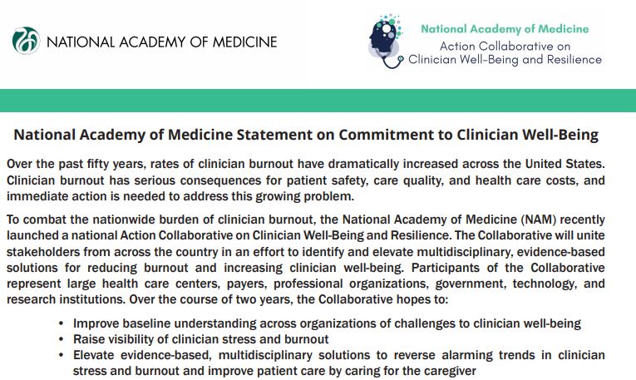
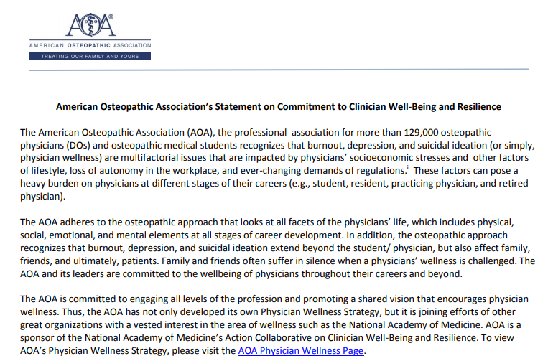
Multiple organizations have committed to physician well-being and resilience

Slide 8

What is physician burnout?^{2,5}
Exhaustion: feeling of not being able to offer any more of oneself at work; a consequence of prolonged exposure to excessive demands.
Cynicism: a negative, calloused, or detached attitude toward tasks, colleagues, and patients (treating people as if they are objects aka depersonalization)
Inefficacy: feeling of inadequate, incompetent performance; lack of productivity; inability to cope with everyday situations; decreased achievement; a sense that work is no longer meaningful

Slide 9
Physician burnout is linked to: ^{2,6}
Professionally
Personally
Patient dissatisfaction
Increased medical errors
Lawsuits
Compassion fatigue
Early attrition/retirement from practice
Substance abuse
MVAs
Stress-related health issues
Divorce

Slide 10
Contributors to physician burnout: ^{3,4,5,7}
High demand but low supply of primary care providers
Expanding geriatric population
Low medical student interest in primary care
Lower primary care reimbursement
Loss of autonomy
Loss of control over practice environment***
Increasing workload compounded by inefficient use of time
Increased clerical burden due to EMR, meaningful use requirements
Alienation in increasingly bureaucratized medical system
High debt incurrence
Physician lack of attention to self-wellness
Lack of work-life balance
Notes:
***Single most powerful predictor of burnout – associated with anxiety, reduced motivation, reduced persistence, impaired decision making, increased sense of helplessness
Lack of work-life balance starts early in medical training: many sacrifice personal wellness and personal life thinking they will have a balanced life AFTER all their training is completed. But when that time comes, they have not been taught the skills to actually achieve this. (5)

Slide 11
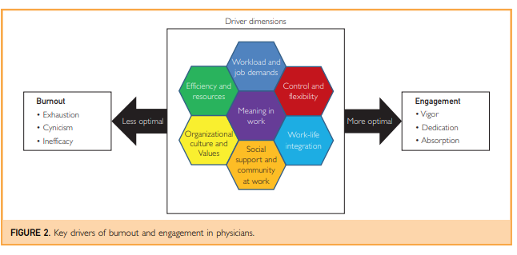
What drives physician burnout vs. physician engagement?¹⁵
Notes:
Engagement: ENERGY, INVOLVEMENT, EFFICACY
Mayo Clinic Proceedings
Volume 92, Issue 1, January 2017, Pages 129-146
https://doi.org/10.1016/j.mayocp.2016.10.004

Slide 12
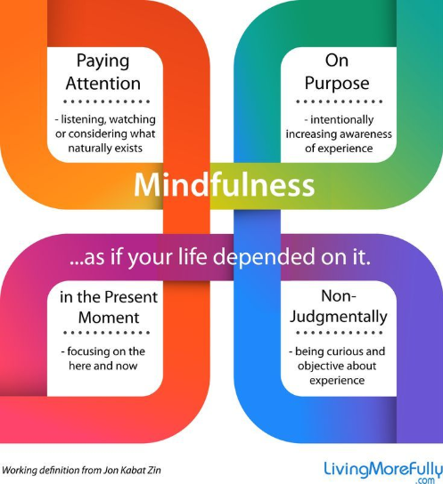
What does the evidence show works to reduce burnout and increase engagement/resilience?

Slide 13

Notes:
https://youtu.be/oqWIqRwCzJA
MBSR Umass Medical School

Slide 14
Mindful Practice^{9,10}
Attending in a nonjudgmental way to our physical and mental processes during ordinary, everyday tasks
Critical self reflection enabling physician to listen attentively, recognize errors, refine technical skills, make evidence based decisions, clarify values
Mindfulness is:
  a link between relationship-centered care and evidence based medicine
  A characteristic of good medical practice
Mindful physicians act with:
  Compassion
  Competence
  Presence
  Insight

Slide 15

Mindful Practice¹⁴
Curiosity instead of premature closure
Presence rather than detachment
Helpful when dealing with difficult patients/families or challenging clinical situations
Allows physician to recognize need for self- care/ self-compassion

Slide 16
What’s in it for me?
Doctors trained in mindfulness exhibit: ^{9,10}
  Attentiveness, curiosity, presence, and the ability to adopt multiple perspectives simultaneously – all qualities that promote greater awareness of self an others
  Lower reactivity and enhanced responsiveness to stressful situations
  Freed attention allowing focus on patient’s concerns and consider variety of explanations in complex situations
  Increased compassion, empathy
  Increased warmth, acceptance, and positive regard in session

Slide 17
What’s in it for me?¹³
Doctors trained in mindfulness exhibit:
  Increased sense of well being
  Increased resilience
  Increased engagement (energy, involvement, efficacy)
  Increased self-compassion
  Lower rates of burnout (exhaustion, cynicism, inefficacy)
  Lower rates of depression, anxiety, stress, emotional exhaustion

Slide 18
What’s in it for my patients?^{7,8}
Patients of doctors trained in mindfulness demonstrate:⁷
  Increased patient centered interaction
  Higher patient satisfaction ratings
  Increased rapport building from patient perspective
  Better communication about patient psychosocial issues
    More positive emotional atmosphere within clinical encounter
Physicians who are more resilient and who cope better with stress are rated more positively overall by their patients. ⁸
Notes:
Doctors with burnout are 2x more likely to involved in patient safety incidents, 2x more likely to deliver suboptimal care due to low professionalism, and 3x more likely to receive low patient satisfaction ratings.

Slide 19
“What if I am too busy to practice meditation?”
Mindfulness is NOT necessarily meditation.
Meditation is one mindfulness based intervention.
Physicians who only devoted 10 minutes per day to Mindfulness Based Interventions (MBIs) were able to achieve significant improvements in self and patient care.⁸

Slide 20
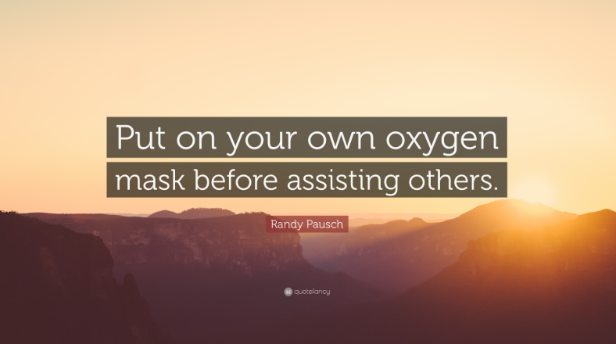
How do I get started?
Techniques you can learn and start using TODAY:
  Square breathing technique
  STOP technique¹⁶
  Sitting meditation¹⁶
  Daily mindful activity¹²
  Mindful stretch¹²

Slide 21
Square Breathing: A technique you can use anytime, anywhere…
Image from Gov’t of Ontario

Slide 22

S.T.O.P. ONE MINUTE BREATHING SPACE
S – Stop and take Stock.
T – Take a breath.
O – Open and Observe.
P – Proceed/new Possibilities

Slide 23
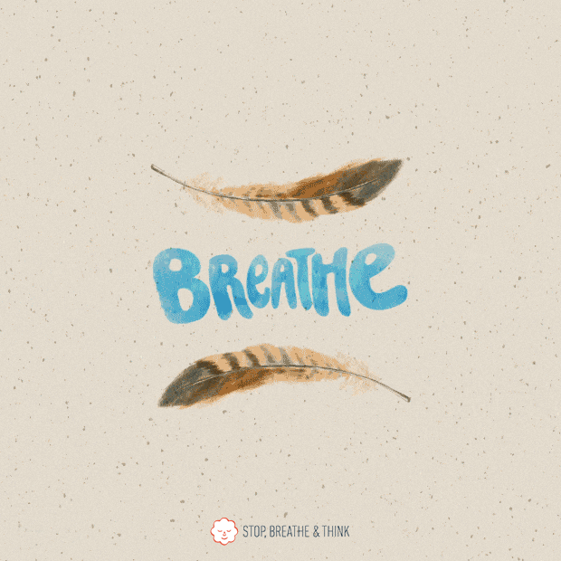
S.T.O.P. Technique
Stop
Take a Breath
Stop and take stock.
  Bring yourself into present moment and check present thoughts, feelings, sensations
  Acknowledge and register your experience, even if it is uncomfortable
Notes:
Gently direct full attention to breathing, to each in breath and to each outbreath as they follow, one after the other.
Your breath can function as an anchor to bring you into the present and help you tune into a state of awareness and stillness.

Slide 24
S.T.O.P. Technique
Open and observe.
Proceed to new possibilities
Expand awareness outward around and beyond your breathing, so that it includes a sense of the body as a whole, your posture, and facial expression, then further outward to what is happening around you: sights, sounds, smells, etc.
Let your attention now move into the world around you, sensing how things are right now. Rather than react habitually/mechanically, you can be curious/open, responding naturally. You may even be surprised by what happens next after having created this pause…

Slide 25

Sitting Meditation

Slide 26
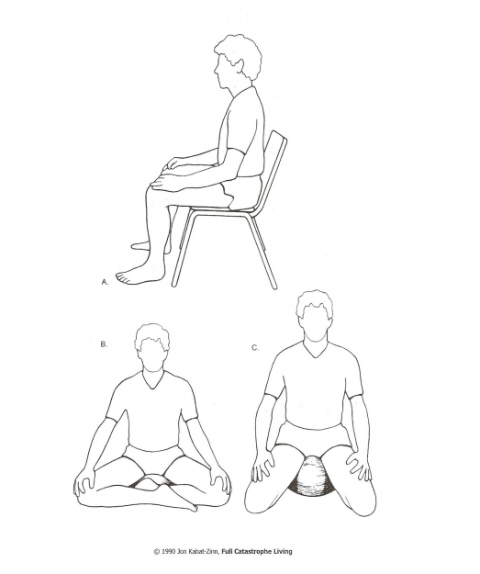
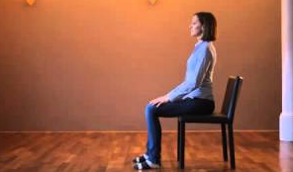
Sitting Meditation

Slide 27
Daily mindful activities
Notes:
https://youtu.be/L-IZArfQHOo
Easy Mindfulness Exercises

Slide 28
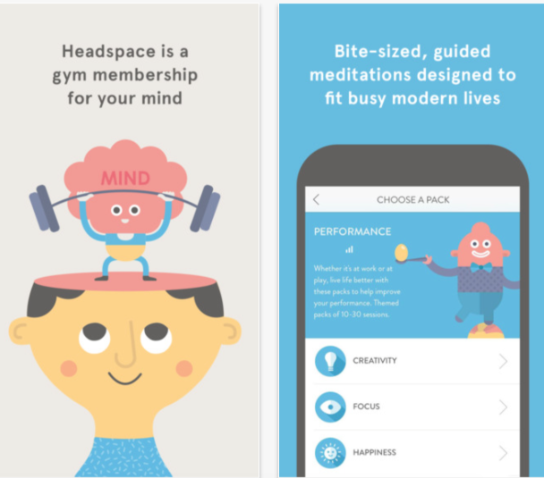
How can I bring mindfulness into my daily routine?¹⁷
“Headspace” app for for mindfulness and guided imagery meditation
“Calm” app for mindfulness, guided imagery meditation

Slide 29

Mindful breathe and stretch

Slide 30
Resource: Palouse Mindfulness¹⁶
FREE Online course
Can be done alone or in small group (weekly accountability)
Each week comprised of:
  Videos: 2-4 brief and user friendly
  Readings: Four readings per week, 2-4 pages
  Formal Practice log (engage in technique at least 6 times during the week)
  Informal Practice log (a mindfulness based cognitive strategy chart or additional practice technique with situational context)
  Supplementary/optional readings
On line teacher is University of Massachusetts MBSR certified with many years of experience.
Wanted to make course widely available to those who could not afford otherwise

Slide 31

Resource: SuperBetter App¹⁸
“SuperBetter” gaming app for resiliency:¹⁸
  Gaming system to accomplish epic missions, epic wins and engage in “quests” (physical activity), “Power Ups” (feel good activities), “Allies” (those invited to help on journey toward better emotional, physical, mental health).
  Score for resilience tallied – as score increases on this game, carries over to an increase in better emotional, psychological, physical health in real life.
  “Playing SuperBetter for 30 days improves mood, reduces symptoms of anxiety and depression and increases belief in ability to successfully achieve goals.” Results form a randomized controlled study conducted by University of Pennsylvania

Slide 32
“That which we practice grows stronger!” ~Shauna Shapiro, PhD
Practice mindful attention to the present.
Practice awareness.
Practice self-compassion.
Practice resilience.
Practice gratitude for the honor and privilege of being a physician.

Slide 33
“Mindfulness may be an important pathway to a more humanistic, effective, and satisfying practice of medicine. The highly reciprocal influence of patients and physicians on one another is in itself a powerful and positive medical tool – perhaps in some situations more powerful than other interventions that can be offered to patients. In an era in which many physicians suffer from professional burnout, mindful practice may be the way in which physicians not only heal themselves but heal their patients as well.”¹¹

Slide 34
Notes:
https://youtu.be/wyj8l9miy4w
Headspace Letting Go of Effort

Slide 35
Thank you for your time and attention!
Leah S. Cobb Snodgrass, MD
leah.snodgrass@lmunet.edu
Office: 423-869-6468

Slide 36
Sources
1. Krasner, M.S. et.al. (2009) Association of an educational program in mindful communication with burnout, empathy, and attitudes among primary care physicians. JAMA.302:12.
2. Montero-Marin, J, et.al. (2015) Mindfulness, resilience, and burnout subtypes in primary care physicians: The possible mediating role of positive and negative affect. Front. Psych.6:1895..
3. Shanafelt, T.D.(2009) Enhancing meaning in work: A prescription for preventing burnout and promoting patient centered care. JAMA. 302:12.
4. Fortney, L. et.al. (2013) Abbreviated mindfulness intervention for job satisfaction, quality of life, and compassion in primary care clinicians: A pilot study. Ann. Fam. Med. 11:5.
5. Callahan, K. et.al. (2018) Battling burnout: Strategies for promoting physician wellness. Adv. In Ped. 65:1-17.
6. Panagioti, M. et.al. (2018) Association between physician burnout and patient safety, professionalism, and patient satisfaction. JAMA Int. Med. Published online Sept. 4, 2018.

Slide 37
Sources
7. Southwick, F.S.(2018) The loss of sense of control as major contributor to physician burnout: A neuropsychiatric pathway to prevention and recovery. JAMA Psych. 75:7
8. Schroeder, D.A. et. Al. (2016) A brief mindfulness-based intervention for primary care physicians: A pilot randomized controlled trial. American Journal of Lifestyle Medicine. 12:1.
9. Epstein, R. (1999) Mindful practice. JAMA. 282:9.
10. Ludwig, D.S., Kabat-Zinn, J. (2008) Mindfulness in medicine. JAMA. 300:11.
11. Beach, M.C. et. Al. (2013) A multicenter study of physician mindfulness and health care quality. Ann. Fam. Med. 11:5.
12. Manotas, M. (2015, June 30). Brief mindfulness exercises for the busy physician. Retrieved from https://hr.ucsf.edu/hr.php?A=2869&AT=cm&org=c&sref=5.

Slide 38
Sources
13. Irving, J.A. et al. (2012) Experience of health care professionals enrolled in mindfulness-based medical practice: a grounded theory model.
14. Epstein, R. (2014) Mindful Practice. In (Feldman, M.D., et al. Eds.), Behavioral Medicine: A Guide for Clinical Practice. New York, N.Y. McGraw Hill.
15. Mayo Clinic Proceedings Volume 92, Issue 1, January 2017, Pages 129-146
https://doi.org/10.1016/j.mayocp.2016.10.004
16. Potter. D., Online Mindfulness Based Stress Reduction Course. Retrieved from: https://palousemindfulness.com/ (Accessed March-October, 2018).
17. Ayala, E. and Olson, D. ‘Stress Reduction and Mindfulness in Medical School: Yes, It’s Worth It.’ (2018) http://in-training.org/stress-reduction-mindfulness-medical-school-yes-worth-10474 (Accesed 7 April, 2018)
18. “SuperBetter: Game Your Way to a Healthier Lifestyle”. https://youtu.be/3-1PSE6g2WQ

