Slide 1
Aortoenteric Fistula:
A rare but serious cause of upper GI bleeding
Trenton Keel, DO
Adam Varbanoff, DO

Slide 2
Objectives
To review clinical vignette exemplifying typical presentation
Be able to recognize the historical cues of aortoenteric fistula
Be able to recognize laboratory anomalies associated with massive hemorrhage
Understand the pathology of aortoenteric fistula
Understand the process of clinical evaluation and potential management strategies
Debrief on case, as to what could have been done better in this situation

Slide 3
Case
CC: GIB
HPI: 77 year-old nondiabetic white male smoker with history of COPD, CAD, HTN, AAA presents to ED complaining of bloody bowel movements and BRBPR for the past 3 days. Additionally, patient has been feeling nauseous and suffering from recurrent syncopal episodes over the past week. Patient has known diverticulitis and has experienced rectal bleeding related to this in the past.

Slide 4
Case
PMH: CAD, DLD, GERD, HTN, CKDIII, COPD, Diverticulitis, Granulomatous lung disease attributed to Sarcoidosis v. GPA (Wegener’s granulomatosis), 3.5cm Infrarenal AAA (stable when compared to prior CT 3/31/13)
PSH: Back surgery, cataract surgery, jaw repair surgery, colonoscopy
Soc Hx: Daily smoker – 1ppd x 63y; denies drug or alcohol use; married, 1 child
FH: Unknown/Non-remarkable

Slide 5
Case
Allergies: Doxycycline
Medications: Aspirin 81mg, Atenolol 50mg, Clonidine 0.1mg, Furosemide 20mg, Lisinopril 10mg, Omeprazole 20mg, Tamsulosin 0.4mg, Ropinirole 0.5mg, Docosahexanoic acid-epa (Fish Oil) 120mg-180mg, Prednisone 15mg; Ventolin HFA 90mcg PRN, Lorazepam 1mg PRN, Tramadol-Acetominophin 37.5mg-325mg

Slide 6
Case
Review of Systems
  Constitutional: Denies fever, chills
  HEENT: Denies vision changes, sore throat
  Cardiovascular: Denies chest pain; Admits syncope
  Respiratory: Denies cough; Admits shortness of breath, dyspnea on exertion
  Gastrointestinal: Admits nausea, vomiting, diarrhea, rectal bleeding
  Genitourinary: Denies urinary symptoms
  Musculoskeletal: Denies weakness, pain, acute changes
  Extremities: Denies numbness, swelling, acute changes
  Integumentary: Denies rash, lesion, acute changes

Slide 7
Case
Vitals: BP 116/88, Pulse 93, Respirations 16, Temp 99.3, Pulse Ox 97% on 2 lpm NC
Physical Exam
  Constitutional: well-developed, well-nourished, in no acute distress
  Head: normocephalic, atraumatic
  Eyes: pupils equal, round, reactive; extra-ocular movements intact
  ENT: TMs clear bilaterally, oropharynx clear, uvula midline
  Respiratory: equal breath sounds bilaterally, clear to auscultation without rales, rhonchi, or wheezes
  Cardiovascular: regular rate and rhythm, no murmurs, rubs, or gallops, peripheral pulses intact 2+, symmetrical
  Abdomen: mild tenderness to palpation over LLQ, soft, nondistended, no rebound tenderness or guarding, no pulsatile masses, bowel sounds positive
  Musculoskeletal: full range of motion and neurovascularly intact globally
  Extremities: pulses equal without cyanosis or clubbing
  Integumentary: skin warm and dry with normal turgor, normal color, no rashes
  Neuro: awake, alert, oriented to person, place, and time; cranial nerves globally intact without focal deficit, speech intact and appropriate, cognition lucid, following commands appropriately

Slide 8
Case
Initial Labs:
  WBC 23.9, Hgb 13.4, Hct 41.8, Platelets 231
  PT 14.3, INR 1.2
  Glucose 164, Sodium 138, Potassium 7.4, Chloride 109, CO2 15, BUN 69, 2.99
  Calcium 9.1, Total Protein 6.2, Albumin 3.5, Total Bilirubin 0.4, Alkaline Phosphatase 141, AST 27, ALT 14
  Lactate 3.0, Osmolality 299
  Lipase 38, CK 61
  Troponin 0.06

Slide 9
Case
Imaging
  CT abdomen and pelvis without contrast:
    Fusiform aneurysm of infrarenal aorta measuring 3.5 cm in maximum diameter. There is inward displacement of the calcified intima consistent with chronic focal dissection. This is unchanged from prior study 3/31/13.
    There are numerous diverticula throughout the descending and sigmoid colon. There is fluid throughout the colon lumen with paracolic fat stranding extending from the proximal transverse colon, junction of the right descending and sigmoid colon. There is no pneumatosis or mesenteric gas.
    Impression:
      Fluid throughout colon with paracolic fat stranding consistent with colitis, possibly ischemic.
      Diverticulosis predominantly involving the descending and sigmoid colon.
      Aneurysmal dilatation of the infrarenal aorta with focal dissection, stable from 3/31/13

Slide 10
Case
Preliminary Diagnosis:
  Severe sepsis and gastrointestinal hemorrhage from diverticulitis and resultant acute kidney injury with hyperkalemia
Plan:
  03:21: Admit patient to CCU, resuscitate with IVF bolus at 30mL/kg per sepsis protocol; treat hyperkalemia; broad spectrum antibiotics; serial monitoring of H/H; transfuse PRBCs PRN

Slide 11
Case
Hospital Course:
03:20: BP 92/56 (66), Pulse 111, Resp 18
04:00: BP 82/46 (56), Pulse 112, Resp 18
04:23: BP 67/42 (52), Pulse 112, Resp 20
04:28: Large bloody stool noted in ED; BP continues to drop despite sepsis bolus (3L total); prepare 2U PRBCs for transfusion; recheck CBC; start low-dose dopamine infusion
04:45 – 05:15: Patient transported to CCU
06:54: CODE BLUE

Slide 12
Case
Large bloody bowel movement noted during code
Large frank blood noted from NGT
Repeat H/H 7.9 (from 13.4 on presentation)
4 units PRBC called for and transfused as rapidly as possible, in addition to 2U FFP and 10mg Vitamin K
Repeat examination of CT Abdomen at bedside by Critical Care physician reveals the following:

Slide 13
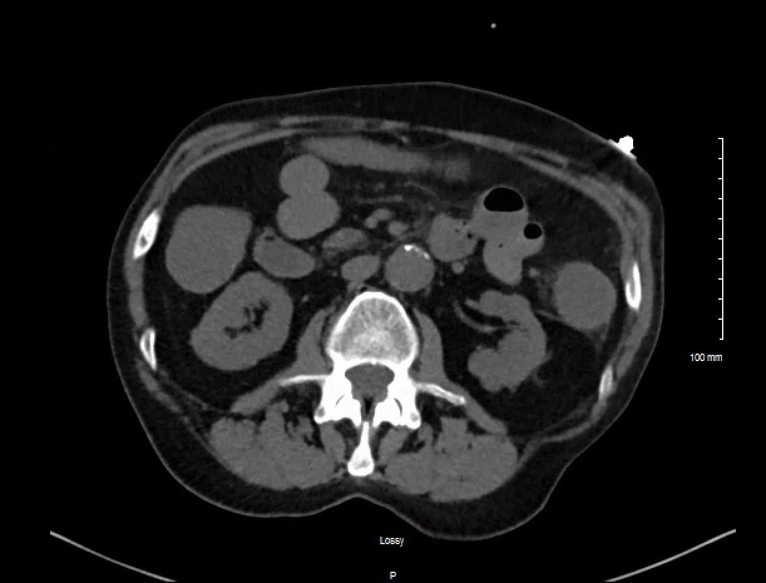
Case

Slide 14
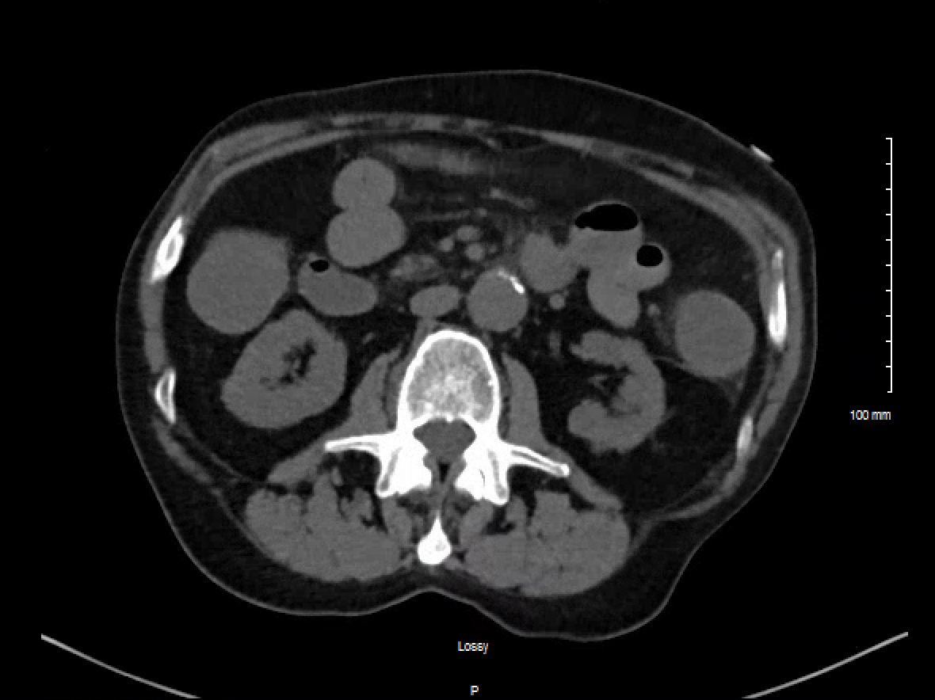
Case

Slide 15

Case

Slide 16
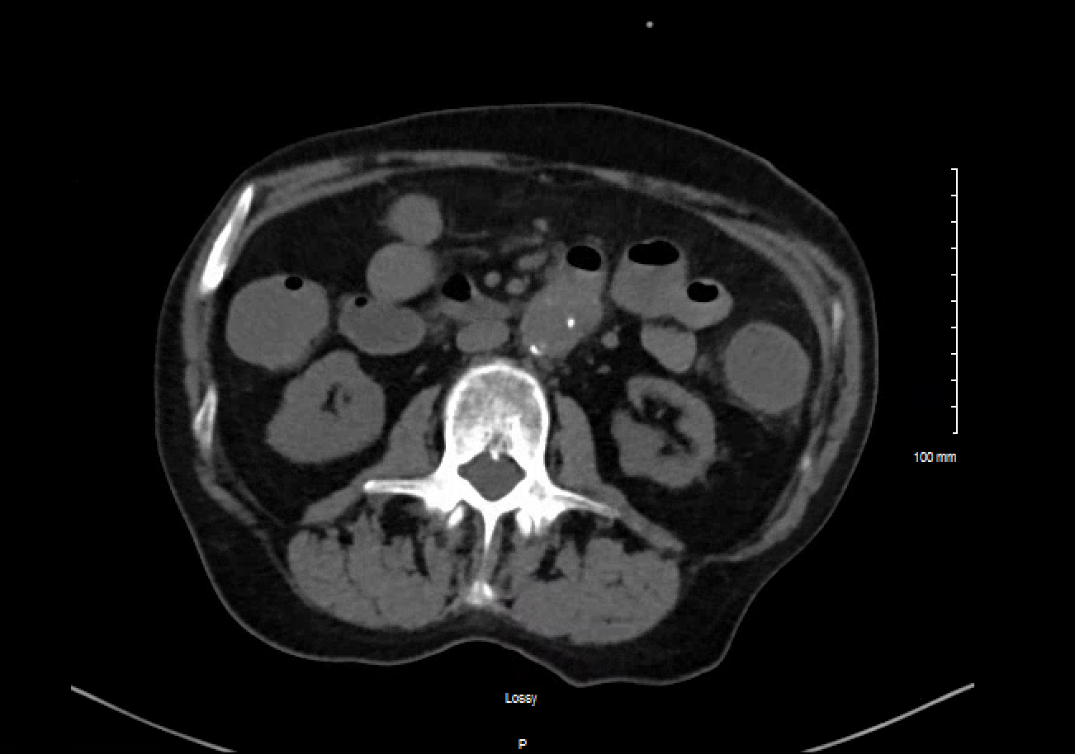
Case

Slide 17
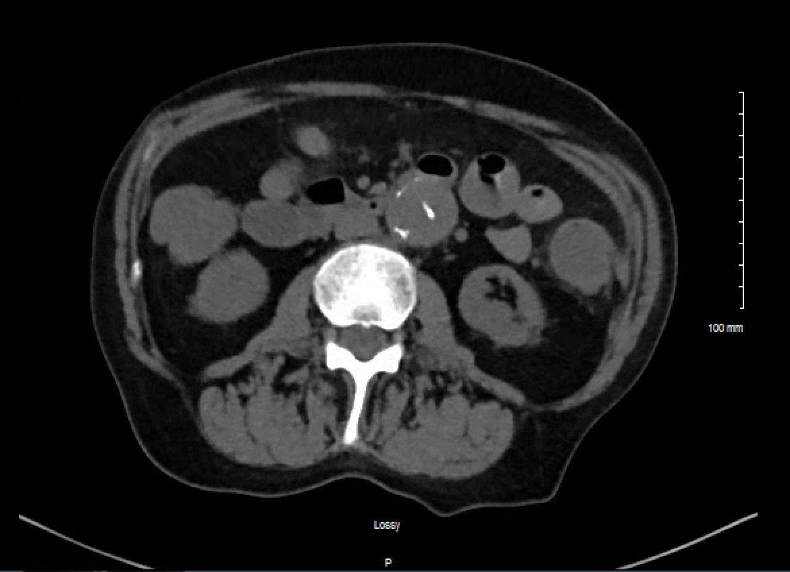
Case

Slide 18
Case
Gastroenterology consulted and emergent EGD performed at bedside:
  Bright red blood and clot noted in 3rd proximal/4th portion duodenum. Unable to visualize source of bleeding.
  No esophageal or gastric varices noted
  “Suspect Aorto-duodenal fistula”
At this time is on 4 pressors: norepinephrine, neosynephrin, vasopressin, dopamine
PRBC transfusions continue

Slide 19
Case
Emergent Vascular Surgery consult placed:
  “Critically ill s/p massive GI hemorrhage. Probable primary aortoduodenal fistula. Comorbidities of CAD, HTN, CKD/AKI, L pneumothorax, hemorrhagic shock. Survival unlikely with treatment, nil without. As above, discussed extensively with wife and her support group. I have quoted a <10% survival with treatment, 0% without treatment.”
  “[Will attempt] Stabilization. If possible, percutaneous placement of endovascular stent graft (Endologix suprarenal extension 28x75) across the putative aortoduodenal fistula. If this succeeds in halting active bleeding, medical stabilization and resuscitation followed by definitive open repair of the fistula are theoretically possible.”

Slide 20
Case
13:00: Percutaneous placement of endovascular stent grafting successfully placed by Vascular surgeon.
  Situation temporized.
Patient remains critical but stable in CCU. Remains on pressors. Transfusion of blood products continued.

Slide 21
Case
Overnight however, Hgb continues to drift down, with corresponding increase in lactate:
Time (9/28-9/29) | Hgb | Lactate
18:10 | 12.0 | 5.7
01:44 | 11.0 | 11.0
09:38 | 10.3 | 12.3
19:03 | 8.6 | 8.8

Slide 22
Case
Ultimately, patient continued to clinically deteriorate. Family was informed of patient’s grim prognosis.
  Patient made DNR
9/29/17; 21:40: “Pt showing vtach on monitor, [Physician] called and arrived at bedside. Pt is DNR. no pulse felt. Family at bedside at this time. EKG performed per verbal order from [physician]. pt showing asystole. pt pronounced at 9:40pm. Pt disconnected from all ivs, vent, chest tube, foley removed and all lines removed, and body cleaned and prepared for funeral home.”

Slide 23
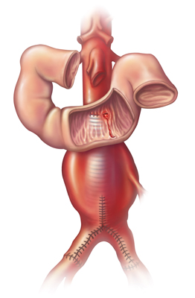
Discussion
Aortoenteric Fistula
  Abnormal connection between Aorta and GI tract
  First described by Sir Astley Cooper in 1829
  Location
    83% occur in duodenum
      53% in distal 1/3 where duodenum is retroperitoneal just anterior to the aorta
    6% Jejunum, 4% sigmoid colon, 4% stomach, 2% ileum

Slide 24
Discussion
Primary Aortoenteric Fistula (PAEF)
  73 % AAA
  26% Traumatic or Mycotic (mostly Salmonella or Klebsiella)
  1% radiation, METs, ulcers, gallstones, appendicitis, diverticulitis
Secondary Aortoenteric Fistula (SAEF)
  Any aortic reconstruction
  Most commonly involves surgically placed aortic graft

Slide 25
Discussion
Pathogenesis
  PAEFs
    Animal studies lead us to believe creation of PAEFs involves mechanical factors of inflammation & infection
    Inflammation thought to play larger role
    Bacteria (aortitis, etc.) though to seed onto inner arterial surface and permit formation of an aneurysm that erodes into adjacent structures

Slide 26
Discussion
SAEFs
  Pathogenesis largely unknown
  Theories include
    Pulsations of AAA graft against bowel wall
    Adhesions from infected and/or inflamed graft to bowel wall
  Due to these reasons surveillance after AAA repairs is warranted

Slide 27

Discussion
Clinical Manifestations
  Massive upper GI Bleed (64%)
  Abdominal Pain (32%)
  Pulsatile Abdominal Mass (25%)
  The “Herald Bleed”
    Intermittent hematemesis, melena, and/or hematochezia before exsanguination
    Temporary thrombus seals fistula
    Bowel may contract around fistula tract
    29% of patients had > 1week between initial bleed and death
  Other signs
    Back pain, fever, sepsis

Slide 28
Discussion
GI Bleed Differential
  PUD
  Gastritis
  Mallory-Weiss Tear
  Esophageal Varicies
  Esophagitis
  Neoplasm
  Angiodysplasia
  Diverticulitis
  Colitis
  Diverticulosis
Bottom Line:
Suspect Aortoenteric Fistula when patient presents with massive upper GI bleed with a history of AAA, especially with repair

Slide 29
Discussion
Diagnosis
  High suspicion
  Imaging
    Controversial whether EDG or CT is the best 1st modality
    With advances in CT technology, latest recommendations prefer CT first
      Preferred with contrast
      Least invasive
    Features
      ectopic gas adjacent to or within the aorta
      focal bowel wall thickening
      discontinuity of the aortic wall
      extravasation of contrast material into the bowel lumen (most specific)

Slide 30
Discussion
Diagnosis
  Imaging
    EGD
      Helps to rule out other etiologies of GI bleed
      Negative EDG does not rule out PAEF/SAEF
      Can show graft, ulcer, erosion, clot, pulsatile mass
      Hard to visualize as majority of Aortoenteric fistulas occur in distal duodenum
      Can potentially dislodge a thrombus in fistula
    Angiography
      Less used to diagnose, but can be beneficial in planning aortic reconstruction surgery
    Magnetic resonance imaging, tagged white blood cell scans, colonoscopy, sonograms, and upper and lower gastrointestinal series are of limited value given the acute and rapid nature of symptomatic PAEF/SAEF

Slide 31
Discussion
Diagnosis
  Exploratory Laparotomy
    If imaging is inconclusive
    Consider PAEF/SAEF until proven otherwise

Slide 32

Discussion
Management of Aortoenteric fistulas
  Recognition of AEF
  Resuscitation & Hemodynamic support
  Antibiotics
    Should be continued after surgical intervention for at least 4-6 weeks
  Surgical repair
    Open
    Endovascular
      Some studies show improved perioperative morbidity and mortality and decreased length of hospital stay

Slide 33
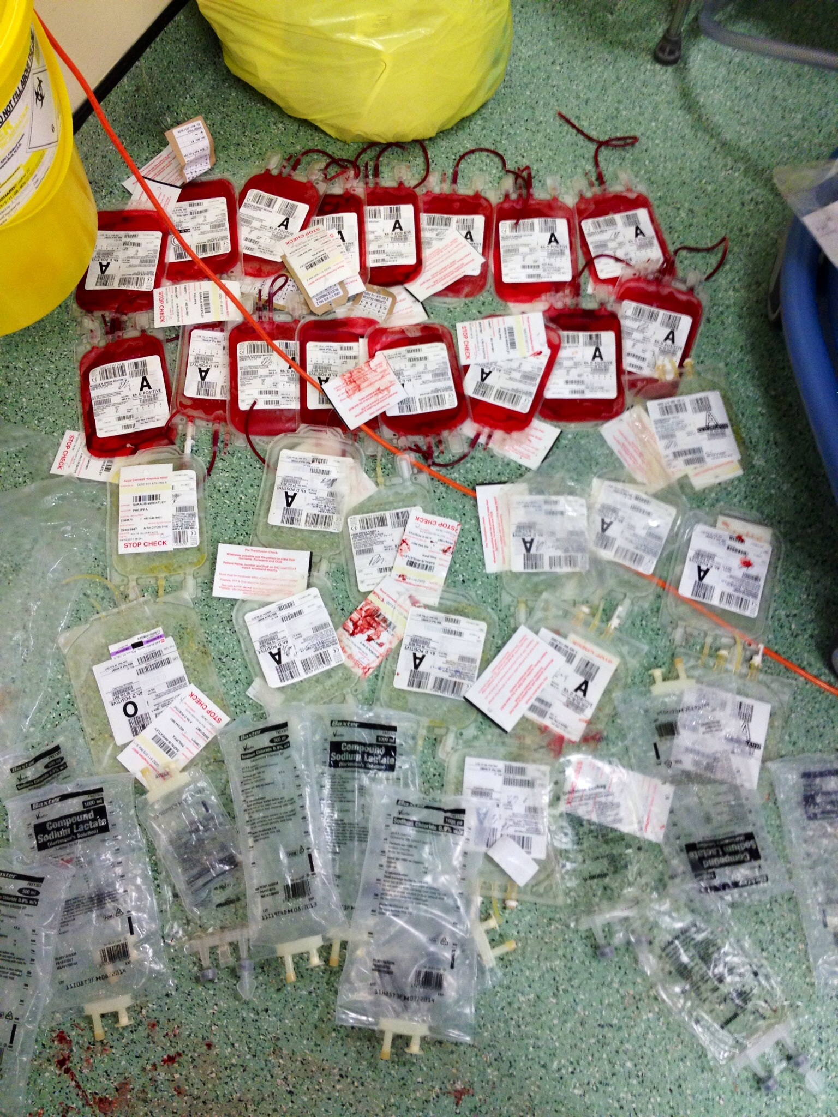
Discussion
Management of Aortoenteric fistulas
  Massive Transfusion Protocols
    Monitor Vitals, HGB, platelets, PT/INR, aPTT, Fibrinogen
    Look out for
      ↓pH, ↓Ca++, ↑K+, ↓body temperature
  Products
    IVFs
    Vasopressors
    Antibiotics
    PRBCs
    Platelets
    FFP
    Cryoprecipitate

Slide 34
Discussion
Mortality
  Without treatment, AEF with hemorrhage is nearly 100%
  Many patients exsanguinate and die before AEF is ever diagnosed
  Survival rates with treatment range from 18-93%
    Not many cases to compare
    May have other comorbidities
    Surgical repairs differ by surgeon, technique, patient’s specific case
  Postoperative Complications occur in 40%
  Postoperative Mortality > 30%

Slide 35
Discussion
What could have been done better?
  Earlier recognition on initial CT
  Having higher index of suspicion given volume of BRBPR
  Earlier GI/Vascular consult
  Mass transfusion protocols
  Others?

Slide 36

Questions?

Slide 37
Acknowledgements
Mahmoud Amarna, MD, Critical Care/Pulmonology
Giovanni Ferrante, MD, Vascular Surgery
William Hood, DO, Gastroenterology
John Patterson, MD, Cardiology
Casandra Blair, NP, Cardiology
Alexandra Bowling, DO

Slide 38
References
O'Mara C, Imbembo AL. Paraprosthetic-enteric fistula. Surgery 1977; 81:556.
Bergqvist D. Arterioenteric fistula. Review of a vascular emergency. Acta Chir Scand 1987; 153:81.
Ikonomopoulos DC, Spanos PK, Lazarides DP. Pathogenesis of aortoenteric fistula. An experimental study. Int Angiol 1986; 5:33.
Deriu GP, Ballotta E. Prevention of enteric erosion by vascular prostheses. Tex Heart Inst J 1982; 9:325.
Hughes FM, Kavanagh D, Barry M, et al. Aortoenteric fistula: a diagnostic dilemma. Abdom Imaging 2007; 32:398.
Medical Staff Conference, aortoenteric fistula. West J Med 1981; 134:242.
Wood A, Bendjelid SM, Bendjelid K. Primary aortoenteric fistula: should enhanced computed tomography be considered in the diagnostic work-up? Anesth Analg 2005; 101:1157.
Hagspiel KD, Turba UC, Bozlar U, et al. Diagnosis of aortoenteric fistulas with CT angiography. J Vasc Interv Radiol 2007; 18:497.91
Low RN, Wall SD, Jeffrey RB Jr, et al. Aortoenteric fistula and perigraft infection: evaluation with CT. Radiology 1990; 175:157.
Choi, Chang Woo. “A Staged Surgical Treatment for Aortoesophageal Fistula in Esophageal Cancer.” Soonchunhyang Medical Science, vol. 22, no. 2, 2016, pp. 200–203., doi:10.15746/sms.16.048.
Baril, Donald T., et al. “Evolving Strategies for the Treatment of Aortoenteric Fistulas.” Journal of Vascular Surgery, vol. 44, no. 2, 2006, pp. 250–257., doi:10.1016/j.jvs.2006.04.031.
Wood, Alice, et al. “Primary Aortoenteric Fistula: Should Enhanced Computed Tomography Be Considered in the Diagnostic Work-Up?” Anesthesia & Analgesia, vol. 101, no. 4, 2005, pp. 1157–1159., doi:10.1213/01.ane.0000175769.11560.fe.
Lemos, David W., et al. “Primary Aortoduodenal Fistula: A Case Report and Review of the Literature.” Journal of Vascular Surgery, vol. 37, no. 3, 2003, pp. 686–689., doi:10.1067/mva.2003.101.

