Slide 1
Resident Research: Tools, Techniques, and Talent
Requirements
Jeffrey LeBoeuf, MBA, CAE
Chief Graduate Medical Education/Rotations Officer
LMU-DCOM

Slide 2
Learning Objectives
The participants will understand:
What counts as scholarly activity from the ACGME Specialty Requirements
Types of research
Basic steps for a literature review.
Finding a research mentor
Navigating Institutional Review Boards
Collecting the data
Obtaining library and statistical support
External funding
Presenting findings

Slide 3
Family Medicine Faculty Requirements for Scholarly Activity
II.B.5. The faculty must establish and maintain an environment of inquiry and scholarship with an active research component. ^{(Core)}
  II.B.5.a) The faculty must regularly participate in organized clinical discussions, rounds, journal clubs, and conferences. ^{(Detail)}
II.B.5.b) Some members of the faculty should also demonstrate scholarship by one or more of the following:
    II.B.5.b).(1) peer-reviewed funding; ^{(Detail)}
    II.B.5.b).(2) publication of original research or review articles in peer reviewed journals, or chapters in textbooks; ^{(Detail)}
    II.B.5.b).(3) publication or presentation of case reports or clinical series at local, regional, or national professional and scientific society meetings; or, ^{(Detail)}
    II.B.5.b).(4) participation in national committees or educational organizations. ^{(Detail)}
  II.B.5.c) Faculty should encourage and support residents in scholarly activities. ^{(Core)}

Slide 4
Family Medicine Resident Requirements
IV.B. Residents’ Scholarly Activities
  IV.B.1. The curriculum must advance residents’ knowledge of the basic principles of research, including how research is conducted, evaluated, explained to patients, and applied to patient care. ^{(Core)}
  IV.B.2. Residents should participate in scholarly activity. ^{(Core)}
    IV.B.2.a) Residents should complete two scholarly activities, at least one of which should be a quality improvement project. ^{(Outcome)}
  IV.B.3. The sponsoring institution and program should allocate adequate educational resources to facilitate resident involvement in scholarly activities. ^{(Detail)}

Slide 5
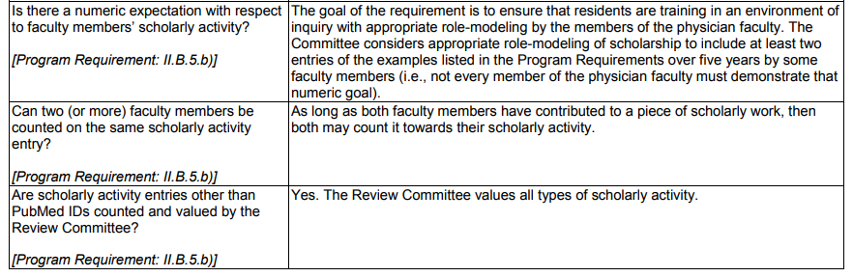
Family Medicine FAQ’s

Slide 6
Internal Medicine Faculty Requirements for Scholarly Activity
II.B.5. The faculty must establish and maintain an environment of inquiry and scholarship with an active research component. ^{(Core)}
  II.B.5.a) The faculty must regularly participate in organized clinical discussions, rounds, journal clubs, and conferences. ^{(Detail)}
II.B.5.b) Some members of the faculty should also demonstrate scholarship by one or more of the following:
    II.B.5.b).(1) peer-reviewed funding; ^{(Detail)}
    II.B.5.b).(2) publication of original research or review articles in peer reviewed journals, or chapters in textbooks; ^{(Detail)}
    II.B.5.b).(3) publication or presentation of case reports or clinical series at local, regional, or national professional and scientific society meetings; or, ^{(Detail)}
    II.B.5.b).(4) participation in national committees or educational organizations. ^{(Detail)}
  II.B.5.c) Faculty should encourage and support residents in scholarly activities. ^{(Core)}

Slide 7
Internal Medicine Resident Requirements
IV.B. Residents’ Scholarly Activities
  IV.B.1. The curriculum must advance residents’ knowledge of the basic principles of research, including how research is conducted, evaluated, explained to patients, and applied to patient care. ^{(Core)}
  IV.B.2. Residents should participate in scholarly activity. ^{(Core)}
  IV.B.3. The sponsoring institution and program should allocate adequate educational resources to facilitate resident involvement in scholarly activities. ^{(Detail)}

Slide 8

Internal Medicine FAQs

Slide 9
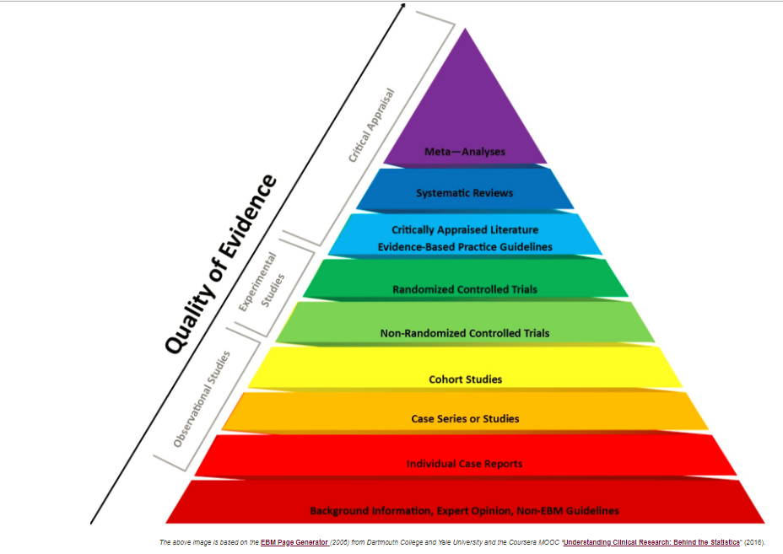
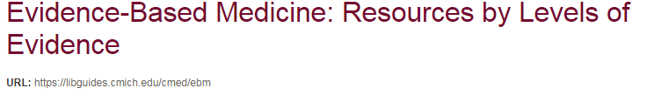

Slide 10
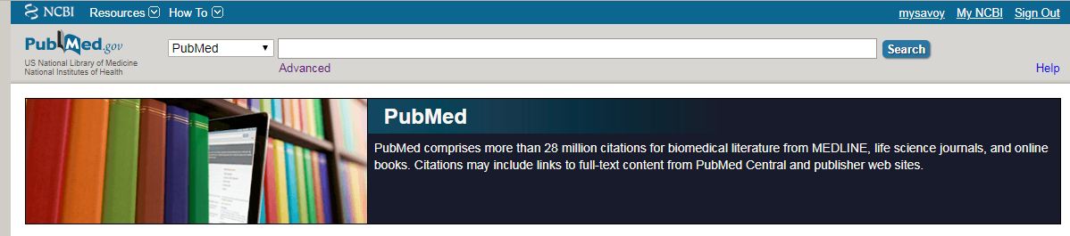
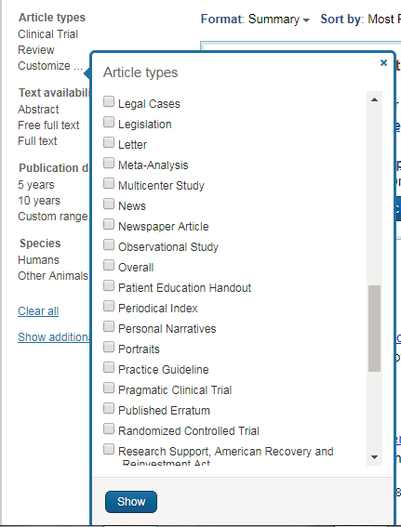
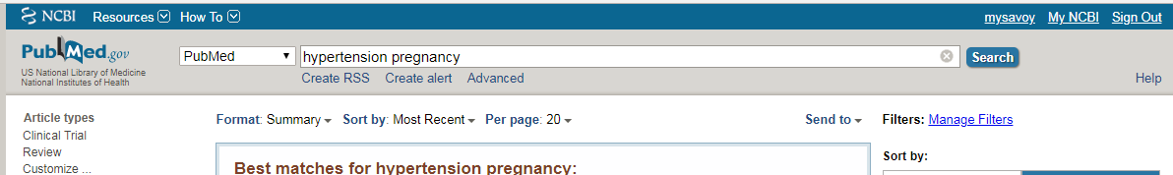
PubMed Search for Randomized Control Trials (RCT)
3. Filter Search by RCT
1. Home Page (https://www.ncbi.nlm.nih.gov/pubmed/)
2. Hypertension in Pregnancy (Sample Search Topic)

Slide 11
Other Free Resources for Literature Searching based on the Evidence Based Medicine Pyramid.
TRIP (Trip medical database, a smart, fast tool to find high quality clinical research evidence.) https://www.tripdatabase.com/
Google Scholar (https://scholar.google.com/)
PubMed Health (https://www.ncbi.nlm.nih.gov/pubmedhealth/) Systematic Reviews and other clinical research evidence

Slide 12



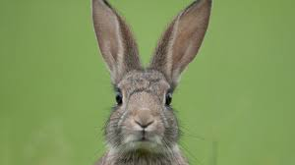
Literature Review
Step 1. Define your question(s)
  Establish guard rails
  Don’t chase rabbits

Slide 13
Literature Review
Step 2. Organize your review
  Broad Categories
  Annotated Bibliography?
  Use free software, Evernote, Zotero, EndNote, Mendley
Step 3. Use structure to critique journal articles
  Qualitative, Quantitative, or Mixed Methods? Meta-Analysis?
  Use critique guidelines (ie templates)
  Limit to recent articles (except for foundational studies)

Slide 14
Literature Review
Step 4. Writing
  Explore and discuss discrepancies of findings, evaluate the strength of each piece of literature
  Ensure that you are weaving a story, not just listing and critiquing article after article
  Don’t discuss your methodology, data, or speculate as to your findings!
  Use templates (MS Word), citation generators, style sets
Step 5. Proof and review
  Are you an expert on the body of knowledge on your question?
  Have you identified experts that have dedicated their lives to the topic?
  Have you determined whether the question has been definitively answered?
  http://advice.writing.utoronto.ca/types-of-writing/literature-review/

Slide 15



Zotero® Demonstration
Look up an article
Save to Zotero ®
Insert a citation
Publish a bibliography

Slide 16


Research mentors
Core faculty members
Medical School faculty
Librarians
Statisticians

Slide 17

Institutional Review Boards
Why are they necessary?
What are the purposes?
Three types of review
  Exempt
  Expedited
  Full
Pitfalls:
  Collecting data prior to IRB approval
  Informed consent
  Varying from approved study protocol
  Data integrity
  Do not wait until year three.
  Do not wait until year three.
  Do not wait until year three!!!

Slide 18
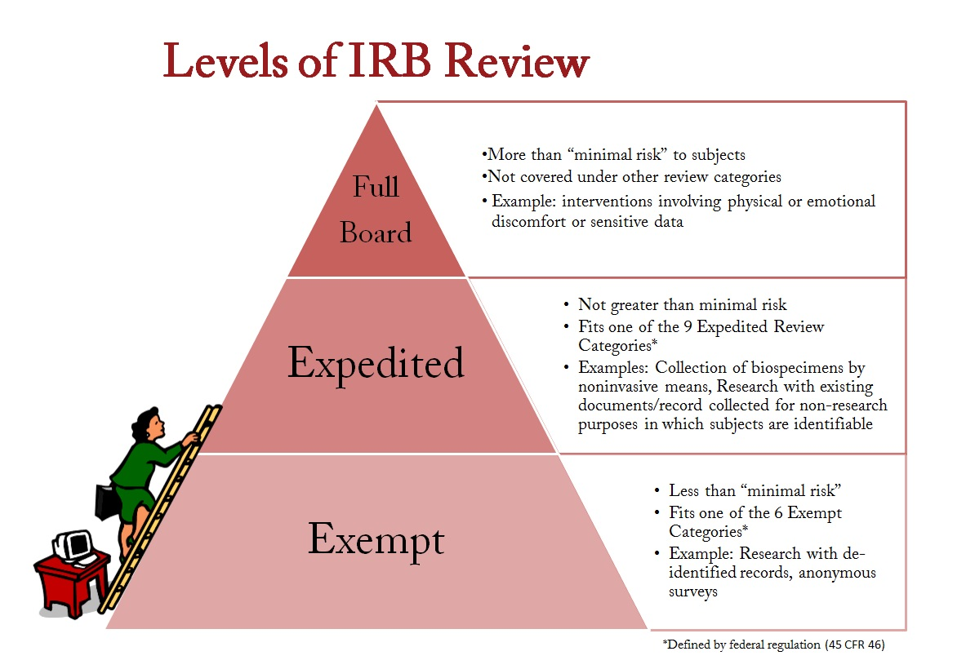
https://www.creighton.edu/researchservices/rcocommittees/irb/irbinstructions/

Slide 19
True or False
It’s up to the researcher to determine if a project will be exempted, expedited or subject to full review?
I can engage the IRB after I’ve begun collecting data.
I can vary my methods of data collection.
If my attending says not to bother with IRB, I’m probably OK.
A robust research project can be done during a month-long third year rotation.

Slide 20
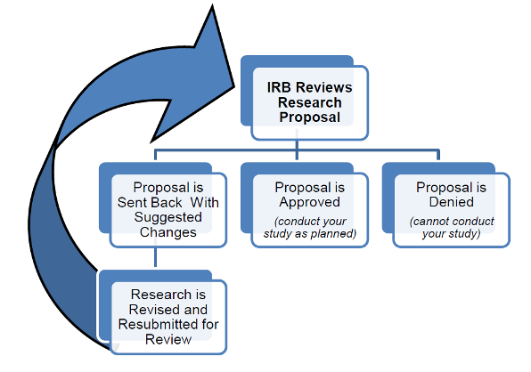
https://study.com

Slide 21
15 Common mistakes
Failure to carefully examine the literature for similar, prior research
Failure to critically assess the prior literature
Failure to specify the inclusion and exclusion criteria for your subjects
Failure to determine and report the error of your measurement methods
Failure to specify the exact statistical assumptions made in the analysis
Failure to perform sample size analysis before the study begins
Failure to implement adequate bias control measures
Fifteen common mistakes encountered in clinical research. (2011). Journal of Prosthodontic Research, 55(1), 1–6. https://doi.org/10.1016/j.jpor.2010.09.002

Slide 22
15 Common mistakes
Failure to write and stick to a detailed time line
Failure to vigorously recruit and retain subjects
Failure to have a detailed, written and vetted protocol
Failure to examine for normality of the data
Failure to report missing data, dropped subjects and use of an intention to treat analysis
Failure to perform and report power calculations
Failure to point out the weaknesses of your own study
Failure to understand and use correct scientific language
Fifteen common mistakes encountered in clinical research. (2011). Journal of Prosthodontic Research, 55(1), 1–6. https://doi.org/10.1016/j.jpor.2010.09.002

Slide 23
Librarian and Statistical Support
Each ACGME Residency Program is affiliated with one or more medical schools
Core Faculty and Residents have access to medical school library access
Medical librarians have unique training and expertise in supporting scientific literature reviews and research methodology
Universities have statisticians one faculty/staff
Often graduate students in statistics and analytics are looking for projects….

Slide 24
External Funding
Grant Writing 101
Rule 1: Read and follow the instructions carefully
Rule 2: Make certain that you’re asking a research question.
Rule 3: Ensure that your methodology is sound
Rule 4: Have someone critique (notice I didn’t say affirm) your grant proposal for readability, conciseness, and obedience to the grant guidance.

Slide 25

Grant sources
Medical Schools
  Some travel and expense grants…..
Specialty Colleges (AOCFP, AAFP, ACOI, ACP, etc.)
AACOM, AAMC
Specialty Colleges
Industry
Governmental Agencies

Slide 26


“Publishing” your findings
Posters
Virtual Posters
Presentations
Journals
E-journals
PubMed ID
Follow the instructions and deadlines!

Slide 27
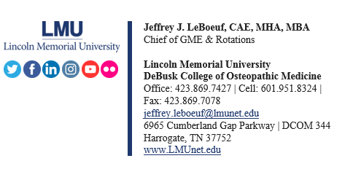
Questions?

