Slide 1
Migratory arthritis and fever
Elizabeth Dockery, DO
Family medicine resident, pgy-2
Johnston memorial hospital

Slide 2
Case presentation
A 55-year-old Caucasian female presented to the emergency department with high fever and flu-like symptoms for the past 2 - 3 days. She called her primary care office a few days before her ER visit and was believed to have influenza. She had taken Tamiflu for 2 days, but continued to decline, with new symptoms of nausea, vomiting and a fever of 103 at home. She had also developed severe body aches and painful joints. The pain originated in her left MCP joint and then spread to her right elbow and right knee. She denied any recent trauma, travel or sick contacts.

Slide 3
Past medical history
Past medical history
  COPD, multiple sclerosis, gout, vulvar and anal cancer s/p chemo and radiation, osteosarcoma
Past surgical history
  Colostomy with reversal , hysterectomy with BSO, carpal tunnel release, amputation of 3rd finger on left hand
Family history
  Mother is healthy without any medical problems she knows of
  Father’s history is unknown
Social history
  Former smoker, quit 1 year ago
  Denies alcohol or illicit drug use
  Single, lives at home with her mother

Slide 4
Medications and allergies
Medications
  Fioricet, Symbicort, gabapentin
Allergies
  Amoxicillin, flagyl, Levaquin, Naprosyn, toradol

Slide 5
Review of systems
Positives:
  Shortness of breath, non-productive cough, sneezing, sore throat, body aches, nausea, vomiting, body aches, joint pain, and a temperature of 103° F at home.
Negatives:
  Headache, dizziness, blurred vision, syncope, chest pain, diarrhea, dysuria.

Slide 6
Physical exam
Vital signs: T 101.1, BP 112/59, P 107, RR 18, SpO2 96% RA
General: The patient was in mild distress and frail appearing.
HEENT was normocephalic, oropharynx slightly erythematous, no lesions, uvula midline. Eyes showed reddened sclera without any exudate or drainage.
Respiratory: Lung sounds were diminished bilaterally, but otherwise clear to auscultation.
Cardiovascular: Heart was regular rate and rhythm, without any murmurs, rubs or gallops.
Extremities: Decreased range of motion, redness, edema and tenderness to palpation on right elbow and right knee, as well as an erythematous, tender, approximately 3 cm circular nodule on the left metatarsal/tarsal joint.

Slide 7
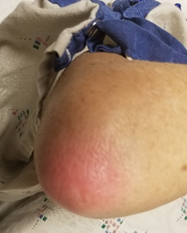
Right elbow

Slide 8
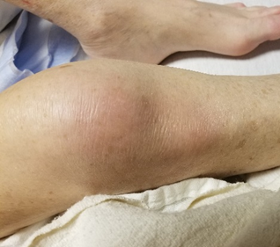
Right knee

Slide 9
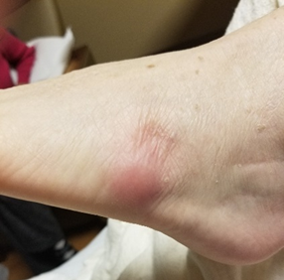
Left foot

Slide 10
Laboratory findings
135 105 19
124
3.0 21 0.89
10.3
10.3 123
30.3
Urinalysis showed:
Trace leukocyte estrace
Moderate blood
Negative nitrite
10 – 15 WBC
Hazy appearance
Flu A : Negative
Flu B: Negative

Slide 11
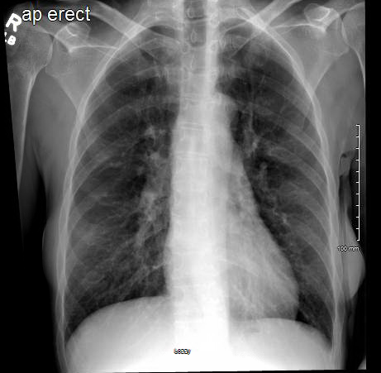
Chest x-ray

Slide 12
Initial diagnosis
Flu
  Tamiflu
UTI
  Rocephin
Gouty arthropathy
  NSAIDs and colchicine
Admitted for observation.
Notes:
Sepsis secondary to UTI.
Blood cultures and urine cultures were drawn.

Slide 13
Hospital course day 1 & 2
Changed to in patient due to worsening clinical presentation.
  T 102.8° F, HR 117, RR 20, BP 119/59, and SpO2 93% RA.
  Lactate: 2.2
  Rocephin & Tamiflu continued, fluids increased.
Increased weakness? Exacerbation of MS due to infection?

Slide 14
Hospital course day 3
Patient still feels weak, joints continue to ache.
Vitals stable, cyclic fever.
Initial blood culture grew out Group A streptococcus.
Urine culture showed mixed flora, likely contaminant.
Notes:
In light of new strep bacteremia, MS flare was pushed down pretty low on differential list.
Rocephin & Tamiflu continued. PT consulted for weakness.

Slide 15
What was the patient’s most likely diagnosis?
a) Acute rheumatic fever
b) Reactive arthritis
c) Lyme disease
d) Rheumatoid arthritis
e) Septic arthritis
Notes:
Correct Answer: a) Acute rheumatic fever
Acute rheumatic fever is characterized by a systemic inflammatory response secondary to group A streptococcus.¹ Presenting symptoms may include high fever, polyarthritis, rash, chorea, and subcutaneous nodules.

Slide 16
Hospital course day 4
Overnight patient still had cyclic fevers, still complaining of weakness and arthralgias.
Steptococcal species identified as streptococcus pyogenes.
  Rocephin continued.
  ID consulted.
  PICC line & repeat BC ordered.
Echocardiogram ordered.
Notes:
Echo ordered to r/o infective endocarditis.

Slide 17
Echocardiogram results
Mild LVH
LVEF 60 – 65%
Moderate aortic regurgitation
Mild mitral regurgitation
No PFO

Slide 18
Hospital course day 5
Patient finally feeling better, still weak with achy joints, but improved.
Vital signs stable, afebrile.
Tamiflu d/c’d after full 5 day course.
ID saw the patient: Could this be rheumatic fever?
  Recommended rapid strep test, Anti-streptolysin-O antibodies, CRP and sed rate
  Place PICC after BC is negative
  Rapids strep test: negative.
  Continue IV Rocephin for 2 weeks, then transition to PO azithromycin for 8 weeks.
Notes:
Patient had several days worth of abx before rapid strep test was ordered.

Slide 19
Based off the diagnosis criteria, how is infection with GAS confirmed in a patient suspected to this disease?
a) Positive blood cultures
b) Elevated ESR
c) Rising anti-strepolysin O titers
d) Elevated CRP
e) All of the above
Notes:
Correct Answer: c) Rising anti-streptolysin O titers
American Heart Association states that evidence of a preceding streptococcal infection for acute rheumatic fever can be either 1) increased or rising anti-streptolysin O titer or other streptococcal antibodies 2) a positive throat culture for group A beta-hemolytic streptococci or 3) a positive rapid group A streptococcal carbohydrate antigen test.² A four-fold rise in anti-streptolysin O titers confirms the diagnosis of ARF after a recent streptococcal infection.¹

Slide 20
Hospital course day 6
Patient continues to improve.
VS stable, still has low grade temperature (99.0)
Repeat BC negative after 36 hours
Labs:
  Sed rate: 114 (<15)
  CRP: 89 (<10)
  Anti-streptolysin O antibodies: +
  Anti-streptolysin O titer: > 1600

Slide 21
Acute Rheumatic fever
Characterized by a systemic inflammatory response secondary to group A streptococcus.
ARF is typically a syndrome of childhood, with most cases occurring in pediatrics aged 5 to 15 years.
Usually develops two to three weeks after a throat infection.
The most common manifestations are carditis (50% – 70%) and arthritis (35% - 66%). Other common clinical manifestations are chorea (10% - 30%), subcutaneous nodules (< 10%), and erythema marginatum (< 6%).
The etiology is not fully understood, but it is believed to involve cross reactivity of streptococcal antibodies with cardiac, synovial, and brain tissue.
Notes:
However, attacks may occur at any age.

Slide 22
Which of the following is considered a major criteria for diagnosis?
a) Fever > 38.5 C
b) Arthritis
c) ESR > 60mm in the first hour
d) Prolonged PR interval
e) Carditis
Notes:
Correct Answer: e) Carditis

Slide 23
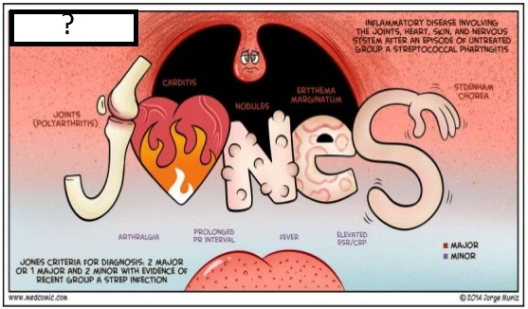
Jones Criteria
Diagnosis is established by evidence of a preceding streptococcal infection in addition to 2 major criteria or 1 major criteria with 2 minor criteria.
Major criteria:
  Polyarthritis, carditis, subcutaneous nodules, erythema marginatum, and chorea.
Minor criteria
  Polyarthralgia, fever (> 38.5 C), ESR > 60mm in the first hour, CRP >3.0 mg/dL, and prolonged PR interval.
With established rheumatic heard disease or a reliable past history for acute rheumatic fever, three minor criteria may be sufficient to diagnose recurrent rheumatic fever.

Slide 24
Polyarthritis
Usually asymmetric, migratory, and involving the large joints such as the elbows, wrists, knees, and ankles.
  Small joint involvement is less common.
Typically self-limited and resolves in several weeks.
NSAIDs and salicylates have proven to be effective for rapid recovery.

Slide 25
carditis
Carditis has been a clinical judgment based on auscultation of murmurs consistent with mitral or aortic valve regurgitation.
Doppler echocardiogram has been found to be a reliable source of diagnosing carditis in the absence of auscultory findings and is recommended in all cases of confirmed or suspected acute rheumatic fever.
Pericarditis and myocarditis may also occur in acute rheumatic fever, and if severe enough, can result in congestive heart failure.
The sequela of carditis can take weeks to months, so patients with an initial normal echocardiogram should have a repeat echo in 2 – 4 weeks.

Slide 26
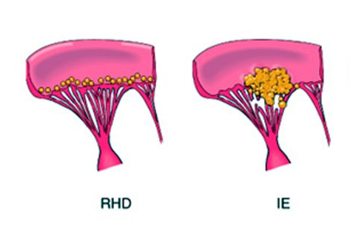
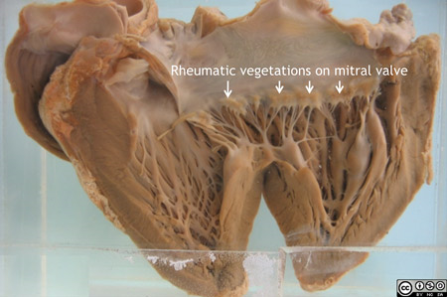
ARF vegetations
Notes:
Vegetations are caused when strep deposits in the heart. Inflammatory response is activated and scarring is left on the valves, resulting in vegetations.

Slide 27
Skin manifestations
Skin manifestations include erythema marginatum and subcutaneous nodules.
Erythema marginatum:
  Rare (occurs in less than 6% of cases)
  It is described as a pink rash with central clearing that blanches with pressure and may worsen with heat. Raised boarders with outward-spreading macules and papules are also characteristic.
  Usually located on the trunk and proximal extremities, sparing the face.
Subcutaneous nodules:
  Also rare
  Usually appear during the first few weeks of the inflammatory phase.
  They are firm protuberances typically found on the extensor surfaces of joints close to boney protuberances. They are approximately 1 cm in size and can be singular or clustered.

Slide 28
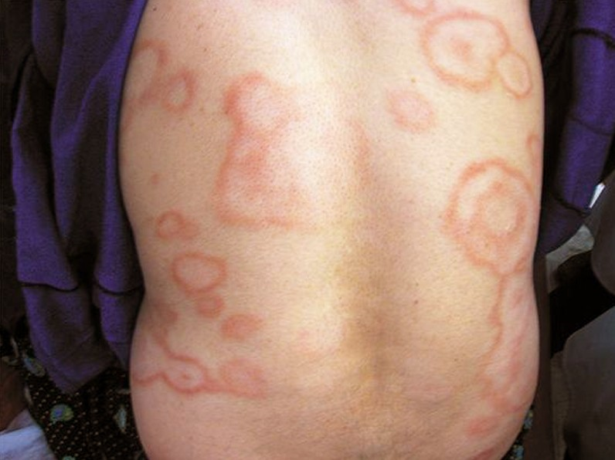
Erythema marginatum

Slide 29
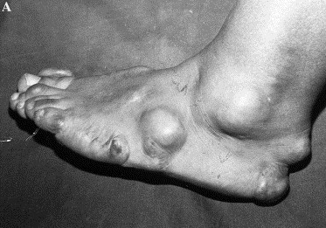
Subcutaneous nodules

Slide 30
chorea
Chorea is characterized by involuntary, rhythmic movements of the trunk and extremities that is often associated with muscle weakness and emotional liability.
It is important to determine that the cause of chorea is not an underlying neurological disorder such as Huntington disease, Wilson disease or systemic lupus erythematous.
Chorea may also only be unilateral, so tics, hyperkinesis and conversion disorder should also be ruled out.
Since chorea is a latent manifestation of ARF, it may not be possible to prove infection with GAS.

Slide 31
Minor criteria
Fever accompanying acute rheumatic fever commonly exceeds 38.5˚ C (101.3˚ F) orally and can be treated with antipyretics.
Elevated C-reactive protein and/or erythrocyte sedimentation rates are lab values consistent with ARF. Normal CRP and ESR should cause a clinician to seriously rethink the diagnosis of ARF.
First degree heart block can be used as a minor criteria for diagnosis in the absence of carditis. PR interval of 0.16 seconds in children younger than age 12 and 0.18 seconds in children 12 years of age and older are considered prolonged.

Slide 32
treatment
Antibiotic treatment of acute rheumatic fever is usually penicillin.
  Oral Penicillin VK 250 mg twice daily in children or 500 mg twice daily in adolescents for 10 days is recommended.
  Another option is a one-time dose of intramuscular benzathine penicillin.
Erythromycin is recommended for patients with a penicillin allergy.
Prophylaxis is recommended to help prevent recurrent episodes of acute rheumatic fever.
  The World Health Organization recommends intramuscular benzathine penicillin injections every three to four weeks for prophylaxis.
  The timeframe is debatable on the duration of prophylaxis treatment, but the consensus is a minimum of 10 years.
Symptoms such as fever and arthritis can be treated with salicylates or NSAIDS.

Slide 33
Discharge recommendations
BC remained negative. Patient was stable.
Midline was placed for long-term IV antibiotics.
Rocephin 2 grams IV daily for 2 weeks from negative BC
Zithromax 250 mg PO daily for 8 weeks after IV abx completed
F/U with PCP in 3 - 5 days
Notes:
Discharged on Day 7.
Patient had an allergy to amoxicillin (penicillins).

Slide 34
Conclusion
Acute rheumatic fever is usually not in the differential diagnosis for adults with fever and arthralgia.
Rare as it is in developed countries, adult-onset ARF is not so uncommon in developing countries.
Sporadic incidences of small endemic areas have been reported in the United States since 1980.
  Carditis and arthritis were the main complaints.
  Throat pain was rare.
ARF should be considered in older patients with new onset arthritis and fevers.

Slide 35
references
Gewitz MH, Baltimore RS, Tani LY, et al. Revision of the Jones Criteria for the Diagnosis of Acute Rheumatic Fever in the Era of Doppler Echocardiography. Circulation. 2015;131(20):1806-1818. http://circ.ahajournals.org/content/131/20/1806.long. Accessed February 18, 2018.
Webb RH, Grant C, Harnden A. Acute rheumatic fever. BMJ. 2015;351:h3443. http://www.bmj.com/content/351/bmj.h3443. Accessed February 18, 2018.
Ben-Dov I, Berry E. Acute rheumatic fever in adults over the age of 45 years: an analysis of 23 patients together with a review of the literature. Seminars in Arthritis & Rheumatism. 1980;10(2):100-110. Abstract. https://doi.org/10.1016/0049-0172(80)90003-7. Accessed February 16, 2018.
Nakashima D, Ueda K, Tsukuda K, et al. Adult-onset Acute Rheumatic Fever. Internal medicine. 2012;51(19):2805-2808. https://www.jstage.jst.go.jp/article/internalmedicine/51/19/51_51.7661/_article. Accessed February 16, 2018.

