Slide 1
RURAL RESIDENTS RESEARCH SYMPOSIUM
CURRENT VIEW OF OPIOIDS AND
POSSIBLE FUTURE OUTCOMES
CNRVMC, DEPT OF PHARMACY
RETAIL OPERATIONS
Charles Tarasidis, Pharm D
APRIL 2018

Slide 2
Disclosure
Dr. C Tarasidis DOES NOT have a financial interest / arrangement or affiliation with any organization that
could be perceived as a real or apparent conflict of interest in the context of the subject matter of this presentation

Slide 3
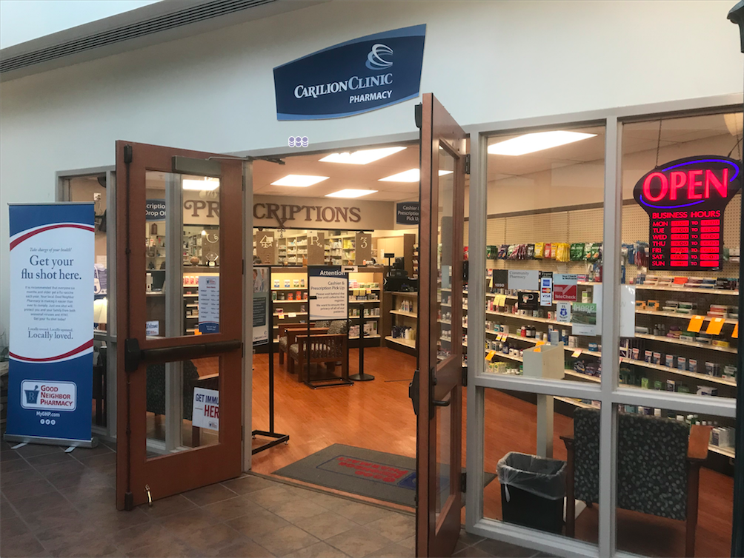
Carilion Clinic Pharmacy, New River Valley

Slide 4
Why me !!!!
Not here to teach MOA, MAT, science and psychology of addiction
Not here to quote literature and present ivory tower lecture
Here to relay personal observations and experiences
Here to give some background of addiction
Here to emphasize EDUCATION as the key

Slide 5
Outline
How this started
Narcotic overdose statistics
Addiction
Epidemiology of epidemic
Criteria of inpatient review
Case studies
Results
Conclusions & Observations
Future directions

Slide 6
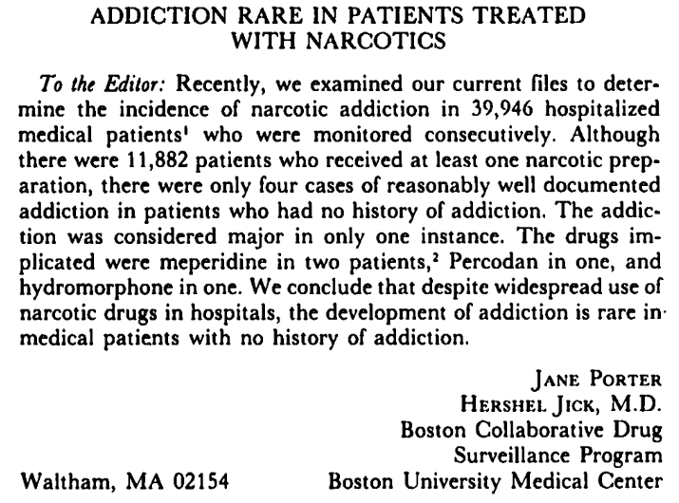
“Addiction rare in patients treated with narcotics.”

Slide 7
Review of Literature citing original letter
NEJM. 2017;376(22): 2194-2195.
608 citations
“In conclusion, we found that a five-sentence letter published in the Journal in 1980 was heavily and uncritically cited as evidence that addiction was rare with long-term opioid therapy”.

Slide 8
FALLOUT
Purdue Pharma…Purdue Frederick
Settled suit in 2007, 3 top executives pleaded guilty to misleading……..
Am J Public Health. 2009 February; 99(2): 221–227.
$650 million in fines from Purdue Frederick
$27 million to VA to establish PMDP, early 2000’s
Received their patent back as part of plea deal

Slide 9
Methadone Clinic Observations
Personal work in a Methadone Maintenance Clinic
Observations of daily dosing
200+ patients daily
Family attendance

Slide 10
Neonatal Abstinence Syndrome
1 in 5 pregnant women exposed to opioids during pregnancy
National average 50-90 percent babies born to this demographic will experience NAS
Becoming involved, our facility rates are 7-15%
Alas, my EPIPHANY !!!!!!!!

Slide 11
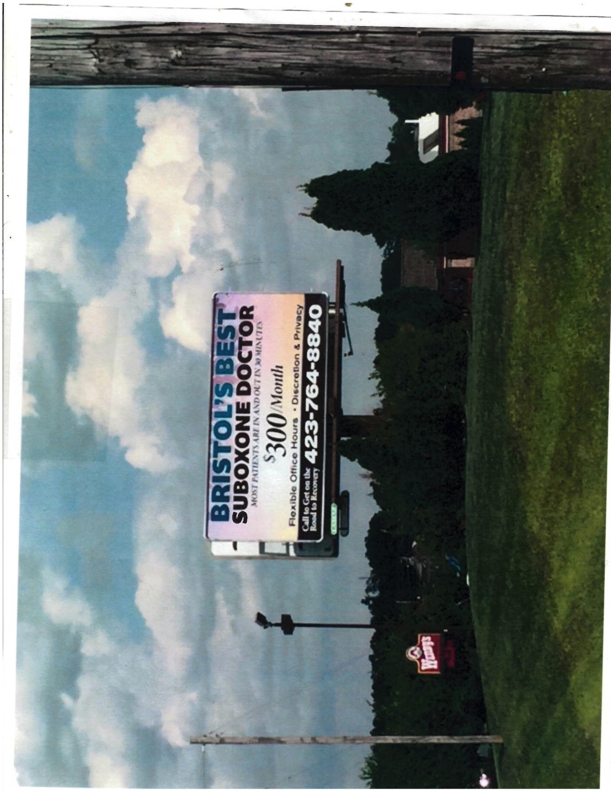
Constant Advertising $$$$$$$

Slide 12
Political monies
Nationally, congressional candidates obtained $15 million in 2016 from Big Pharma
Nearly $500,000 to Virginia and Tennessee lobby groups from Big Pharma
M Griffith,VA; P Roe, Tn; M Warner, VA; T Kaine, VA; B Corker, Tn.
Big Pharma spent 3 times the dollars than gun lobbyists

Slide 13
Epidemic vs Pandemic
Black Death in 14th century; 1346-1353
  Estimated to have killed 30–60% of Europe’s total population --- 375 to 450 million total
  200 year recovery of world population
  Average yearly deaths ---60 million

Slide 14
Epidemic vs Pandemic
Approximately 60,000 have died nationally in 2016,
1 every 10 minutes dies of an opioid overdose.
Approximately 1300 died in Virginia during same time period
Don’t be overwhelmed, keep in perspective, remain calm, a death is a death

Slide 15
Statistics
More than three out of five drug overdose deaths involve an opioid.
Overdose deaths from opioids, including prescription opioids and heroin, have nearly quadrupled since 1999.
Average of 124 deaths per day from drug overdose
Current death rate is 1 every 10 minutes; 144 per day
https://www.overdoseday.com/resources/facts-stats/
https://www.drugabuse.gov/related-topics/trends-statistics/overdose-death-rates

Slide 16
Defining Statistics
99% of the world production of HYDROCODONE is consumed in the USA
85% of Oxycodone used in the USA
SWVA carries a higher risk of overdose from opioids (Pulaski Co is 8x higher)
Martinsville is number one town in the USA for opioid prescriptions

Slide 17
Statistics: SUD vs Diabetes
Recent data shows 27 million SUD diagnoses
Data shows 30 million diabetics
$322 billion annually on diabetes and pre-diabetes care
$750 billion annually on SUD (dated 4 years) --- $280 billion on treatment alone

Slide 18
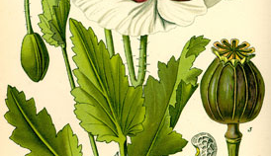
The Poppy Plant

Slide 19
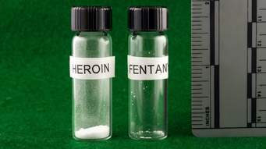
Comparative Lethality

Slide 20
Comparative Lethality
Morphine < Heroin < Fentanyl < Carfentanyl
1 < 50 < 100 < 10000
Carfentanyl is a elephant tranquilizer
Available from China via Mexico
Games…..Skittles Party and Honey Tar!

Slide 21
Identifying at Risk Patients
Continuously updated report that pulls patients based on risk factors
Identification criteria:
  Admitting diagnosis of overdose or poisoning
  Order for an opioid
    Extended release or scheduled immediate release
  Orders for a benzodiazepine AND an opioid

Slide 22
Patient Review
Trial time period: 15 working days
Patients identified: ~15 per day
5-10% of identified population determined to benefit from naloxone
  Limited due to time allotment
30%
Chronic Opioids and/or with Benzodiazepines
70%
No Opioids on PTA List

Slide 23
Observations
Over 15 days, 26 patients were identified where naloxone in the home would be beneficial
Patient goal set at 1-2 per day based on time allocated
Education on opioids was given to each patient and their families
1 of 26 categorized as a SUD patient
25 of 26 patients on chronic opioids for pain management
Pain managed in recognized Pain Clinics or Family Practice environments

Slide 24
Case Study
Admitting diagnosis: Overdose
  Methadone for chronic back pain
  Benzodiazepines for anxiety
Admitted to the ICU
  ~10 days in the ICU
  ~5 additional days in a step down unit
Patient had a Narcan Nasal kit at home but did not use it
  “Too expensive and I am on a limited income from disability.”
  $125 was his copay because the billing was not done correctly.
http://images.dailykos.com/images/137659/small/drug.jpg?1428526593

Slide 25
Case Study continued
Education provided
  No need to budget money if you die
  The average cost of a 3-day hospital stay is around $30,000
  His corrected copay was $17
Now he says he will use it in the future, as this was not his first overdose!
https://www.healthcare.gov/why-coverage-is-important/protection-from-high-medical-costs/

Slide 26
Patient vignette
3.5 month pregnant heroin addict
Previously addicted to oxycodone
Heroin <$ alternative
Economy, survival and maintenance of habit
$80/10 hits, resale at $30/hit….
  $220 ROI
  $80 for the personal high
  $140 to live on for 3 days

Slide 27
Truck stop overdose
Electrical apprentice found unresponsive in bathroom of local truck stop
Heroin OD, Naloxone administered in the ED
Chance interview 40 min post OD
Depression and feeling of numbness
Referred for help

Slide 28
Patient Readmit for Respiratory Depression
Patient identified to benefit from NALOXONE
Significant MME and Benzo’s
Cost was issue and refused to acknowledge concern
Readmitted and discussed with daughter – drug interaction
Obtained Narcan

Slide 29
Preliminary Results
ALL Accepted Recommendation for Naloxone
  20 of 26 identified patients were sold naloxone
    10 Narcan kits
    9 Naloxone kits
    1 EVZIO kits
  3 of 26 already had kits, but would have obtained otherwise
  3 of 26 wanted kits, but did not have the money
All received training from REVIVE! Guidelines
  Return demonstration utilized
http://bloximages.newyork1.vip.townnews.com/pilotonline.com/content/tncms/assets/v3/editorial/a/8a/a8af60d3-cf34-5603-b0c8-91dc03d9f411/57f030cc5bffd.image.jpg?resize=1200%2C864

Slide 30
Conclusions & Lessons Learned
Most know someone who has experienced an overdose or death due to overdose
Many times family members were candidates for a Naloxone kit
Many did not realize their pain medications were opioids
Healthcare has done a great job treating pain, but we can improve our education of:
  Opioid risks and benefits
  Risk of overdose and how to treat
  SBIRT

Slide 31
Future Goals
Expand program for all pharmacists to identify patients and provide training
  Need to train on REVIVE!
May expand criteria list: Suicide attempt
Solidify coordination process between outpatient and inpatient pharmacies to provide pricing and product availability
Improve affordability of medication
  Education to pharmacies to check multiple brands

Slide 32
Updated Results
ALL Accepted Recommendation for Naloxone
  31 of 43 identified patients were sold naloxone
    18 Narcan
    10 Naloxone
    3 EVZIO
  5 of 43 wanted medication, but did not have the money
  4 of 43 already had medication
  2 of 43 received paperwork for free EVZIO
  1 of 43 wanted naloxone, but left ED before obtaining
All received training from REVIVE! Guidelines
  Return demonstration utilized
http://bloximages.newyork1.vip.townnews.com/pilotonline.com/content/tncms/assets/v3/editorial/a/8a/a8af60d3-cf34-5603-b0c8-91dc03d9f411/57f030cc5bffd.image.jpg?resize=1200%2C864

Slide 33
Opioid Risk Tool
There is a definite need to educate BEFORE prescribing opioids
As noted, we observed 70% were opiate naïve patients
Education is the key to the treatment goal
Many tools & apps available. Use what is most comfortable

Slide 34
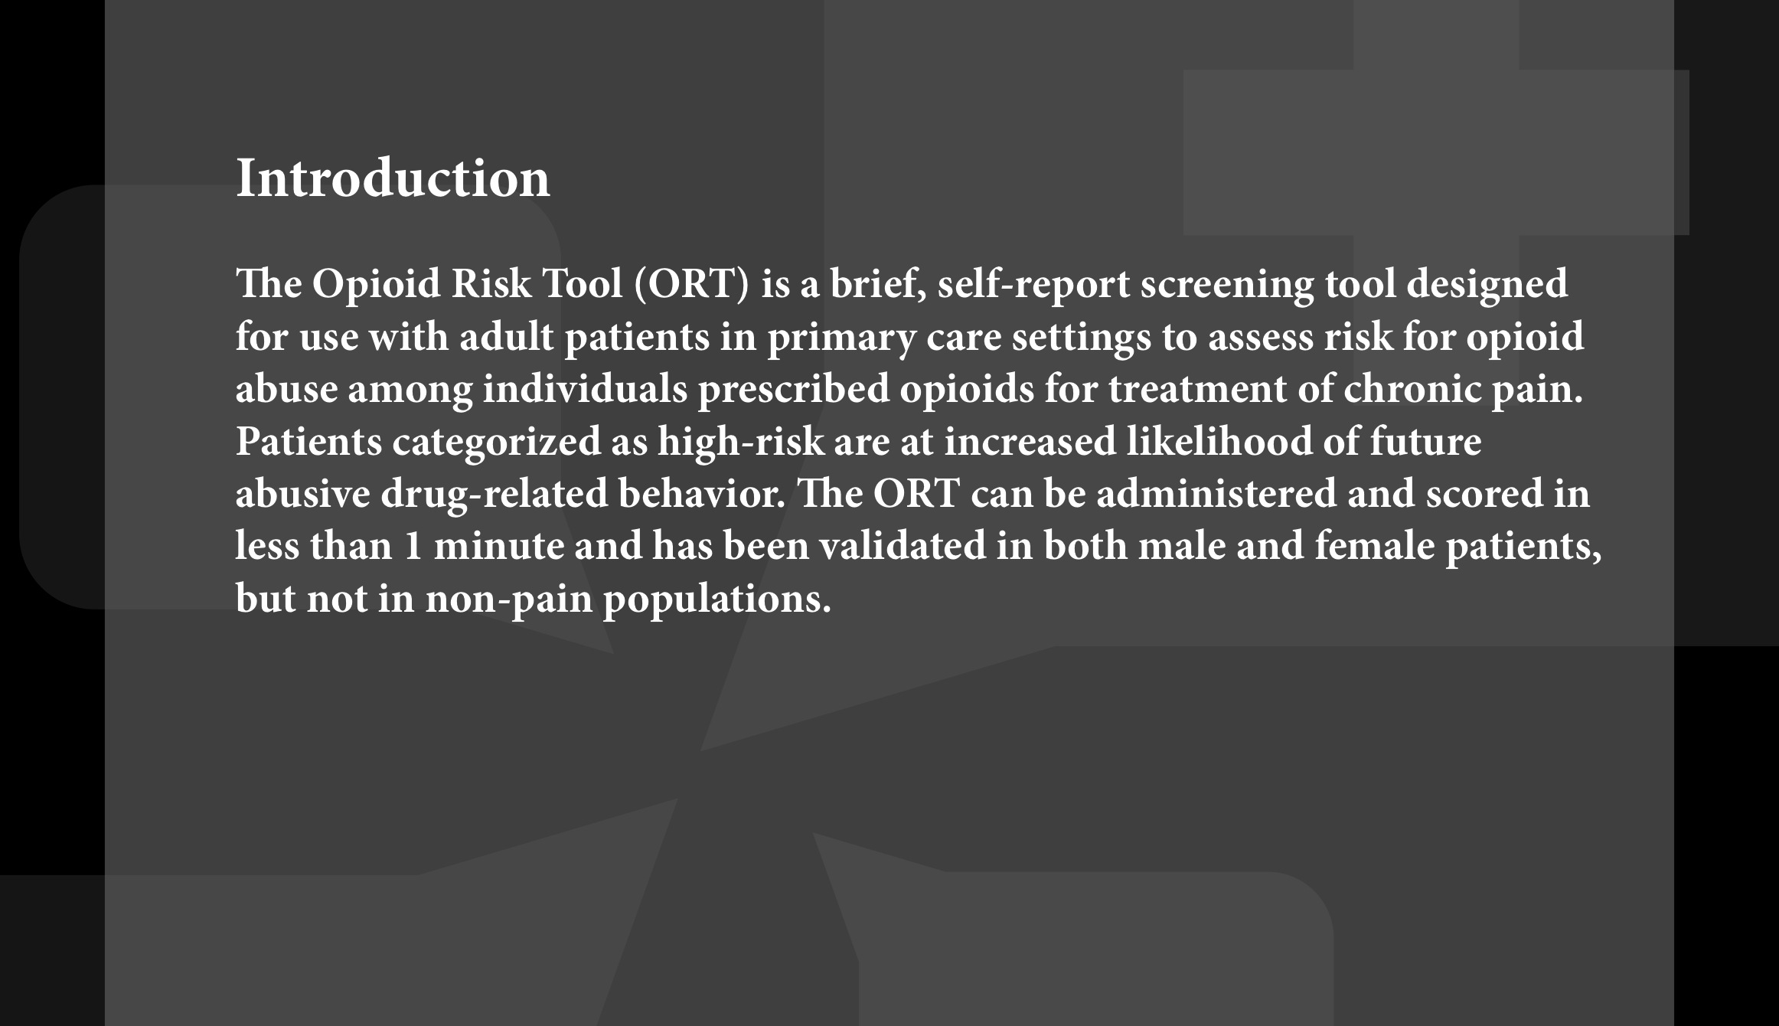
Opioid Risk

Slide 35
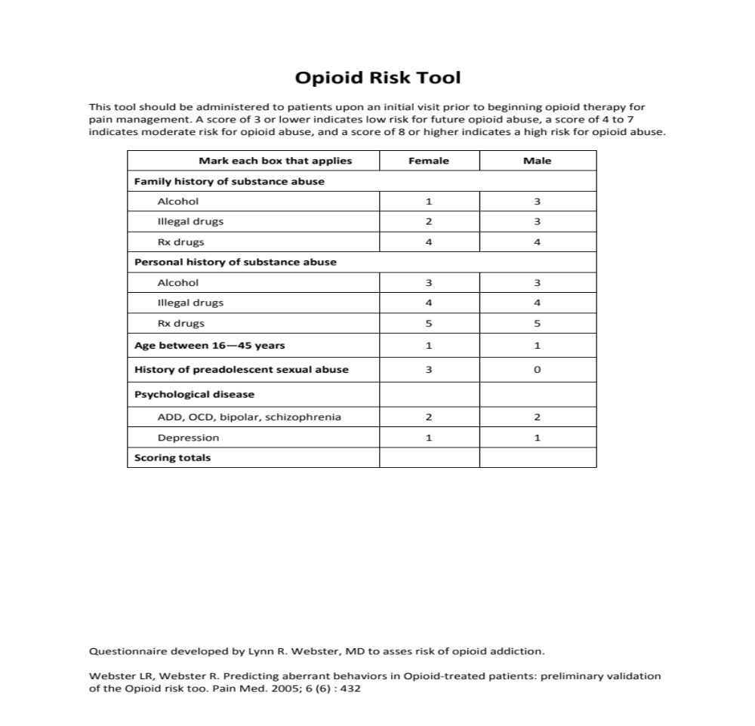
ORT, Scoring

Slide 36
SBIRT
Screening Brief Intervention Referral for Treatment
Clinicians have the most powerful opportunity to get help for those in need
Intuitive histories and very detailed interviews; open ended questions and motivational skills
Development of EMPATHY

Slide 37
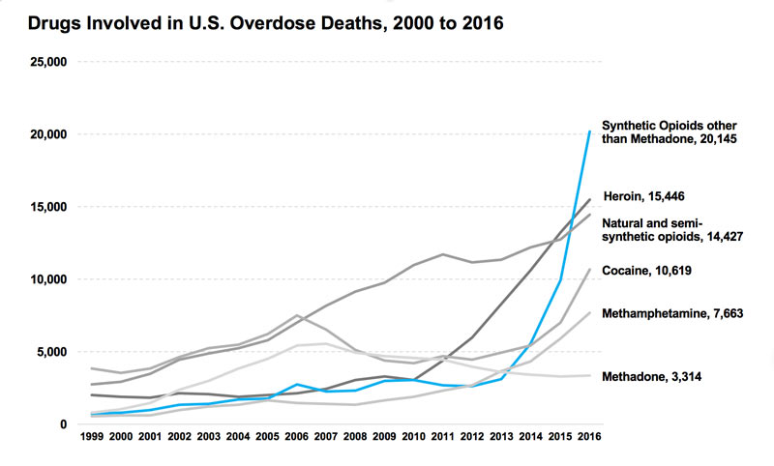
Overdose deaths still increasing

Slide 38
Naloxone
Naloxone has become the key to open the door for conversation
Many patients do not feel at risk
Patients are the epicenter of the opioids
Providers now required to write a prescription if MME >120 in Virginia, with or without concurrent use of benzodiazepines or history of misuse

Slide 39
Naloxone
Cost issues, co-pays vs cash
Who to educate
Uninsured…..Evzio program
Any patient with an opioid prescription is presented the opportunity for education on the benefits versus risks
Even in our facility, one armed paper hangers

Slide 40

Questions
THANK YOU FOR YOUR TIME

