Slide 1
A Challenging Case of Recurrent Pneumonia in a Patient with Coal Worker's Pneumoconiosis
Lena Manning PGY-1, Johnston Memorial Hospital
Sana Yakoob PGY-1, Johnston Memorial Hospital
April 26, 2018

Slide 2
Background
Coal Worker’s Pneumoconiosis
(CWP)
Chronic occupational lung disease which can trigger inflammation of the alveoli leading to irreversible lung damage
  Severe forms can result in progressive massive pulmonary fibrosis (PMF)
High prevalence in Appalachia as compared to other geographical areas; thought to be related to pyrite

Slide 3
Case
72 year old Caucasian male with a history of working in the coal mines for about 27 years with known diagnosis of CWP and PMF
PMH: COPD, CWP, PMF, DM2, HTN, chronic anemia, arthritis
PSH: hernia repair
FH: non-contributory
SH: worked in coal mines for 27 years. Non-smoker, non-drinker, no substance abuse
MEDs: Inhalers, Verapamil, Metformin, Losartan, Ibuprofen
Allergies: NKA

Slide 4
Pulmonary Function Testing
FEV1/FVC is 0.48 pre-treatment and 0.51 after bronchodilator treatment. FEV1 is 1.06 L, which is 38% of predicted value that improved to 1.26 L which is 45% of predicted value with a 20% change. Total lung capacity is 59% of predicted value. DLCO is 44% of predicted value.
Mixed obstructive and restrictive defects. Severe obstructive defect with good response to bronchodilator treatment and moderate restrictive defect associated with moderate decrease in diffusion capacity.

Slide 5
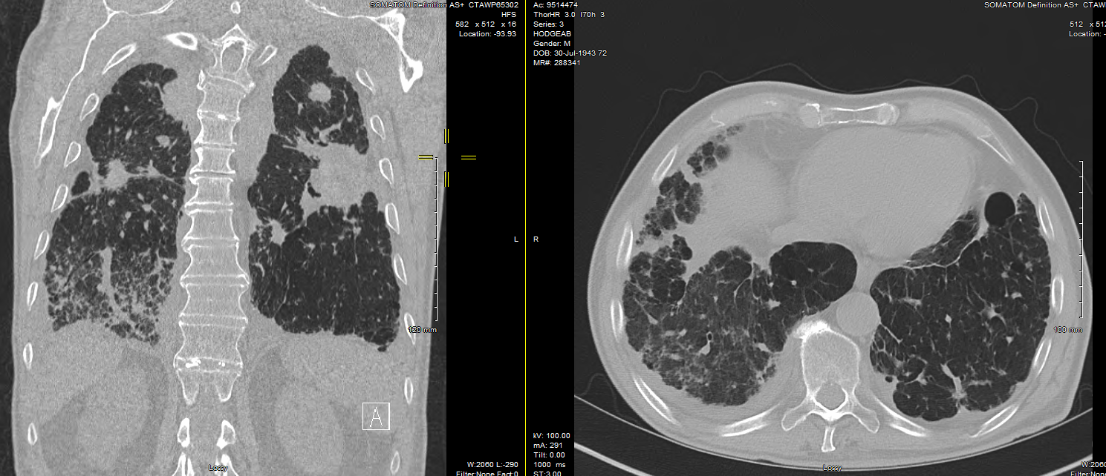
CT Chest
Notes:
The heart size is normal. Mild coronary artery calcifications.
Mediastinal vascular structures are otherwise normal. There are calcified
paratracheal, prevascular, subcarinal and hilar lymph nodes. No
suspicious mediastinal or hilar nodal masses. There are numerous small
irregular interstitial nodules throughout both lungs as well as larger
spiculated conglomerate masses in the mid and upper lung zones. There is
architectural distortion surrounding the larger nodules. There is also
diffuse nodular pleural thickening. There is no recurrent pneumothorax.
There are nonspecific groundglass opacities in the basilar segments of
the right lower lobe. There are groundglass opacities and interspersed
areas of lung consolidation in the basilar segments of the right lower
lobe which have improved slightly since 10/31/2015. Lungs are otherwise
clear. There are small bilateral pleural effusions.
CWP/silicosis and progressive massive fibrosis. Resolution of left
pneumothorax since prior study.
2. Groundglass opacities and consolidation in the basilar segments of the
right lower lobe slightly improved from 10/31/2015.
3. Small bilateral pleural effusions.

Slide 6
Initial hospitalization
Presented with productive cough without hemoptysis, chills, pyrexia, worsening dyspnea, and hypoxia
CT chest showed severe CWP with PMF and RLL consolidation with cavitary mass in LUL
Blood and respiratory cultures grew ESBL + E coli and patient was treated with 4 weeks of IV Ertapenem

Slide 7
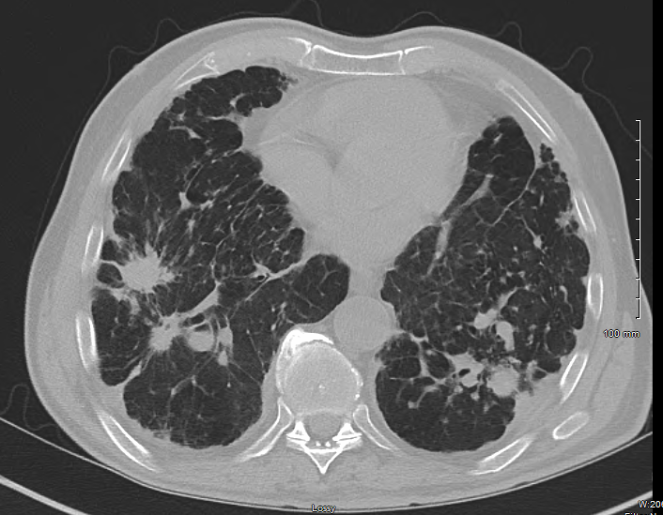

Slide 8
Second hospitalization
Patient readmitted shortly after finishing 4 week course of antibiotics with similar symptoms as his prior hospitalization
Diagnosed with Streptococcus pneumoniae bacteremia and pneumonia and was started on IV Rocephin
CT guided biopsy of cavitary mass was negative for malignancy
  Procedure was complicated by pneumothorax requiring chest tube and pleurodesis by general surgery
Bronchoscopy and EBUS was performed
  Negative for malignancy and AFB
  One BAL sample showed prominent eosinophils

Slide 9
Labs
  CBC showed eosinophil number of 2.
  IgE level elevated at 1,909
    IgA, IgG, and IgM level all within normal limits
  Quantiferon TB gold was negative
  Strongyloides antibody was elevated at 1.66

Slide 10
Treatment
Patient was treated with 1 dose of Ivermection
Patient was followed in the outpatient pulmonology clinic with no further hospitalizations due to pneumonia

Slide 11
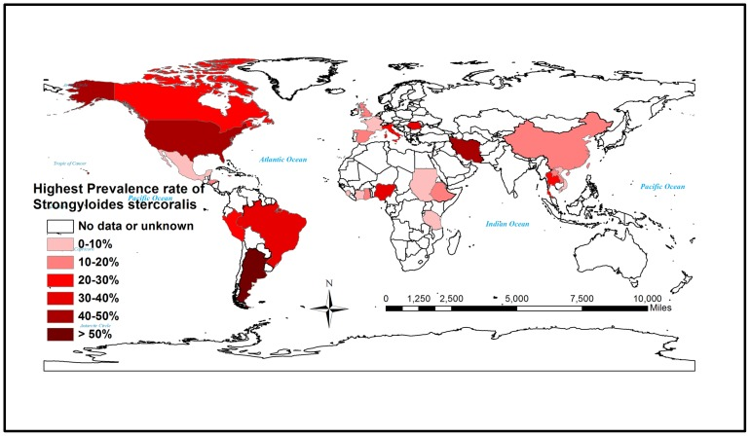

Slide 12
Strongyloides stercoralis hyperinfection syndrome
Strongyloides stercoralis is an intestinal parasitic nematode
Transmitted through contact with contaminated soil
Increased risk
  Males, people working with soil (such as in coal mines and farms), people of white race, patients with altered cellular immunity (especially those on long-term steroid therapy), patients with lymphoma, allograft transplant recipients, travelers to areas of endemicity, and other institutionalized individuals are at the greatest risk of acquiring this disease
Most cases reported are linked to chronic immunosuppression secondary to chronic steroid use or HIV
Hyperinfection syndrome denotes a phenomenon in which a tremendous increase in the number of worms leads to excessive worm burden without the spread of larvae outside the usual migration pattern. The worms are detectable in extraintestinal regions, especially in the lungs, and the detection of larvae in stool and/or sputum is the hallmark in diagnosis of hyperinfection

Slide 13
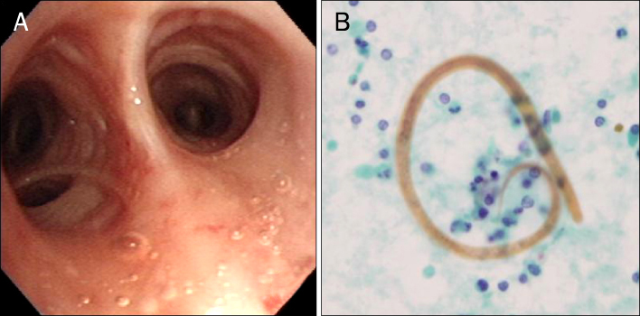
Notes:
Bronchoscopy finding, no abnormal lesions was observed in the bronchus, filariform larvae of strongyloides stercoralsi observed in BAL fluid

Slide 14
Life Cycle
Infection begins when human skin contacts filariform larvae of S. stercoralis which are found in soil or other materials contaminated with human feces.
Filariform larvae penetrate the skin and migrate through the blood to the lungs where they penetrate the alveolar air sacs.
Larvae ascend the tracheobronchial tree and are swallowed.
Mature into adult worms that burrow into the mucosa of the duodenum and jejunum.
Adult female produces eggs from which noninfectious rhabditiform larvae develop within the GI tract. These larvae are passed in feces. Cycle takes 3-4 weeks.

Slide 15
Autoinfection
S. stercoralis is unique from other helminthic parasites in that it can complete its entire life cycle within human host.
Rhabditiform larvae mature into filariform larvae within GI tract. Larvae can then penetrate the perianal skin or colonic mucosa.
Transformation may be accelerated by constipation, diverticula, other conditions that reduce bowel motility, and steroid use.
In patients with depressed cell-mediated immunity, autoinfection may give rise to potentially fatal hyperinfection with disseminated disease.
Notes:
Discuss diseeminated

Slide 16
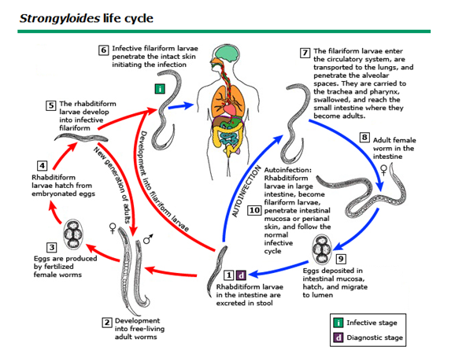
Notes:
S. stercoralis exhibits a complex and unique developmental phase with two distinct life cycles: a free-living heterogonic cycle and a parasitic life cycle completed in the same host [28]. In the free-living phase, during the development of nonparasitic adults, both males and females occur in soil, which maintains infestation of the soil (Figure 2). The parasitic phase allows noninfective new larvae to molt in the human host into infective filariform larvae, which then penetrate the intestine and set up a new cycle, leading to autoinfection or hyperinfection to increase the worm burden without exogenous reinfection [29]. This autoinfective phase is responsible for the decade-long persistence of infection in untreated hosts.

Slide 17
Conclusion
Strongyloides stercoralis has a high prevalence in the Appalachian region likely secondary to coal mining and soil composition specific to this geographic location.
We should have increased clinical suspicion for Strongylodies hyperinfection syndrome in patient’s who live in this area and have coal worker’s pneumoconiosis and/or progressive massive fibrosis with peripheral eosinophilia, risk factors, and pulmonary or gastrointestinal symptoms.
Notes:
S. stercoralis infection can remain latent for decades; life-threatening systemic hyperinfection can occur when an infected person becomes immunocompromised by medications or other conditions

Slide 18
Questions ?

Slide 19
References
Arnold, Carrie. "A Scourage Returns: Black Lung in Appalachia." Environmental Health Perspective (2016): A13-A18. Epublished January 1, 2016.
Asdamongkol N, Pornsuriyasak P, Sungkanuparph S. "Risk factors for strongyloidiasis hyperinfection and clinical outcomes." The Southeast Asian Journal of Tropical Medicine and Public Health (2006): 875-884.
Gourahari Pradhan, M.D.,1 Priyadarhini Behera, M.D.,1 Manoj Kumar Panigrahi, M.D.,corresponding author1 Sourin Bhuniya, M.D.,1 Prasanta Raghab Mohapatra, Jyotirmayee Turuk, and Srujana Mohanty, M.D. et. al. "Pulmonary Strongyloidiasis Masquerading as Exacerbation of Chronic Obstructive Pulmonary Disease." Tuberculosis and Respiratory Disease (2016): 301-311. Epublished October 5, 2016.
Joo Yun Cho, Joong Goo Kwon, Kyung Ho Ha, Jae Young Oh, Myung In Jin, Seong Wook Heo, Geun Ho Lee, Chang Ho Cho, A case of steroid-induced hyperinfective strongyloidiasis with bacterial meningitis; J Gastroenterol. 2012 Nov; 60(5): 330–334.
Puthiyakunnon, Santhosh et al. “Strongyloidiasis—An Insight into Its Global Prevalence and Management.” Ed. Gary L. Simon. PLoS Neglected Tropical Diseases 8.8 (2014): e3018. PMC. Web. 7 Apr. 2018.

