Slide 1
Insomnia: Tips for a better night’s sleep
By: Lauren Burns, DO PGY2
Mentor: Dr. Kyle Ward, DO

Slide 2



Insomnia
Loosely defined a difficulty falling asleep, staying asleep or poor quality of sleep that interferes with daily activities

Slide 3
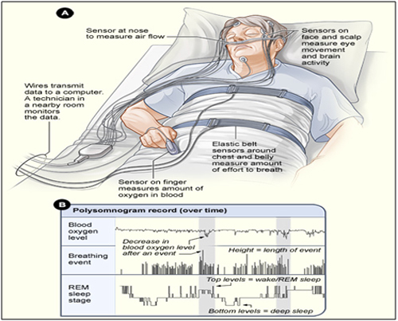
Polysomnography evidence
Signs of insomnia:
  Prolonged sleep latency
  Frequency nocturnal awakenings
  Prolonged periods of wakefulness during the sleep period
  Frequent transient arousals

Slide 4
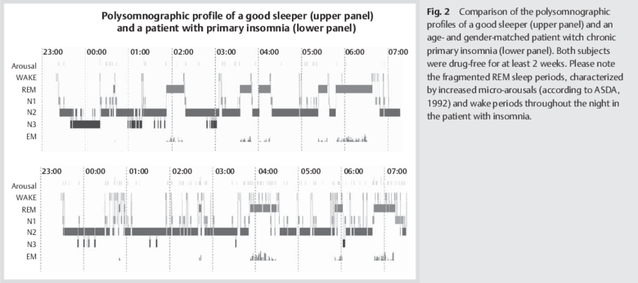
Riemann D Spiegelhalder K et al. REM sleep instability-a new pathway for insomnia? Pharmaopsychiatry45(5):167-76 · January 2012

Slide 5
Prevalence
One of the most common medical complaints
  Generates over 5 million office visits per year in US
Prevalence increases with age
More common in adult women whom report it 50% more often than men
Higher prevalence in unemployed, divorced, widowed, separated, lower socioeconomic status

Slide 6
DSM-V Diagnostic Criteria
Dissatisfaction with sleep quantity or quality
  Associated with one or more:
    Difficulty initiating sleep
    Difficulty maintaining sleep
    Early morning awakening with inability to return to sleep
Sleep disturbance causes clinically significant distress or impairment in social, occupation, educational, academic, behavioral or other importance areas of functioning
Occurs at least 3 nights per week
Present for at least 3 months

Slide 7
DSM-V continued
Occurs despite adequate opportunity for sleep
Not better explained by or occur exclusively during the course of another sleep-wake disorder
Not attributable to physiological effects of illicit substances or medications
Coexisting mental disorders and medical conditions do not adequately explained the predominant complaint

Slide 8




Insomnia symptoms
Problems with attention
Problems with concentration
Memory deficits
Poor performance at school or work
Changes in mood
Daytime sleepiness
Lack of energy or motivation

Slide 9
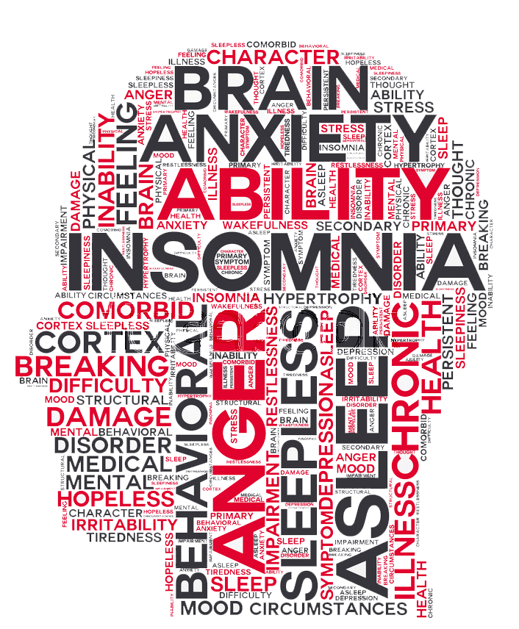
Predispositions of insomnia
Car accidents
Errors at work
  Including industrial disasters
Hypertension
Diabetes
Depression
Obesity

Slide 10

How much sleep do we need?
NIH recommendations:
  School aged kids at least 10 hours per night
  Adolescents: 9-10 hours per night
  Adults: 7-8 hours per night

Slide 11
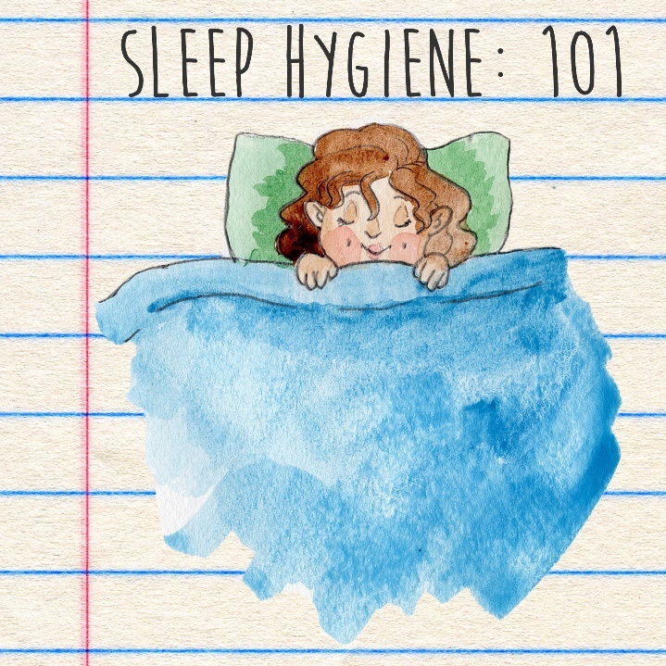
Sleep Hygiene
Adoption of good sleep habits every night to improve how you sleep
Good sleep hygiene can greatly improve people’s enjoyment of life and daily functioning

Slide 12



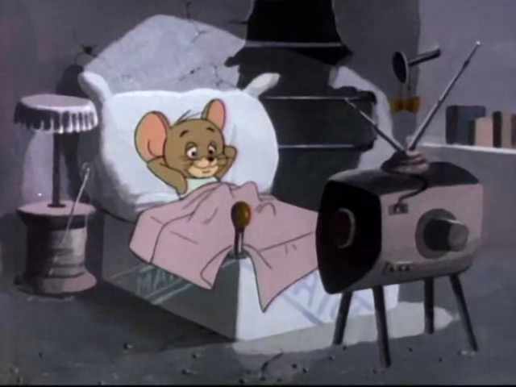


Slide 13
Tips for a better night’s sleep
Keep a regular sleep schedule
Develop a relaxing bedtime routine away from bright lights
Avoid watching screens in the bedroom right before bed
Keep your bedroom cool and comfortable
  Between 60-70 degrees
Keep your bedroom free from any noise, distractions or excess lights

Slide 14

Tips continued
Make sure mattress and pillows comfortable/supportive
  Most mattresses last about 9-10 years before replacement
Calming activity the last 1 hour before bed
  Reading, warm bath, meditating
If you cannot sleep when you lay down, go to another room and do something relaxing until you feel tired
Keep work materials, computers and televisions out of the sleeping area

Slide 15

Exercise and sleep
Shown to help people sleep better at night
At least 20 minutes per day
More than 4-5 hours before bedtime

Slide 16

Controversy about napping…
Avoid afternoon naps, even short ones
  Show to disturb the normal sleep wake cycle

Slide 17

Substances to avoid
Alcohol
Heavy/spicy meals
  At least 2-3 hours before bed time
Drinks with caffeine later in the day before bed

Slide 18

Patient Education
Engages patient’s in their health care
Interdisciplinary approach to understanding conditions
Important in patient understanding of their condition |
Shown to improve patient compliance with recommendations

Slide 19
How to educate patients
Assess patient’s current knowledge about their condition
Find out how your patient likes to learn
Focus on what your patient needs to know
Pay attention to patient’s concerns
Respect patient’s limits
  Offer only the amount of information they can handle at one time
Organize information for easier comprehension
Adjust education based on patient

Slide 20

Basic goals in education
What your patient needs to do and why
When your patient can expect results
Warning signs to watch for
What patient should do if a problem occurs
Who your patient should contact for questions/concerns

Slide 21
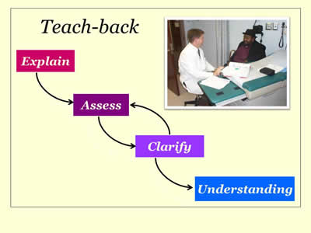
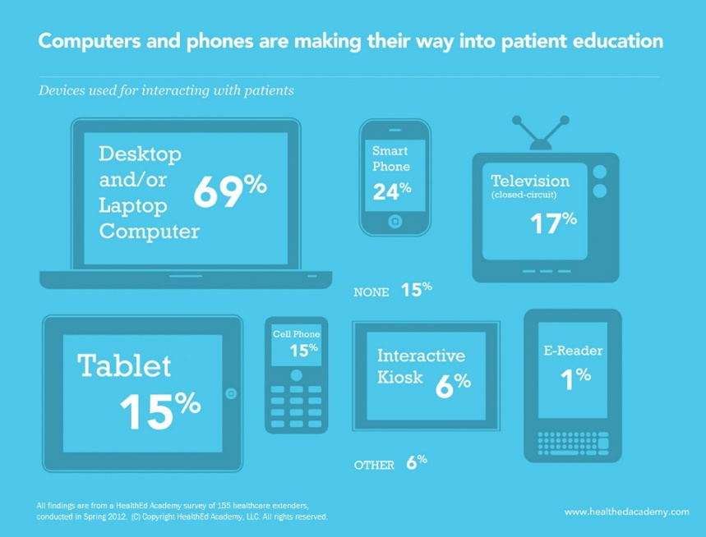
Teaching tools
Brochures or other printed materials
Podcasts, YouTube videos
Videos/DVDs
PowerPoint presentations
Models or props
Posters or charts
Group classes
Trained peer educators

Slide 22
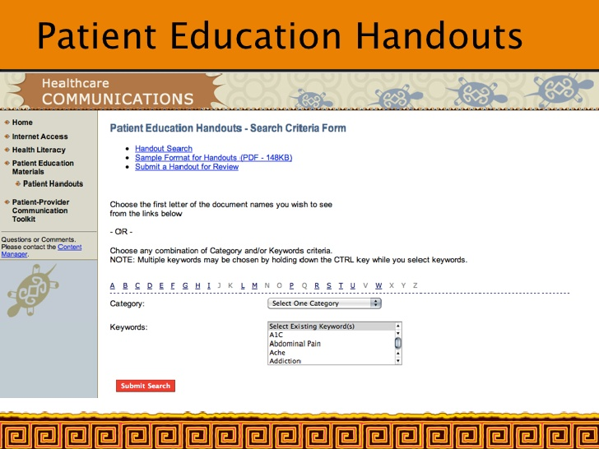
Patient education handouts
Organizations such as Uptodate, AAFP, ACOFP sponsor/publish
Published online and in medical journals
Part of EMR systems which can be printed at office visits

Slide 23

My research project
Development of patient education handout
Will be published in 2018 insomnia issue of the journal
Can be dispersed by family doctors to patient’s in attempt to educate them about this issue

Slide 24
Thank you!
Questions?

Slide 25
References
National Sleep Foundation
Centers for Disease Control and Prevention
American Academy of Sleep Medicine
Falvo DR. Communicating effectively in patient teaching: enhancing patient adherence. In: Falvo DR, ed. Effective Patient Education: A Guide to Increased Adherence. 4th ed. Sudbury, MA: Jones and Bartlett; 2010:chap 8
Uptodate: Insomnia

Slide 26
Image references
https://socalhomeownerscorner.com/having-trouble-sleeping-try-these/
https://www.ruperthealth.com/blog/health/do-you-have-trouble-sleeping/
http://whywecantsleepinsomnia.blogspot.com/2016/10/how-is-insomnia-diagnosed.html
https://okasaneko.wordpress.com/2011/01/14/better-days/
https://i247.photobucket.com/albums/gg158/MDA2008/MDA2010/businessmanworkinglate.jpg
https://www.huffingtonpost.com/entry/poor-sleep-hygiene-is-killing-you-and-your-career_us_58f7cc23e4b081380af51864
http://tomandjerry.wikia.com/wiki/File:The_Wacky_World_of_Sports_-_Jerry_in_his_bed_watching_T.V.PNG
https://www.capitalfm.co.ke/lifestyle/2015/05/15/30-minutes-of-exercise-is-key-to-health-in-old-age/
https://www.consumerhealthdigest.com/menopause-center/menopause-mood-swings.html
https://ravishly.com/sleep-hygiene-11-tips-improving-your-very-important-sleep
https://visual.ly/community/infographic/health/computers-and-phones-patient-education

