Slide 1
Addiction: A Love/Hate Relationship
Head For The Hills September 30, 2017
Dr. Melanie L. Skeen

Slide 2
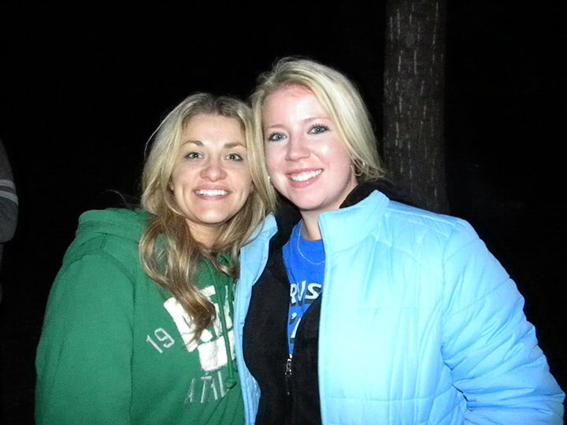
The Breaks 2010

Slide 3

The Breaks 2010

Slide 4
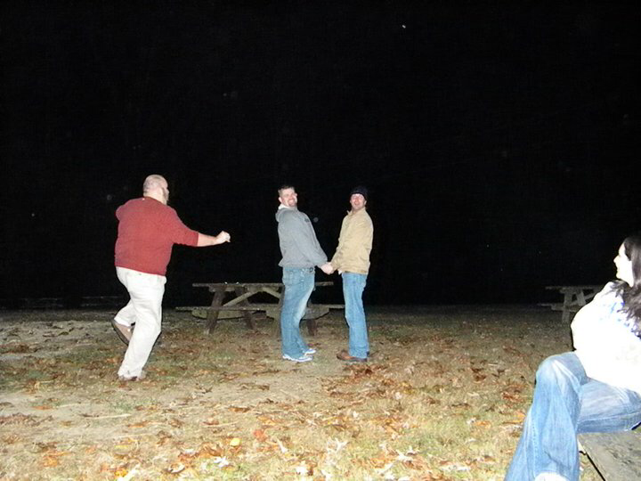
The Breaks 2010

Slide 5

The Breaks 2010

Slide 6
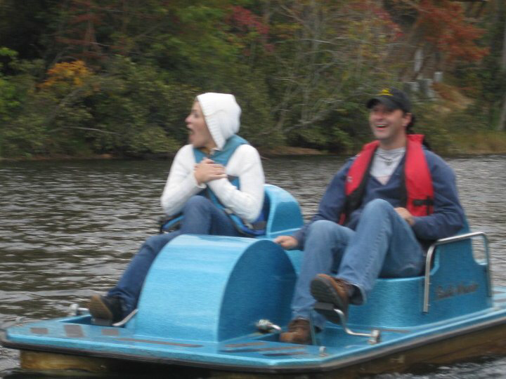
The Breaks 2010

Slide 7
Common Views on Addiction
Not a disease
Weakness
Only a choice
Mind over matter
Poor
Uneducated

Slide 8
My Story…..

Slide 9
What I Learned About Addiction In Med School
…uh…?

Slide 10
Medical Myths About Addiction
If the patient is taking opiates for true pain, there is no risk of addiction
Withdrawal should be over in about 3 days
If the patient tests + for opiate, then they cannot be experiencing withdrawal
If the patient tests – for opiate, then withdrawal should be over
After the patient is through withdrawal sx, then they should be fine
It takes continued use over a long period of time to develop addiction and tolerance

Slide 11
So..What IS Addiction?
Addiction is a chronic disease characterized by drug seeking and use that is compulsive, or difficult to control, despite harmful consequences. The initial decision to take drugs is voluntary for most people, but repeated drug use can lead to brain changes that challenge an addicted person’s self-control and interfere with their ability to resist intense urges to take drugs. These brain changes can be persistent, which is why drug addiction is considered a "relapsing" disease—people in recovery from drug use disorders are at increased risk for returning to drug use even after years of not taking the drug.¹

Slide 12
So What IS Addiction?
“Many people don't understand why or how other people become addicted to drugs. They may mistakenly think that those who use drugs lack moral principles or willpower and that they could stop their drug use simply by choosing to. In reality, drug addiction is a complex disease, and quitting usually takes more than good intentions or a strong will. Drugs change the brain in ways that make quitting hard, even for those who want to. Fortunately, researchers know more than ever about how drugs affect the brain and have found treatments that can help people recover from drug addiction and lead productive lives”¹

Slide 13
If You’re a Stats Kind of Guy/Gal..
2009 SAMHSA National Survey on Drug Use and Health (12yo and older)
  23.5 million needed tx for addiction (9.3%)
  Only 2.6 million (11.2% of those who needed tx) received tx at a specialty facility

Slide 14
Is Addiction Treatable?
YES! And it can be successfully managed
Pts in recovery will be at risk for relapse for years, possibly their entire lives
Rx treatment of opioid addiction increases retention in tx programs and decreases drug use, infectious diz, and criminal activity
Addiction tx meds + behavioral therapy = best chance

Slide 15
Barriers To Treatment
Fear of withdrawal (rehab)
Stigma placed on addicts
Fear of relapse/failure
Financial
Fear of inability of cope with stressors

Slide 16
How Do I Learn About Addiction?
Talk to your patients!
Do a rotation in Addiction Medicine
National Institute on Drug Abuse or NIDA (drugabuse.gov)
American Society of Addiction Medicine (asam.org)
Substance Abuse and Mental Health Services Administration (samhsa.gov)

Slide 17
References
www.drugabuse.gov

Slide 18

Thanks!

