Slide 1


Educating Children about Sugar and Exercise in the Community
Mylanie Facelo, DO
JMH FM PGY3 Resident
9/29/17

Slide 2

Financial Interest
I, Mylanie Facelo,
DO NOT have a financial interest/arrangement or affiliation with one or more organizations that could be perceived as a real or apparent conflict of interest in the context of the subject of this presentation.

Slide 3

Overall Goal
To bring awareness of this epidemic and attempt to potentially change the outcome of this trend.

Slide 4

Remember
¹Drug Abuse Resistance Education (D.A.R.E.)

Slide 5
The Background

Slide 6
Obesity Trends in Children
Childhood obesity is a global epidemic
  Global Burden of Disease Study 2013²
    1980-2013 study showed overweight and obesity on rise world wide
      27.5% in adults
      47.1% in children
      857 million in 1980 to 2.1 billion in 2013
  more than 1/3 of American children and adolescents are overweight or obese³
    = nearly 3x increase in obesity prevalence since 1980
Overweight child = Obese adult

Slide 7
Obesity Trends in Children (continued)
    Defining Childhood Obesity⁴
Weight Status Category | Percentile Range
Underweight | Less than the 5th percentile
Normal or Healthy Weight | 5th percentile to less than the 85th percentile
Overweight | 85th to less than the 95th percentile
Obese | 95th percentile or greater
Notes:
Example of 10 yo Boy of average height of 56inches who weigh 102# and BMI is 22.9 ; boy is 95% for BMI= obese and means his BMI greater than BMI of 95% of 10 yo Boys

Slide 8
Obesity Trends in Children (continued)
2011-2014
  Children and adolescents aged 2-19 years⁵:
    The prevalence of obesity has:
      remained fairly stable at about 17% and affects about 12.7 million children and adolescents.
      higher among Hispanics (21.9%) and non-Hispanic blacks (19.5%) than among non-Hispanic whites (14.7%).
      lower in non-Hispanic Asian youth (8.6%) than in youth who were non-Hispanic white, non-Hispanic black, or Hispanic.
      8.9% among 2- to 5-year-olds compared with 17.5% of 6- to 11-year-olds and 20.5% of 12- to 19-year-olds.

Slide 9
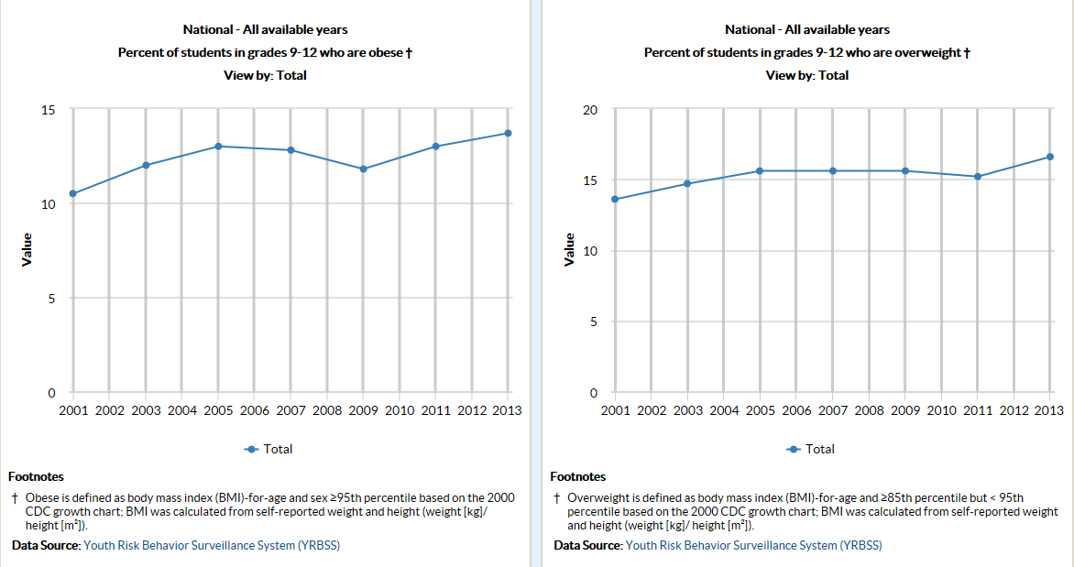
Sugar
CDC showing sugar intake

Slide 10
Potential links

Slide 11
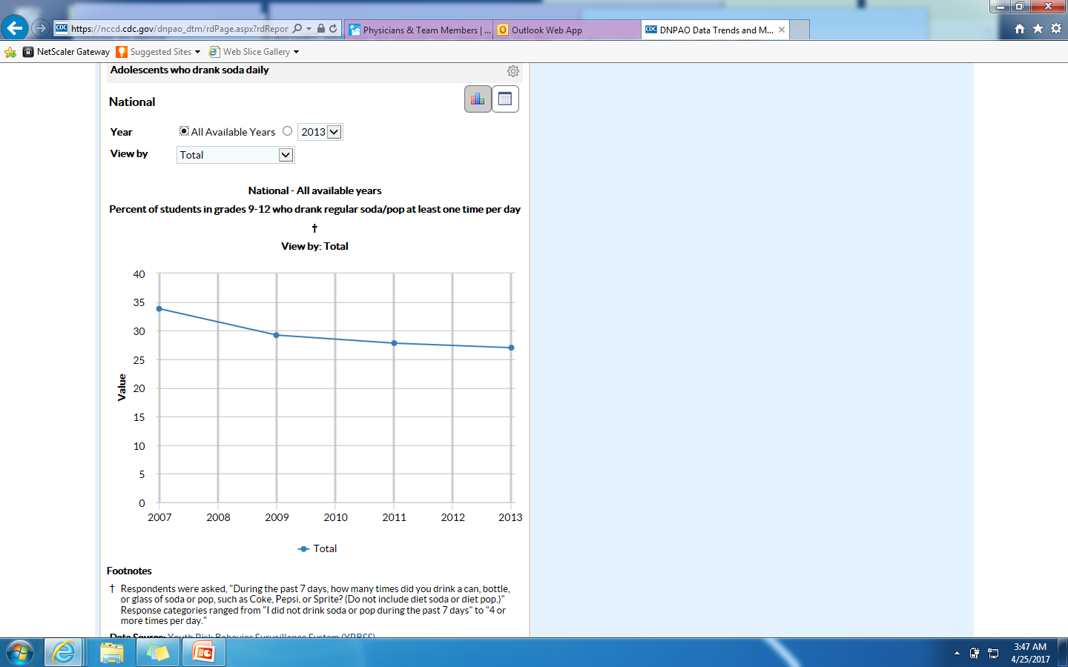
Obesity Trends in Children (continued)
Picture

Slide 12
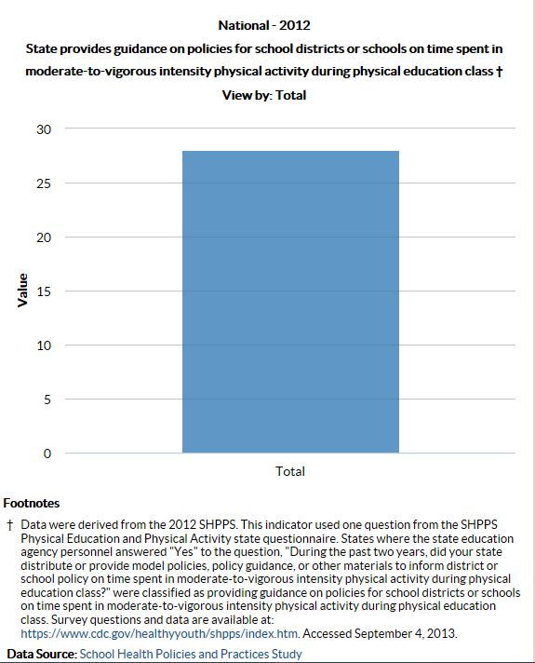
Obesity Trends in Children (continued)
Picture

Slide 13
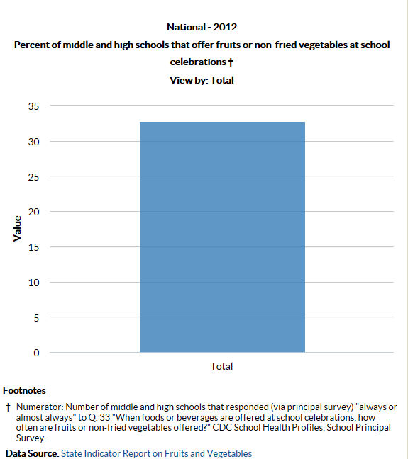
Obesity Trends in Children (continued)
Picture

Slide 14
Why important?

Slide 15
Why Important to know about Obesity trend in Children?
Harmful effects on body⁶
  High blood pressure, high cholesterol = risk factors for cardiovascular disease
  Increased risk of impaired glucose tolerance, insulin resistance and type 2 diabetes
  Breathing problems like asthma and sleep apnea
  Fatty liver disease /gallstone/gastroesophageal reflux
  Joint problems and musculoskeletal discomfort

Slide 16
Why Important to know about Obesity trend in Children?
Other effects⁶
  Psychological problems
    anxiety, depression
  Low self-esteem and lower self-reported quality of life
  Social problems such as Bullying
Risk factors in adulthood likely to be more severe

Slide 17
Why Important to know about Obesity trend in Children?
8/31/2017-CDC media advisory acknowledged the extent of the problem stating “Preventing and reducing obesity in the United States will require action by many parts of society. State and community leaders, employers, government agencies, health care providers and many others can help make it easier for adults and their family to move more and eat healthier to reduce the risk of obesity.”⁷

Slide 18
What has been done?

Slide 19
Obesity Trends in Children (continued)
Prevalence of obesity among in low-income children varied by WIC state agency
  8.2% in Utah
  20% in Virginia

Slide 20
Obesity Trends in Children (continued)
Women, Infant, Children (WIC)
  A federal program that promotes healthy eating and nutrition education for infants and children up to age 5, and low-income women who are pregnant, postpartum, or breastfeeding.
  To be eligible for WIC: women, infants, and children must meet residential, income, and nutrition risk requirements
Notes:
Nutrition during pregnancy and early childhood is critical for healthy child growth and development.

Slide 21
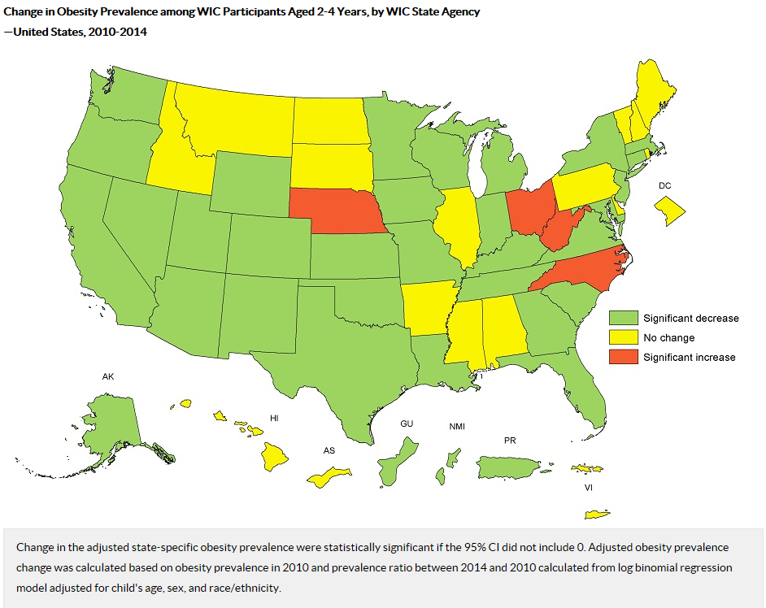

Slide 22
Obesity Trends in Children (continued)
Improvements through WIC from 2010- 2014
  Non-Hispanic blacks (From 12.7% to 11.9% = -.8%)
  Non-Hispanic whites (From 12.8 to 12.2% = -.6%)
  Hispanics (From 19.3% to 17.3% = -2.0%)
  Asians/Pacific Islanders (From 12.5% to 11.1% = -1.4%)
  American Indians/Alaska Native (From 20.9% to 18.0% = -2.9%)
Notes:
Nutrition during pregnancy and early childhood is critical for healthy child growth and development.

Slide 23
How does education fit?

Slide 24
Educational system
How important is education system?
  Correlation of education level with obesity prevalence⁷
    Less education = more likely to report obesity
    Without high school education=35.5%
    High school graduate= 32.3%
    Some college=31%
    College graduates=22.2%

Slide 25
Educational system
Education system used as tool to promote intervention for prevention⁸
  review was limited to school-based studies with a quantitative evaluation using anthropometric outcomes and that intervene on diet or activity related behaviors.
    68% of the interventions, or 17 of the 25, were ‘effective’ based on a statistically significant reduction in body mass index (BMI)
    Study targeted direct physical activity intervention through the physical education program combined with nutrition education
      Found physical education in schools and reducing television viewing interventions successful

Slide 26
Educational system
Intervention in the school system increasing vegetable consumption in 4th and 5th graders followed to middle school age children⁷
  After controlling for family sociodemographic background
    Students most exposed to the intervention increased their consumption of fruits and vegetables by nearly 0.5 cups (one standard serving)
    Students most exposed to the programming also showed a significantly greater increase in preference for fruit and green leafy vegetables, compared to students least exposed to the programming

Slide 27
The Study

Slide 28
Objective and Purpose of Study
To educate middle school aged children
  about sugar in their diet
  what it converts to in their body
  how much activity/energy then need to burn off a specific amount of sugar
With hopes of obesity prevention in the long run and evaluate limitation of resources in the school system as well as social economic resources by incorporating parental component.

Slide 29
Patient Selection
Looking at one title 1 funded middle school versus one non-title 1 funded middle school
Inclusion criteria
  6-8th graders, age 11-13, capable of understanding, reading, writing, and cooperating in educational program
Exclusion criteria
  No english speaking, declining cooperation, unable to do above inclusion criteria
Estimated number of participants- approximately 100-160 participants

Slide 30
Trial Design
Randomized study, Cohort study
Going to 2 different schools
Survey middle school children from grade 6-8( 11 a 13-year-old) about diet and exercise and potentially obtaining a BMI.
  Brief <5 minute survey will include:
    what they eat throughout the day
    what do they do on their spare time
    how much physical activity they do in a day
    what kind of physical activity they do in a day
    who provides their meal

Slide 31
Trial Design
After survey directly educate them:
  about sugar in their diet
  what that sugar in her diet converts to
    fat
  how much energy /activity is needed to burned off the same amount of sugar
    jump roping
  Jump ropes will be given away to encourage physical activity encourage activity and teach them the equivalent of sugar in their diet and what it does and how it relates to the activity with anticipation to help prevent obesity in kids

Slide 32
Trial Design
Directly after educational time:
  Another survey will be given to the Kids
    2 minute survey
    Asking what they learned
    If they will try to improve their diet and physical activity
    Asking if they will tell their parents what they learned

Slide 33
Trial Design
Directly after Kids educational time:
  Educational Handout to be given to kids to take to their parents with a 5 minute survey for parents before reading the educational material
    What their level of education is
    What they eat throughout the day
    What do they do on their spare time
    How much physical activity they do in a day
    What kind of physical activity they do in a day
    Do they provide meals to their children
      Is their meal different from their children
    Do they encourage physical activity in their children
      If they do, who much and what kind

Slide 34
Trial Design
Directly after Parents educational Handout:
  Another 5 minute survey given
    Asking what they learned
    If they will try to improve their diet and physical activity
    If they will try to encourage their children to improve their diet and physical activity
    What do they foresee as barriers

Slide 35
Trial Design
2 weeks later
  Another 5 minute survey given
    Children who participated
      What are they eating now
      Is it healthier than before
      Are they physically active
        is this more than before the talk
    Parents who participate
      What are they eating now
      Is their diet healthier than before
        Is this the same for their children
      Are their children more physically active than before
      What are the children doing to be more active
      What are some of the barriers they are experiencing
        Cost, time, etc.

Slide 36
Where are we now
Selecting schools/Setting up interaction time
Putting together supplemental information
  Presentation
  Surveys
  Materials
  Educational handouts
IBR submission
Grant submission

Slide 37
References
¹http://www.dare.com/
²Tucker, M.E., Obesity Epidemic is Global, New Study Confirms. May 29, 2014. Medscape. www.medscape.com/viewarticle/825858. Accessed April 25, 2017.
³Showell, N.N., Fawole, O., Segal, J., et. Al. (2013) A Systematic Review of Home-Based Childhood Obesity Prevention Studies. www.pediatrics.org/cgi/doi/10.1542/peds.2013-0786
⁴https://www.cdc.gov/obesity/childhood/defining.html
⁵Ogden CL, Carroll MD, Fryar CD, Flegal KM. Prevalence of obesity among adults and youth: United States, 2011–2014. NCHS data brief, no 219. Hyattsville, MD: National Center for Health Statistics. 2015. https://www.cdc.gov/nchs/data/databriefs/db219.pdf
⁶https://www.cdc.gov/obesity/childhood/causes.html
⁷News staff. CDC Data show Obesity Among U.S. Adults Remain High. AAFP. http://www.aafp.org/news/health-of-the-public/20170905obesitymaps.html?cmpid=em_AP_20170906
⁸Doak C, Visscher T, Renders C, Seidell J. The prevention of overweight and obesity in children and adolescents: a review of interventions and programmes. Obesity Reviews: An Official Journal Of The International Association For The Study Of Obesity [serial online]. February 2006;7(1):111-136. Available from: MEDLINE Complete, Ipswich, MA. Accessed October 19, 2016, April 24, 2017
⁹Wang, May C. et al. Exposure to a Comprehensive School Intervention Increases Vegetable Consumption. Journal of Adolescent Health , Volume 47 , Issue 1 , 74 – 82. DOI: http://dx.doi.org/10.1016/j.jadohealth.2009.12.014. http://www.jahonline.org/article/S1054-139X(09)00698-3/pdf. Accessed October 19, 2016, April 24, 2017.
¹⁰https://nccd.cdc.gov/dnpao_dtm/rdPage.aspx?rdReport=DNPAO_DTM.ExploreByLocation&rdRequestForwarding=Form
¹¹https://nccd.cdc.gov/dnpao_dtm/rdPage.aspx?rdReport=DNPAO_DTM.ExploreByLocation&rdRequestForwarding=Form
¹²https://nccd.cdc.gov/dnpao_dtm/rdPage.aspx?rdReport=DNPAO_DTM.ExploreByLocation&rdRequestForwarding=Form
¹³https://www2.ed.gov/programs/titleiparta/index.html?exp=0

Slide 38
Thank You!
Special thanks
  Dr. Nonna Stepanov, Ph. D
  Dr. Pam Myers, MD
  Dr. Sarah Seeley-Dick, MD

