Slide 1
Virginia Healthcare:
Key Strategies, Value Performance, Health Status and Policy Priorities

Slide 2
Current Context in Healthcare Generally
Period of remarkable transformation
All parties being required to do business in a very different way
Four main themes of transformation:
Volume |  | Value
Fragmented care |  | Clinically Integrated
Individual practice |  | Team care
Information silos |  | Seamless exchange

Slide 3
Triple Aim Goals
Better care for patients
  Our primary responsibility (all providers)
  Committed to achieving top-tier performance
Better health for populations
  Shared responsibility, public and private
  Patient/employee engagement, support and incentives critical
  Major driver of productivity and cost
Lower trajectory on total health care costs
  Delivery system and payment reform essential
  Everyone will need to do business differently

Slide 4
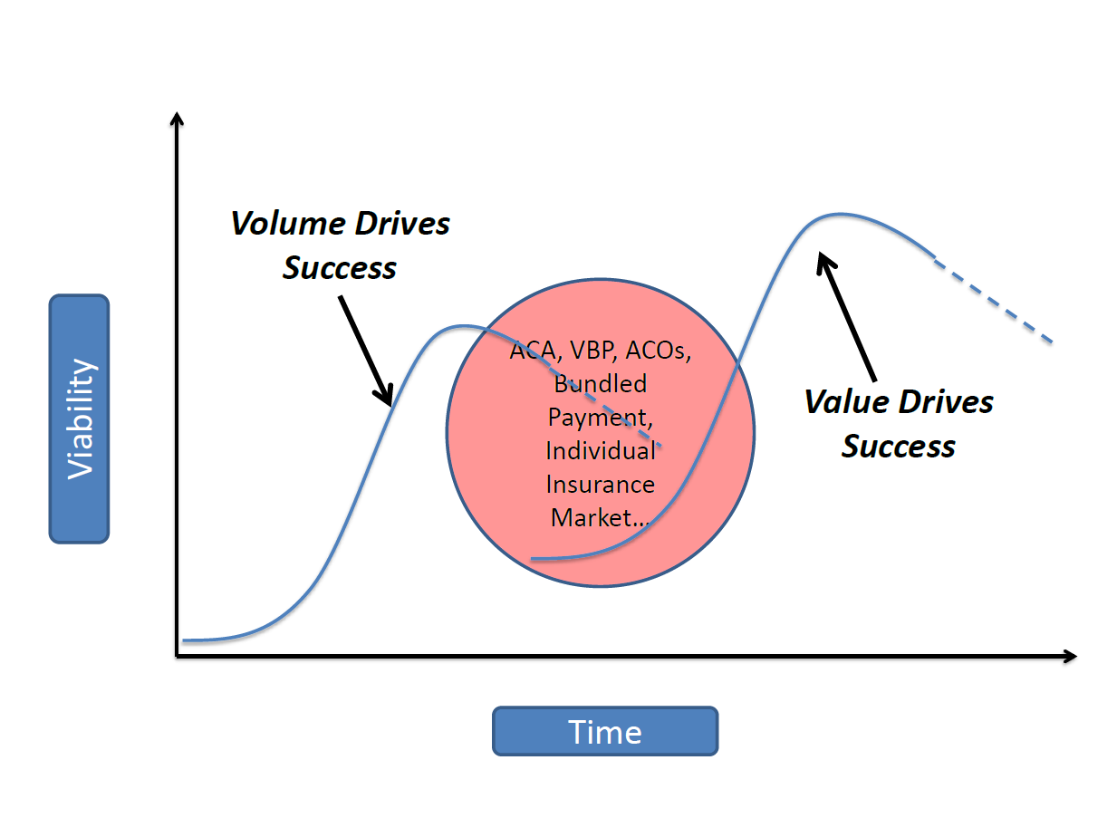
Key Strategic Question for Health Systems
When to make the leap?
Source: Jim Reinertsen, Reinertsen Group

Slide 5
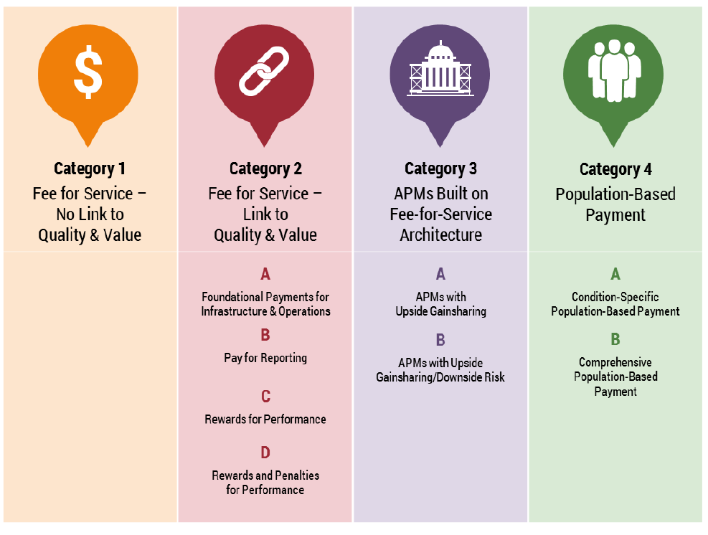
What does Payment Reform mean?
Source: Melinda Hancock VHHA Payment Reform Summit, Alternative Payment Model Framework and Progress Tracking Workgroup, “Alternative Payment Model (APM) Framework”, HCP-LAN. 12 Jan 2016. Web. 31 Jan 2016.

Slide 6
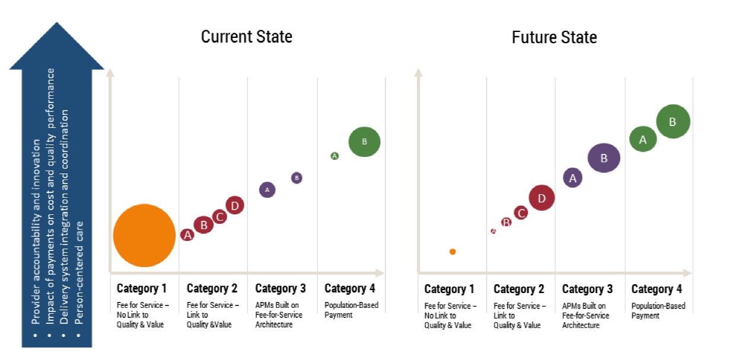
Where are we today and where are we going?
Source: Melinda Hancock, VHHA Payment Reform Summit presentation.

Slide 7
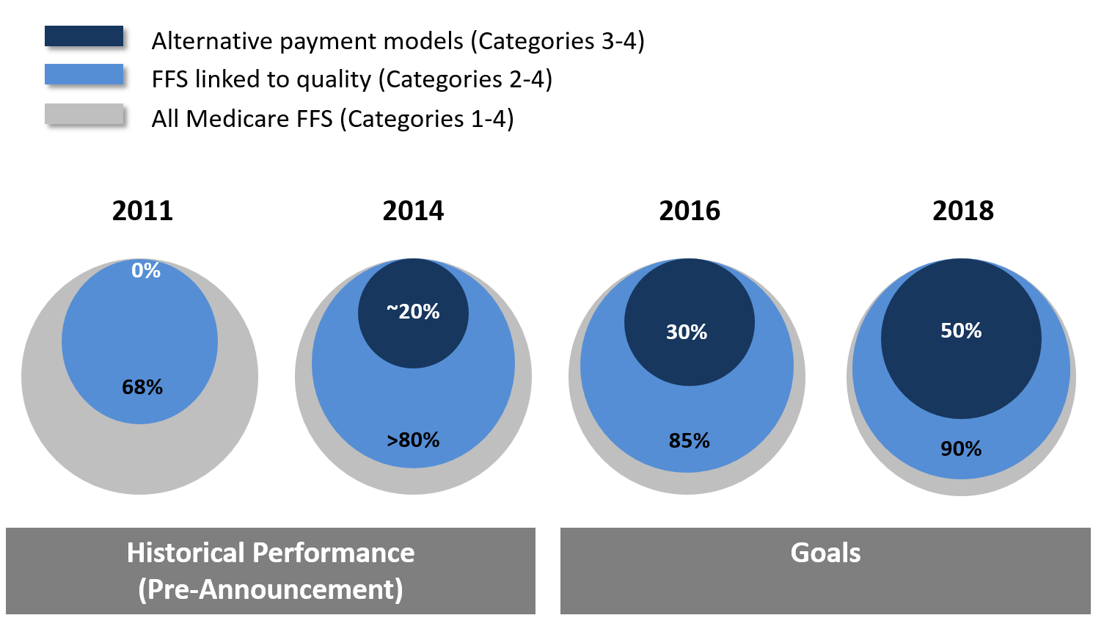
Moving From Volume to Value – CMS plans

Slide 8
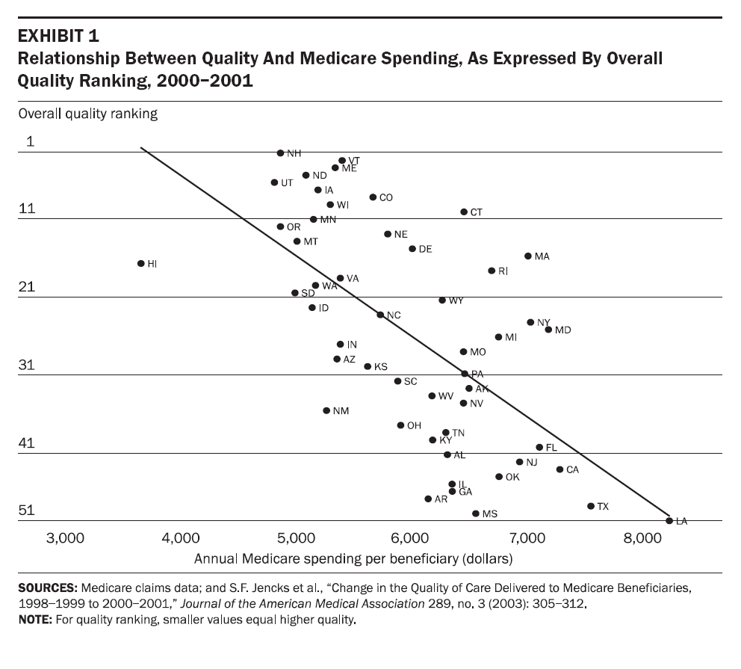
Quality and Cost Related

Slide 9
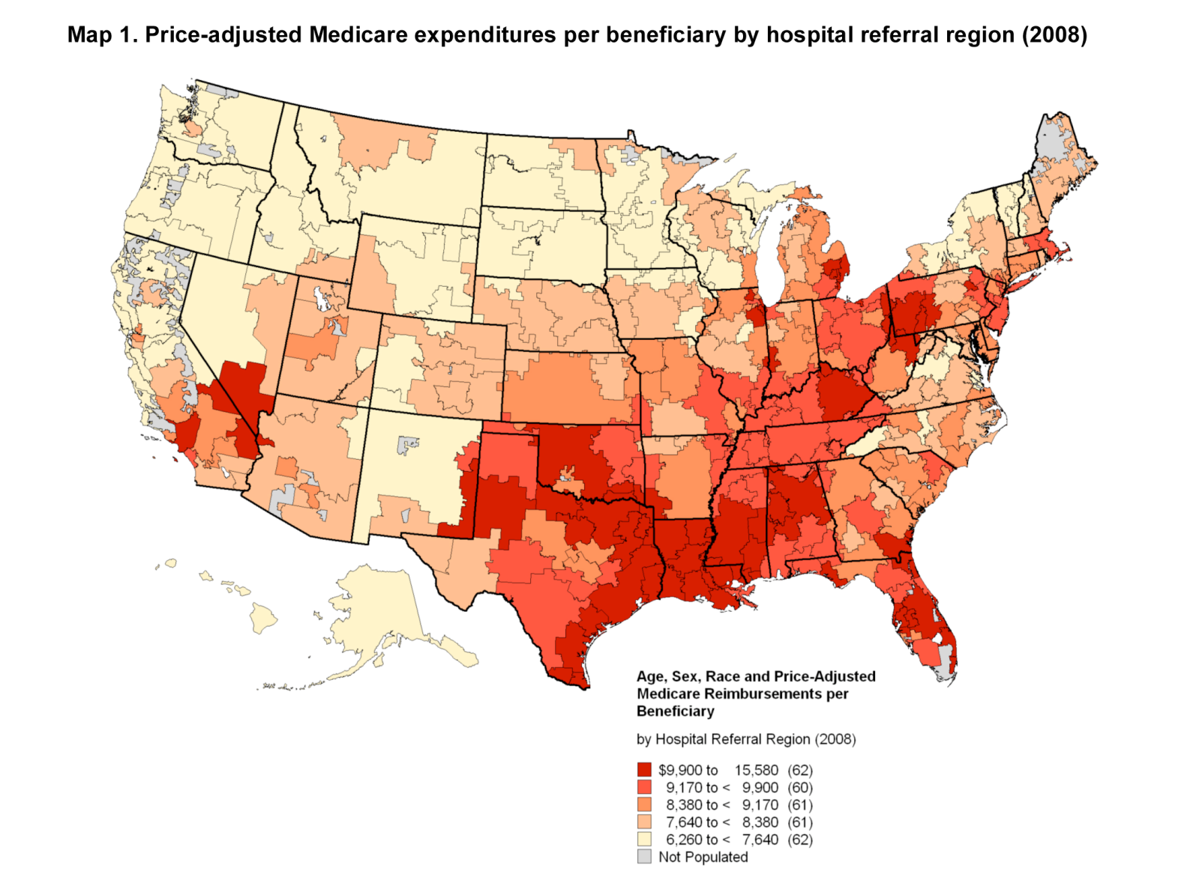
Q: How does Virginia healthcare value rank?
A: Defining value a challenge, but promising evidence on costs
Source: Dartmouth Atlas of Health Care

Slide 10
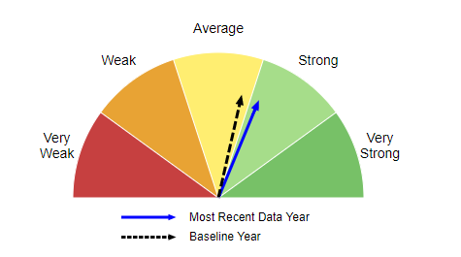
High marks on many healthcare quality scores
But achieving and sustaining top-tier performance on quality, safety and service is work that never ends
Virginia is 9th overall on AHRQ’s national quality report;
All but one of the states scoring higher on quality has higher coverage;
Virginia is among the top five in many acute care measures, but less high in some chronic disease, access and disparities measures.
Variation within the state as well.

Slide 11
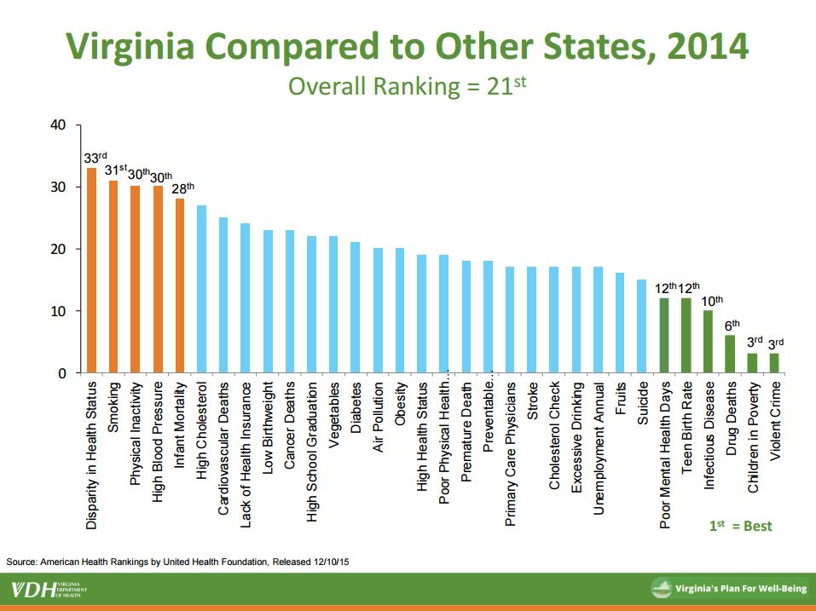
How does Virginia Rank on Health?

Slide 12
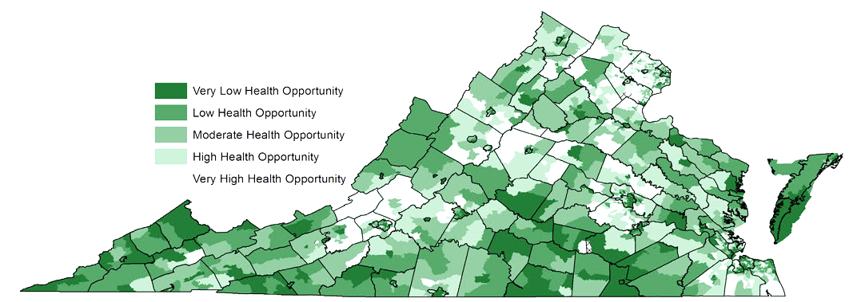
Virginia Health Opportunity Index
A composite measure comprised of 13 indices that reflect a
broad array of social determinants of health
Air Quality ● Population Density ● Population Churning ● Walkability ● Affordability ● Education ● Food Access ● Material Deprivation ● Employment ● Income Inequality ● Job Participation ● Segregation ● Access to Health Care

Slide 13
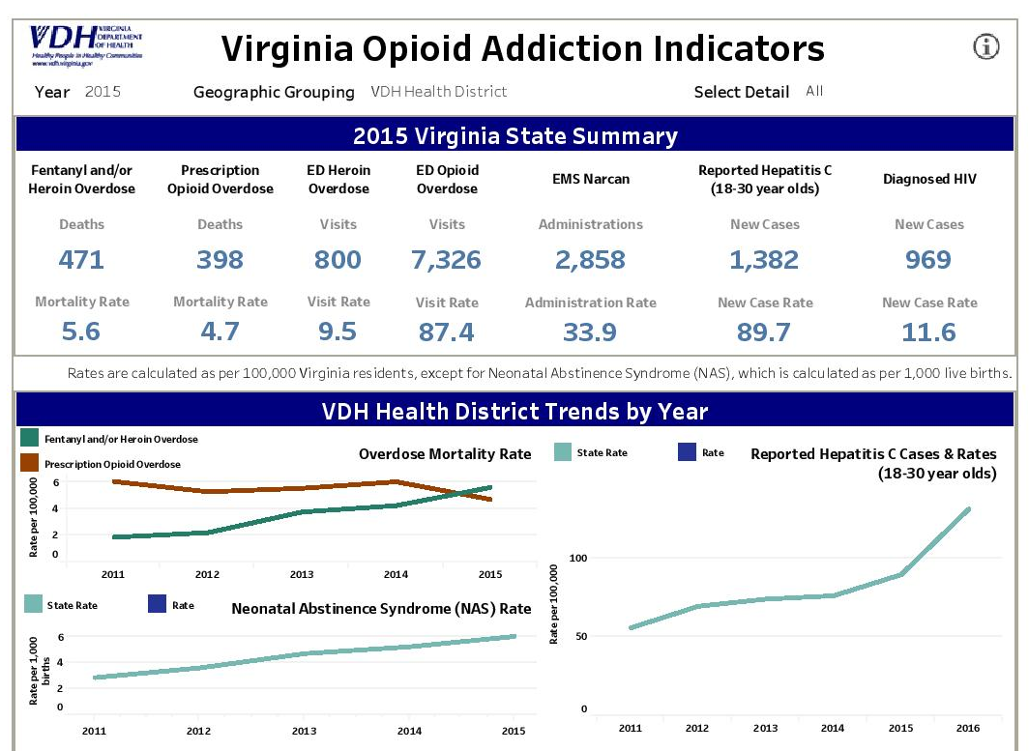
Mental Health & Substance Abuse

Slide 14
The Patient Protection and Affordable Care Act (ACA)

Slide 15
Key Provisions of the ACA
Employer and Individual Mandates
  Tax penalties for non-compliance
New limits on HSAs and employer contributions to a flexible spending account (FSA) limited to $2,500 per year
Premium Assistance Tax Credits to assist individuals with purchasing insurance
  Individuals with incomes between 100% FPL and 400% FPL
  Age and income adjusted
Cost-sharing subsidies
  Individuals with incomes between 100% and 250% FPL
  Paid to insurers to reduce premiums and out-of-pocket costs for eligible individuals
Medicaid Expansion – non-elderly adults with income up to 138% FPL
Notes:
Penalties –
$2,000/12 multiplied by the number of employees minus 30 if an employer does not offer coverage to at least 95 percent of full-time employees.
$3,000/12 for each employee receiving a premium tax credit that month up to a maximum of that formula times the number of full-time employees minus 30 if an employer offers coverage to at least 95 percent of full-time employees but one or more employees is receiving a credit in the marketplace because coverage was not affordable.
2% of income/$695 (whichever is higher)
2017 National Average Tax Credit:
34 year old - $6,019 at 100% FPL
49 year old - $7,686 at 100% FPL
64 year old - $12,068 at 100% FPL

Slide 16
Key Provisions of the ACA
Created new state-based and a federal insurance exchange
Imposed numerous new requirements on insurance companies and plans
  Guaranteed issue
  Rating variation limited to four factors: age (3:1), geography, family composition, tobacco use
  Prohibition on pre-existing conditions exclusions
  Prohibition on lifetime and annual limits
  Dependent coverage up to age 26
  Limits on annual cost sharing: $7,150 for individuals and $14,300 for families, indexed to inflation
  Mandated four cost sharing levels: bronze (60% AV), silver (70% AV), gold (80% AV) and platinum (90% AV)
  All plans must cover 10 essential health benefits
Notes:
10 EHBs – ambulatory care, emergency care, hospitalization, maternity and newborn care, mental health and substance abuse care, prescription drugs, rehabilitative care, laboratory services, preventive care, chronic disease management, and pediatric dental and vision care.

Slide 17
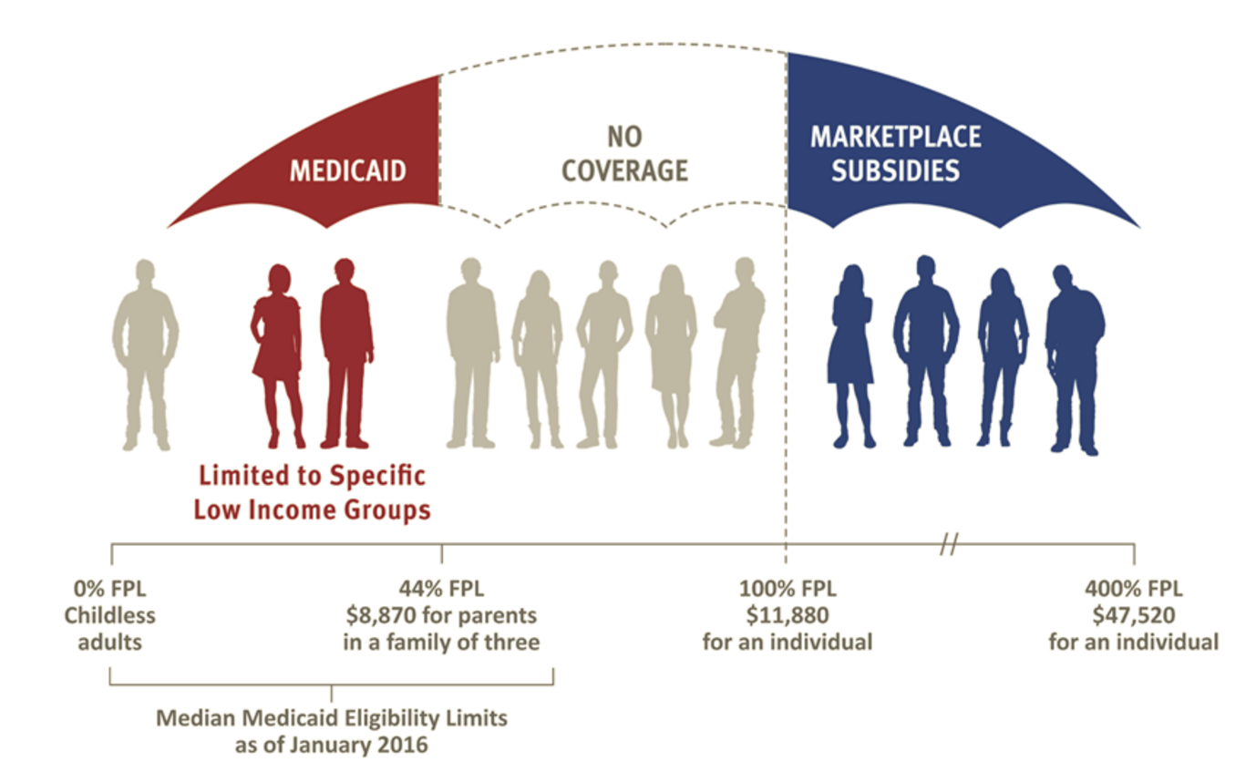
Key Provisions of the ACA – Medicaid
Expanded Medicaid to all non-elderly adults with incomes up to 138% FPL
Provided states with 100% federal funding for the expansion population phased down to 90%
States initially required to expand their Medicaid program, but the Supreme Court rendered it optional

Slide 18
The ACA’s Mixed Results

Slide 19
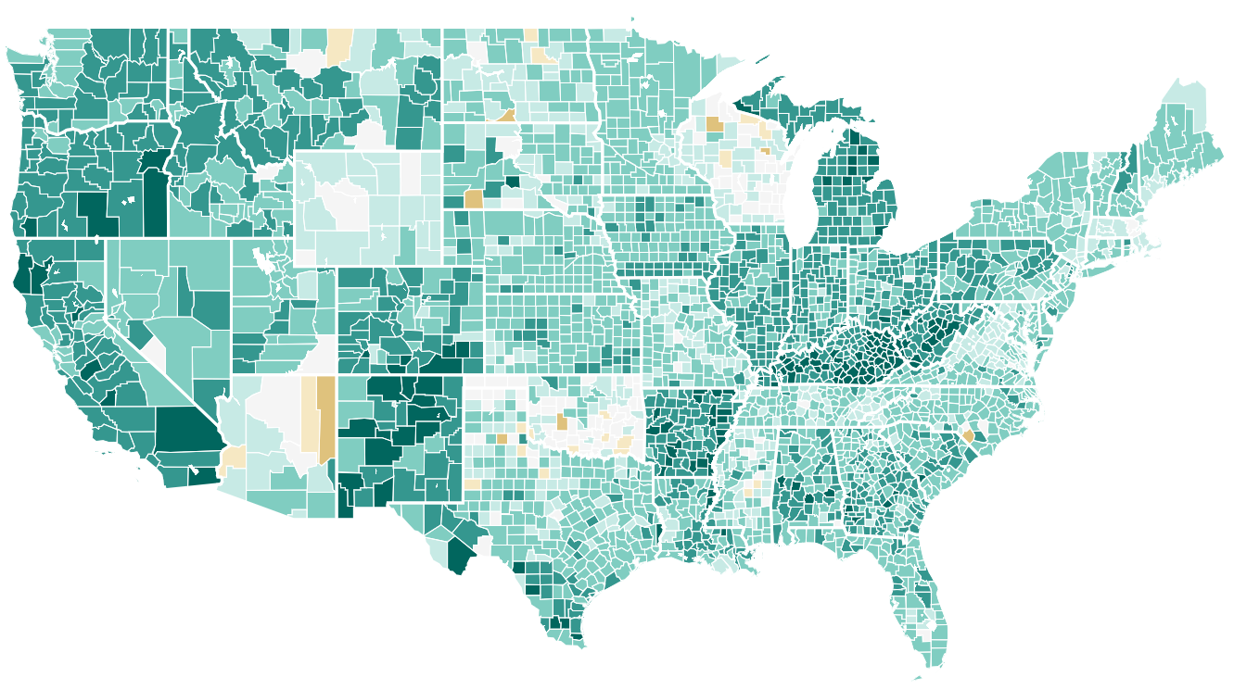
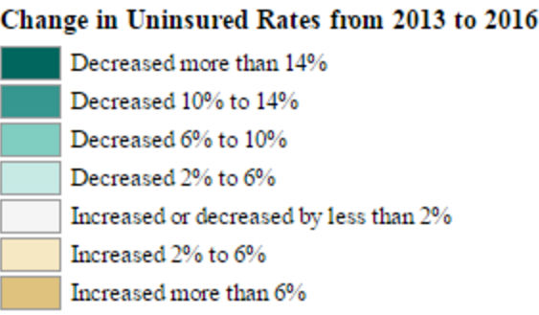
Decline in Uninsured Rate
What gains have occurred in Virginia are predominantly in the individual marketplace; 410,726 Virginians signed up for coverage during 2017 open enrollment.

Slide 20
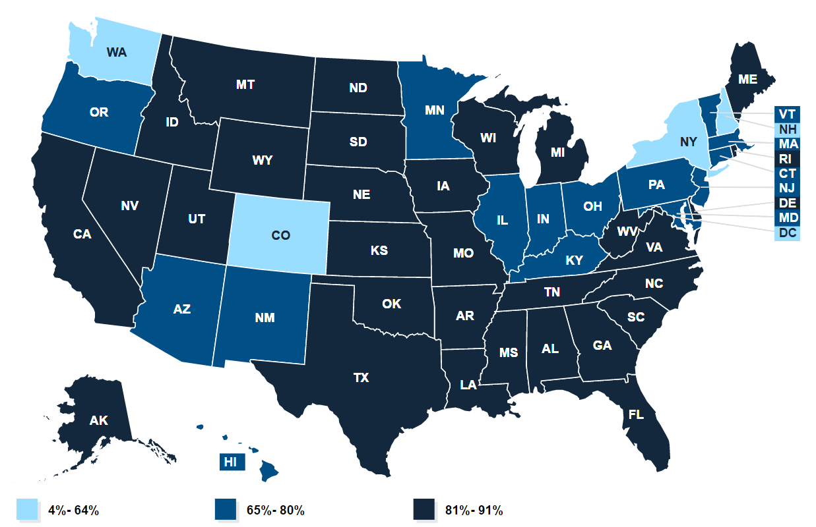
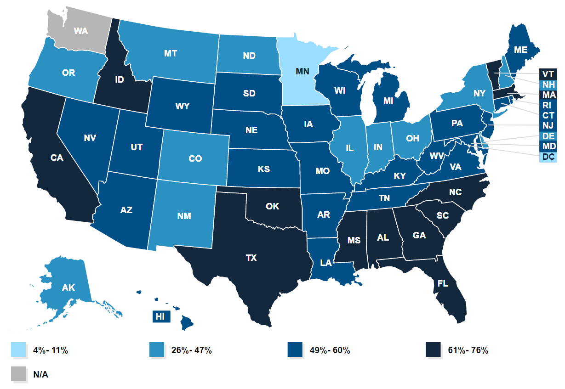
Individual Marketplace
82% of Virginians enrolled in a marketplace plan are receiving premium assistance tax credits
59% of Virginians enrolled in a marketplace plan are receiving cost-sharing subsidies

Slide 21
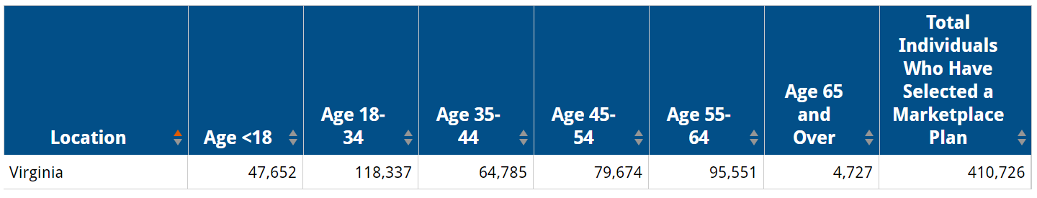
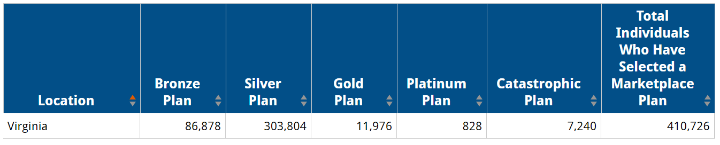
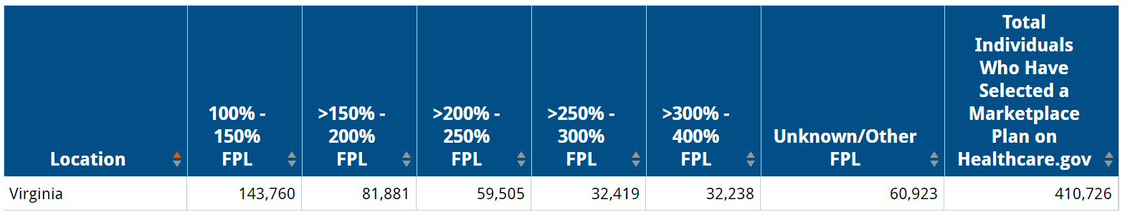
Individual Marketplace
During the 2017 open enrollment period, 410,726 Virginians signed up for coverage through the individual marketplace

Slide 22
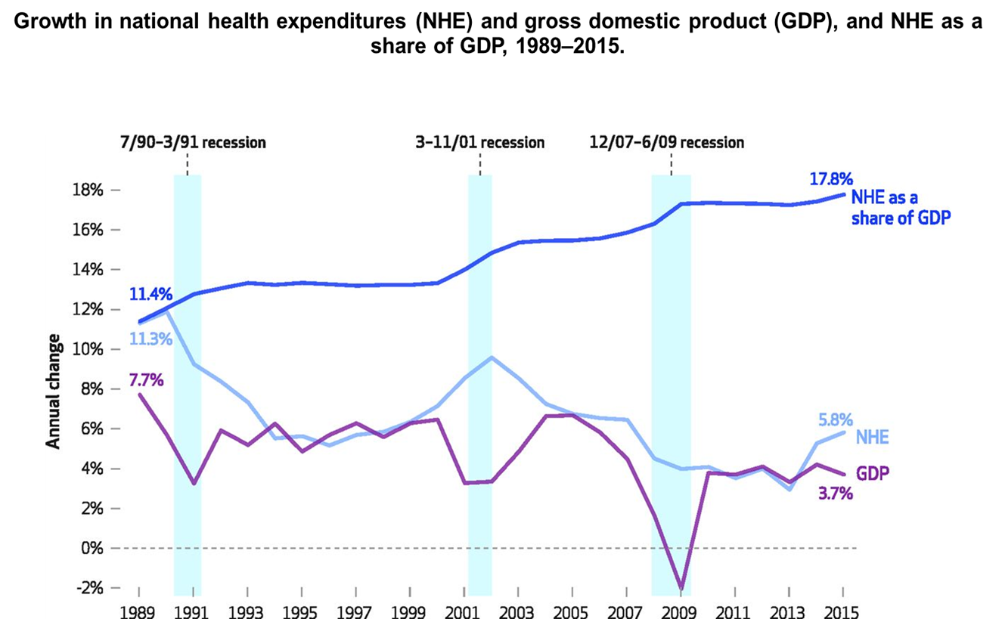
Recent Progress on Healthcare Costs
But Individual Insurance Premiums Spiking in Some States
Large employer and group premiums increased on average 3% in 2016*
Overall health care expenditures have moderated significantly over last six years, although further progress depends on further coverage gains and continued innovation in payment and delivery reform
Declining plan choices and premium jumps in some exchange/individual insurance markets due to adverse risk selection, not overall healthcare costs

Slide 23
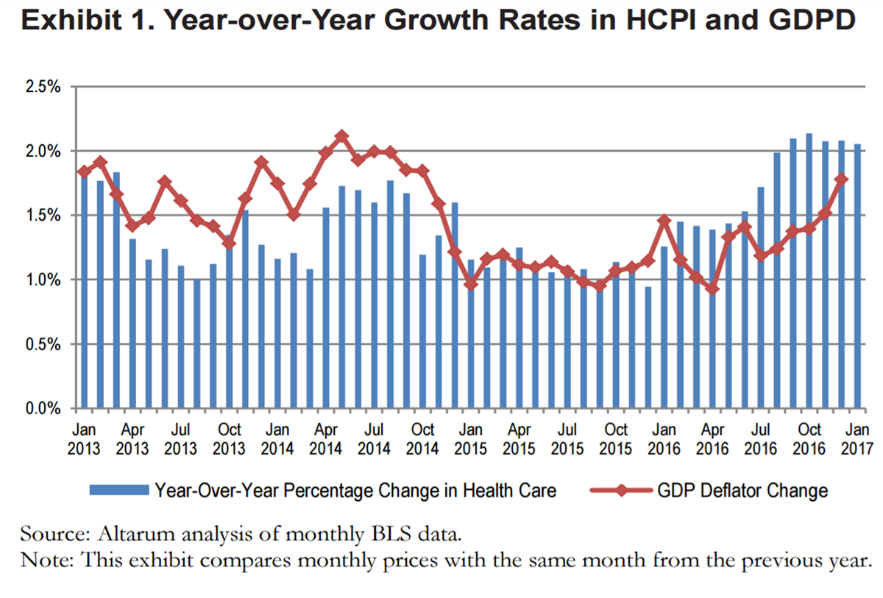

Healthcare Spending in the United States

Slide 24
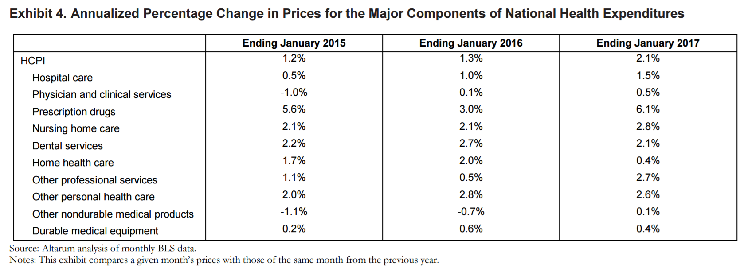

Change in Prices for Health Care Elements

Slide 25
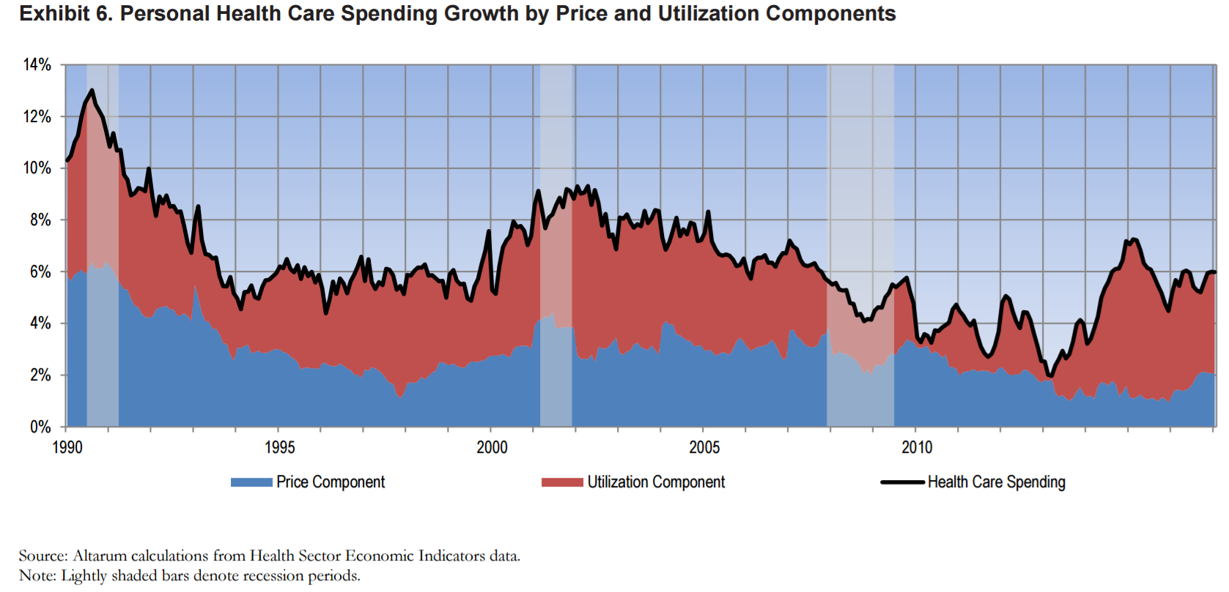

Healthcare Spending is Increasing Due to Utilization

Slide 26
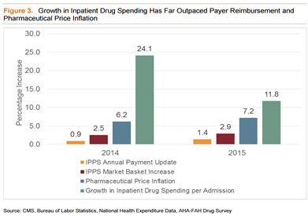
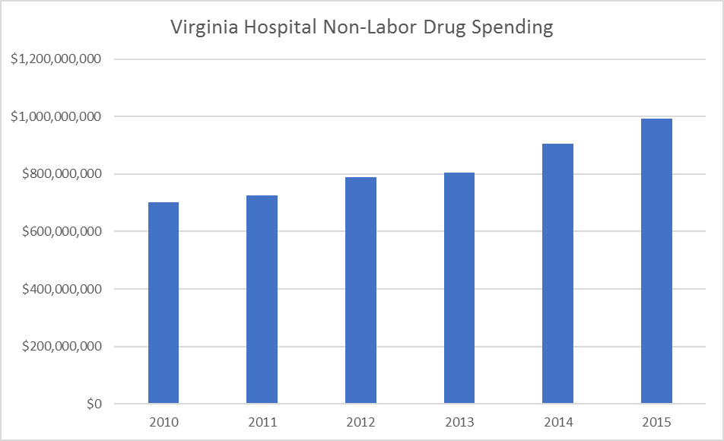
Drug Costs
Virginia hospitals have seen a more than 41% increase in spending on drugs in the past 6 years.

Slide 27
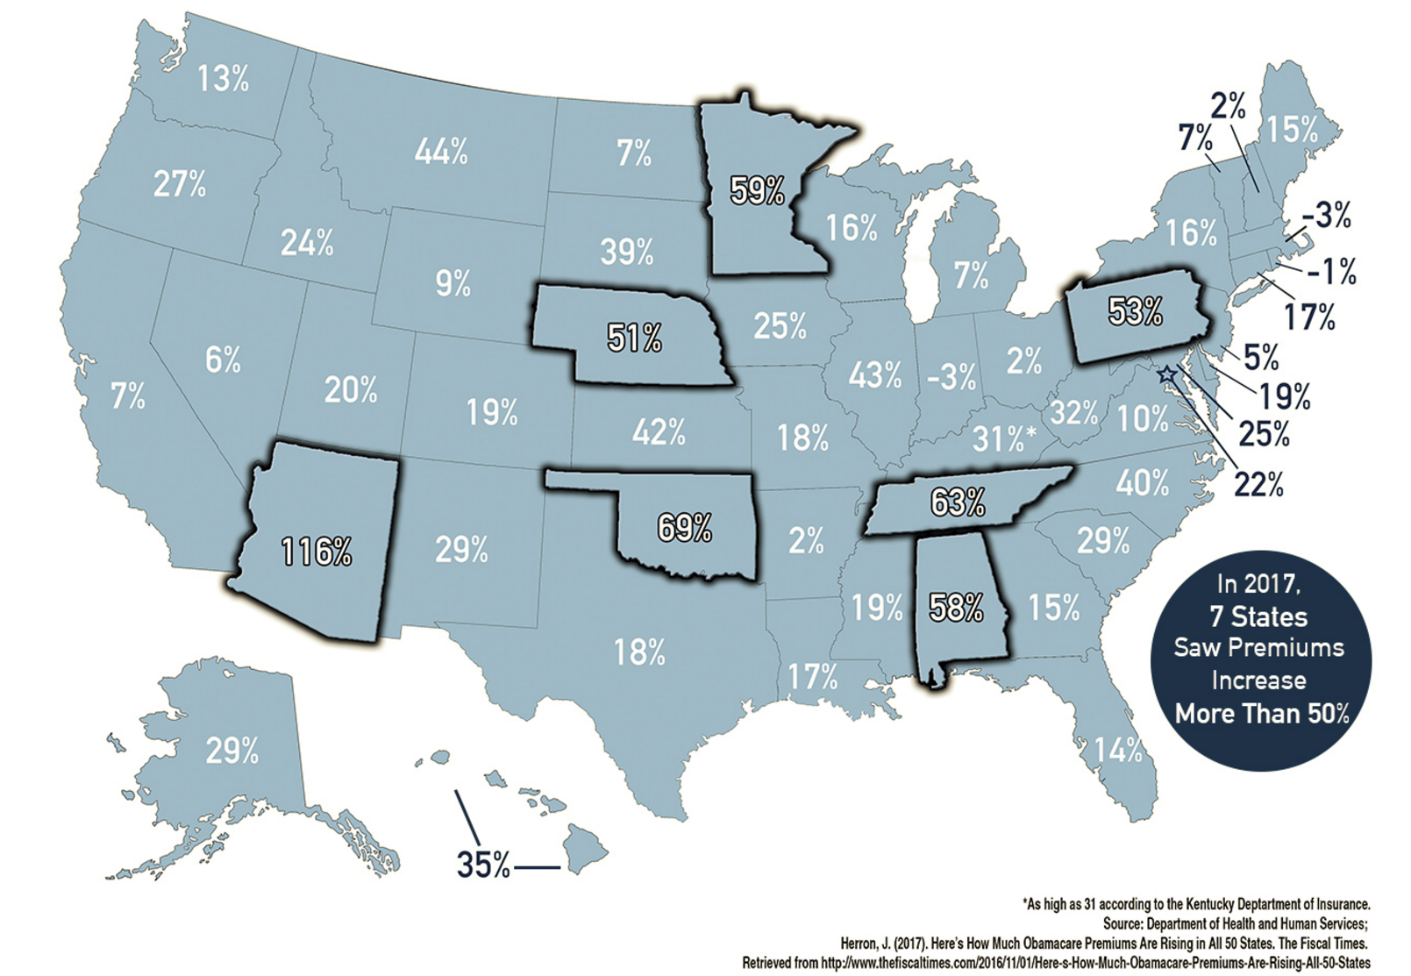
Individual Market Premiums
…
Notes:
In 2017, the average statewide premium in Virginia grew by 10%
The premium cost for the second-lowest priced silver exchange plan grew by 2.7% in 2015, 10.8% in 2016, and 7% in 2017 in Richmond, VA
Premiums in the large group market grew by an average of 3% this year

Slide 28
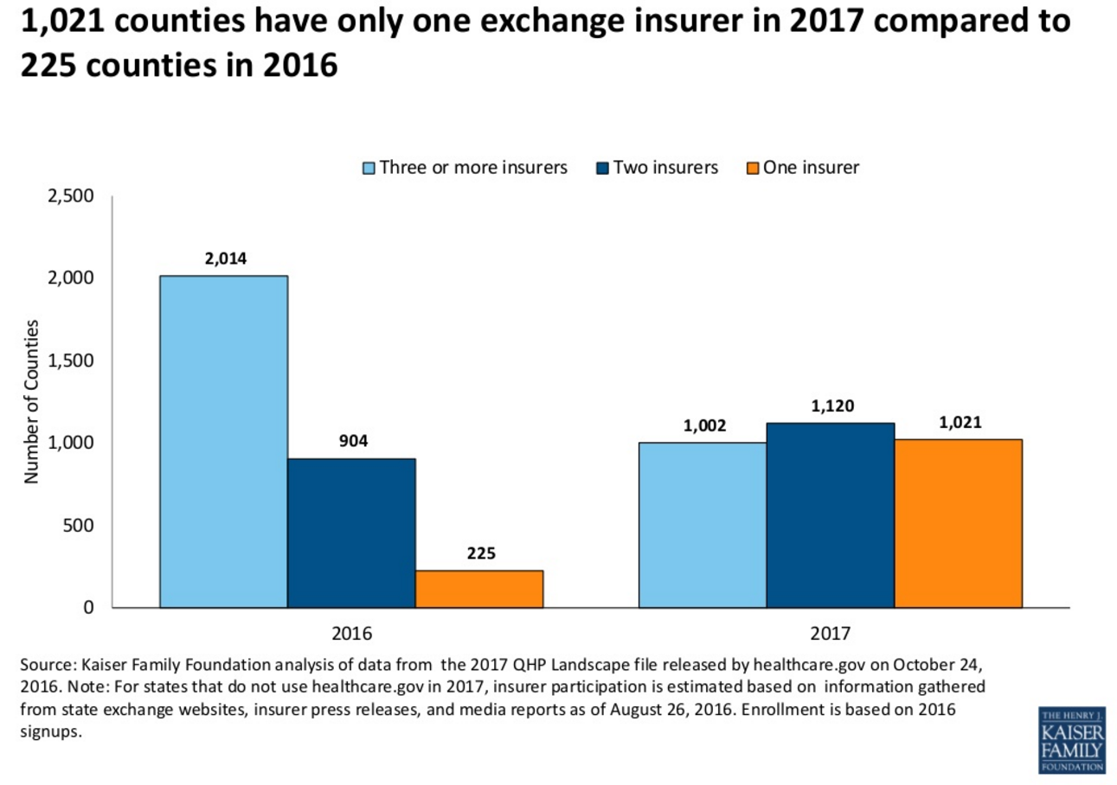
Insurer Availability in Exchanges
…

Slide 29
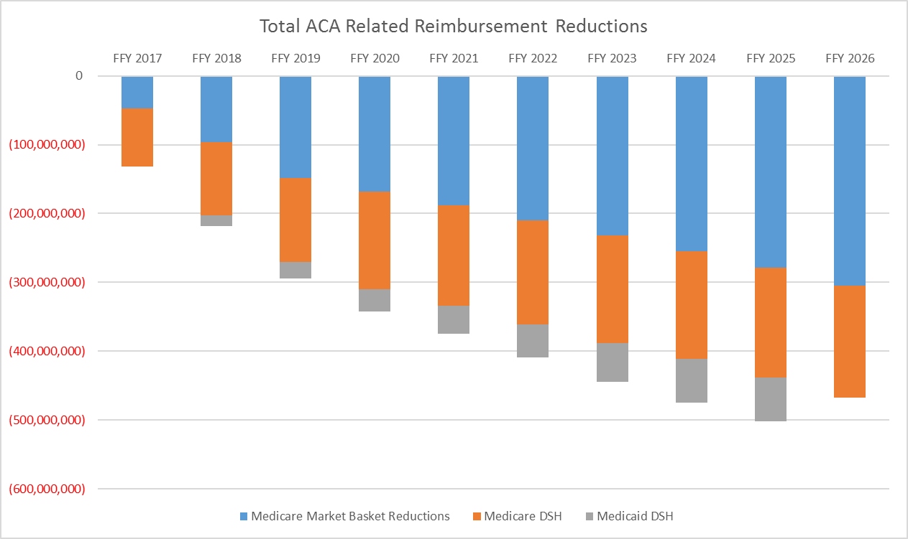
ACA Hospital Reimbursement Cuts
…
Notes:
Note: Patient/Payer Mix…60% statewide 74% rural

Slide 30
Total Federal Reimbursement Cuts

Slide 31
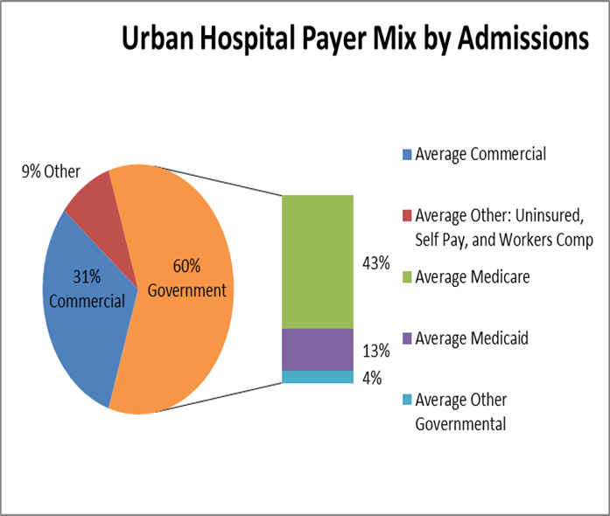
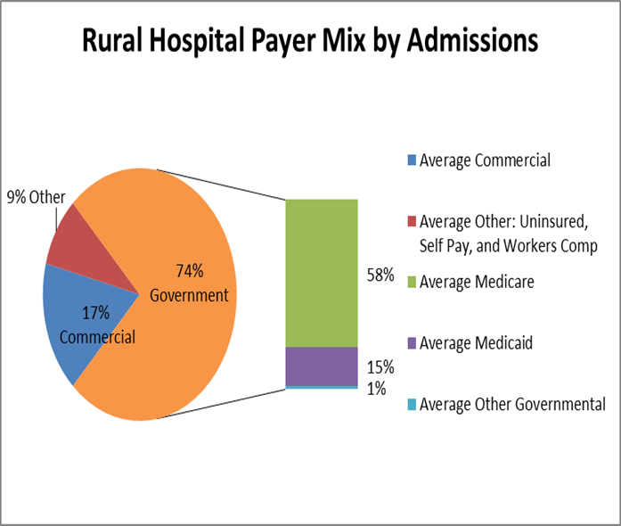

Patient Payer Mix

Slide 32
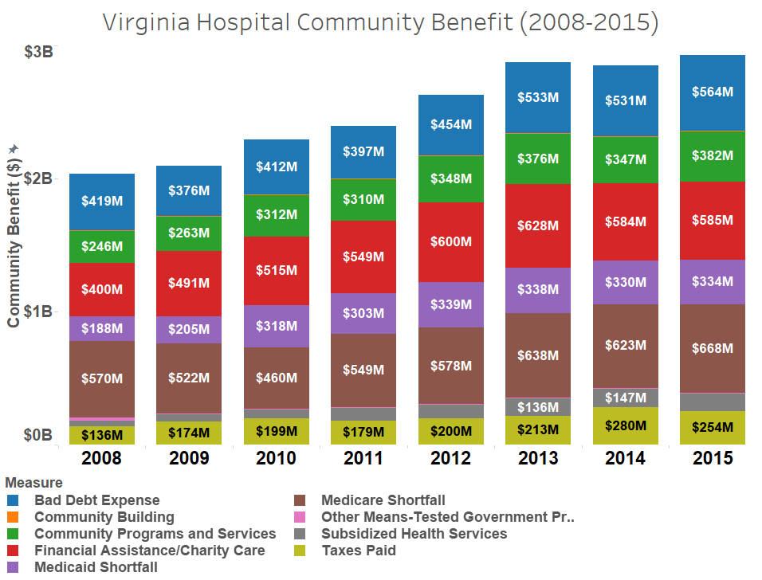
Significant Growth in Bad Debt and Medicare Shortfalls

Slide 33
The 115th Congress

Slide 34
American Health Care Act
Because reconciliation must deal with federal spending, most of the insurance market requirements imposed by ACA remain
Essentially eliminates the employer and individual mandates by zeroing out the penalties beginning in taxable year 2016
Authorizes insurers to charge a 30% premium penalty for individuals who lacked insurance for longer than 63 days in the preceding 12 month period
Repeals the ACA’s Premium Assistance Tax Credits and implements new age-adjusted, advanceable, and refundable tax credits
  Credits are phased out above $75,000/$150,000 but are not means tested
  Range from $2,000 for individuals under 30 to $4,000 for individuals 60 and older
  Capped at $14,000 maximum credit for families
Continues Medicaid expansion through 2019, but phases out enhanced federal funding thereafter
Notes:
Enables states to continue Medicaid expansion through December 31, 2019
Non-expansion states have the option to expand
States will continue to receive enhanced federal funding for enrollees enrolled prior to this date
Individuals who lose their eligibility for one month and new enrollees after this date will be at the traditional 50/50 match instead of the enhanced funding

Slide 35
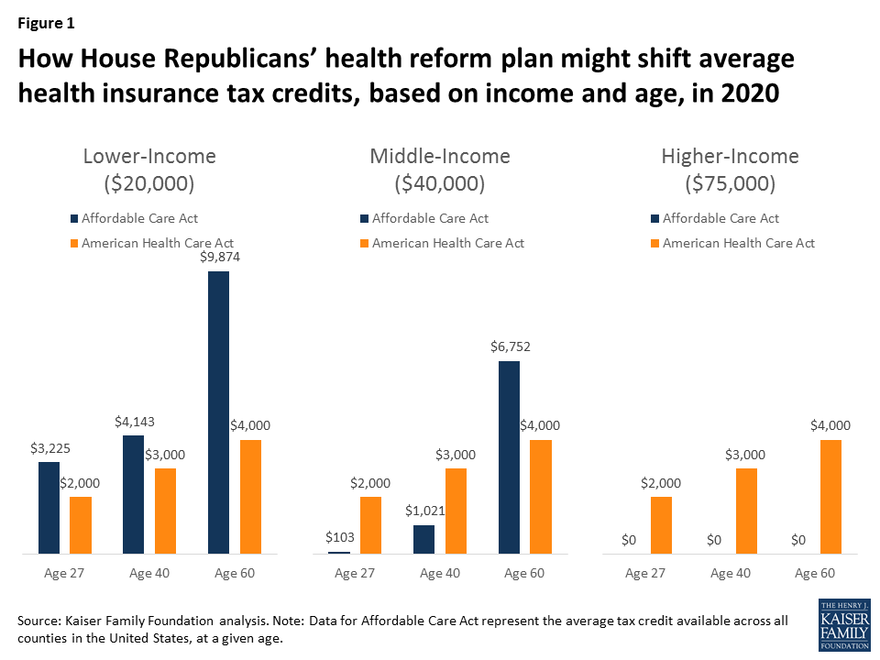
American Health Care Act
Notes:
Enables states to continue Medicaid expansion through December 31, 2019
Non-expansion states have the option to expand
States will continue to receive enhanced federal funding for enrollees enrolled prior to this date
Individuals who lose their eligibility for one month and new enrollees after this date will be at the traditional 50/50 match instead of the enhanced funding

Slide 36
American Health Care Act
Converts Medicaid program funding to a per capita allotment or block grant
Provides $100 billion for the Patient and State Stability fund to help lower the costs of insurance for high-risk individuals
Provides $10 billion for non-expansion states for safety net provider funding
Eliminates ACA limitations on HSAs and increases the maximum annual contribution limit
Eliminates ACA-related taxes and fees including, among others:
  Limitations on the business expense deduction for prescription drug costs
  The increased threshold for deducting medical expenses
  The medical device tax, the tanning tax, and the net investment tax
  The fee on certain brand name pharmaceuticals
  The fee on health insurers
Notes:
Converts the Medicaid program to a per capita allotment program versus its current open-ended federal match structure
Base year cap established for each eligibility group
Adjusted each year thereafter by medical CPI and to adjust for enrollment
Provides more budget certainty for the federal government, without transferring enrollment risk to the states

Slide 37
American Health Care Act
The Budget Committee recommend several changes to the proposed legislation, including:
  Giving states the option to choose a pure block grant
  Enhancing the value of the tax credits for elderly and low-income populations
  Authorizing states to impose work requirements on able-bodied adults
The Manager’s Amendment proposed several substantive and a number of technical amendments to the legislation, including:
  The changes recommended by the Budget Committee
  Prohibiting additional states from expanding and capping enrollment in 2017
  Eliminating the ACA’s taxes and fees in 2017 instead of 2018
Prior to the Easter Recess, the Budget Committee approved an amendment to the legislation creating a new $15 billion Federal Invisible High Risk Pool
MacArthur Amendment – enables states to seek waivers from three insurance market requirements
  Age rating
  Essential Health Benefits
  Factoring in health status in setting premiums, provided a state participates in the PSSF or has its own high-risk pool
Upton amendment added another $8 million to address high-cost individuals

Slide 38
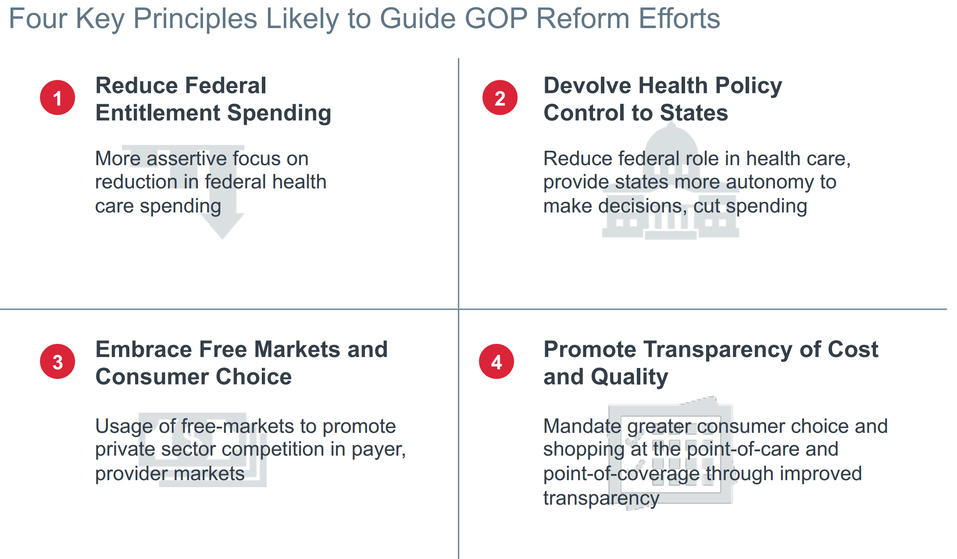
Republican Replacement Proposals
Source: The Advisory Board

Slide 39
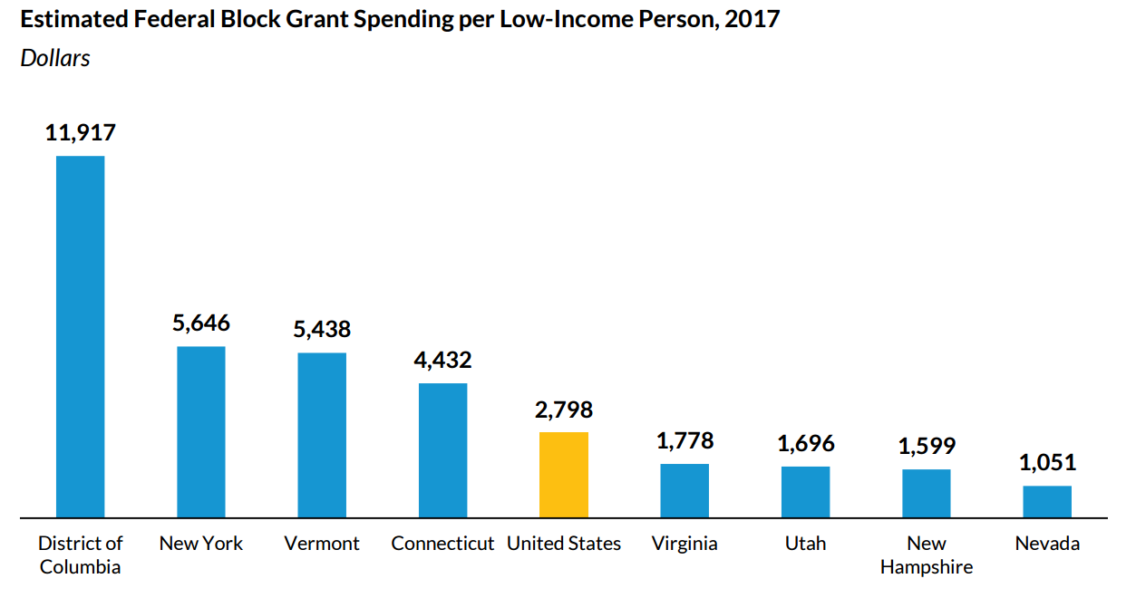
Medicaid Block Grants
Estimates from the Urban Institute show that Virginia will be on the losing end of Medicaid per capita or block grant proposals.

Slide 40
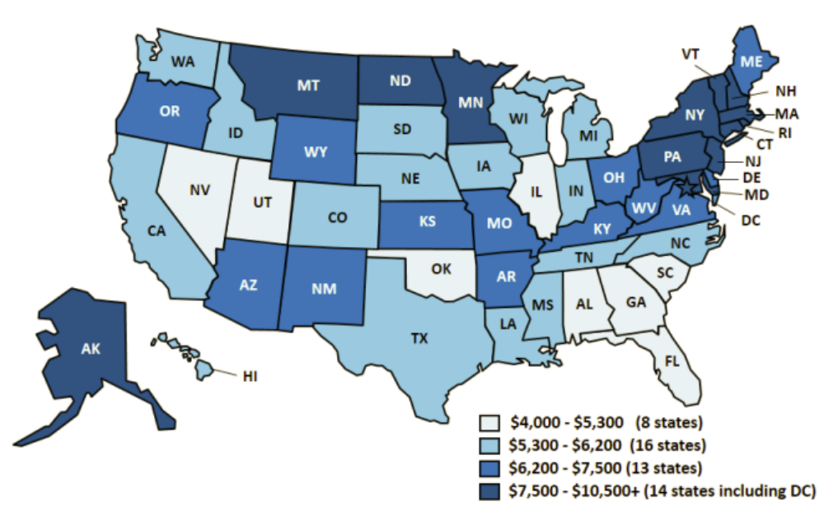
Medicaid Spending Differences
Total Spending per full Medicaid Enrollee FY2011

Slide 41
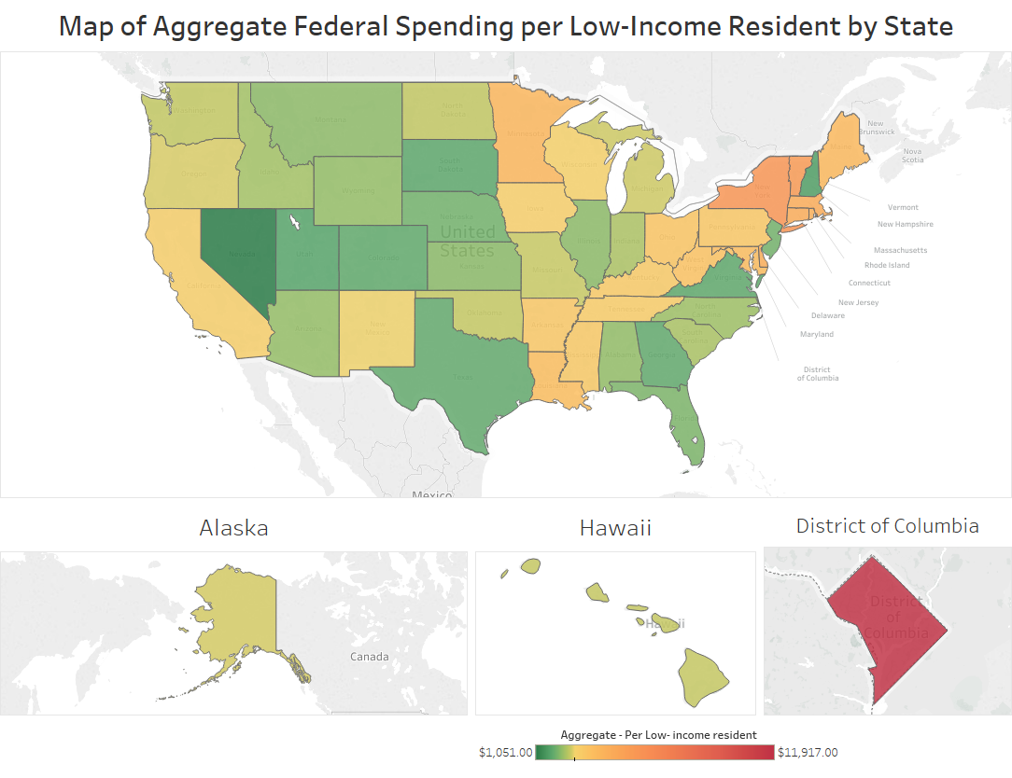
Medicaid Block Grants:
If History is the guide, geography is destiny

Slide 42
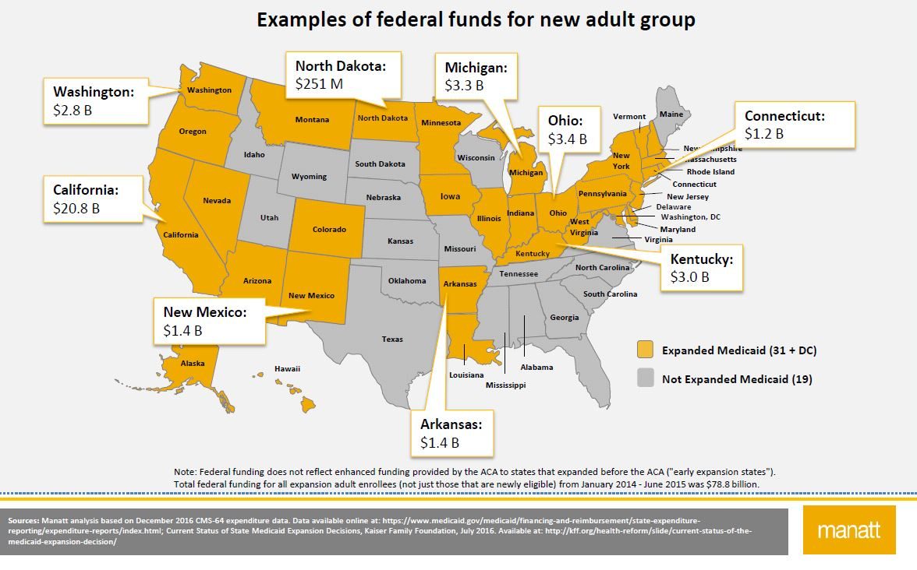
Medicaid Variation with Expansion

Slide 43
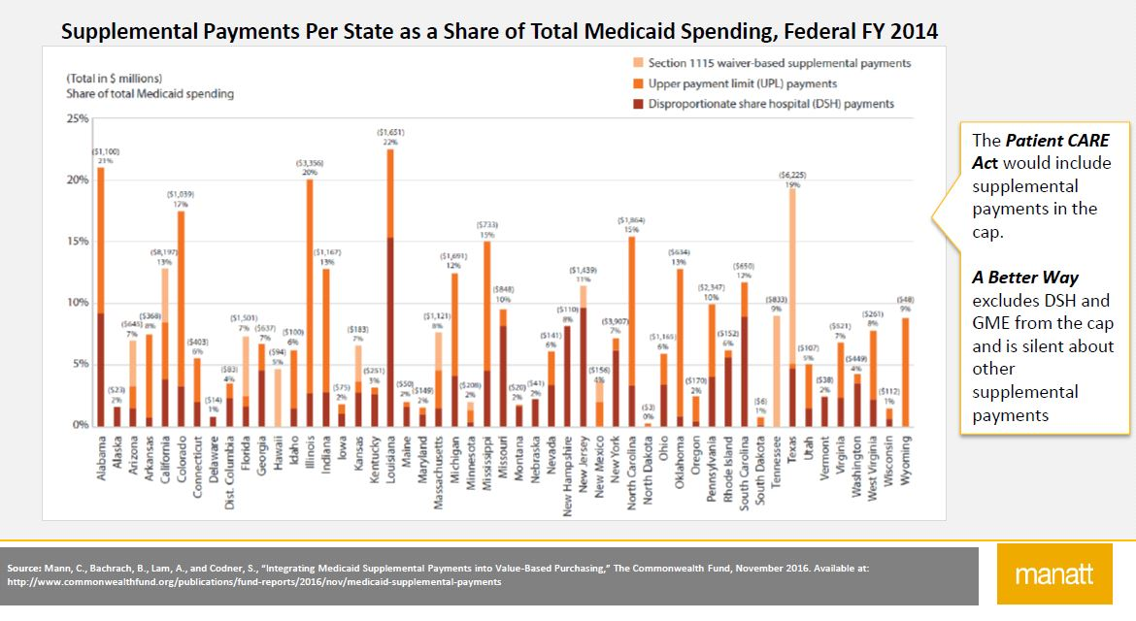
State Use of Medicaid Creative Financing

Slide 44
Senate plans – Cassidy/Graham
Most significant departure from the ACA to date
Takes exchange subsidies and Medicaid expansion funds and reallocates among the states in relation to low-income population
  More equitable in concept, but the formula ignores current state variability
  Overall, moves funds away from states that fully implemented the ACA (thereby eliminating coverage to many who have gained) to those that did not
States given wide latitude on how to spend the funds
Eliminates federal rules prohibiting coverage exclusions for pre-existing conditions and lifetime caps (popular policies)

Slide 45
Moving Forward
Partisan health care plans vs. bi-partisan incremental improvements
Key Issues to track:
  Medicaid expansion, treatment of state differences in eligibility and funding
  Medicaid financial restructuring – per capita caps and/or block grants
  Income adjustments to premium subsidies
  Pre-existing conditions and essential benefits
If ACA architecture remains largely intact, responsibility shifts to the states
Status quo for Virginia is not sustainable
STAY ENGAGED!

Slide 46
Republican Replacement Proposals
Source: The Advisory Board

Slide 47
VHHA Advocacy Priorities
Crafting a common-sense Virginia plan on health and health care improvement
Investing in the healthcare workforce (e.g., additional GME funding)
Supporting strong health IT linkages, tele-health and other innovations
Tackling the addiction and behavioral health crises
  Investing in community services and assets
  Broadening access via evidence-based benefits/coverage
  Strengthening community collaborations between health care, law enforcement and local leaders

Slide 48
Constants Among the Political Chaos
Pressure to lower overall costs intensifies, but we know too that better quality leads to lower costs
Incentives to coordinate care and manage risk will continue to expand
Technological change can help, but better data and better connectivity absolutely essential
Partnerships and leadership on underlying causes of illness and disparities key

