Slide 1



The New Virginia Guidelines on Pain Treatment and What They Mean For Primary Care
Head for the Hills
The Breaks
September 29, 2017
Notes:
This module specifically addresses issues defining addiction and its treatment, and introducing the participant to Virginia specific addiction disease management.

Slide 2
Mary G. McMasters, MD, DFASAM
Addiction Medicine
Master Trainer, Addiction Disease Management
State of Virginia
mary.mcmasters@gmail.com
Lisa Wooten, MPH, BSN, RN
Injury and Violence Prevention Program Supervisor
Division of Prevention and Health Promotion
Virginia Department of Health
109 Governor St, 9th Floor
Richmond, VA 23219
ph (804)864-7735
fx (804)864-7748
www.vdh.virginia.gov/ofhs/prevention/

Slide 3
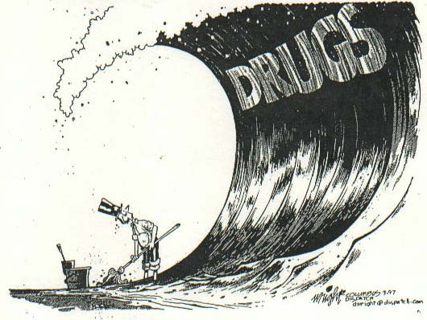
The United States of Drugs

Slide 4
It isn’t an “Opioid Crisis”
Before the first World War- Laudanum for menopausal women, “It’s a female problem.”
Opium among Chinese immigrants, “It’s an immigrant problem.”
Heroin and cocaine in urban areas, “It’s a minority problem.”
Oxycontin in Appalachia, “It’s a hillbilly problem.”
Methamphetamine in rural areas, “It’s a redneck problem.”

Slide 5
The Cost of Prescription Drug Abuse
John Deskins, Bureau Business and Economy, WVU
2013- estimated 62 billion lost
  4% drug abuse tx
  2% medical complications
  15% criminal justice costs including victims
  79% lost productivity
    Premature death
    Unemployment
    Subemployment
  Does NOT account for multipliers
  Presentation Appalachian Drug Summit, USDOJ, 2013, Johnson City, TN

Slide 6
John Deskins con’t
Per year:
  WV- entire state and local government spending on police
  KY- entire amount spent on elementary and secondary education
  TN- entire amount spent on highways annually
How much does substance mis-use cost employers??? National Safety Council Hhttps://www.nsc.org/forms/substance-use-employer-calculator/index.aspx
Alan B. Krueger; BPEA Article; Brookings Institute; Thursday, September 7, 2017; “Where have all the workers gone? An inquiry into the decline of the U.S. labor force participation rate”; https://www.brookings.edu/bpea-articles/where-have-all-the-workers-gone-an-inquiry-into-the-decline-of-the-u-s-labor-force-participation-rate/

Slide 7

Virginia’s Burden of Addiction:
A Public Health Perspective
http://www.dmas.virginia.gov
Notes:
N/A

Slide 8
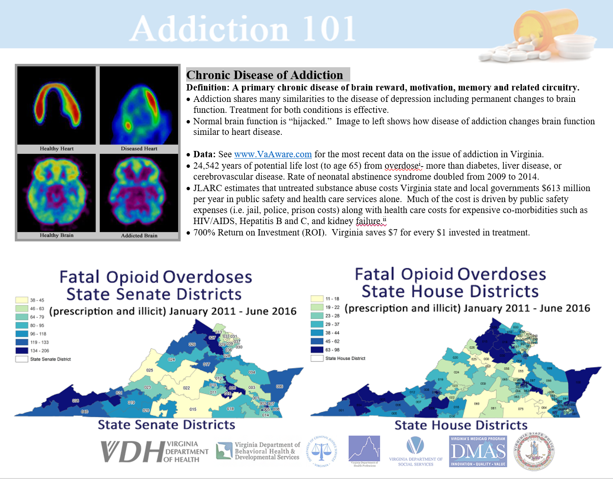
Notes:
Created a one-pager for thought leaders in the state.
Accurate definition of the disease of addiction.
Clear understanding of impact of the epidemic. Graphics to demonstrate.

Slide 9
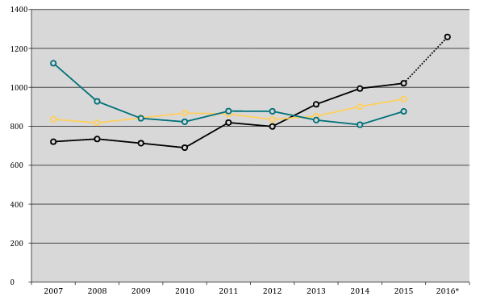
Top 3 Methods of Death by Year, 2007-2016
Drugs
Guns
MVAs
* Data for 2016 is a predicted total for the entire year
** All manners of death are included (accident, homicide, suicide, and undetermined)
Notes:
This slide depicts the top three methods of death by year, from 2007-2016. All manners of death are included (accident, homicide, suicide, and undetermined). The take away message is that deaths related to the misuse of drugs have emerged as a leading cause.

Slide 10
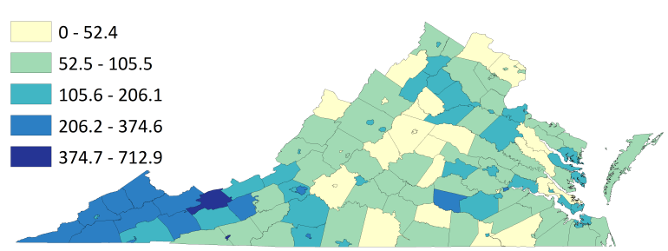
Reported hepatitis C per 100,000*
*This map excludes results from hepatitis C testing performed at correctional facilities to prevent false clustering of cases. Incarcerated individuals are not included in census population data for the counties where correctional facilities are located. Trends in hepatitis C in the incarcerated population are described separately
Notes:
Of immediate concern are the adverse health consequences that emerge often as a result of misuse of injectable substances. This slide depicts the report of Hepatitis C per 100,000 persons. The map excludes results from hepatitis C testing performed at correctional facilities to prevent false clustering of cases.

Slide 11
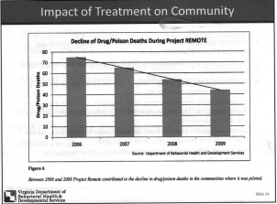
Project Remote 2006-2008

Slide 12

Defining the Problem
The terminology involving Addiction is VERY confusing:
Substance Abuse, Substance Misuse Disorder, Dependence, Addiction.
By understanding the following definitions, you can then “translate” them into any classification system: ICD11, DSM5, ASAM Criteria.
McMasters, 2016. Google images
Notes:
The terminology involving Addiction is VERY confusing:
Substance Abuse, Substance Misuse Disorder, Dependence, Addiction.
By understanding the following definitions, you can then “translate” them into any classification system: ICD11, DSM5, ASAM Criteria.

Slide 13

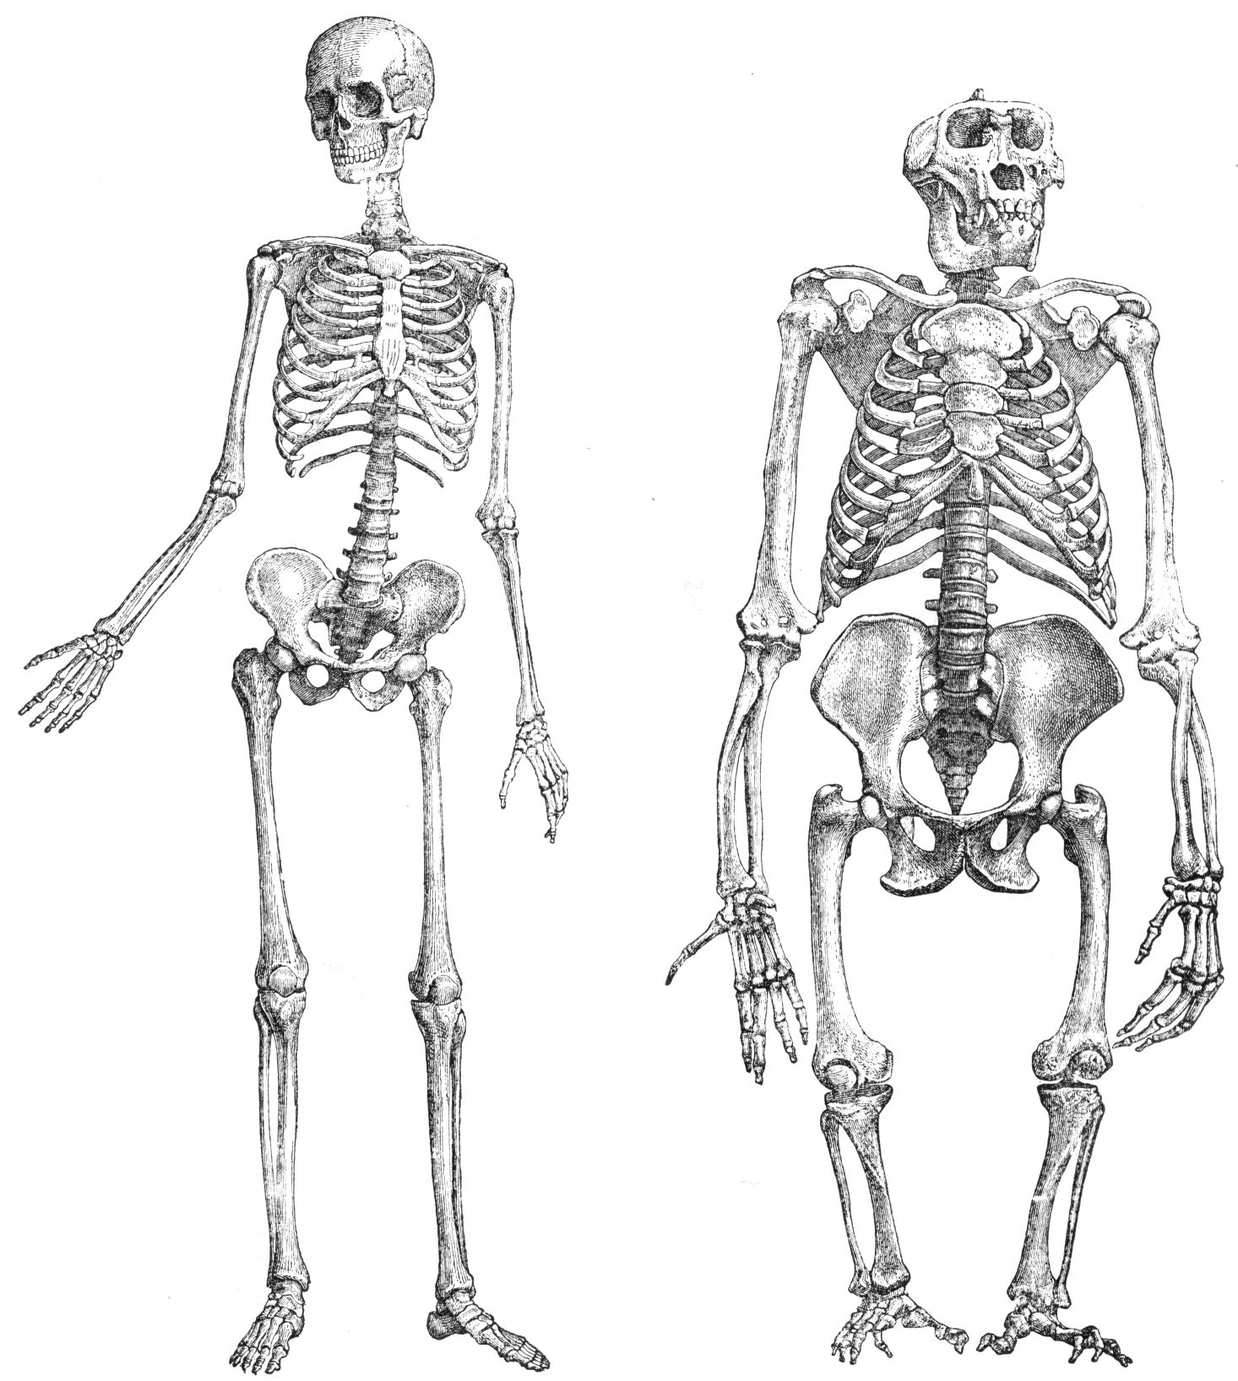


ICD11
ASAM
DSM5

Slide 14
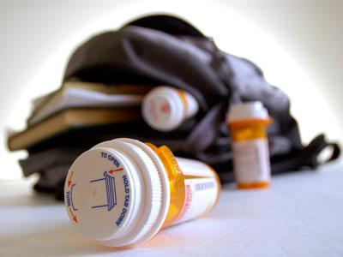

Diversion
Diversion- obtaining substances, particularly controlled substances, under false pretenses and using them for purposes other than their intended medical purposes.
example: The patient who exaggerates his pain level in order to get Vicodin is diverting. A patient who obtains Ritalin for ADHD and then gives it to friends to use recreationally is diverting.
McMasters, 2016. Google images
Notes:
Diversion- obtaining substances, particularly controlled substances, under false pretenses and using them for purposes other than their intended medical purposes. For instance, the patient who exaggerates his pain level in order to get Vicodin is diverting. A patient who obtains Ritalin for ADHD and then gives it to friends to use recreationally is diverting.

Slide 15


Substance Misuse
Substance Misuse (preferred term for Substance Abuse) - using substances, particularly controlled substances, for other than their intended purpose.
In general the patient knows what are doing is harmful but they can stop if they so choose.
McMasters, 2016; Google images
Notes:
Substance Misuse (preferred term for Substance Abuse) - using substances, particularly controlled substances, for other than their intended purpose.
In general the patient knows what are doing something is harmful but they can stop if they so choose.

Slide 16
Addiction
LOSS OF CONTROL
Objective Symptoms: Poor Functioning
Subjective Symptom: CRAVINGS
Addiction IS NOT Substance Specific
Addiction is a CHRONIC Brain Disease

Slide 17
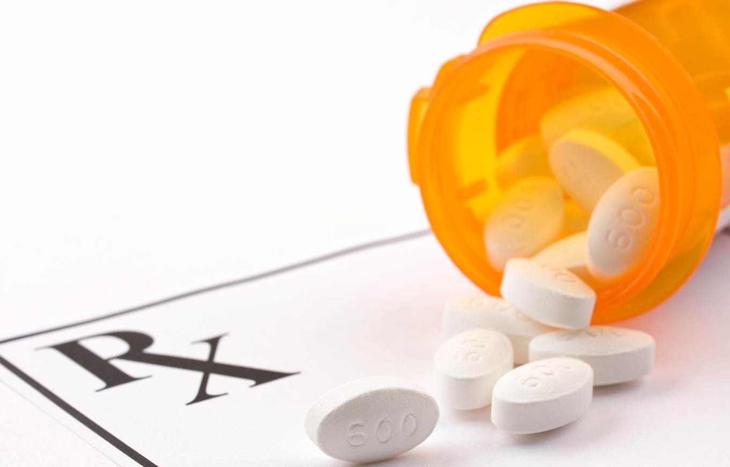
Withdrawal and Physical Dependence
Withdrawal is a physical syndrome caused when a substance to which the body has become accustomed (dependent) is suddenly stopped.
BEING PHYSICALLY DEPENDENT AND HAVING WITHDRAWAL IS NOT THE SAME THING AS ADDICTION.
McMasters, 2016 ; Google images
Notes:
Withdrawal is a physical syndrome caused when a substance to which the body has become accustomed (dependent) is suddenly stopped. BEING PHYSICALLY DEPENDENT AND HAVING WITHDRAWAL IS NOT THE SAME THING AS ADDICTION. Many medications other than those which are abused can cause a withdrawal syndrome if they are stopped suddenly: beta blockers (anti hypertensive medicines), sertraline (Zoloft®, an anti-depressant).

Slide 18

Tolerance
Tolerance - This is when a patient requires more of a medication to achieve the same effect.
In general, tolerance DOES NOT continue to increase after the initial adjustment period.
McMasters, 2016 ; Google images
Notes:
Tolerance- This is when a patient requires more of a medication to achieve the same effect. For instance, a patient placed on a beta blocker to control their blood pressure often requires an increased amount of the beta blocker 6-8 weeks after starting this medicine. This is because the body has “gotten use to” the beta blocker in a way which counteracts the desired effects. In general, tolerance DOES NOT continue to increase after the initial adjustment period.

Slide 19
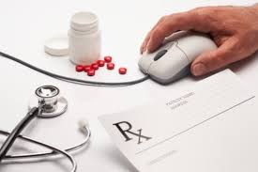

Psychoactive or Reinforcing or Abuse Able
“Psychoactive” or “Reinforcing” or “Abuse able”- Substances of Abuse activate the reward center in the brain.
In general, THE MORE MISUSE ABLE A SUBSTANCE IS, THE HIGHER ITS STREET VALUE IS.
McMasters, 2016; Google images
Notes:
“Psychoactive” or “Reinforcing” or “Abuse able”- Substances of Abuse activate the reward center in the brain. Under ordinary circumstances, these are the same rewards the brain gives to activities which promote survival of a species: eating, drinking, procreating, nurturing the young. The reward is a strong, happy feeling called euphoria or a “high”. In order for a substance to induce euphoria, it has to do two things: cross the blood-brain barrier into the brain and cause an increase in the amount of certain neurotransmitters in the brain. The FASTER and HIGHER a substance increases these neurotransmitters, the more abuse able it is. A substance which passes into the brain and causes a slow upswing of neurotransmitters is not as abuse able as a substance which passes into the brain and causes a fast upswing. Also, a substance which causes a fast upswing of only a small amount of neurotransmitters is less abuse able than a substance which causes a fast upswing of a large amount of neurotransmitters. This is why people who want a “better high” graduate from taking substances by mouth to inhaled to injected: substances which are injected reach the brain faster than substances which are inhaled which reach the brain faster than substances which are swallowed.
By the way, in general, THE MORE ABUSE ABLE A SUBSTANCE IS, THE HIGHER ITS STREET VALUE IS. For instance, my patients with addiction tell me that methadone sells from 50 cents to one dollar per milligram, whereas Hydromorphine (Dilaudid®) sells for as much as 25 dollars per milligram! This is because, while methadone can cause euphoria, it isn’t a very powerful euphoria. Hydromorphine (Dilaudid®) on the other hand causes a “really good high” and thus is worth much more on the street.]

Slide 20

Substances of Choice
Substance of Choice- While patients with addiction generally have preferences about what they abuse, ADDICTION IS NOT SUBSTANCE SPECIFIC.
McMasters, 2016; Google images
Notes:
Substance of Choice- While patients with addiction generally have preferences about what they abuse, ADDICTION IS NOT SUBSTANCE SPECIFIC. In other words, a patient who is addicted to alcohol (an alcoholic) who stops using alcohol but IS NOT utilizing abstinence counseling will switch the addiction to another substance (usually benzodiazepines), or, more likely, resume alcohol. Patients with the disease of addiction generally give a history of alternating substances (cocaine replaced by methamphetamine replaced by marijuana replaced by gambling or compulsive internet pornography use) as well as the simultaneous use of abuse able substances (alcohol plus methamphetamine). Addiction also results in other brain changes leading to poor judgment, and insight deficit.

Slide 21

Enabling
Roughly defined, it is when service provided to an individual benefits that individual in the short term, but harms them in the long term.
Individuals
Institutions
Non EBM
Allowing $ to dictate care
Silo-ing
McMasters, 2016; Google images
Notes:
An example is the parent who lets their child use their opioid pain pills so he/she, “won’t have to use switch to heroin.” This may keep the child out of withdrawal and off the street, but in the long run, it makes it easier for him/her to avoid confronting a very lethal disease.

Slide 22
What Damage do substances of misuse do to Brains?
Toxins and Free Radicals
Upregulation of Pain Signals (amplifier), i.e. hyperalgesia
Predispose to the Development of Addiction
CHANGES STRUCTURE AND CHEMISTRY OF THE BRAIN FOR THE WORSE!!!!!!!

Slide 23
Brains don’t have pain receptors!!!
Instead, a damaged brain will become
  Psychotic
  Depressed
  Anxious
  Unable to concentrate
  Unable to coordinate movement
  Insomniac
  Abnormally aware of pain (hyperalgesia)
  Less able to process and understand information
  Less “smart”, i.e. have a decreased IQ
  Maturationally and developmentally impaired
These can become permanent

Slide 24
“Co-Morbid” Psychiatric Diagnoses
It is VERY important that NO major mental illness be diagnosed until a patient has been substance free for X amount of time.
Many (not all) other psychiatric problems will go away once the brain is given time to heal
Medications for depression, anxiety, etc. are NOT effective when other substances are affecting the brain

Slide 25
Standard of Care
Derived from Evidence Based Medicine
Final common pathway for Addiction Medicine
AMERICAN SOCIETY OF ADDICTION MEDICINE
AMERICAN ASSOCIATION OF ADDICITON PSYCHIATRY
Research and Peer Review
ASAM Criteria
levels of risk to the patient resulting in individualized treatment plans
avoid too much care (inpatient detox for everyone which is very expensive)
avoid too little care (inadequate length of treatment)
Weighs Risks and Benefits, HARM REDUCTION
Discourages “parasites and predators”

Slide 26
“Pirates and Predators”
Patients with the disease of Addiction are the most vulnerable population in health care
  They’ll pay anything to get the monkey off their back
  They are ashamed
  Treatment failure is always their fault
  They’re just as poorly informed about the disease as anyone else
There is A LOT of money to be made, especially with all the recognition addiction is (finally) getting
Michael Corkery, Sept 14, 2017, Google Sets Limits on Addiction Treatment Ads, Citing Safety https://www.nytimes.com/2017/09/14/business/google-addiction-treatment-ads.html

Slide 27
Treating Addiction-It is ALL ABOUT the Brain (ASAM CRITERIA)
The Way You Think Affects the Structure of the Brain.
(Don’t just Detox!!!!!)
Community Support Groups (lifelong)
Counseling
Etc.
Adjunct Medications
  Minority of patients

Slide 28
LEVELS OF CARE ASAM CRITERIA
Diabetes Addiction
Inpatient, IOP
Plus Insulin
Plus Methadone Clinic
Plus Oral Medication
Plus Outpatient Buprenorphine Tx
12 Step Participation
Plus Addiction Specific
Professional Counseling
Basic Diabetic Teaching Plus
Dietician Monitoring
Basic Diabetic Teaching and
Home Blood Sugar Monitoring
12 Step Participation

Slide 29
ADJUNCT TO COUNSELING:
MEDICATION ASSITED ADDICTION TREATMENT primarily
Medication- (FDA approved)
  Nicotine
    Varenicline
    Nicotine Replacement
  Alcohol
    Acamprosate
    Naltrexone (pills and injections)
  Opioids
    Methadone (Methadone Maintenance Therapy- MMT)
    Buprenorphine
    Naltrexone – oral and Intramuscular depot (Vivitrol)
Decrease Cravings!!!
Aversive Medication-
Disulfiram

Slide 30
The one medication every one should have on hand:Naloxone (Narcan)
Reverse Opioid Overdoses
SHORT acting, still need to call 911
Has NOT been shown to increase opioid mis-use
Good Samaritan
Project Lazarus
REVIVE!
DO YOU HAVE NARCAN AT YOUR PLACE OF EMPLOYMENT???????????

Slide 31

Opioid and Buprenorphine
Prescriber Regulations Guide

Slide 32
WHY???????
NO PRESCRIBER LIKES THE GOVERNMENT TELLING HIM/HER WHAT TO DO!!!!
The 5th Vital Sign
We all learned something about the physiology behind pulse rate, respiratory rate, blood pressure and temperature. Most of us were taught little to nothing about pain, opioids and iatrogenic substance missue and addiction.
Public Health Crisis
Medical Schools and Residencies Slow to include Addiction Medicine in their curricula
Major source of illicit opioids are prescribers
Financial incentives for bad prescribing (Systems problems)
Buprenorphine being prescribed with substandard care
No additional services
Large quantities
Plain buprenorphine
Large quantity seizures
Gateway opioid use
Buprenorphine OD and Death

Slide 33
The Board of Medicine asks professional organizations and experts in the field to elucidate the Standard of Care (SOC). The Board then uses these guidelines to identify practitioners who practice below the standard of care and pose a threat to the safety of the citizens of Virginia. Rarely, the guidelines are codified. Even more rarely, the Governor signs them into law in emergency legislation.

Slide 34

Universal Precautions
Addiction can be managed through a Universal Precaution approach similar to implemented strategies to infection control
    Infection Control: Universal precautions is an approach to infection control that all human blood and certain human body fluids have a potential risk for bloodborne pathogens (Bloodborne Pathogens Standard 29 CFR 1910.1030(b) definitions).
    Historically, at the emergence of bloodborne pathogens, there was a significant fear instilled in the healthcare provider community
      that patients could not be identified on visual assessment to be at risk; and
      that healthcare providers were at significant risk for contact with patients at risk
      Evidence Based Universal Precautions guidelines reports released by the Centers for Disease Control and Prevention in the 1980s offered tools and strategies for reducing stigma and fear for healthcare provider
    The heightened interest in pain management is making the need for appropriate boundary setting within the clinician–patient relationship even more apparent. A parallel is drawn between the chronic pain management paradigm and our past experience with problems identifying the “at-risk” individuals from an infectious disease model (Gourlay et al, 2005).

Slide 35
Universal Precautions for Prescribing Controlled Substances
Have a “real” diagnosis: check the labs, look at the x-rays, read the consultant reports
Try the less risky interventions first: PT, NSAIDS, etc. TREATING PAIN WITH NON-NARCOTIC INTERVENTIONS IS TREATING PAIN.
Get informed consent: Controlled Substance Agreement
UDS and Prescription Monitoring Program Queries
  Protects the patient AND YOU
  Every patient
5. Assess Risk Factors for Substance Misuse Disorders
  Family History
    Addiction is a GENETIC disease
    “Do any of your first degree relatives have heart disease, cancer, diabetes or a drinking or drug problem?”
  Current Addiction
    Smoking
  Behaviors symptomatic of a Substance Misuse Disorder
    Legal problems, MVAs, DUIs, etc
McMasters, 2016
Notes:
Universal Precautions for Prescribing Controlled Substances
Have a “real” diagnosis: check the labs, look at the xrays, read the consultant reports
2. Try the less risky interventions first: PT, NSAIDS, etc. TREATING PAIN WITH NON-NARCOTIC INTERVENTIONS IS TREATING PAIN.

Slide 36
Universal Precautions for Prescribing Controlled Substances
6. Assess Functioning
7. Time limited Trial
  Expectations
    No problematic behavior
    IMPROVED FUNCTIONING
8. Exit Strategy
  See REMS (Risk Evaluation and Mitigation Strategy)
9. Periodic Reassessment
10. Use the controlled substance with the LOWEST abuse potential (long acting versus short acting)
DOCUMENT, DOCUMENT, DOCUMENT!
McMasters, 2016
Notes:
6. Assess Functioning
7. Time limited Trial
Expectations
No problematic behavior
IMPROVED FUNCTIONING
8. Exit Strategy
See REMS (Risk Evaluation and Mitigation Strategy)
9. Periodic Reassessment

Slide 37
Opioid and Buprenorphine
Prescriber Regulations Guide

Slide 38
Opioid and Buprenorphine Prescriber Regulations Guide
The Virginia Board of Medicine has adopted emergency regulations 18 VAC 85-21-10 et seq. that establish new rules regarding the prescribing of opioids for pain treatment and buprenorphine for addiction treatment. The regulations are effective immediately. We have published an abbreviated summary of the new regulations for your reference. To view a full copy of the regulations, please visit the Virginia Board of Medicine website.
New Requirements for Treating Acute Pain
(Pain lasting less than 3 months)
Step 1
Before prescribing an opioid for acute pain, consider the following:
� Consider non-pharmacologic and non-opioid treatments. If an opioid is necessary for acute pain treatment, prescribe short-acting opioids at the lowest effective dose and frequency
Special Considerations
Do co-prescribe naloxone when the following risk factors exist:
� Prior overdose
� Substance abuse
� Doses in excess of 120 MME/day
� Concomitant benzodiazepine is present
Don’t co-prescribe an opioid if these medications are currently prescribed:*
� Benzodiazepines
� Sedative hypnotics
� Carisoprodol
� Tramadol
*If there is an extenuating circumstance, a prescriber may co-prescribe an opioid. In this case, the prescriber is required to document a tapering plan to achieve the lowest possible effective dose.
Buprenorphine is not indicated for acute pain in outpatient setting, except when a waivered
buprenorphine prescriber is treating pain in a patient whose primary diagnosis is the disease of addiction.
Step 2
Query the Prescription Monitoring Program (PMP) in
accordance with Virginia Code § 54.1-2522.1.
� Query the PMP for opioid prescriptions longer than 7 days and longer than 14 days following surgery or invasive procedures, unless exempted.
Effective upon Governor’s signature (Spring 2017)
Current law and exceptions can be found here.
� Assign delegate to query the PMP on your behalf.
Step 3
Follow these guidelines when choosing the strength, length, and pill supply:
� Limits to the number of days in a supply:
Acute: 7 days*
Emergency department discharge: 7 days*
Post-surgical: 14 days*
� Limits to the number of pills in a supply:
Follow manufacturer’s directions for use*
� Limits to the prescribed strength:
> 50 MME, document reasons in the medical record
> 120 MME, document reasonable justification or refer to or consult with a pain management specialist
*May prescribe longer and/or exceed the manufacturer’s directions for use if extenuating circumstances are clearly documented in the medical record.
Step 4
Include the following required documentation in the medical record:
� Description of the pain
� Presumptive diagnosis for the pain origin
� Examination appropriate to the complaint
� Treatment plan
� The medication prescribed or administered and include the date, type, dosage, and quantity
2 | Treating Acute Pain
www.msv.org

Slide 39
New Requirements for Treating Chronic Pain
(Pain lasting more than 3 months)
Step 1
Before prescribing an opioid for chronic pain, complete the following:
� Consider non-pharmacologic and non-opioid treatment for pain
� Perform a medical history, physical examination, including a urine drug screen or serum medication level, and mental status examination and document in the medical record
� Discuss with the patient:
The known risks and benefits of opioid therapy
The responsibilities of the patient during treatment, including secure storage and proper disposal
An exit strategy for the discontinuation of opioids if not effective
Special Considerations
Do co-prescribe naloxone when the following risk factors exist:
� Prior overdose
� Substance abuse
� Doses in excess of 120 MME/day
� Concomitant benzodiazepine is present
Do regularly evaluate for opioid use disorder and initiate treatment, consult with an appropriate healthcare provider, or refer for evaluation for treatment if indicated
Don’t co-prescribe an opioid if the patient is already taking these medications*
� Benzodiazepines
� Sedative hypnotics
� Carisoprodol
� Tramadol
*If there is an extenuating circumstance, a prescriber may co-prescribe an opioid. In this case, the prescriber is required to document a tapering plan to achieve the
lowest possible effective dose.
Buprenorphine may be prescribed or administered for chronic pain in formulation and dosages that are FDA- approved for that purpose.
Step 2
Query the Prescription Monitoring Program (PMP) in accordance with § 54.1-2522.1 of the Virginia Code.
� Query the PMP for opioid prescriptions longer than 7 days and longer than 14 days following surgery or invasive procedures, unless exempted.
Effective upon Governor’s signature (Spring 2017)
Current law and exceptions can be found here.
� May assign a delegate to query the PMP on your behalf.
Step 3
When choosing the strength of an opioid prescription, follow these guidelines:
� Limits to the prescribed strength:
> 50 MME/day, document reasons in the medical record
> 120 MME/day, document reasonable justification in the medical record and refer to or consult with a pain management specialist
Treating Chronic Pain | 3

Slide 40
Opioid and Buprenorphine Prescriber Regulations Guide
Step 4
Establish a treatment plan that includes:
� Measures to determine progress in treatment
Pain relief and improved physical and psychosocial function
Quality of life
Daily activities
� Further diagnostic evaluations and the extent to which the pain is associated with physical and psychosocial impairment
� The presence or absence of any indicators for medication misuse, abuse, or diversion and take appropriate action
Step 7
During the course of treatment, complete the following every 3 months:
� Review the course of treatment
� Document the rationale to continue opioid therapy
� Check the Prescription Monitoring Program
� Order and review a urine drug screen or serum medication levels at least every 3 months for the first year of treatment and at least every 6 months thereafter
� If continuing opioid treatment, document the continued benefit in the medical record. If a patient’s progress is unsatisfactory, consider other treatment options
Step 5
Include informed consent in the medical record:
� Risks
� Benefits
� Alternative approaches
Step 8
Perform additional consultations if needed
� When necessary to achieve treatment goals, refer the patient for additional evaluation and treatment
� When a prescriber makes the diagnosis of opioid use disorder, the prescriber shall:
Initiate treatment for opioid use disorder OR
Refer the patient for evaluation and treatment
Step 6
Include a written treatment agreement in the medical record that includes:
� Parameters of treatment
� Permission for the practitioner to obtain urine drug screens or serum medication levels, query and receive reports from the PMP, and consult with other prescribers or pharmacists
� Expected outcomes of treatment
� Limitations and side effects
� Patient signature
Step 9
Keep detailed medical records that include:
� Medical history and physical examination
� Past medical history
� Applicable records from prior treatment providers and/or any documentation of attempts to obtain
� Diagnostic, therapeutic and laboratory results
� Evaluations and consultations
� Treatment goals
� Discussion of risks and benefits
� Informed consent and agreement for treatment
� Treatments
� Medications (including date, type, dosage, and quantity prescribed and refills)
� Patient instructions
� Periodic reviews
4 | Treating Chronic Pain
www.msv.org

Slide 41
New Requirements for Prescribing of Buprenorphine for Addiction Treatment
Step 1
All prescribers must be waivered by the Substance Abuse Mental Health Services Administration (SAMHSA), registered with the Drug Enforcement Administration (DEA), and follow all state and federal laws governing buprenorphine prescribing.
� Nurse Practitioners and Physician Assistants must be waivered and have a practice agreement with a waivered physician
Special Considerations
Do refer the patient to a mental health service provider, as defined by § 54.1-2400.1 of the Virginia Code, for counseling or provide counseling within the practice and document in the medical record
Don’t co-prescribe buprenorphine if the patient is already taking these medications*
� Benzodiazepines
� Sedative hypnotics
� Carisoprodol
� Tramadol
*If there is an extenuating circumstance, a prescriber may co-prescribe buprenorphine. In this case, the prescriber is required to document a tapering plan to achieve the lowest possible effective dose.
Step 2
Before prescribing buprenorphine to treat opioid use disorder, perform and document a patient assessment that includes:
� Comprehensive medical and psychiatric history
� Substance abuse history
� Family history and psychosocial supports
� Appropriate physical examination
� Urine drug screen
� Pregnancy test for women of childbearing age and ability
� Infectious disease testing for HIV, Hepatitis B, Hepatitis C and TB, when clinically indicated
Step 5
During the induction phase, follow these guidelines:
� Initiate treatment with no more than 8 mg. buprenorphine, except for medically indicated circumstances as documented in the medical record
� The prescriber shall see the patient at least once a week
Step 3
Query the Prescription Monitoring Program (PMP) before initiating and during treatment
� May assign a delegate to query the PMP on your behalf.
Step 6
During the stabilization phase, follow these guidelines:
� Increase the daily dosage of buprenorphine in safe
and effective increments to achieve the lowest dose that avoids intoxication, withdrawal, or significant drug craving
Step 4
Establish a treatment plan that includes:
� The practitioner’s rationale for selecting medication assisted treatment
� Patient education
� Written informed consent
� How counseling will be accomplished
� A signed treatment agreement that outlines the responsibilities of the patient and the prescriber
Prescribing of Buprenorphine for Addiction Treatment | 5

Slide 42
Opioid and Buprenorphine Prescriber Regulations Guide
Step 7
During the course of treatment:
� Ensure counseling for the patient (see special considerations for details)
� Limits to strength of prescription:
Document in the medical record rationale for prescribed doses exceeding 16 mg. of buprenorphine per day
Do not exceed 24 mg. of buprenorphine per day
� Require urine drug screens or serum medication levels at least every 3 months for the first year of treatment and atleast every 6 months thereafter
� Take steps to reduce the chances of buprenorphine diversion by:
Using the lowest effective dose
Appropriate frequency of office visits
Pill counts
Checks of the Prescription Monitoring Program (PMP)
� Incorporate relapse prevention strategies into counseling or assure that they are addressed by a mental health service provider, as defined by § 54.1-2400.1 of the Virginia Code
Step 8
Include the following required documentation in the medical record
� Records shall be timely, accurate, legible, complete and readily accessible for review
� Treatment agreement and informed consent
� Confidentiality requirements of 42 CFR, Part 2
� Compliance with Board of Medicine Regulations 18VAC85-20-27
Prescribing Limits of Buprenorphine Mono-products:
� Do not prescribe buprenorphine without naloxone (buprenorphine mono-product) unless:
The patient is pregnant
Converting a patient from methadone to buprenorphine containing naloxone for a period not to exceed 7 days
Prescribing in formulations other than tablet form for indications approved by the FDA
� Buprenorphine mono-tablets may be administered directly to patients in federally licensed opioid treatment programs (OTPs), but, with the exception of those conditions listed above, only the buprenorphine product containing naloxone shall be prescribed or dispensed for use offsite from the program
� Document in the medical record evidence for the decision to use buprenorphine mono-product
Special Populations in Addiction Treatment:
� Pregnant women
Treat pregnant women with buprenorphine mono-product, usually 16 mg. per day or less
� Patients under 16 years
Do not prescribe buprenorphine for addiction treatment unless such treatment is approved by the FDA
� Patients with chronic pain
Assess the progress of patients with chronic pain by reduction of pain and functional objectives which can be identified, quantified and independently verified
� Patients with medical comorbidities:
Evaluate by history, physical exam, appropriate laboratory studies, and be aware of interactions of buprenorphine with other prescribed medications
� Patients with psychiatric comorbidities and that are not stable
Do not undertake buprenorphine treatment
Refer the patient for psychiatric evaluation and treatment prior to initiating medication-assisted treatment
6 | Prescribing of Buprenorphine for Addiction Treatment
www.msv.org

Slide 43
Other Laws Affecting Your Practice
Harrison Narcotic Act
  Addiction is not a real disease and doctors cannot treat it
  A prescriber cannot prescribe opioids to patients addicted to opioids (two exceptions)
    This is why you have to DIAGNOSE addiction
    It is NOT an excuse to fire patients!
42 CFR Part 2
  Additional Privacy for patients with Addiction
  This is why Patients getting Methadone from federally licensed Methadone clinic (and they’re all federally licensed) will not have their Methadone prescriptions show up on Prescription Monitoring reports
    ANOTHER REASON TO DO UDS!!!!!

Slide 44

Functioning
  FUNCTIONING
IF YOU ARE TREATING PAIN, FUNCTIONING GETS BETTER
IF YOU ARE FEEDING AN ADDICTION, FUNCTIONING GETS WORSE
THINK DEVELOPMENTAL STAGES!
McMasters, 2016; Google images
Notes:
FUNCTIONING
IF YOU ARE TREATING PAIN, FUNCTIONING GETS BETTER
IF YOU ARE FEEDING AN ADDICTION, FUNCTIONING GETS WORSE
THINK DEVELOPMENTAL STAGES!!!

Slide 45
Contact Information
Virginia Board of Medicine
Perimeter Center
9960 Mayland Drive, Suite 300
Henrico Virginia 23233-1463
Telephone: 804-367-4600 medbd@dhp.virginia.gov
Virginia Prescription Monitoring Program
Perimeter Center
9960 Mayland Drive, Suite 300
Henrico, Virginia 23233-1463
Telephone: 804-367-4514 or 804-367-4409
Fax: 804-527-4470
pmp@dhp.virginia.gov
Medical Society of Virginia
2924 Emerywood Pkwy Ste 300
Richmond, VA 23294-3746
804-377-1033
healthpolicy@msv.org
Contact Information | 7

Slide 46
QUESTIONS
For more information on the Medicaid Addiction and Recovery Treatment Services (ARTS), please go to:
http://www.dmas.virginia.gov/Content_pgs/bh-sud.aspx
If you have questions about ARTS, please contact:
SUD@dmas.virginia.gov

Slide 47
PLEASE, Consider holding a VDH Addiction Disease Management Training at your institution.
FREE CMES!!!
Contact: Lisa Wooten, MPH, BSN, RN
(804)864-7735
fx (804)864-7748
www.vdh.virginia.gov/ofhs/prevention/

Slide 48
References
Addiction: A Disease of Learning and Memory Steven E. Hyman, M.D. If neurobiology is ultimately to contribute to the development of successful treatments for drug addiction, researchers must discover the molecular mechanisms by which drug-seeking behaviors are consolidated into compulsive use, the mechanisms that underlie the long persistence of relapse risk, and the mechanisms by which drug-associated cues come to control behavior. Evidence at the molecular, cellular, systems, behavioral, and computational levels of analysis is converging to suggest the view that addiction represents a pathological usurpation of the neural mechanisms of learning and memory that under normal circumstances serve to shape survival behaviors related to the pursuit of rewards and the cues that predict them. The author summarizes the converging evidence in this area and highlights key questions that remain. (Am J Psychiatry 2005; 162:1414–1422)

Slide 49
Murray, Durazzo, et al REGIONAL CEREBRAL BLOOD FLOW IN OPIATE DEPENDENCE RELATES TO SUBSTANCE USE AND NEUROPSYCHOLOGICAL PERFORMANCE, Addict Biol. 2017 Jun 19. doi:10.1111/abd.12523 [Epub ahead of print]
Introduction: Addiction and Brain Reward and Anti-Reward Pathways , Eliot L. Gardner Neuropsychopharmacology Section, Intramural Research Program, National Institute on Drug Abuse, National Institute of Health, Baltimore, MD, USA
Marc Galanter MD, Zoran Josipovic PhD, Helen Dermatis PhD, Jochen Weber & Mary Alice Millard , An initial fMRI study on neural correlates of prayer in members of Alcoholics Anonymous, The American Journal of Drug and Alcohol Abuse Encompassing All Addictive Disorders ISSN: 0095-2990 (Print) 1097-9891 (Online) Journal homepage: http://www.tandfonline.com/loi/iada20

Slide 50
White, W. (2014). Opium, morphine, and the Civil War. Posted at www.williamwhitepapers.com , NOTE: The original 1,000+ page manuscript for Slaying the Dragon: The History of Addiction Treatment and Recovery in America had to be cut by more than half before its first publication in 1998. This is an edited excerpt that was deleted from the original manuscript.
Yih-Ing Hser, PhD, Larissa J. Mooney, MD, Andrew J. Saxon, MD, Karen Miotto, MD, Douglas S. Bell, MD, PhD, Yuhui Zhu, MS, Di Liang, BM, and David Huang, DrPh, High Mortality Among Patients With Opioid Use Disorder in a Large Healthcare System, (J Addict Med 2017;xx: xxx–xxx)

Slide 51
. Transition to Chronic Use Begins after Day 3 of Opioid use for Acute Pain
https://www.cdc.gov/mmwr/volumes/66/wr/mm6610a1.htm?s_cid=mm6610a1_w
-ISSN: 0095-2990 (Print) 1097-9891 (Online) Journal homepage: http://www.tandfonline.com/loi/iada20
Virginia Board of Medicine Regulations regarding Opioid and Buprenorphine prescribing
https://www.msv.org/sites/default/files/opioid_and_buprenorphine_prescriber_regulations_guide.pdf

