Slide 1
Preparing for an HIV/HCV Outbreak in a Rural Community
Presented by:
Dr. Charles Helton, DO – Hospitalist at Holston Valley Medical Center

Slide 2
Disclosures
Neither I nor any other members of the project team have actual or potential conflicts of interest in relation to this project or presentation.

Slide 3
Project introduction
Definition and Key Actions

Slide 4

Introduction
Purpose: To proactively create an HIV/HCV Outbreak Response Plan to aid in addressing the rapid increase in HIV/HCV infections related to People Who Inject Drugs (PWID).
Core Team: E. Cantrell, M. Mcpheron, M. Hamilton, M. Freeman, B. Jett, A. Sturgill, C. Cantrell, B. McCabe, P. Lucas, C. Helton, S. Manis, D. Hunsucker
Dr. Charles M. Helton, DO
Wellmont Hospitalist at HVMC
Recent Graduate of Wellmont Family Medicine Residency
Sep 21, 2017

Slide 5
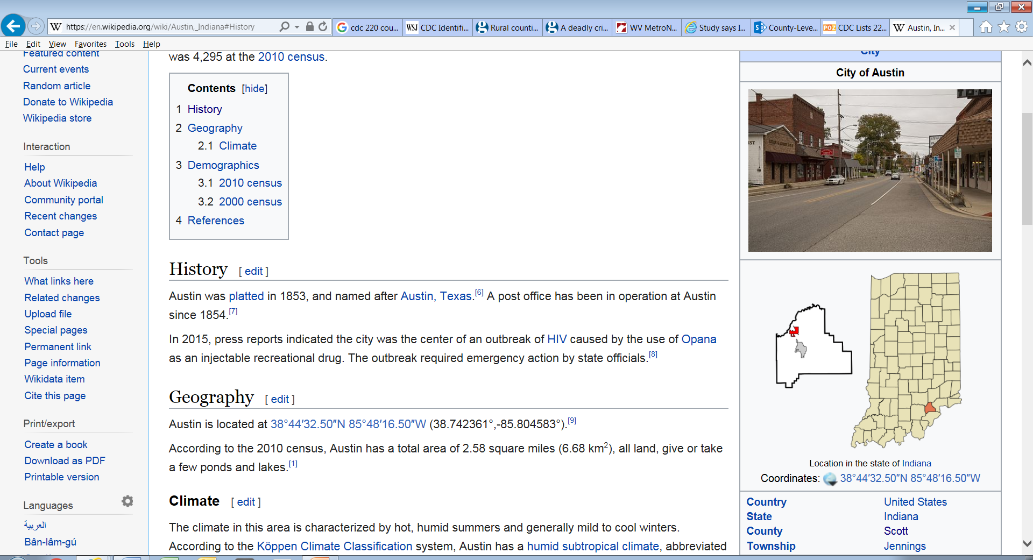
Why Is This Important?
Austin, Indiana located in Scott County
  Became infamous in 2014 as ground zero in the rapid spread of HIV and hepatitis C associated with needle-sharing by drug addicts. This was the first known U.S. town to suffer an HIV/HCV outbreak related to the opioid epidemic and resulted in 194 infected persons in a city of approximately 4158 people (4.7%).
Notes:
HIV infections caused by the use of Opana as an injectable recreational drug.
Named after Austin, TX in 1853.

Slide 6
Why Is This Important?
The percentage of new HIV infections due to persons who inject drugs (PWID) in the U.S. had sharply declined to 48% from 2008 to 2014 (CDC.gov, HIV and Injection Drug Use).
But in 2014, there were 47,055 drug overdose deaths in the U.S.
This was the most of any year on record.
61% (28,704) of these deaths were prescription opioid drug related.
Notes:
That’s 129 deaths per day. The majority of those deaths – almost 80 per day – involved a prescribed opioid.

Slide 7
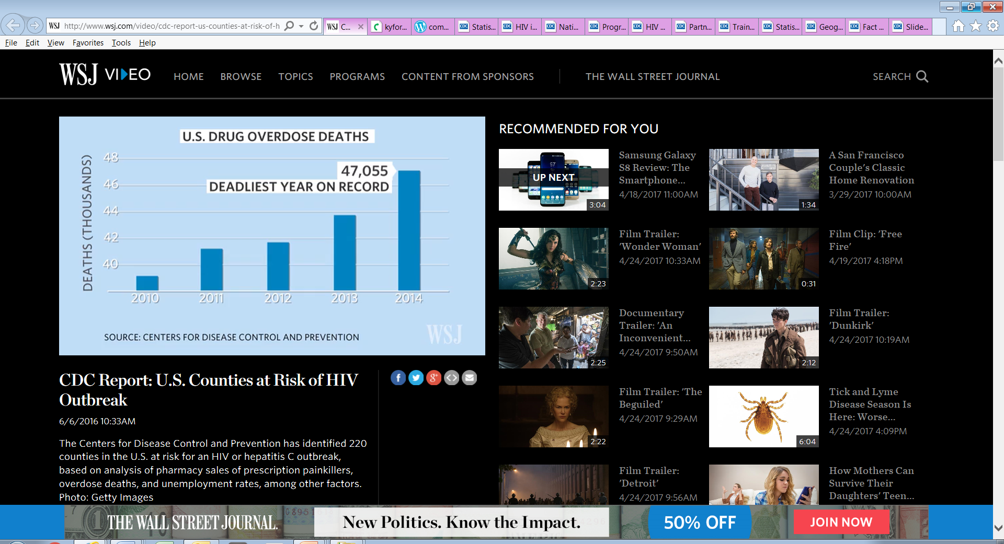
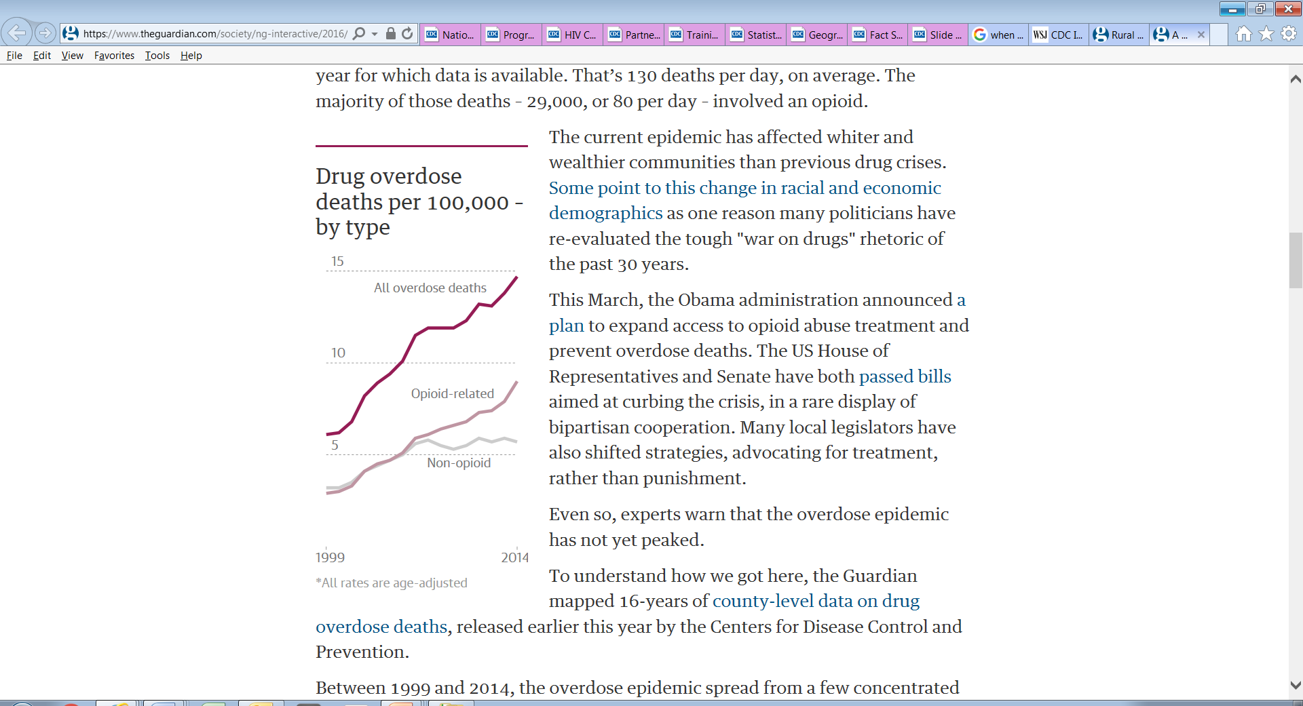
Why Is This Important?

Slide 8
Why Is This Important?
After the outbreak in Indiana, the Centers for Disease Control studied the region and identified the most at-risk counties in the U.S..
The study considered the following factors:
  drug-overdose deaths,
  prescription opioid sales,
  per capita income,
  white, non-Hispanic race/ethnicity,
  unemployment,
  education levels,
  and opioid prescribing potential.

Slide 9
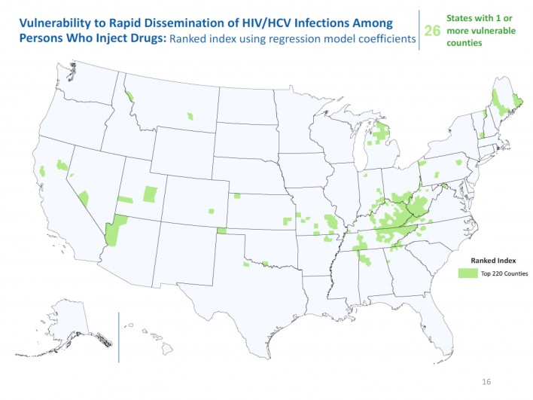
Why Is This Important?
As a result, in 2016 the CDC identified the 220 counties below at the greatest risk of a similar HIV/HCV outbreak. This is out of 26 states and 3143 counties in the U.S.
Notes:
These painkillers were aggressively marketed throughout the 1990s, early 2000s.
As prescriptions proliferated, so did misuse and abuse.
At the time, it wasn't understood how addicting these prescription pain medications were.

Slide 10
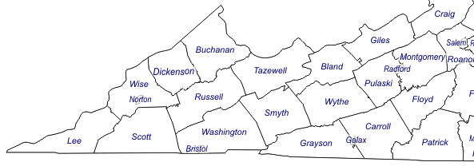
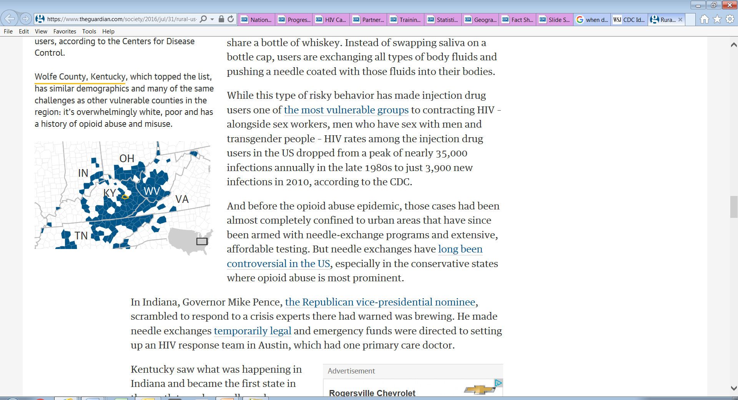
Why Is This Important?
Of the 220 counties, 56% are in Kentucky, Tennessee and West Virginia and most are within the Appalachian region.
Notes:
8 counties in VA. The largely rural area – dominated by physically taxing industries, coal mining, agriculture and timbering – was susceptible to the pain-relief promise of prescription opioids such as OxyContin and Vicodin.
In central Appalachia, the crack-down on prescription painkiller epidemic also fueled the influx of a cheap, alternative opioid: heroin.
As painkiller-related deaths began to fall in the early 2010s following federal and state crackdowns on prescription opioids, heroin-related deaths began to rise.

Slide 11
Why Is This Important?
From the study, the CDC made the following conclusions:
  The “analysis highlights U.S. counties potentially vulnerable to HIV and HCV infections among PWID (persons who inject drugs) in the context of the national opioid epidemic.”
  “State and local health departments will need to further explore vulnerability and target interventions to prevent transmission.”

Slide 12
Lenowisco HIV/HCV Outbreak Response Plan
As a result of these findings and as part of the CDC initiative, this project was undertaken

Slide 13
Project Description
The Goal
  to develop a comprehensive outbreak response plan for HIV and/or hepatitis (HBV and HCV) among PWID.
The Outbreak Response Plan
  intended to prepare for and intervene in the spread of HIV and/or hepatitis under the scenario that it could be primarily transmitted through injection drug use (IDU).

Slide 14
Project Description
The Lenowisco Health District is leading the development of the outbreak response plan.
Once completed, the plan is intended to be shared with local health departments across our region and the country.
In addition, the Lenowisco Health District has educated the community through town-hall style meetings, and is working to increase access to harm reduction information and resources.

Slide 15
Work Plan
Objective 1: Coordinate and conduct an outbreak response tabletop exercise to build on the accomplishments of the previous tabletop in April 2016 and confirm key elements of a comprehensive outbreak response plan for the local area.
Details:
  Analyze results of the “Southwest Outbreak Tabletop Exercise” held in April 2016 for lessons learned. – Complete.
  Collaborate with key players from the HIV outbreak in Scott County, IN for lessons learned. – Complete.
  Plan a “Viral Hepatitis and HIV Outbreak Tabletop Exercise” for the DiLenowisco localities with key stakeholders in the community invited to participate. – Complete.
  Assemble a task force to design and facilitate the tabletop exercise and conduct a “hotwash” at the conclusion of the exercise. – Complete.
  Conduct the “Viral Hepatitis and HIV Outbreak Tabletop Exercise”. – Complete.
Notes:
HEART performed on 3/9/17

Slide 16
Work Plan
Objective 2: Develop a comprehensive local outbreak response plan for viral hepatitis and/or HIV among PWID and related at-risk populations (sexual partners, household contacts, etc.).
Details:
  Develop an after action report from the tabletop exercise. – Complete.
  Review and analyze the results of the tabletop exercise. – Complete.
  Create and document the incident command structure, in preparation to respond to an outbreak. – Complete.
  Develop a comprehensive outbreak response plan for viral hepatitis and/or HIV among PWID based on the information gathered. – Draft completed.
  Identify a timeline for review of the response plan to assure key elements of the plan are current. – Reviews in-process.
Notes:
HEART performed on 3/9/17

Slide 17
Work Plan
Objective 3: Coordinate town hall-style meetings to educate, engage, and establish trust and buy-in from local stakeholders, including community members, to address the vulnerability to rapid increases in viral hepatitis and/or HIV among PWID, and related at-risk populations, and the connection between this vulnerability and increasing rates of opioid abuse.
Details:
  Design the meeting format and agenda. – Complete.
  Develop a widespread communication and outreach plan to encourage participation in meetings from partners, stakeholders and community members including PWID and other impacts segments of the population, including flyers, online resources and broadcast media. – Complete.
  Produce and disseminate printed promotion materials and coordinate the release of online and broadcast media. Complete.
  Conduct the town hall-style meetings in the local community to review the outbreak response plan, provide feedback and education on risks of opioid abuse and misuse, viral hepatitis and HIV as well as to build rapport and trust with local health officials and the community. Complete.
Notes:
HEART performed on 3/9/17

Slide 18
Work Plan
Objective 4: Increase the availability of educational materials focused on harm reduction messages and interventions for the prevention of viral hepatitis and HIV among PWID, and related at-risk populations.
Details:
  Modify existing harm reduction messages and interventions to include viral hepatitis risk awareness and substance abuse prevention messaging. – In-process.
  Print and produce materials for dissemination. – In-process.
  Disseminate materials to medical providers, correctional facilities, homeless shelters, food banks, faith communities and members of the community. – In-process.
Notes:
HEART performed on 3/9/17

Slide 19
Collaboration with Scott County, IN

Slide 20
Collaboration Efforts
Establish communications via telephone and video conference between key players of the HIV outbreak in Scott County and Lenowisco Health Department.
Learn from the Scott County HIV outbreak for the development of a comprehensive outbreak response plan for viral hepatitis (HBV and HCV) and/or HIV among PWID.
Review outbreak management, lessons learned and long term planning and incorporate as appropriate in Lenowisco outbreak response plan.

Slide 21
Features of Scott Co. IN Outbreak
Newly HIV/HCV diagnosed population was rural, all white, and nearly evenly split between men and women.
Other factors were similar to our region, including a high rate of poverty (19%), unemployment (9%), low education level (21% without a high school diploma) and limited access to insurance and health care.
Age range of the 135 participants interviewed after the outbreak were 18–57 years old (mean = 35 years; median = 32 years)
108 of participants (80.0%) reported injection drug use.

Slide 22
Features of Scott Co. IN Outbreak
Interviewed participants reported injection drug use in this community is often multi-generational, and family and community members frequently inject together and share syringes and other equipment.
Coinfection with hepatitis C virus was diagnosed in 114 of the 194 (84.4%) patients involved with the outbreak.
Testing indicated a picture consistent with the HIV virus newly spreading in the community along with a high prevalence of pre-existing HCV.

Slide 23
Scott Co. IN Outbreak Challenges
Many of the residents were unemployed, most were uninsured and many did not have identifying documents such as birth certificates.
The county is an "abstinence-only" jurisdiction that does not teach comprehensive sex education in schools.
Medication-assisted or opiate substitution therapy for addiction treatment was not locally available.
The community's sole family practitioner saw outpatients only four hours per week, and most people who received care for HIV or hepatitis C travelled out of town to do so.

Slide 24
Scott Co. IN Outbreak Management
The Indiana State Department of Health worked with the only health care provider, local health officials, law enforcement, community partners, regional health care providers and the CDC to launch a comprehensive response to the outbreak including the following:
  a public education campaign,
  establishment of an incident command center and a community outreach center,
  short-term authorization of syringe exchange,
  and support for comprehensive medical care including HIV and hepatitis C treatment as well as substance abuse counseling.
  Health officials set up a "one-stop shop," where people could access multiple medical services.

Slide 25
Scott Co. IN Outbreak Management
Indiana increased funding to expand capacity for HIV testing, care, and pre-exposure prophylaxis (PrEP) and medication-assisted addiction treatment.
Public health officials started a media campaign and sent out mailers to all county residents about HIV and hepatitis testing.
Billboards and bus shelter ads encouraged people not to share needles.
Antiretroviral treatment was made available for everyone with diagnosed with HIV.

Slide 26
Scott Co. IN Outbreak Management
Expanded testing was established in prisons, emergency rooms and addiction services.
Efforts were made to decrease opioid over-prescribing.
The Indiana governor declared a public health emergency, allowing temporary needle exchange programs (prior to the outbreak, needle exchange was illegal in Indiana).
A new law allowed lay people (not just medical providers) to administer naloxone (Narcan) to prevent overdose deaths.
Notes:
Continuation of the Following:
Viral load reduction through continuation of antiretroviral therapy, monitoring of viral load and of medical care to infected patients.
Continued HIV clinical care locally and to inmates.
Established mental health, behavioral health and addition services via satellite locations.
Worked toward federal grants for Scott County.
Continued One Stop Shop concept for care.
Establishment of additional Primary Care physicians in the area.
Continued adult immunizations, HIV and HCV testing.
Continued Needle Exchange Program.
Continued Public Relations/Education campaign.
Continued a capacity building for ISDH infectious diseases.
Continued overdose intervention via Narcan at City and County Services (not just health providers).

Slide 27
Scott Co. IN Outbreak Conclusions
The outbreak highlighted the vulnerability of many rural, resource-poor populations to drug use, misuse, and addiction.
The outbreak also demonstrated the importance of timely HIV and Hepatitis C surveillance activities and rapid response to interrupt disease transmission.
The outbreak pointed to the need for expanded mental health and substance use treatment programs in medically underserved rural areas.

Slide 28
Implementation of the Appalachian H.E.A.R.T Initiative
(HEP/HIV Emergency Action Response Tabletop)

Slide 29
H.E.A.R.T. Exercise Purpose
The purpose of the HIV/HCV Outbreak Tabletop Exercise was to aid in the development of a comprehensive community response plan to address a rapid increase in viral hepatitis or HIV infections.

Slide 30
H.E.A.R.T.
The tabletop exercise was performed on March 9, 2017 at Mountain Empire Community College.
Participants included:
  Representatives from Lee County, Wise County, Scott County, and Norton City Departments of Health.
  Representatives from the National Association of City and County Health Officials (NACCHO)
  Local physicians, resident physicians, nurses and mid-levels.
  State and local law enforcement.
  Local hospital and out-patient case managers.
  Representatives from local drug abuse management programs.
  Local Pharmacists.
  Social Services.

Slide 31
H.E.A.R.T. Objectives
Objective 1: Discuss epidemiological and community methods of outbreak prevention and mitigation.
Objective 2: Discuss essential viral hepatitis/HIV outbreak response needs.
Objective 3: Examine information sharing processes with community partners.
Objective 4: Discuss laws, regulations, and procedures for viral hepatitis/HIV outbreak response and recovery.

Slide 32
Participant Roles and Responsibilities
Players: Respond to the situation presented based on current plans, policies, and procedures
Facilitators: Provide situation updates and moderated discussions
Evaluators: Observe and document player discussions
Observers: Support players in developing responses, but do not participate in moderated discussion
Notes:
Introduce evaluators

Slide 33
H.E.A.R.T. Exercise Structure
A HIV and hepatitis outbreak scenario was created for the exercise.
The exercise consists of three modules:
  Module 1: Exercise background and initial outbreak response in affected counties
  Module 2: Community Impact and Public Information/Education
  Module 3: Looking forward
Each module began with a multimedia update that summarizes key events occurring within that time period.
After the updates, participants reviewed the situation and engaged in a functional group discussion on the appropriate responses to the issues presented.

Slide 34
Module 1: Recipe for Disaster
Establish the background and initial outbreak details in the affected counties

Slide 35
Module 1: Recipe for Disaster
The scenario was presented as part of the annual Remote Area Medical (RAM) held at the Wise County Fairgrounds each July
  Southwest Virginia’s Health Wagon partners with RAM yearly for this event and along with 1,000- 1,500 volunteers from many organizations and regions; provides medical, dental, and vision care to an estimated 2,500 attendees, at no cost.
  Attendees come from outside of Wise County and Virginia and many sleep in their cars or tents.
  Attendees are usually low-income, uninsured or under-insured.
  Patients are electronically registered prior to receiving services.

Slide 36
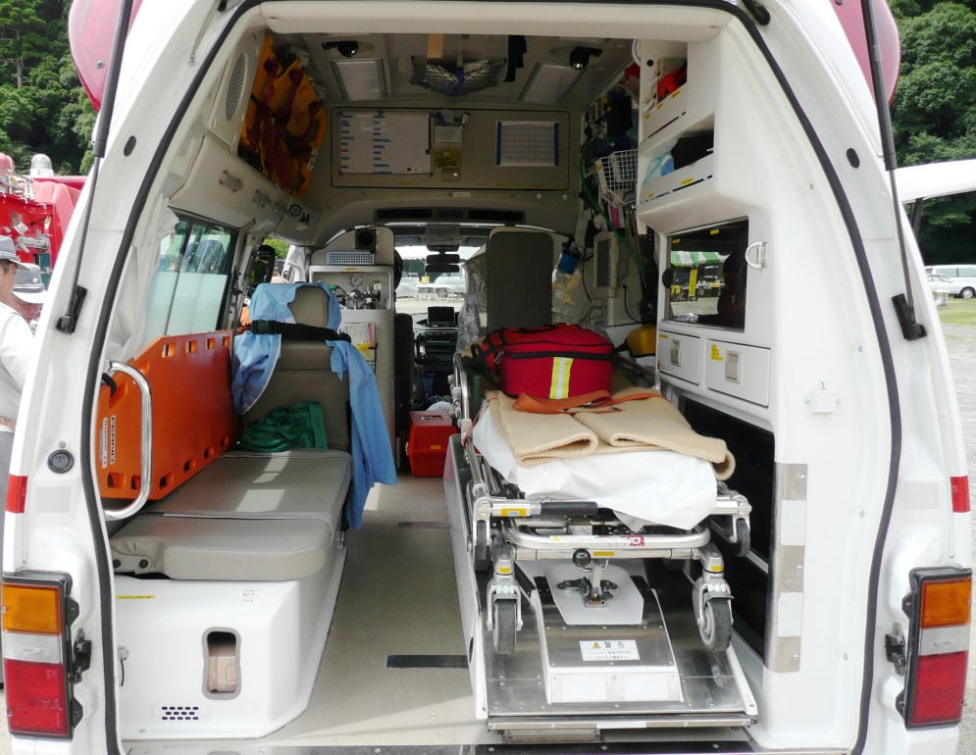
Module 1: Recipe for Disaster
August 28, 2016
Law enforcement responded to a 911 call about an overdose in Wise.
Counterfeit prescription opioid pills (OxyContin®) laced with Fentanyl were the presumed cause.
Patient was transported and naloxone was administered by EMS.

Slide 37

Module 1: Recipe for Disaster
The patient died due to overdose. No information about his contacts was available.
Patient’s initial test results were positive for HIV, hep C, antibodies and hep B surface antigen.
An investigation revealed he was present at the July RAM in Wise County and attended a party on Day 2 of the event.
He also engaged in extensive drug use, including needle sharing, and unprotected sex with multiple partners.
Notes:
Decedent

Slide 38
Module 2: The “Tupperware” Party
Community Impact and Public Information and Education

Slide 39

Module 2: “Tupperware” Party
September 13, 2016
A 23 year-old male overdosed and the police were first to the scene.
He had fallen from a tree and hit his head. He was transported via EMS to Mountain View Regional Medical Center.
During transport, EMT was stuck with a needle as an IV was attempted at the same time the ambulance almost hit a deer.
The patient died in hospital ER.

Slide 40
Module 2: “Tupperware” Party
September 13, 2016
The responding Deputy was concerned about blood exposure because he had moved the patient before realizing there were minor head cuts with lots of bleeding.
Neighbors saw police at the patient’s property and posted photos on Facebook and Twitter.
News organizations were contacting the health department and county administrators within 2 hours.
The local health departments received a flood of requests for HIV testing because word had spread about an HIV outbreak.

Slide 41
Module 2: “Tupperware” Party
The publicity resulted in a large increase in the number of HIV reports and a spike in acute hepatitis B reports.
Investigators learned that the deceased was also at the July RAM and attended a “Tupperware” party receiving this name since assorted drug paraphernalia were being stored in Tupperware containers.
Also, the deceased had two molars removed at the RAM dental clinic and that status of blood exposure was unknown.

Slide 42
A New “Tupperware” Policy
Looking Forward

Slide 43

Module 3: New “Tupperware” Policy
October 31, 2016
The VA Governor has now declared a public health emergency.
The VA Governor has also signed a House Bill authorizing the establishment of a syringe exchange program during the emergency.
National news media has been in the Lenowisco and Cumberland Plateau health districts gathering information.
And a second, larger spike in acute hepatitis B reports has occurred as reports of HIV continue to rise.

Slide 44
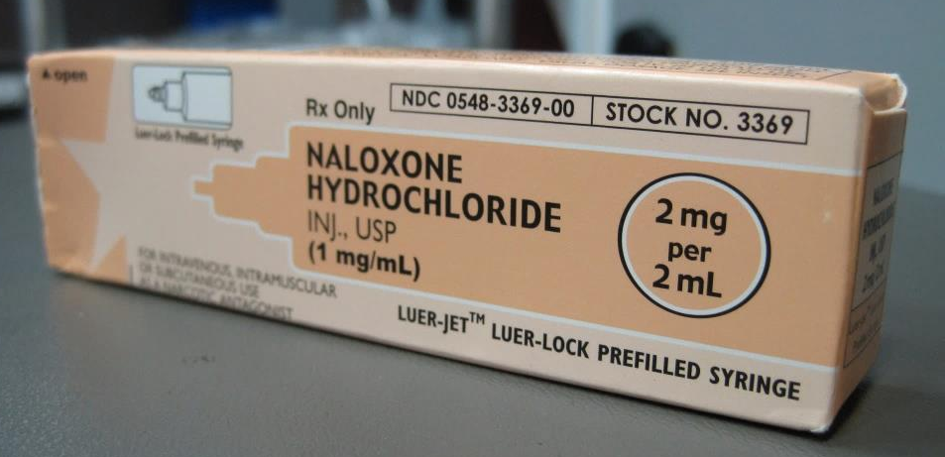
Module 3: New “Tupperware” Policy
Our community and the region needs to now address this nationally publicized outbreak on the public stage. What are the next steps for the community?
All players must establish additional plans related to the following:
Harm reduction initiatives
Hepatitis C treatment
Naloxone
Sharing of injection equipment
Non-US residents
Non-Virginia residents

Slide 45
Break Out Sessions
After each module, the participants were divided into cross-functional teams and discussed each module and the how each participant would participate in managing that aspect of the outbreak.
Handouts were filled out detailing each of the group’s answers.
A spokesperson from each group presented a summary of their suggested actions to the entire group for comparison.

Slide 46
Current Project status
Open Items, Next Steps and Conclusions

Slide 47
Status of Key Steps of the Project
Objective 1 - Outbreak Response Tabletop
  Complete.
Objective 2 - Outbreak Response Plan
  A final draft is complete and circulated for review.
Objective 3 - Town Hall Meetings
  Meetings have been conducted and were considered effective in educating and engaging the public.
Objective 4 – Associated Educational Materials
  Modifications to existing educational materials are underway and will be distributed in the near future.

Slide 48
Next Steps
This project has been funded by the National Association of County and City Health Officials (NACCHO) via a grant from the Centers for Disease Control (CDC).
NACCHO and the CDC have been so pleased with the project, they have asked that the work flow used for developing the Response Plan be provided to the CDC so that a “Toolkit” can be created and posted on the CDC website for other counties to use to establish similar Response Plans.

Slide 49
Conclusions
Based on the information obtained from the tabletop exercise and the collaborative efforts with Scott County, IN, it is believed that utilizing a simulation of an HIV/HCV outbreak is more effective an Outbreak Response Plan.
Based on feedback received from Scott County, IN, a formal plan detailing an established strategy for managing their outbreak would have been welcomed and possibly resulted in a more timely response to the outbreak and thus reduced harm to the community.

Slide 50
Acknowledgements
Wise County, VA Health Department
Scott County, IN Health Department
CDC Division of HIV/AIDS Prevention (DHAP)
Division of Viral Hepatitis (DVH)
The Centers for Disease Control and Prevention (CDC)
National Association of City and County Health Officials (NACCHO)
Wellmont Family Medicine Residency Program
Foundations Family Medicine
LifeSpring

Slide 51

Questions

Slide 52
Thank You!

Slide 53
References
Wall Street Journal Online, CDC Identifies Counties at Risk of HIV Outbreaks, A. Campo-Flores, B. McKay, 6/3/16.
The Guardian Online. A deadly crisis: mapping the spread of America's drug overdose epidemic. N. Popovich. 2016.
JAIDS Journal of Acquired Immune Deficiency Syndromes. County-Level Vulnerability Assessment for Rapid Dissemination of HIV or HCV Infections Among Persons Who Inject Drugs, United States. 1 Nov 2016 - Vol 73 - Issue 3 - p 323–331.
cdc.gov/hepatitis/pdfs/dvh-strategicplan2016-2020
National Notifiable Diseases Surveillance System (NNDSS) Online.

