Slide 1

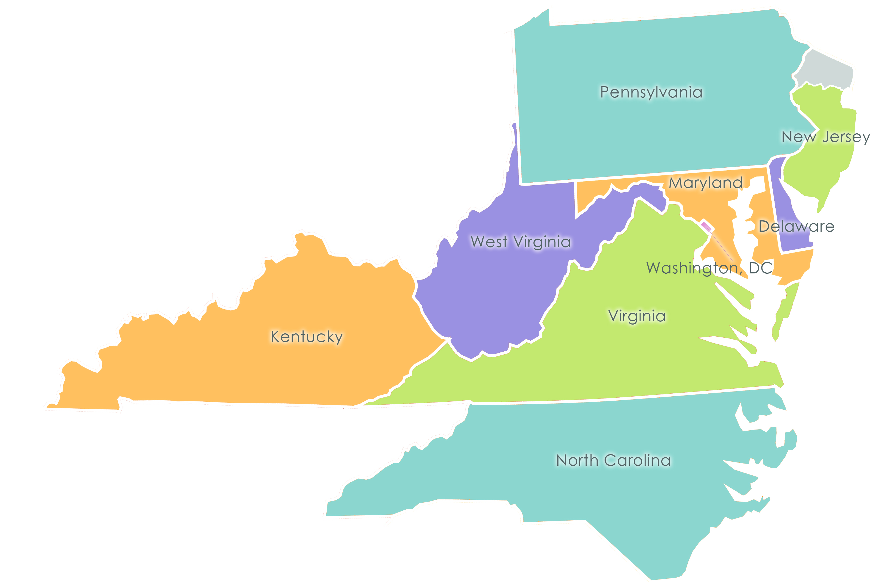
What Doctors Need to Know About Telehealth
Head for
the Hills
October 1, 2016
Serving Delaware, Kentucky, Maryland, New Jersey, North Carolina, Pennsylvania, Virginia, Washington DC and West Virginia

Slide 2
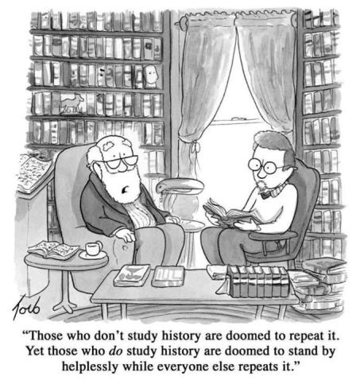
Looking Back
How We Got Here

Slide 3
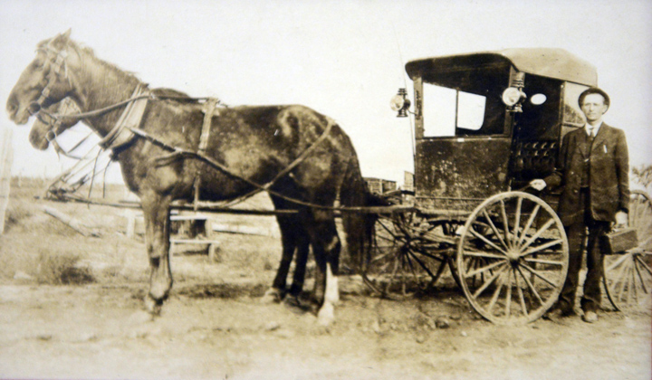
Looking Back
Health Care - Past
Notes:
Until the 1940s, the majority of physicians in America saw their patients in their homes. This meant the physician would spend the majority of time on the road, in car or buggy, and considerable amount of time would be spent with each family. A physician from Kentucky chronicled a house call he made in the early 20th century: “I recall an experience I had one winter day with the thermometer near zero and about five inches of snow on the ground. I was called about eight miles from home and found a young farm boy with a well marked case of appendicitis with apparent abscess formation. I called a very fine, competent surgeon from Henderson, Kentucky, to come prepared to operate in the home. . . . The patient being satisfactorily anesthetized, the surgeon removed the appendix and sutured the wound in about forty minutes. After [the] operation, the surgeon got in his buggy and started home, a distance of about twenty-five miles. I spent the night with the family and saw the patient daily for several days. He made a very rapid and satisfactory recovery. Not only was the amount of time spent with each patient drastically different, but also the frequency of visits was astonishingly higher. Towards the end of the 1920s, American Family Physicians were making 3.6 calls for the average illness, 2.4 calls for a cold, 3.6 calls for a typical case of mumps or other “communicable disease”, 4.7 calls for a “nervous disease,” etc. Of American physicians practicing in 1928, high percentage, 74, were general practitioners (GPs). By 1942, the percentage of GPs had fallen to below half. This decline continued, as in 1980, while there were 403,000 practicing physicians in America, only 15% comprised family physicians.

Slide 4
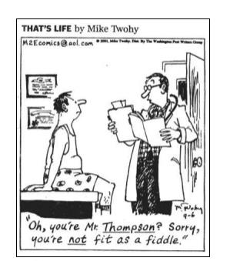
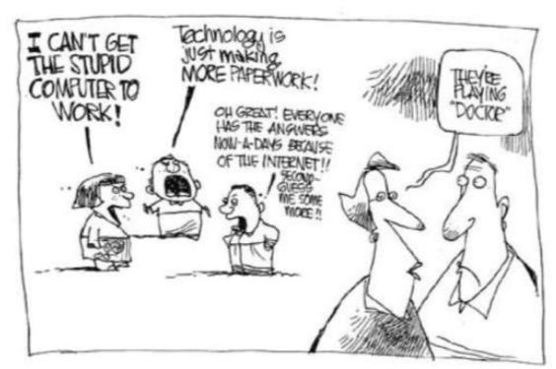
Today
Health Care - Present
Notes:
The trend of declining home visits has persisted over the decades, and has certainly played a role in the changing doctor-patient relationship. Whereas once a physician visited a patient in their home, often multiple times for a single complaint, now the patient may be placed in a ten minute block in a clinic setting, clearly altering the doctor patient
dynamic. In 2000, Canadian Family Physician noted that most commonly cited reasons for practitioners’ being unable to do house calls were the lack of efficiency, the time required, and poor reimbursement. Further reasons noted by the Journal of American Geriatric Society were the result of an explosion access of patients to a growing medical system, the growth of third-party payers, and heightened liability concerns.

Slide 5
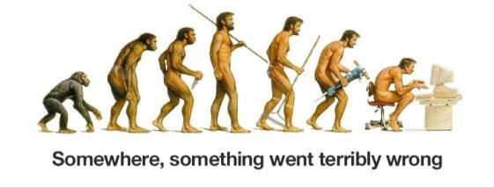
Progress?
CARE | PAST | PRESENT
Location | Home | Clinic/Hospital
Provider | Generalists | Specialists
Interaction | Frequent | Episodic/Periodic
Relationship | Personal | Impersonal
Unit | Family/Community | Individual
Focus | Health | Disease

Slide 6
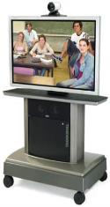
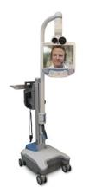




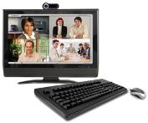

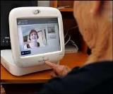
Telehealth
The Promise of Telehealth
A mechanism for enhancing health care, public health, health administration and health education delivery and support, using electronic communication and information technology.
Notes:
But before we jump into how we got to where we are today, I want to make sure we have a common understanding of what we mean by telehealth. First of all, telehealth is not about technology. Rather, telehealth is the use of electronic information and telecommunications technology to support and enhance the delivery of health care, public health, health administration, and patient and professional health related education. It is a mechanism or tool for service delivery and not a service line in and of itself. Right now, telehealth is primarily delivered in four ways:

Slide 7
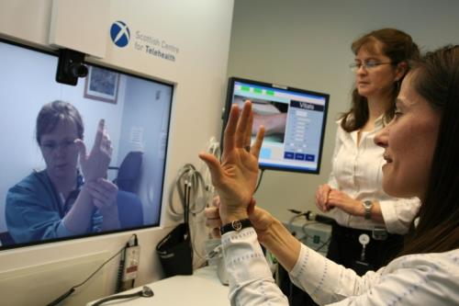
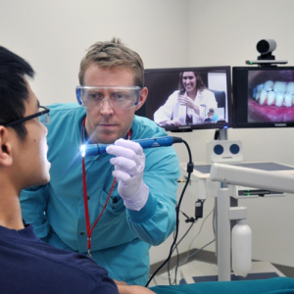
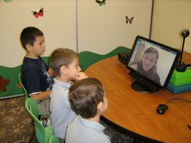
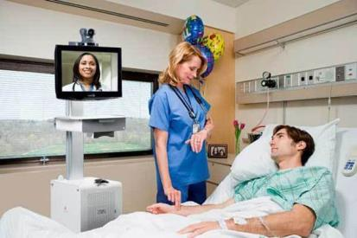
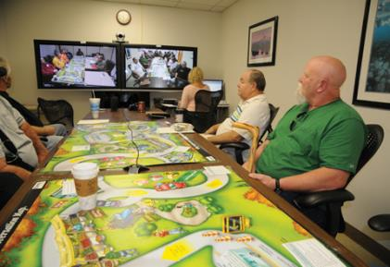
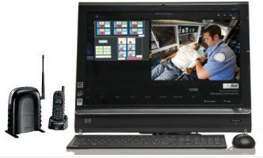
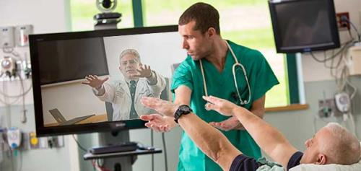
Synchronous
Notes:
First is live videoconferencing which synchronous. This is what most people think of. Live, two-way interaction between a person and a provider using audio-visual telecommunications technology and supported by digitally transmitted sounds, images and other data. Virtual visits are accomplished using high speed connections and high definition monitors. Kind of what people think of as “Skype” on steroids and within the framework of HIPAA.

Slide 8
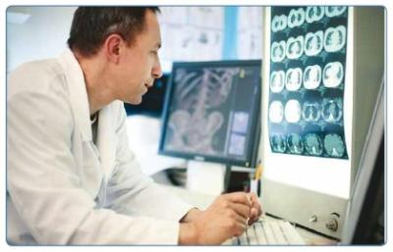
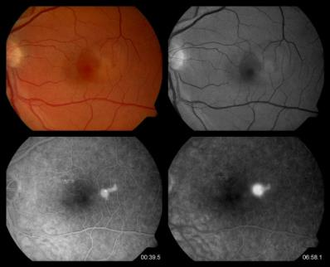
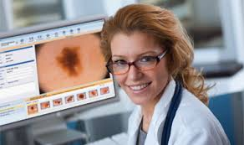
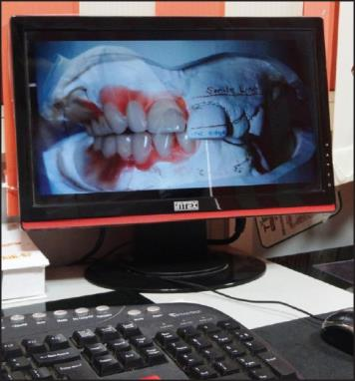
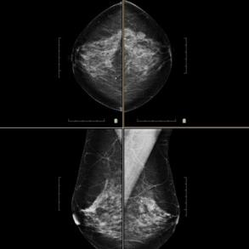
Asynchronous
Notes:
Second is store and forward or what is considered asynchronous. This is transmission of recorded health history through an electronic communications system to a practitioner, who uses the information to evaluate the case or render a service without having real time interaction with the patient. Applications in the pictures include things like tele-radiology, tele-dermatology, diabetic retinopathy screening, mammography and teledentistry

Slide 9
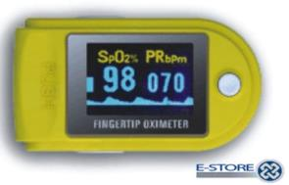
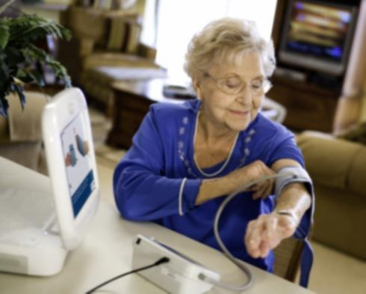
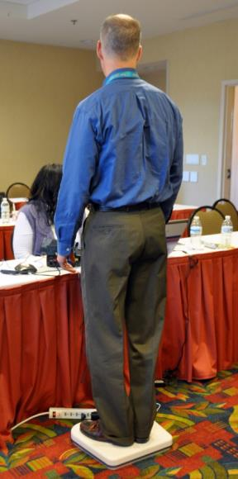
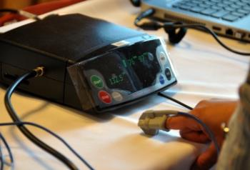
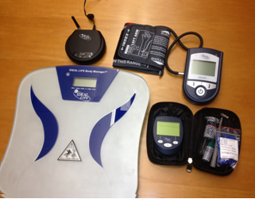
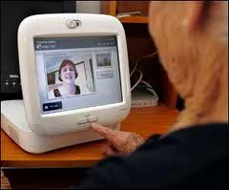
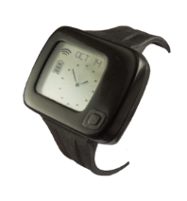
Remote Monitoring
Notes:
Third is Remote Patient Monitoring (RPM). This is where personal health and medical data is collected from an individual in one location via electronic communication technologies and transmitted to a provider in a different location for use in patient care and chronic disease management. The types of information transmitted wirelessly can includes things like blood pressure, glucose, weight, pulse, ECG, blood oxygen, peak flow, temperature and more! The information is collected daily (occasionally more frequently) and most frequently monitored by a clinician managed call center. The system alerts the call center staff if readings are outside the “normal” range for that particular patient. Should this alert take place, the patient would get either a phone call or video call. This is an opportune time for patient education and engagement. There are some devices that are wearables that also do continuous monitoring.

Slide 10
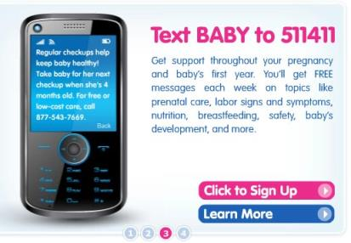
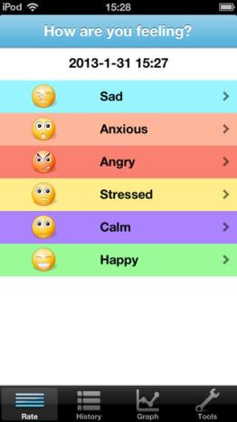
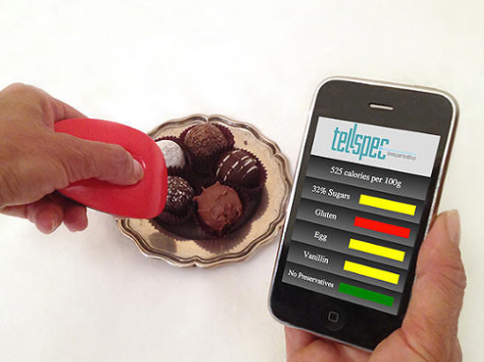
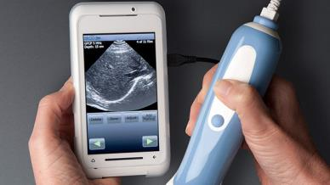
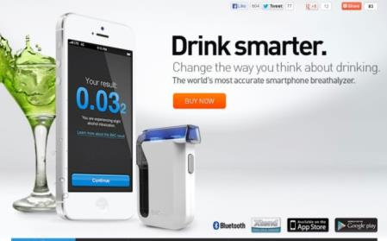
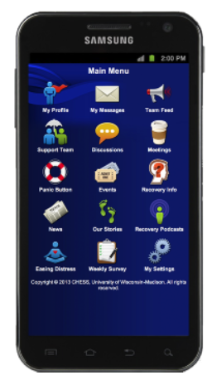
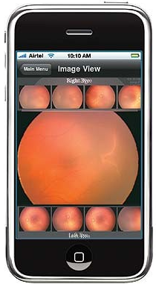
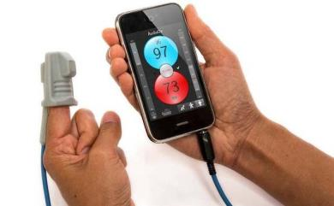
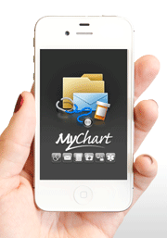
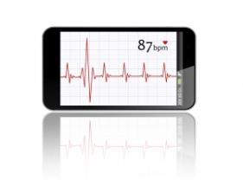
mHealth
Notes:
Fourth is Mobile Health (mHealth). This is where health care and public health practice is supported by mobile communication devices such as cell phones, and tablet computers. Applications can range from targeted text messages that promote healthy behaviors to applications that help people make healthy choices to mental health and physical health assessment to secure videoconferencing for medical services to wide-scale alerts about disease outbreaks.

Slide 11
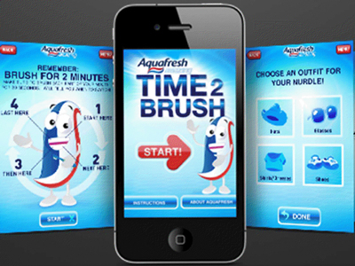
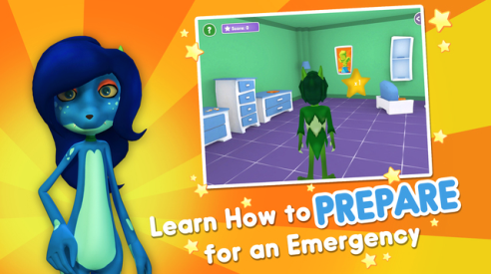
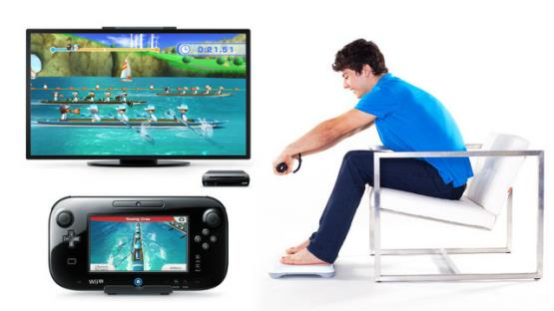


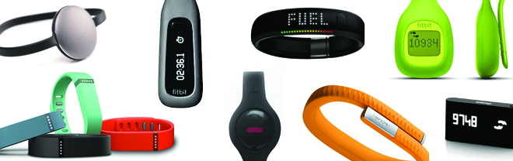
mHealth
Notes:
Also included in mobile health is the gamification of health (making healthy behaviors fun) and the evolution of the wearables for personal health monitoring and tracking.

Slide 12

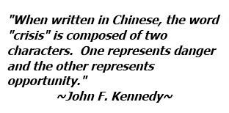

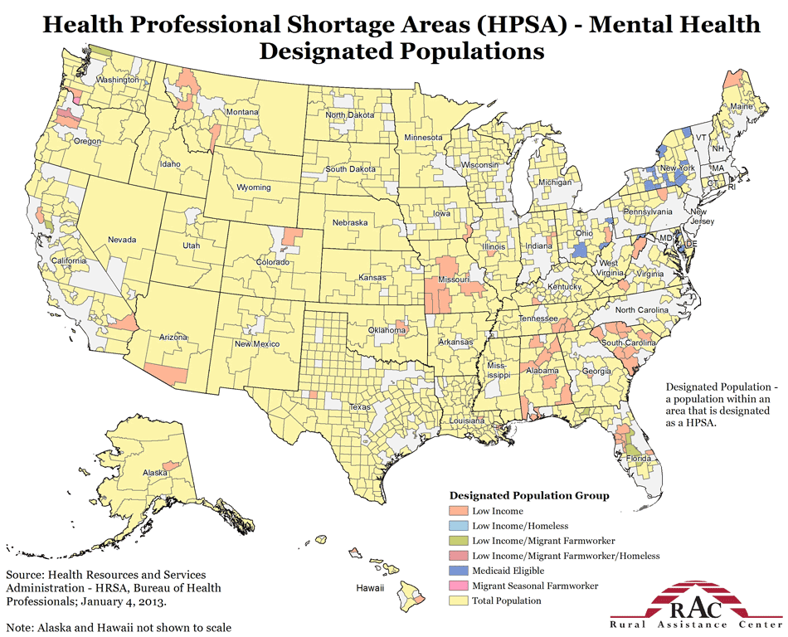
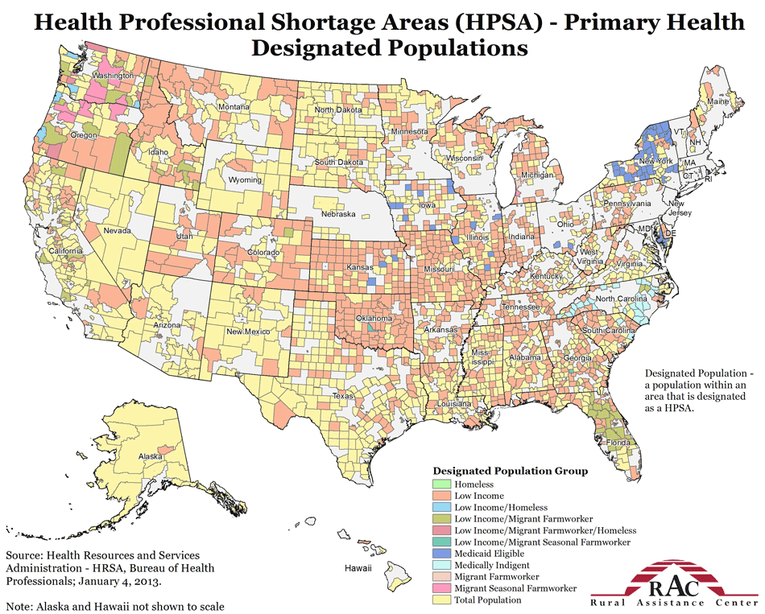
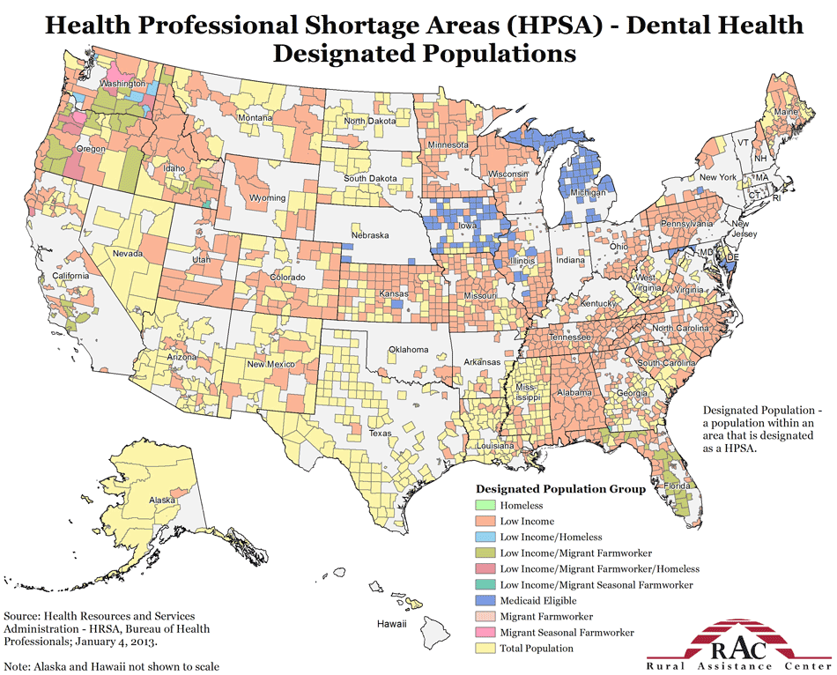
Necessity Breeds Invention
It Started With This

Slide 13
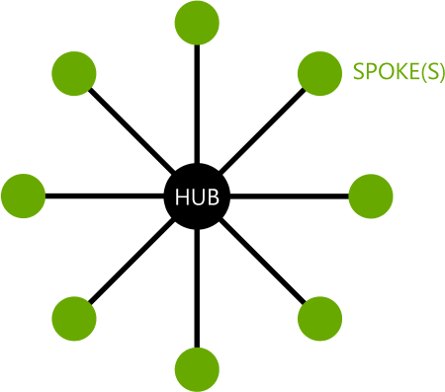
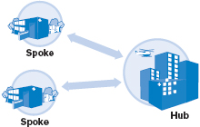
It Looked Like This
Notes:
When telehealth began, the model looked primarily like this. It was a purely hub and spoke model. It was almost all hospital to hospital specialty care consults from an urban tertiary care center to a smaller rural community hospital. The beginnings were rough. Prices were high, bandwidth was low, and best practices had not been developed. In spite of that, we saw some incredible rural successes. Things like telestroke, teleradiology, telepsychiatry/mental health, teledermatology all took shape during this era and has in many cases become the standard of care.

Slide 14
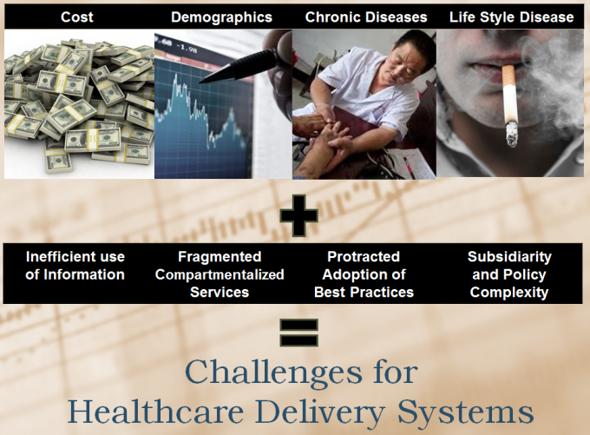
Things Changed
Notes:
Fast forward about a decade and our focus in our country really to move in the direction of cost, chronic disease, life style disease. In addition, bandwidth increased and technology improvements and data availability got to a point where people could start imagining how it could be better used to address some of these major challenges.

Slide 15



Things Changed
Notes:
The shift from volume based to value based care started to take place, albeit slowly.

Slide 16

Things Changed
Notes:
The patient centered medical home concept began to evolve, albeit slowly.

Slide 17


Things Changed
It Now Looks Like This
Notes:
As a result, telehealth began to take this direction…where health facilities began to connect to other facilities, and these facilities began to connect to other facilities, both inside the communities and to other communities. For the most part, however, these were still facility to facility connections.

Slide 18


Telehealth
A Tool in the Toolbox for Rural

Slide 19






Rural Successes
Telestroke – Time is Brain
Administration of tPA at stroke centers = 10% - 20% of ischemic stroke patients
Administration of tPA outside of stroke centers = 1% - 2% (without telestroke) and 10% - 20% (with telestroke)

Slide 20



Rural Successes
Mobile Pre-Hospital Telestroke

Slide 21



Rural Successes
Parkinson’s Care
This program has saved patients roughly 20,000 miles of travel

Slide 22

Rural Successes
Retinopathy Screening

Slide 23






Rural Successes
Types of School Based Telemedicine Care Provided – 2011 Survey of 46 Organizations
Notes:
Everything from acute care, oral health, mental health, well visits, speech, health education to functional analysis and communication training for kids with autism.

Slide 24

Rural Successes
High Risk OB
Notes:
45% of pregnancy women referred to on-site care at UVA did not keep their appointments
collaborative high risk prenatal care telemedicine clinics were initiated in 5 rural locations between 2009 – 2012 at public health departments and FQHCs
Training was provided for advanced practice nurses
Research Questions: 1) Does the use of telemedicine improve access to subspecialty prenatal care for at-risk in rural areas? 2) Does use of telemedicine for high risk prenatal care improve perinatal outcomes? 3) Are pregnancy women satisfied receiving high risk care through telemedicine?
Pretelemedicine: N-181
Telemedicine: N = 323
Findings:
Improved access to care – 21.3% missed visits vs. 57.1%, increase of 1.2 avg visits and 162,126 miles of travel saved
Comparable rates for prematurity, birth weight and NICU admissions, HOWEVER, reduced the mean NICU stay by 8 - 9 days
High patient acceptance and satisfaction

Slide 25


Rural Successes
Remote Patient Monitoring: Real Patients/Real Outcomes –
Medium Sized Rural Health System

Slide 26





Rural Successes
Remote Patient Monitoring: Real Patients/Real Outcomes –
Small Rural FQHC Look-Alike
72% decrease in costs
50% decrease in hospital bed days
81% decrease in ER visits
Replication Underway
http://cotnexperience.blogspot.com/p/blog-page.html

Slide 27

Rural Successes
Chronic Pain
Palliative Care
Dementia Care
HIV/AIDS
Epilepsy
Rheumatology
Addictions
Hepatitis C
Diabetes
Weight Management
Osteoporosis
Developmental Pediatrics
Psychiatry
High Risk Pregnancy
And Many More…
Notes:
Project ECHO (Extension for Community Healthcare Outcomes) is a collaborative model of medical education and care management that empowers clinicians everywhere to provide better care to more people, right where they live.
The ECHO model™ does not actually “provide” care to patients. Instead, it dramatically increases access to specialty treatment in rural and underserved areas by providing front-line clinicians with the knowledge and support they need to manage patients with complex conditions such as hepatitis C, rheumatoid arthritis, chronic pain, and behavioral health disorders among many others. It does this by engaging clinicians in a continuous learning system and partnering them with specialist mentors at an academic medical center or hub.

Slide 28

Telehealth flips the paradigm
Paradigm Shift
Notes:
Telehealth is a paradigm shift for most of us.

Slide 29

Around the Bend
Notes:
We are on the cusp of a whole new revolution in telehealth, the direct to consumer revolution.

Slide 30


Around the Bend
Notes:
Many of you have already seen many of these companies.

Slide 31


Around the Bend

Slide 32

Around the Bend
Integration of telehealth into mainstream care delivery
https://www.accenture.com/us-en/insight-virtual-health.aspx

Slide 33
Show of Hands
What percent of outpatient care can be effectively done virtually?
15% or less
50% or less
70% or less
More than 70%

Slide 34

Reasons for Adoption Abound
Access
I need a dermatologist
I need a psychiatrist
I need a clinician after hours
I need a pediatrician
I need an OB/GYN
I need a cardiologist
Notes:
Successful virtual health strategies will help us achieve four important objectives: better outcomes, improved access and patient experience, reduced costs, and revenue growth. They can also improve retention among both patients and clinicians. Most people have lots of needs.

Slide 35

Outcomes
Reasons for Adoption Abound
Improved Chronic Disease Management
Access to Patient Education
Access to Preventive Screening
Increased Treatment Compliance
Access to Best Practices for Patient Safety
Access to Clinician Continuing Ed
Notes:
Most people have areas of frustration because you just can’t get a handle on some aspect of patient care so health outcomes don’t seem to improve

Slide 36

Reasons for Adoption Abound
Costs
Recruitment and Retention
Readmission Penalties
Unnecessary Transfers
Meaningful Use Penalties
Reputation and Patient Satisfaction
Medical Errors
Notes:
Most people have financial viability issues if they don’t get a handle on some major cost drivers.

Slide 37
Show of Hands
House calls are better than virtual care because the provider:
Has patient's medical history
Can touch the patient
Can use medical devices
Virtual care is equivalent

Slide 38

But The Struggle Is Real
Challenges
Notes:
Virtual health has the potential to transform the healthcare industry. Although the concept of virtual medicine has existed for decades, the U.S. healthcare industry has failed to make a large-scale transition to virtual health thus far. Adopting virtual health is not easy. Health systems will have to make significant investments in technology and overhaul their fundamental operating models.

Slide 39


Quality and Safety?
Notes:
When is telehealth appropriate? This is the question that many have been grappling with. The Federation of State Medical Boards in 2014 came up with a Model Policy for the Appropriate Use of Telemedicine Technologies in the Practice of Medicine. In that policy, they explicitly say “Generally, telemedicine is not an audio-only, telephone conversation, e-mail/instant messaging conversation, or fax.“. This has been an issue of heated debate. Is phone only considered telemedicine? Can diagnostics take place without seeing the patient? Should you be able to prescribe?

Slide 40



Informed Consent
Notes:
Some states require it, others do not. No matter, it is good practice. Informed consent should include:
Identification of the patient, the physician and the physician’s credentials
Types of transmissions permitted via technology
Physician determines if diagnoses and/or treatment is appropriate for the telemedicine encounter
Security and privacy
Hold harmless clause if there is a technical failure
Disposition of medical record
Informed consent is not just a signature. The patient must really understand.

Slide 41

Standard of Care
Notes:
Good medicine is good medicine. Bad medicine is bad medicine. There is no such thing as bad telemedicine. As a clinician, you are responsible for maintaining acceptable and appropriate standards of care. If a patient is in your office experiencing heart issues and your stethoscope or ECG device is malfunctioning, you would not proceed to diagnose the patient. This is no different than with telemedicine. If you cannot get a clear image, you are unable to hear clearly, etc…you do not proceed. The standard of care should not be compromised. You must use good clinical judgment.

Slide 42


Liability?
Notes:
At what point is the doctor-patient relationship established? Who is liable? Some states have malpractice caps and others don’t. Can I be sued if I don’t use telemedicine when I could/should have? Do I need special insurance? We have a fractured legal framework and there are so many moving parts. In February, more than one hundred telemedicine-related bills were introduced in state legislatures across the country

Slide 43


Medical Malpractice
Physician Patient Relationship Exists
Standard of Care is Breached
The Breach Causes Injury
Medical Expenses, Lost Wages, Pain and Suffering
Notes:
This does not change when it comes to telehealth, but you should make sure your medical malpractice carrier covers you at all practice sights.?

Slide 44



My Patients?
Notes:
In a direct to consumer market, how do I coordinate care? Anyone can come in and see my patients and I would never know it. How do telehealth consults make it into the patient’s medical record? Will the direct to consumer market destroy the PCMH?

Slide 45




Help Patients Know
Notes:
Document everything and establish a patient record. Patients should be able to seek, with relative ease, follow-up care or information from the physician [or physician’s designee] who conducts an encounter using telemedicine technologies. Physicians solely providing services using telemedicine technologies with no existing physician-patient relationship prior to the encounter must make documentation of the encounter using telemedicine technologies easily available to the patient, and subject to the patient’s consent, any identified care provider of the patient immediately after the encounter.

Slide 46

Licensure
Ask yourself:
Am I licensed in the state I am practicing?
Am I licensed in the state where the patient is located?
Notes:
The FSMB released a final version of its interstate medical licensing compact in September 2014. The compact streamlines the process for applying for medical licenses in multiple states while keeping the responsibility for licensing and disciplining physicians within the state boards. You must have a license in the State where your practice AND where the patient is receiving care. This may be done via the full licensing process, licensure by endorsement, reciprocity, special purpose telemedicine license or mutual recognition. Find out! You must abide by the scope of practice as it pertains to your license in the State where the patient is receiving care. There are a few exceptions – provider to provider consultation, emergencies and some border states.

Slide 47





Reimbursement
Notes:
You need to learn the various policies pertaining to telehealth reimbursement. Medicare reimburses for a limited set of services, requires live interactive (no store and forward) with the exception of chronic disease management through RPM, has limits on types of eligible providers, and has geographic restrictions (originating site must be rural and HPSA). Google Medicare Telehealth Payment Eligibility Analyzer. Medicaid and private payors vary by state as to who and what can be reimbursed.

Slide 48

Reimbursement
Notes:
27 states and DC have enacted parity laws mandating coverage of telehealth services under private health insurance plans. 7 states have proposed/pending legislation. To find out what the policies are in your state, visit the National Telehealth Policy Resource Center website for a searchable database.

Slide 49

Privacy + Security
Notes:
Everyone claims to be HIPAA client. What does this even mean where telehealth is concerned? What about FDA regulations? FCC regulations? ONC? Meaningful use? OCR? HIPAA applies to you if you transmit PHI in electronic form. There are 18 types of identifiers considered PHI. In telehealth, this could mean names, phone numbers, birthdates, IP addresses, email addresses, device identifiers and photos and images. You have a business associate if anyone creates, receives, maintains or transmits PHI on your behalf or has the ability to come in contact with PHI in your practice. If you have a business associate, your compliance is dependent on their practices. You can protect yourself by having a Business Associates Agreement (BAA) and performing due diligence to verify their security practices. Encryption alone is not compliance. Technology alone cannot guarantee compliance.

Slide 50

HIPAA

Slide 51

HIPAA

Slide 52

HIPAA

Slide 53


What About Rural?
WIRED, August 2015
U.S. Chamber of Commerce, April 2009
“Telemedicine has been a buzzword for years now, but the rural communities that could benefit most from it also have the least access to fast and reliable Internet—an obvious prerequisite.”
Notes:
Telemedicine infrastructure is lagging in rural on two fronts. First, many rural clinics have Internet access that is still too slow and unreliable.

Slide 54

Rural Disparities?
Notes:
Second, telemedicine is increasingly moving from the clinic into the home, with at-home monitoring and mobile apps. Here, the facts on the ground are even worse: According to the FCC’s 2015 Broadband Progress Report, 55 million Americans still do not have access to broadband speed Internet access, which includes more than half of rural Americans.
On this map, the blue shows rural areas without access to fixed 25 Mbps/3 Mbps Broadband. The yellow shows rural areas with that access. Rural clinics do have usually have broadband connections now, but they can be T1 lines, which top out at just 1.544 Mbps. (In comparison, Comcast offers cable Internet up to 150 Mbps in the San Francisco area.) “There are significant rural areas that still do not have the speed necessary to do the telemedicine they would like,” says Alan Morgan, CEO of the National Rural Health Association.

Slide 55



Rural Disparities?
Notes:
While rural respondents were just as likely as urban ones -- 88 percent -- to say they use a cellphone, they were much less likely to use a smartphone: only 43 percent, compared to 64 percent in urban areas and 60 percent in suburbs. Americans living in rural and urban areas adopt broadband at similar rates where that service is available.

Slide 56


Policy Changes
Notes:
One bright spot is the FCC’s recently proposed changes to its Lifeline program. Lifeline has given millions of low-income Americans a $9.25 per month subsidy to pay for a mobile or landline phone, and the FCC is now considering broadening the program to include broadband.

Slide 57



Policy Changes
Notes:
Another bright spot is the new focus on deployment of wireless infrastructure…

Slide 58
Back to the Future
Intentional Design
CARE | PAST | PRESENT | FUTURE
Location | Home | Clinic/Hospital | Anytime/Anywhere
Provider | Generalists | Specialists | Team
Interaction | Frequent | Episodic/ Periodic | Continuous
Relationship | Personal | Impersonal | Personal
Unit | Family/Community | Individual | Population
Focus | Health | Disease | Prevention
Notes:
WHAT DO WE WANT FOR OUR OWN HEALTH CARE AND HOW CAN WE BE INTENTIONAL ABOUT ITS DESIGN?

Slide 59
Back to the Future
Telehealth Is Here to Stay
What Do You Want YOUR Health Care to Be Like?
What do you want for YOUR patients?
What do your PATIENTS want?
Notes:
WHAT DO WE WANT FOR OUR OWN HEALTH CARE AND HOW CAN WE BE INTENTIONAL ABOUT ITS DESIGN?

Slide 60


Who We Are?
TRCs are funded by the U.S. Department of Health and Human Service’s Health Resources and Services Administration (HRSA) Office for the Advancement of Telehealth, which is part of the Office of Rural Health Policy.

Slide 61

Who We Are?

Slide 62

On the Web
http://matrc.org/
Notes:
One place to start is to visit our website where you will find a host of resources on different use cases, payment and reimbursement mechanisms, evidence base and more. You can also request technical assistance.

Slide 63

TRC Services
How To Get Started/Strategic Planning
Program/Protocol Development
Business Model Development/Reimbursement
Program Evaluation/Quality Assessment
Best Practices/Networking
National Telehealth Technology Assessment Resource Center
    Guidance on selecting appropriate technology
National Telehealth Policy Resource Center
    Guidance on legal, regulatory and other policy issues

Slide 64

TRC Services
The National Telehealth Resource Center Webinar Series
3rd Thursday of every month
  9:00 AM HST
  10:00 AM AKST
  11:00 AM PST
  12:00 PM MST
  1:00 PM CST
  2:00 PM EST
All past webinars recorded and available at: http://www.telehealthresourcecenter.org/past-webinars

Slide 65

For More Information:
Contact
www.facebook.com/MATRC
www.MATRC.org

